Slide 1

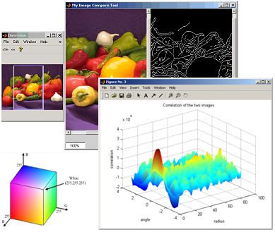
Image Processing with Deep Learning
Amashi Niwarthana (amashini001@ntu.edu.sg),
Sankeerthana Satini (sati0004@e.ntu.edu.sg)
February 06th, 2026

Slide 2
Agenda
Time | Item
2:00-2:15 | Introduction to Convolution
2:15-2:45 | Convolutional Neural Networks (CNNs)
2:45-3:15 | Classification with CNNs
3:15-3:30 | Break

Slide 3
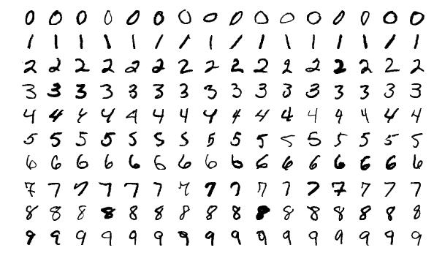
A Real-World Problem...
Imagine you run a post office
All letters have a 5-digit zip code for routing
You receive millions of letters and packages a day and need to decide where to send them
Human labor is costly and time consuming
How can you automate this task?
Examples of handwritten Arabic numerals from 1000 different writers [1]
[1] Y. Lecun, L. Bottou, Y. Bengio and P. Haffner, "Gradient-based learning applied to document recognition," in Proceedings of the IEEE, vol. 86, no. 11, pp. 2278-2324, Nov. 1998.

Slide 4
A Real-World Problem...
This was the problem facing the USPS in 1989
How would you solve this problem?
Examples of handwritten Arabic numerals from 1000 different writers [1]
[1] Y. Lecun, L. Bottou, Y. Bengio and P. Haffner, "Gradient-based learning applied to document recognition," in Proceedings of the IEEE, vol. 86, no. 11, pp. 2278-2324, Nov. 1998.

Slide 5
Introduction To Convolution

Slide 6
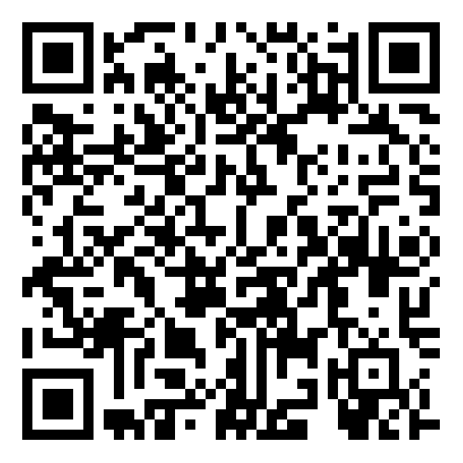
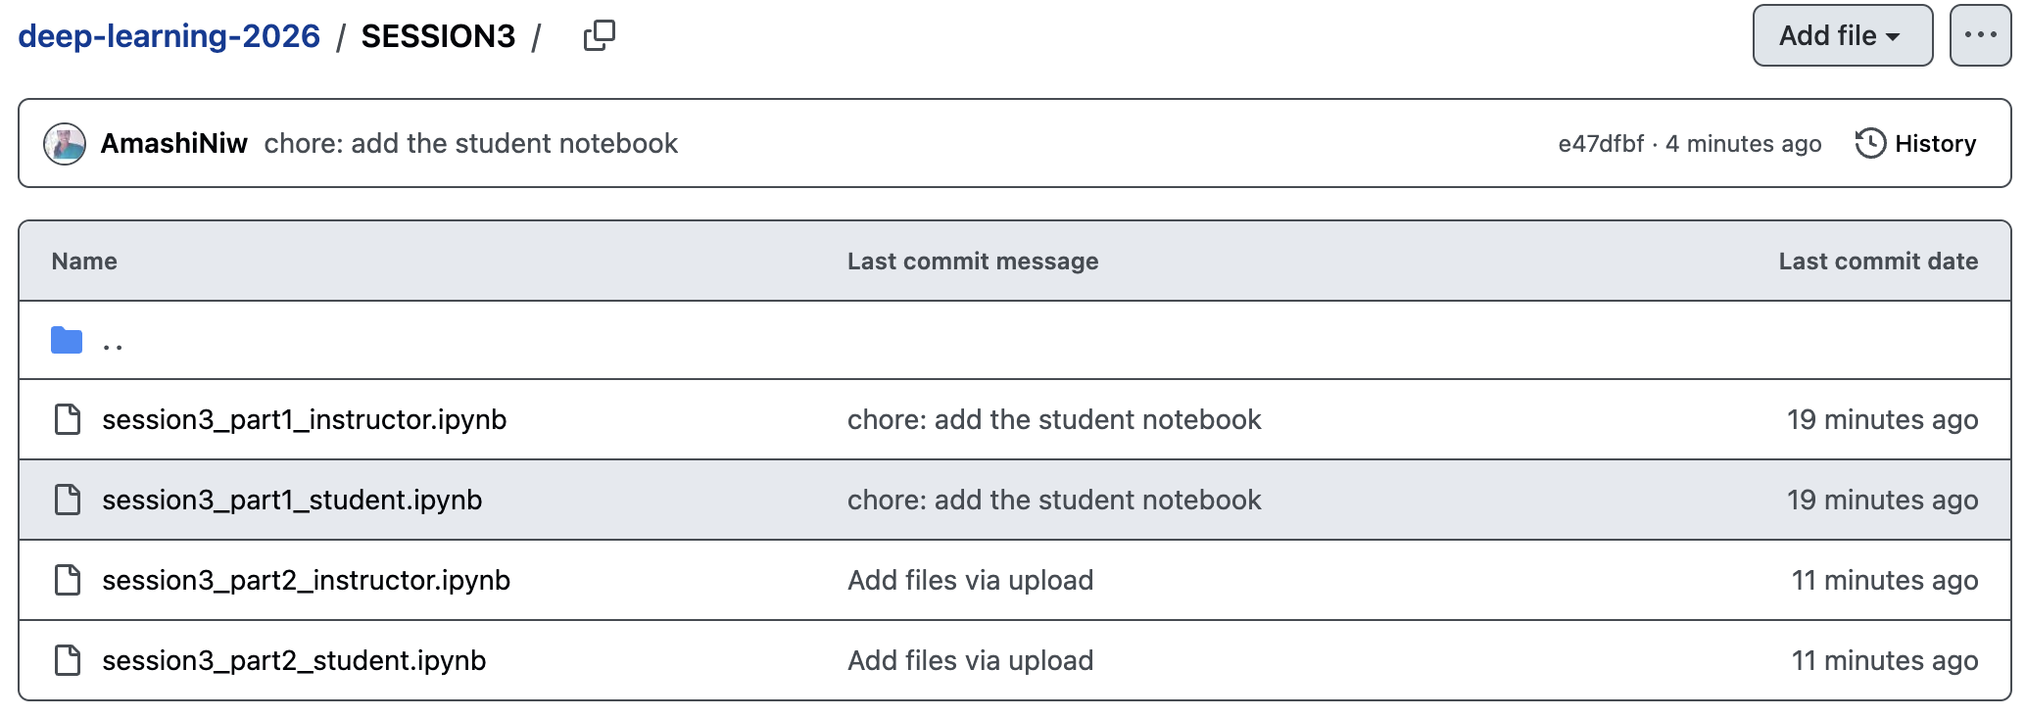
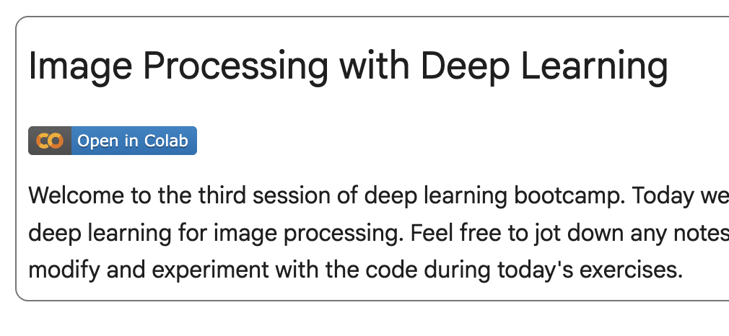
Project Notebook
Scan the QR code and open session3_part1_student.ipynb
Find the option to open the notebook in Google Colab

Slide 7
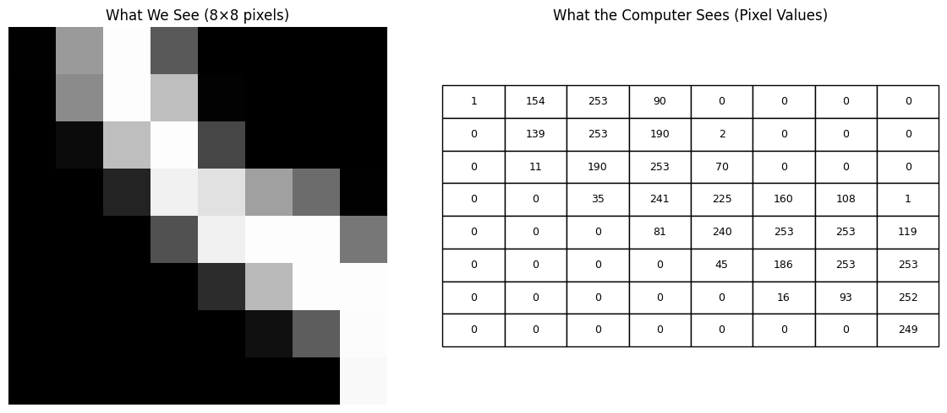

Convolution
0
1
5
1
0
0
5
0
5
0
An image is represented as a matrix of numbers
Higher Value = More intensity
0
5
5
5
0
$$x$$
0
5
0
5
0
1
5
0
5
1

Slide 8
Convolution
0
1
5
1
0
0
5
0
5
0
An image is represented as a matrix of numbers
Higher Value = More intensity
The simplest form of an image only has grayscale colours
0
5
5
5
0
$$x$$
0
5
0
5
0
1
5
0
5
1

Slide 9



0
1
5
1
0
Convolution
0
1
5
1
0
0
0
5
0
5
0
1
5
1
0
An RGB image extends this idea by using three matrices instead of one.
Each pixel is described by three intensity values:
R – Red channel
G – Green channel
B – Blue channel
So instead of a single number per pixel, we now have a triplet:
{R,G,B}
0
5
0
5
0
0
0
5
5
5
0
$$B$$
5
0
5
0
0
5
5
5
0
$$G$$
0
0
5
0
5
0
5
5
5
0
$$R$$
0
5
0
5
0
0
1
5
0
5
1
5
0
5
0
1
5
0
5
1
1
5
0
5
1

Slide 10
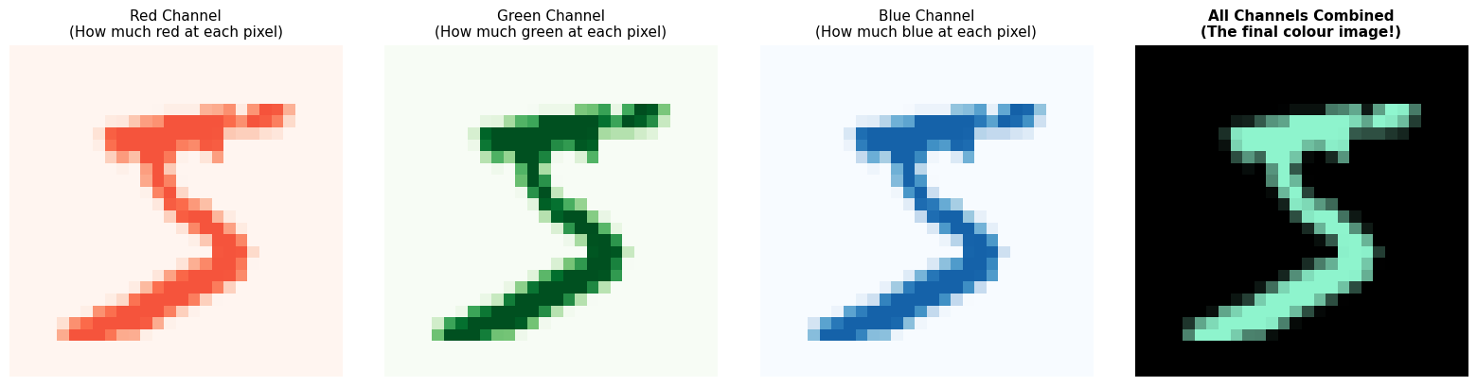
0
1
5
1
0
Convolution
0
1
5
1
0
0
0
5
0
5
0
1
5
1
0
An RGB image extends this idea by using three matrices instead of one.
Each pixel is described by three intensity values:
R – Red channel
G – Green channel
B – Blue channel
So instead of a single number per pixel, we now have a triplet:
{R,G,B}
0
5
0
5
0
0
0
5
5
5
0
$$B$$
5
0
5
0
0
5
5
5
0
$$G$$
0
0
5
0
5
0
5
5
5
0
$$R$$
0
5
0
5
0
0
1
5
0
5
1
5
0
5
0
1
5
0
5
1
1
5
0
5
1

Slide 11
Convolution
0
1
5
1
0
0
5
0
5
0
An image is represented as a matrix of numbers
Higher Value = More intensity
The simplest form of an image only has grayscale colours
0
5
5
5
0
$$x$$
0
5
0
5
0
1
5
0
5
1

Slide 12

0
1
5
1
0
Convolution
0
5
0
5
0
An image is represented as a matrix of numbers
Higher Value = More intensity
A kernel is also a matrix containing some pattern
0
5
5
5
0
$$x$$
0
5
0
5
0
1
5
0
5
1
0
1
2
$$h$$
2
2
0
0
1
2

Slide 13
0
1
5
1
0
Convolution
0
5
0
5
0
An image is represented as a matrix of numbers
Higher Value = More intensity
A kernel is also a matrix containing some pattern
0
5
5
5
0
0
5
0
5
0
1
5
0
5
1
0
1
2
2
2
0
0
1
2

Slide 14
0 x 0
1 x 1
2 x 5
1
0
Convolution
2 x 0
2 x 5
0 x 0
5
0
An image is represented as a matrix of numbers
Higher Value = More intensity
A kernel is also a matrix containing some pattern
Slide a kernel along an image, multiply overlapping values, and sum the result
0 x 0
1 x 5
2 x 5
5
0
0
5
0
5
0
1
5
0
5
1

Slide 15
0 x 0
1 x 1
2 x 5
1
0
+0
Convolution
2 x 0
2 x 5
0 x 0
5
0
An image is represented as a matrix of numbers
Higher Value = More intensity
A kernel is also a matrix containing some pattern
Slide a kernel along an image, multiply overlapping values, and sum the result
0 x 0
1 x 5
2 x 5
5
0
0
5
0
5
0
1
5
0
5
1
0

Slide 16
0 x 0
1 x 1
2 x 5
1
0
+1
Convolution
2 x 0
2 x 5
0 x 0
5
0
An image is represented as a matrix of numbers
Higher Value = More intensity
A kernel is also a matrix containing some pattern
Slide a kernel along an image, multiply overlapping values, and sum the result
0 x 0
1 x 5
2 x 5
5
0
0
5
0
5
0
1
5
0
5
1
1

Slide 17
0 x 0
1 x 1
2 x 5
1
0
+10
Convolution
2 x 0
2 x 5
0 x 0
5
0
An image is represented as a matrix of numbers
Higher Value = More intensity
A kernel is also a matrix containing some pattern
Slide a kernel along an image, multiply overlapping values, and sum the result
0 x 0
1 x 5
2 x 5
5
0
0
5
0
5
0
1
5
0
5
1
11

Slide 18
0 x 0
1 x 1
2 x 5
1
0
Convolution
2 x 0
2 x 5
0 x 0
5
0
+0
An image is represented as a matrix of numbers
Higher Value = More intensity
A kernel is also a matrix containing some pattern
Slide a kernel along an image, multiply overlapping values, and sum the result
0 x 0
1 x 5
2 x 5
5
0
0
5
0
5
0
1
5
0
5
1
11

Slide 19
0 x 0
1 x 1
2 x 5
1
0
Convolution
2 x 0
2 x 5
0 x 0
5
0
+10
An image is represented as a matrix of numbers
Higher Value = More intensity
A kernel is also a matrix containing some pattern
Slide a kernel along an image, multiply overlapping values, and sum the result
0 x 0
1 x 5
2 x 5
5
0
0
5
0
5
0
1
5
0
5
1
21

Slide 20
0 x 0
1 x 1
2 x 5
1
0
Convolution
2 x 0
2 x 5
0 x 0
5
0
+0
An image is represented as a matrix of numbers
Higher Value = More intensity
A kernel is also a matrix containing some pattern
Slide a kernel along an image, multiply overlapping values, and sum the result
0 x 0
1 x 5
2 x 5
5
0
0
5
0
5
0
1
5
0
5
1
21

Slide 21
0 x 0
1 x 1
2 x 5
1
0
Convolution
2 x 0
2 x 5
0 x 0
5
0
An image is represented as a matrix of numbers
Higher Value = More intensity
A kernel is also a matrix containing some pattern
Slide a kernel along an image, multiply overlapping values, and sum the result
+0
0 x 0
1 x 5
2 x 5
5
0
0
5
0
5
0
1
5
0
5
1
21

Slide 22
0 x 0
1 x 1
2 x 5
1
0
Convolution
2 x 0
2 x 5
0 x 0
5
0
An image is represented as a matrix of numbers
Higher Value = More intensity
A kernel is also a matrix containing some pattern
Slide a kernel along an image, multiply overlapping values, and sum the result
+5
0 x 0
1 x 5
2 x 5
5
0
0
5
0
5
0
1
5
0
5
1
26

Slide 23
0 x 0
1 x 1
2 x 5
1
0
Convolution
2 x 0
2 x 5
0 x 0
5
0
An image is represented as a matrix of numbers
Higher Value = More intensity
A kernel is also a matrix containing some pattern
Slide a kernel along an image, multiply overlapping values, and sum the result
+10
0 x 0
1 x 5
2 x 5
5
0
0
5
0
5
0
1
5
0
5
1
36

Slide 24
0 x 0
1 x 1
2 x 5
1
0
Convolution
2 x 0
2 x 5
0 x 0
5
0
An image is represented as a matrix of numbers
Higher Value = More intensity
A kernel is also a matrix containing some pattern
Slide a kernel along an image, multiply overlapping values, and sum the result
0 x 0
1 x 5
2 x 5
5
0
0
5
0
5
0
1
5
0
5
1
36

Slide 25
0
0 x 1
1 x 5
2 x 1
0
Convolution
0
2 x 5
2 x 0
0 x 5
0
An image is represented as a matrix of numbers
Higher Value = More intensity
A kernel is also a matrix containing some pattern
Slide a kernel along an image, multiply overlapping values, and sum the result
0
0 x 5
1 x 5
2 x 5
0
0
5
0
5
0
1
5
0
5
1
36
0

Slide 26
0
0 x 1
1 x 5
2 x 1
0
Convolution
0
2 x 5
2 x 0
0 x 5
0
+0
An image is represented as a matrix of numbers
Higher Value = More intensity
A kernel is also a matrix containing some pattern
Slide a kernel along an image, multiply overlapping values, and sum the result
0
0 x 5
1 x 5
2 x 5
0
0
5
0
5
0
1
5
0
5
1
36
0

Slide 27
0
0 x 1
1 x 5
2 x 1
0
Convolution
0
2 x 5
2 x 0
0 x 5
0
+5
An image is represented as a matrix of numbers
Higher Value = More intensity
A kernel is also a matrix containing some pattern
Slide a kernel along an image, multiply overlapping values, and sum the result
0
0 x 5
1 x 5
2 x 5
0
0
5
0
5
0
1
5
0
5
1
36
5

Slide 28
0
0 x 1
1 x 5
2 x 1
0
Convolution
0
2 x 5
2 x 0
0 x 5
0
+2
An image is represented as a matrix of numbers
Higher Value = More intensity
A kernel is also a matrix containing some pattern
Slide a kernel along an image, multiply overlapping values, and sum the result
0
0 x 5
1 x 5
2 x 5
0
0
5
0
5
0
1
5
0
5
1
36
7

Slide 29
0
0 x 1
1 x 5
2 x 1
0
Convolution
0
2 x 5
2 x 0
0 x 5
0
+10
An image is represented as a matrix of numbers
Higher Value = More intensity
A kernel is also a matrix containing some pattern
Slide a kernel along an image, multiply overlapping values, and sum the result
0
0 x 5
1 x 5
2 x 5
0
0
5
0
5
0
1
5
0
5
1
36
17

Slide 30
0
0 x 1
1 x 5
2 x 1
0
Convolution
0
2 x 5
2 x 0
0 x 5
0
An image is represented as a matrix of numbers
Higher Value = More intensity
A kernel is also a matrix containing some pattern
Slide a kernel along an image, multiply overlapping values, and sum the result
0
0 x 5
1 x 5
2 x 5
0
0
5
0
5
0
1
5
0
5
1
36
17

Slide 31
0
0 x 1
1 x 5
2 x 1
0
Convolution
0
2 x 5
2 x 0
0 x 5
0
An image is represented as a matrix of numbers
Higher Value = More intensity
A kernel is also a matrix containing some pattern
Slide a kernel along an image, multiply overlapping values, and sum the result
0
0 x 5
1 x 5
2 x 5
0
0
5
0
5
0
1
5
0
5
1
36
17

Slide 32
0
0 x 1
1 x 5
2 x 1
0
Convolution
0
2 x 5
2 x 0
0 x 5
0
An image is represented as a matrix of numbers
Higher Value = More intensity
A kernel is also a matrix containing some pattern
Slide a kernel along an image, multiply overlapping values, and sum the result
0
0 x 5
1 x 5
2 x 5
0
0
5
0
5
0
1
5
0
5
1
36
17

Slide 33
0
0 x 1
1 x 5
2 x 1
0
Convolution
0
2 x 5
2 x 0
0 x 5
0
+5
An image is represented as a matrix of numbers
Higher Value = More intensity
A kernel is also a matrix containing some pattern
Slide a kernel along an image, multiply overlapping values, and sum the result
0
0 x 5
1 x 5
2 x 5
0
0
5
0
5
0
1
5
0
5
1
36
22

Slide 34
0
0 x 1
1 x 5
2 x 1
0
Convolution
0
2 x 5
2 x 0
0 x 5
0
+10
An image is represented as a matrix of numbers
Higher Value = More intensity
A kernel is also a matrix containing some pattern
Slide a kernel along an image, multiply overlapping values, and sum the result
0
0 x 5
1 x 5
2 x 5
0
0
5
0
5
0
1
5
0
5
1
36
32

Slide 35
0
1
0 x 5
1 x 1
2 x 0
Convolution
0
5
2 x 0
2 x 5
0 x 0
An image is represented as a matrix of numbers
Higher Value = More intensity
A kernel is also a matrix containing some pattern
Slide a kernel along an image, multiply overlapping values, and sum the result
0
5
0 x 5
1 x 5
2 x 0
0
5
0
5
0
1
5
0
5
1
36
32

Slide 36
0
1
0 x 5
1 x 1
2 x 0
Convolution
0
5
2 x 0
2 x 5
0 x 0
An image is represented as a matrix of numbers
Higher Value = More intensity
A kernel is also a matrix containing some pattern
Slide a kernel along an image, multiply overlapping values, and sum the result
0
5
0 x 5
1 x 5
2 x 0
0
5
0
5
0
1
5
0
5
1
36
32
16

Slide 37
0
1
5
1
0
Convolution
0 x 0
1 x 5
2 x 0
5
0
An image is represented as a matrix of numbers
Higher Value = More intensity
A kernel is also a matrix containing some pattern
Slide a kernel along an image, multiply overlapping values, and sum the result
2 x 0
2 x 5
0 x 5
5
0
0 x 0
1 x 5
2 x 0
5
0
1
5
0
5
1
36
32
16

Slide 38
0
1
5
1
0
Convolution
0 x 0
1 x 5
2 x 0
5
0
An image is represented as a matrix of numbers
Higher Value = More intensity
A kernel is also a matrix containing some pattern
Slide a kernel along an image, multiply overlapping values, and sum the result
2 x 0
2 x 5
0 x 5
5
0
0 x 0
1 x 5
2 x 0
5
0
1
5
0
5
1
36
32
16
20

Slide 39
0
1
5
1
0
Convolution
0
0 x 5
1 x 0
2 x 5
0
An image is represented as a matrix of numbers
Higher Value = More intensity
A kernel is also a matrix containing some pattern
Slide a kernel along an image, multiply overlapping values, and sum the result
0
2 x 5
2 x 5
0 x 5
0
0
0 x 5
1 x 0
2 x 5
0
1
5
0
5
1
36
32
16
20

Slide 40
0
1
5
1
0
Convolution
0
0 x 5
1 x 0
2 x 5
0
An image is represented as a matrix of numbers
Higher Value = More intensity
A kernel is also a matrix containing some pattern
Slide a kernel along an image, multiply overlapping values, and sum the result
0
2 x 5
2 x 5
0 x 5
0
0
0 x 5
1 x 0
2 x 5
0
1
5
0
5
1
36
32
16
20
40

Slide 41
0
1
5
1
0
Convolution
0
5
0 x 0
1 x 5
2 x 0
An image is represented as a matrix of numbers
Higher Value = More intensity
A kernel is also a matrix containing some pattern
Slide a kernel along an image, multiply overlapping values, and sum the result
0
5
2 x 5
2 x 5
0 x 0
0
5
0 x 0
1 x 5
2 x 0
1
5
0
5
1
36
32
16
20
40

Slide 42
0
1
5
1
0
Convolution
0
5
0 x 0
1 x 5
2 x 0
An image is represented as a matrix of numbers
Higher Value = More intensity
A kernel is also a matrix containing some pattern
Slide a kernel along an image, multiply overlapping values, and sum the result
0
5
2 x 5
2 x 5
0 x 0
0
5
0 x 0
1 x 5
2 x 0
1
5
0
5
1
36
32
16
20
40
30

Slide 43
0
1
5
1
0
Convolution
0
5
0
5
0
An image is represented as a matrix of numbers
Higher Value = More intensity
A kernel is also a matrix containing some pattern
Slide a kernel along an image, multiply overlapping values, and sum the result
0 x 0
1 x 5
2 x 5
5
0
2 x 0
2 x 5
0 x 0
5
0
0 x 1
1 x 5
2 x 0
5
1
36
32
16
20
40
30

Slide 44
0
1
5
1
0
Convolution
0
5
0
5
0
An image is represented as a matrix of numbers
Higher Value = More intensity
A kernel is also a matrix containing some pattern
Slide a kernel along an image, multiply overlapping values, and sum the result
0 x 0
1 x 5
2 x 5
5
0
2 x 0
2 x 5
0 x 0
5
0
0 x 1
1 x 5
2 x 0
5
1
36
32
16
20
40
30
30

Slide 45
0
1
5
1
0
Convolution
0
5
0
5
0
An image is represented as a matrix of numbers
Higher Value = More intensity
A kernel is also a matrix containing some pattern
Slide a kernel along an image, multiply overlapping values, and sum the result
0
0 x 5
1 x 5
2 x 5
0
0
2 x 5
2 x 0
0 x 5
0
1
0 x 5
1 x 0
2 x 5
1
36
32
16
20
40
30
30

Slide 46
0
1
5
1
0
Convolution
0
5
0
5
0
An image is represented as a matrix of numbers
Higher Value = More intensity
A kernel is also a matrix containing some pattern
Slide a kernel along an image, multiply overlapping values, and sum the result
0
0 x 5
1 x 5
2 x 5
0
0
2 x 5
2 x 0
0 x 5
0
1
0 x 5
1 x 0
2 x 5
1
36
32
16
20
40
30
30
35

Slide 47
0
1
5
1
0
Convolution
0
5
0
5
0
An image is represented as a matrix of numbers
Higher Value = More intensity
A kernel is also a matrix containing some pattern
Slide a kernel along an image, multiply overlapping values, and sum the result
0
5
0 x 5
1 x 5
2 x 0
0
5
2 x 0
2 x 5
0 x 0
1
5
0 x 0
1 x 5
2 x 1
36
32
16
20
40
30
30
35

Slide 48
So What?
0
1
5
1
0
Convolution
0
5
0
5
0
An image is represented as a matrix of numbers
Higher Value = More intensity
A kernel is also a matrix containing some pattern
Slide a kernel along an image, multiply overlapping values, and sum the result
0
5
0 x 5
1 x 5
2 x 0
0
5
2 x 0
2 x 5
0 x 0
1
5
0 x 0
1 x 5
2 x 1
36
32
16
20
40
30
30
35
22

Slide 49
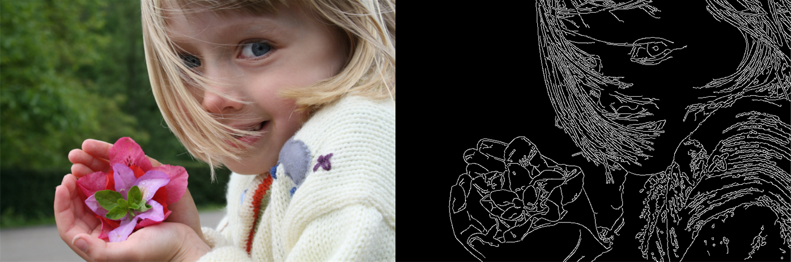
Edge Detection
Useful to segment an image
Sobel kernel – a special kernel used for edge detection
Value is high when the gradient is high in one direction
Thought Experiment - what happens when the Sobel kernel is convolved with:
[2] J. McLoone, Edge Detection Applied to a Photograph, Jun. 2010.
-1
0
1
0
5
5
5
5
5
-2
0
2
0
5
5
5
5
5
-1
0
1
0
5
5
5
5
5
Sobel Kernel
An Edge?
A Solid Color?

Slide 50
Image Classification With CNNS

Slide 51
-1
0
1
Learnable Filters
-2
0
2
What if we were able to learn kernel weights instead of crafting them ourselves?
-1
0
1

Slide 52
w_{0,0}
w_{1,0}
w_{2,0}
Learnable Filters
w_{0,1}
w_{1,1}
w_{2,1}
What if we were able to learn kernel weights instead of crafting them ourselves?
w_{0,2}
w_{1,2}
w_{2,2}

Slide 53
w_{0,1}
w_{0,0}
w_{1,0}
x_{2,0}
w_{2,0}
Learnable Filters
What if we were able to learn kernel weights instead of crafting them ourselves?
This pattern, summing the multiplication of weights is the same thing that happens in a neural network
x_{1,1}
w_{1,1}
x_{2,1}
w_{2,1}
Σ
x_{0,2}
w_{0,2}
x_{1,2}
w_{1,2}
x_{2,2}
w_{2,2}

Slide 54
w_{0,1}
w_{0,0}
w_{1,0}
x_{2,0}
w_{2,0}
Learnable Filters
What if we were able to learn kernel weights instead of crafting them ourselves?
This pattern, summing the multiplication of weights is the same thing that happens in a neural network
Not just limited to three color channels
x_{1,1}
w_{1,1}
x_{2,1}
w_{2,1}
Σ
x_{0,2}
w_{0,2}
x_{1,2}
w_{1,2}
x_{2,2}
w_{2,2}
[3] M. Görner, 2D Conv with 3D Inputs, 2017

Slide 55
Convolution Parameters
Stride
Padding
Pooling
Dilation
https://ezyang.github.io/convolution-visualizer/
[4] Intuitively Understanding Deep Convolution, Towards Data Science (2018)

Slide 56
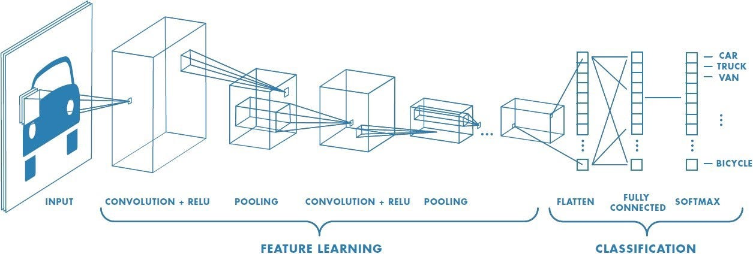
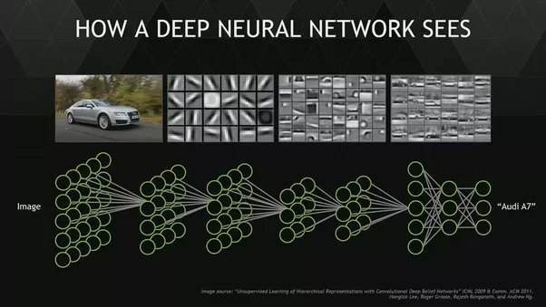
Adding Depth
In shallow networks we learn a function that maps a feature space to an output
In deep learning, we don’t know the features, so we use a convolutional layer to learn them
Repeat ad infinitum
Usually early layers find simple patterns like edges while later layers learn more complex concepts
[7] S. N. Gupta, Deep Convolutional Neural Networks Explained in Layman’s Terms, Medium (2022).

Slide 57


Slide 58
Agenda
Time | Item
3:30-3:45 | Introduction to Computer Vision tasks and Pipeline
3:45-4:15 | Image Classification
4:15-4:30 | Image Segmentation
4:30-5:00 | Diffusion Models (DDPM)

Slide 59
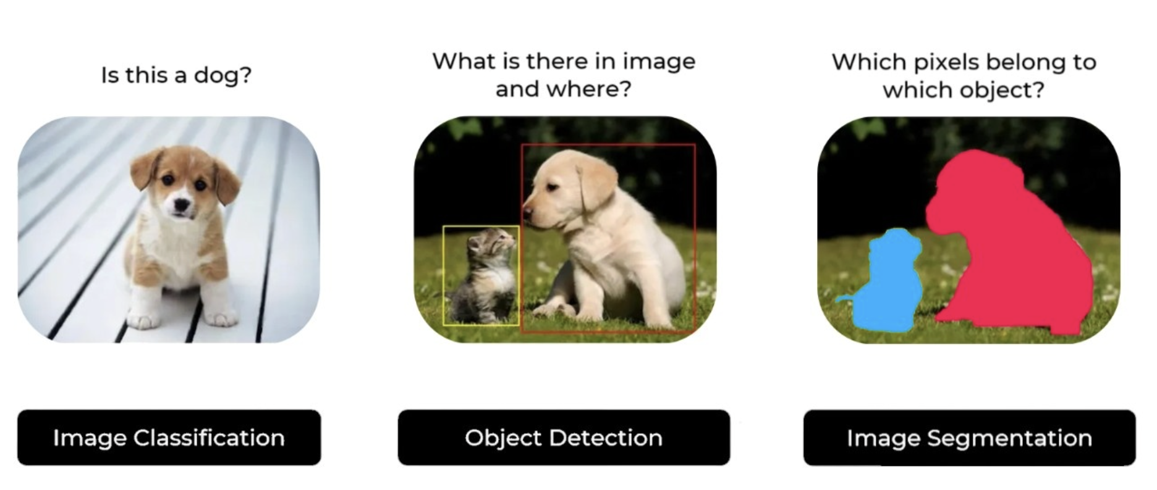
Core Computer Vision Tasks

Slide 60
Vision Transformers
ResNet
YOLO
Applied Transformer's architecture (originally designed for NLP) to images and outperformed CNNs
VGG-16
Introduced "Skip Connections" to overcome the Vanishing Gradient Problem
Detected objects in a single pass through the network with high accuracy and speed
LeNet-5
Proved that Increasing Depth helped performance
Foundational CNN
1998
2014
2015
2016
2020
2012
2014
2015
2020
AlexNet
GANs
Faster R-CNN
DDPM
Known for winning ILSVRC and proving that Deep NNs can significantly outperform ML techniques
Introduced adversarial training, enabling neural networks to generate synthetic data by competing generator–discriminator models.
2-stage framework that introduced RPN, which accelerated Object Detection while increasing its accuracy
Known for producing high-quality, diverse, and realistic outputs, particularly in image synthesis, by simulating a denoising process.
Notes:
Add u-net and then add GaN and DDPM and remove some stuff

Slide 61
End-to-End Computer Vision Tasks Pipeline
Problem Formulation
What are we trying to classify?
Decide the problem type – Image Classification/Object Detection/ Segmentation
Decide classes (e.g., cats vs dogs, 10 digits, 100 plant diseases)
Decide evaluation goal (accuracy, precision, recall)
Data Collection and Annotation
Where should we get our images from?
Open-source public datasets VS Built from scratch?
Annotation type – folder labels VS bounding boxes VS Masks
Annotation file format – JSON vs PASCAL VOC format VS folder structure etc.
Data Pre-processing
How do I feed in the data to the Model?
Resize images (e.g., 224 × 224)
Normalize pixel values (0–255 → 0–1)
Handle corrupted/blurred images
Split the dataset into Training-Validation-Test sets

Slide 62
End-to-End Computer Vision Tasks Pipeline
Model Development and Evaluation
How do we build and train the model?
Building the model from scratch VS Using pretrained model?
Choosing and Fine-tuning the hyperparameters
Analyzing the performance of the model and carrying out different iterations of training.
Model Testing and Inference
How well does the model perform on unseen data?
Testing the model on unseen data from the Test Set.
Testing the model on a totally new, unseen yet related data.
Deployment
Where do I deploy my model?
Web Application VS Mobile Phone Application?
Server?
Monitoring Real-time performance

Slide 63
Core Computer Vision Tasks

Slide 64
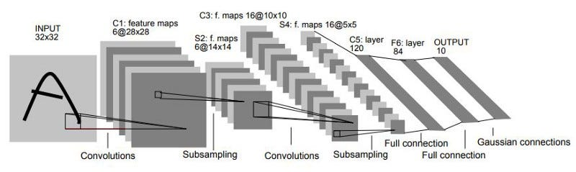
LeNet
LeNet 5 Architecture [1]
Invented by Yann LeCun in 1989 to classify postcode digits
2 convolutional layers followed by 2 fully connected layers
Input: 28x28 greyscale image
Surprisingly powerful (can use this to make a car follow lanes)
[1] Y. Lecun, L. Bottou, Y. Bengio and P. Haffner, "Gradient-based learning applied to document recognition," in Proceedings of the IEEE, vol. 86, no. 11, pp. 2278-2324, Nov. 1998.

Slide 65
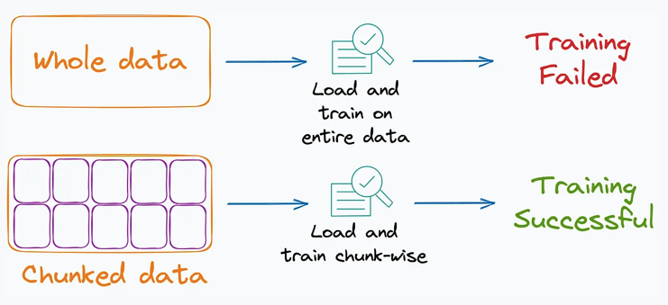
Minibatches
Why Mini-Batches Work So Well
Memory efficient
Only a small number of images are in memory at once
Works on GPUs with limited VRAM
Faster learning
Model updates weights many times per epoch
Learning starts immediately
Better generalization
Each mini-batch is slightly different
This introduces helpful randomness
Prevents overfitting to exact patterns

Slide 66
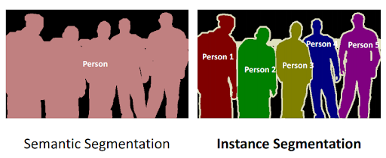
Image Segmentation
What is Image Segmentation?
Instead of predicting a single label or a bounding box, segmentation assigns a class label to every single pixel in the image.
Types of Segmentation:
Semantic Segmentation
Labels each pixel by class
All objects of the same class share the same label
Instance Segmentation
Separated individual object instances

Slide 67
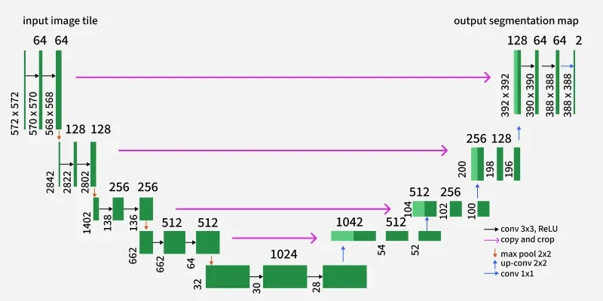
U-Net
U-Net is a fully convolutional neural network designed for pixel-wise image segmentation, originally proposed for biomedical imaging.
U-Net has a U-shaped architecture:
Encoder (Contracting Path) → captures what is in the image → Learns high level features
Decoder (Expanding Path) → recovers where it is
Skip Connections → preserve fine spatial details → produces pixel-wise predictions
Notes:
U-Net is called U-Net because of its shape — it first compresses the image to learn what is present, then expands it back to learn where each structure is.”
“The most important feature is the skip connections. They pass high-resolution details from the encoder directly to the decoder.”
“This is why U-Net is extremely popular in medical imaging — small errors in boundaries matter a lot.”

Slide 68
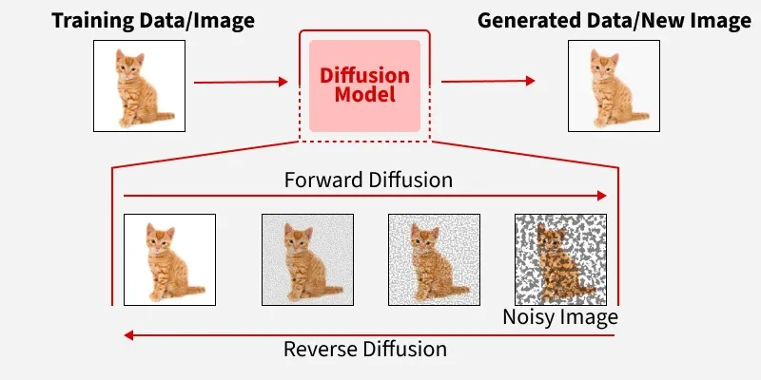
Diffusion Models
Diffusion Models are Generative tools that create data by learning to reverse a gradual "noising" process, starting from pure noise and iteratively denoising it into a coherent sample, inspired by physics.

Slide 69


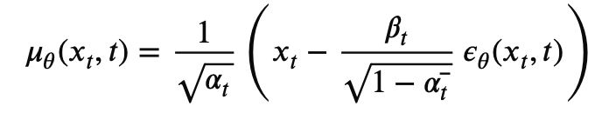

Diffusion Models
Forward Diffusion
Reverse Diffusion
The goal of the forward process is to turn structured data (an image) into unstructured noise.
Step-by-Step Decay: We start with a clean image. At each small time step (t), a tiny amount of Gaussian noise is added.
The Markov Chain: This is a sequential process. The state of the image at step t depends only on the state at t−1.
The End State: By the time we reach the final step (often T=1000), the original image is completely gone, leaving behind nothing but pure, "white" noise.
Mathematical Fact: This stage is fixed. There is no "learning" here; we are simply following a predefined mathematical schedule to scramble the pixels
Since we can't simply "undo" randomness, we train a Neural Network (usually a U-Net) to predict how much noise was added at any given step.
The Goal: Start with a block of random static and "denoise" it step-by-step.
Learning the Path: The model looks at the noisy image at step t and tries to estimate what it looked like at t−1.It’s essentially subtracting the "fuzz" to reveal the signal.
Iterative Refinement: By repeating this hundreds of times, the model slowly coaxes a coherent structure out of the chaos.
Conditional Generation: This is also where your prompts come in. The model uses your text as a guide to decide which shapes and colors should emerge from the noise.

Slide 70


Slide 71
