Slide 1

ANALYSIS AND VISUALIZATION OF YAHOO FINANCE FUNDS DATASET
Ian Mbaya
Irene Kibet

Slide 2

Introduction
Mutual Funds – Financial instruments that pool money from multiple investors and invest in different securities.
Helps to diversify risk.
Investors need to assess characteristics like historical performance, asset allocation, sector investment, returns and risk.
We use a Kaggle Dataset from Yahoo Finance to visualize Mutual Funds in the US.
Primary audience: New Investors.
Others: Financial analysts and experienced investors.

Slide 3

Literature Review & Project Justification
Existing solutions for this problem include: MorningStar, FinViz, Yahoo Finance, Financial Times, etc.
These tools are not curated to focus on mutual funds and can be very complex for new investors.
We relied on Edward Tufte’s principle of data integrity to create simple and straightforward charts and dashboards for inexperienced investors.

Slide 4
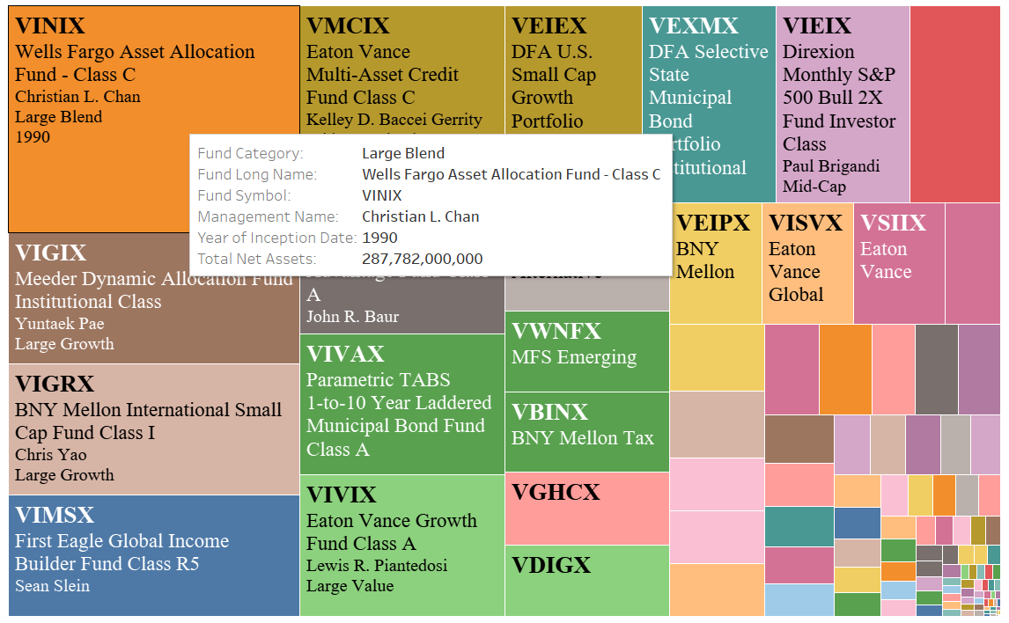
Mutual Fund Characteristics - Treemap
Treemap to show important characteristics of each fund.
Sized by Total Net Asset Value.
Different color for each fund.
Tooltip to resolve space constraint.

Slide 5
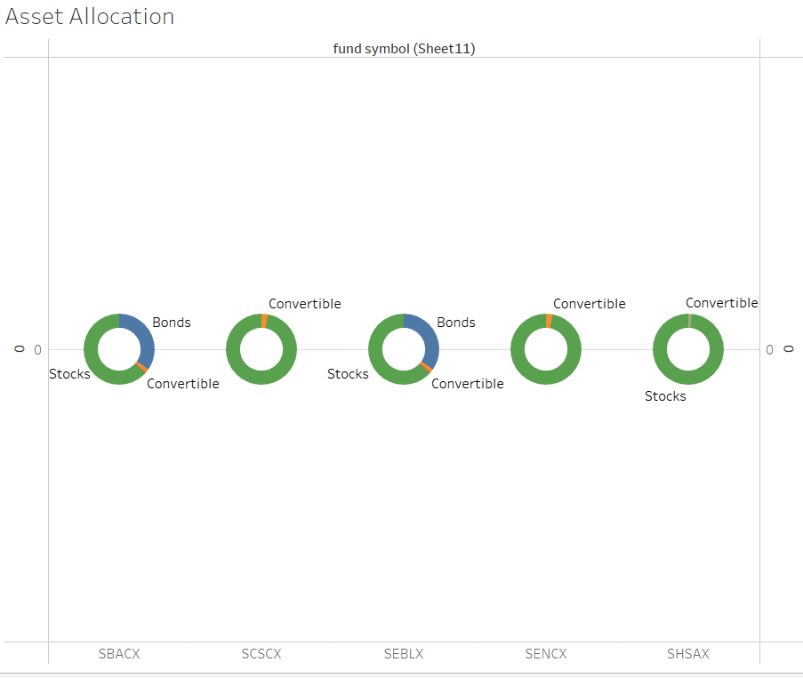
Asset Allocation – Donut Chart
Mutual funds can be allocated to different securities i.e., Stocks, Cash, Bonds, Convertibles etc.
Donut chart displays the market allocation of each security.
Stocks are the most prominent security in the dataset.

Slide 6
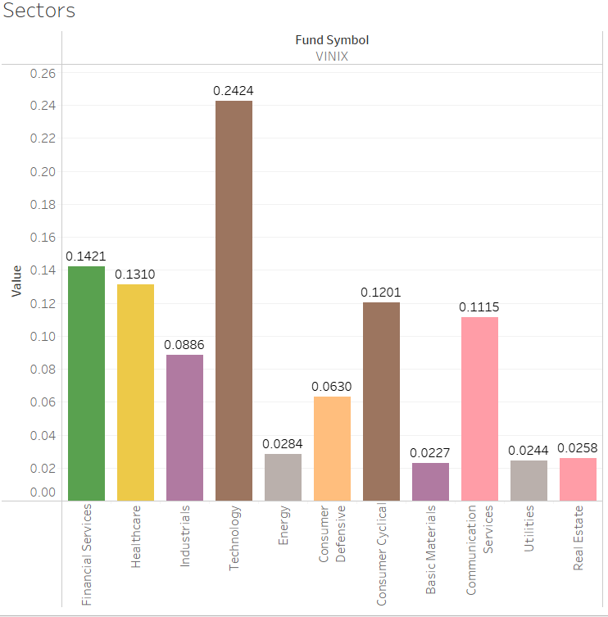
Sectors – Bar Chart
Mutual funds can be diversified into different industries i.e, Health, Energy, Tech, etc.
Helps investors identify how diversified or concentrated a fund is.
Diversified less risky.
Concentrated funds tend to be more profitable.

Slide 7
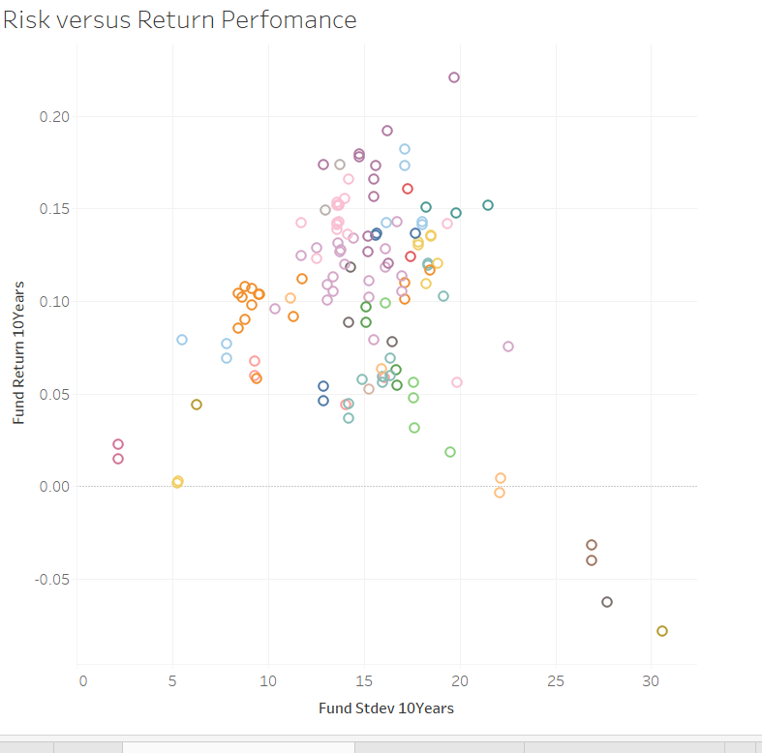
Risk and Return - Scatterplot
Plots the Returns of a fund against standard deviation risk.
Helps identify the potential returns of a fund and the associated risk.
Filtered and colored by category to facilitate comparison with other funds in similar category.

Slide 8
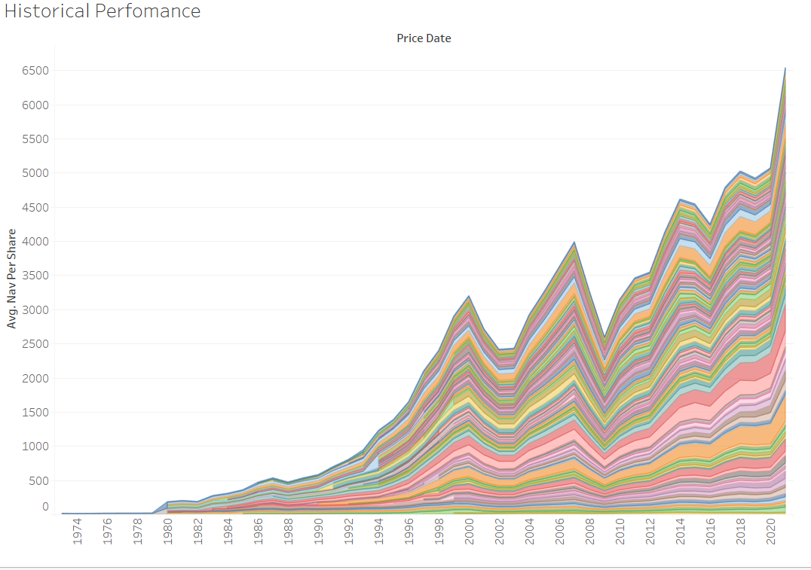
Historical Performance – Area Chart
Plots the average Nav Per Share across time.
Investors can use this plot to see the average price of share at different periods.
Visualize price rise and falls.
Can be filtered to show only a few funds

Slide 9
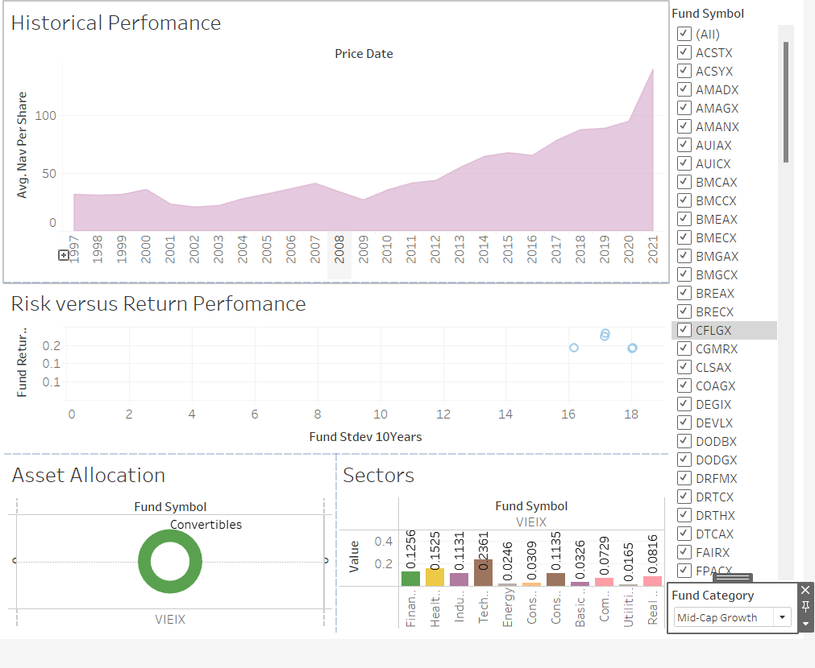
Dashboard
Combines Historical Performance, Risk and Returns, Asset Allocation, and Sectors.
Filter to select funds you want to compare or visualize.
Can be assessed by selecting a fund on the Characteristics Treemap.

