Slide 1
CAT 2 • PARALLEL SYSTEMS UNIT
Parallel Image Processing
Pipeline
Multi-Paradigm Implementation and Benchmarking
Sequential C
OpenMP
POSIX Threads
MPI
CUDA
Ian • Final-Year CS Project • Parallel Systems CAT 2

Slide 2
01
Project Overview
From a sequential pipeline to five parallel paradigms
The Goal
BY THE NUMBERS
Take a simple sequential image-processing pipeline (CAT 1) and rebuild it as a serious parallel system that exercises every major parallel programming paradigm covered in the unit.
5
parallel paradigms
5
Approach
Re-implement five filters across five runtimes
Same kernel library, same image I/O, same benchmark CSV
Validate every parallel output against the sequential reference
One unified dashboard auto-generated from the results
image filters
20 MP
test image (6000×3376)
100%
CPU outputs bit-identical
Parallel Image Processing Pipeline • CAT 2
2 / 12

Slide 3
02
The Five Filters
Chosen to cover the canonical parallel patterns
Filter | What it does | Parallel pattern | Halo
blur | Gaussian 5×5 smoothing | Stencil | 2
sobel | Edge detection, normalised by global max | Stencil + reduction | 1
sharp | Unsharp mask: blur → subtract → amplify | Composite | 2
bc | Brightness / contrast adjustment | Pointwise (map) | 0
histeq | Histogram equalisation | Reduction + scan + map | 0
Why histeq is the deliberate non-trivial filter
It cannot be parallelised by simply splitting rows — each worker only sees a fraction of the pixels and cannot build the global histogram alone. This forces a real reduction + prefix scan in every paradigm.
Parallel Image Processing Pipeline • CAT 2
3 / 12

Slide 4
03
Histogram Equalisation
A three-stage parallel pattern that recurs in every paradigm
1
2
3
4
Private Histograms
Reduction
Prefix Scan
Pointwise Map
Each worker builds its own 256-bin histogram from its slice
Per-worker histograms are summed into one global histogram
Global histogram converted to a CDF lookup table
Every pixel mapped through the lookup table
The same shape, expressed five different ways
OpenMP: reduction(+:hist[:256]) • POSIX threads: per-worker hists, summed by main • MPI: MPI_Allreduce(MPI_SUM) • CUDA: atomic adds in shared memory
Parallel Image Processing Pipeline • CAT 2
4 / 12

Slide 5
04
Five Implementations
Same maths, very different mechanics
REFERENCE
SHARED MEMORY
SHARED MEMORY
Sequential C
OpenMP
POSIX Threads
The correctness oracle. Plain nested loops, no threads, no SIMD. Every parallel output is diffed against this.
Lightest touch — one #pragma per outer loop. reduction(max:…) and reduction(+:hist[:256]) handle the tricky cases.
Hand-rolled thread pool: mutex + 2 condition variables, work submitted as row-strip task structs. Shows what OpenMP hides.
DISTRIBUTED MEMORY
GPU OFFLOAD
MPI
CUDA
Image scattered across ranks; halo rows exchanged with neighbours via MPI_Sendrecv; final image gathered on rank 0.
Run on Colab T4. Naive vs tiled blur kernels. Timing split into H2D + kernel + D2H to expose data-movement cost.
Parallel Image Processing Pipeline • CAT 2
5 / 12

Slide 6
05
Methodology
How every number in this report was produced
⏱ TIMING
✓ CORRECTNESS
Same routine in every paradigm
Two checks, used together
2 warm-up runs to absorb cache & disk effects
5 timed runs → mean, std-dev, min, max into all.csv
Image I/O excluded — only the filter is measured
CUDA additionally records H2D, kernel, D2H separately
PSNR vs sequential reference must exceed 40 dB
Max per-pixel difference must be ≤ 2.0 grey levels
Both — because PSNR alone hides bad strip boundaries
Validated for every paradigm × thread-count × filter
All 100 CPU outputs bit-identical to the sequential reference (PSNR = ∞, maxDiff = 0)
Parallel Image Processing Pipeline • CAT 2
6 / 12

Slide 7
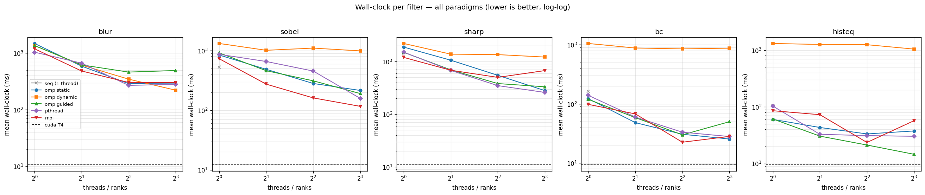
06
Wall-clock per Filter
Plot 01 — every paradigm sweeping over thread/rank count, log-log, lower is better
Each panel is one filter; each line is one paradigm. Dashed black line is the CUDA T4 result.
Every paradigm beats sequential decisively
CUDA is roughly an order of magnitude faster
Sequential (orange) is the slow ceiling
On most filters, all paradigms converge to roughly the same wall-clock at 4 threads (the physical core count).
The T4 dominates raw compute, but most of that gap is data-movement, not arithmetic — see Plot 03.
It does not move with thread count. It is the baseline every speedup is measured against.
Parallel Image Processing Pipeline • CAT 2
7 / 12

Slide 8
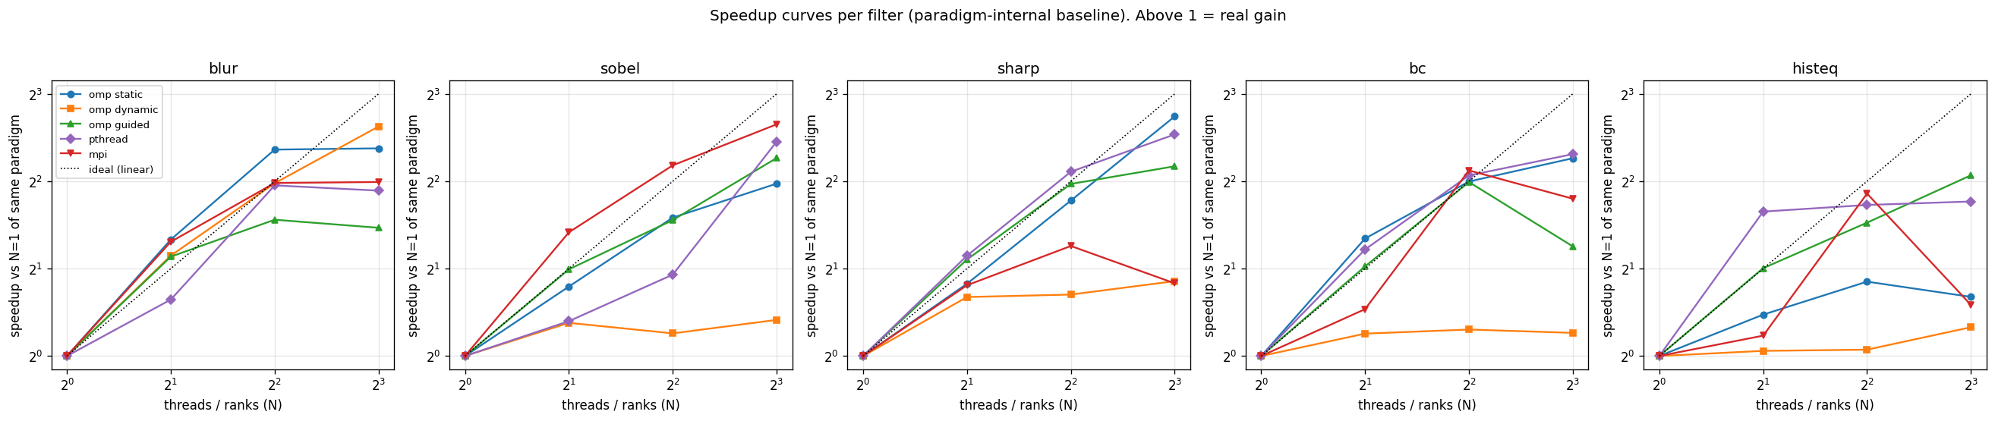
07
Speedup Curves
Plot 02 — speedup vs each paradigm's own 1-thread baseline; dotted line = ideal linear
Above 1.0 = real gain. The dotted line is theoretical ideal speedup (2 threads = 2×, etc.).
5–6×
Why the curves bend below ideal
Communication, synchronisation, memory bandwidth
Amdahl's Law: serial fraction caps speedup
Past 4 threads: hyper-threading gives diminishing returns
MPI flattens hardest — oversubscribing wastes effort on context switches
best speedup at 8 threads on a 4-core CPU
Parallel Image Processing Pipeline • CAT 2
8 / 12

Slide 9
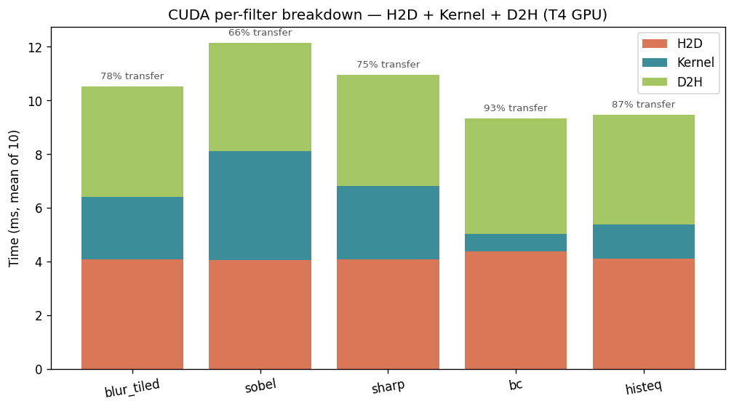
08
CUDA Timing Breakdown
Plot 03 — H2D + Kernel + D2H per filter on the T4 GPU
60–85%
of GPU time is spent moving the image, not processing it
Naive blur (1.8 ms) beats tiled (2.3 ms)
Textbooks say shared-memory tiling should win because it cuts redundant global reads. On the T4 the L2 cache is large enough to absorb those reads for free, so the tiled version's extra synchronisation cost is not amortised. The simpler kernel happens to be faster on this hardware.
Each bar: H2D (host→device), kernel (compute), D2H (device→host). Numbers above = % spent on transfer.
Parallel Image Processing Pipeline • CAT 2
9 / 12

Slide 10
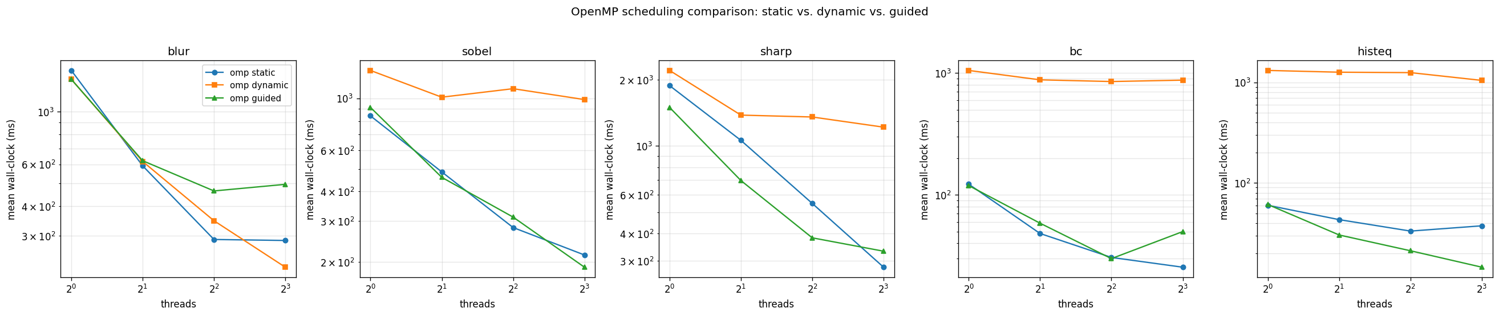
09
OpenMP Scheduling: Static vs Dynamic vs Guided
Plot 04 — schedule() clause matters more than you think
All three schedules run the exact same loops; only the work-distribution policy differs.
STATIC
DYNAMIC
GUIDED
Equal contiguous chunks at compile time. Scales well; safe default.
One iteration per request — default chunk = 1 is catastrophic for fine-grained loops.
Starts large, shrinks. Tracks static closely on this workload.
Key finding: dynamic with default chunk size can be >20× slower than static for fine-grained loops (histeq, bc).
Parallel Image Processing Pipeline • CAT 2
10 / 12

Slide 11
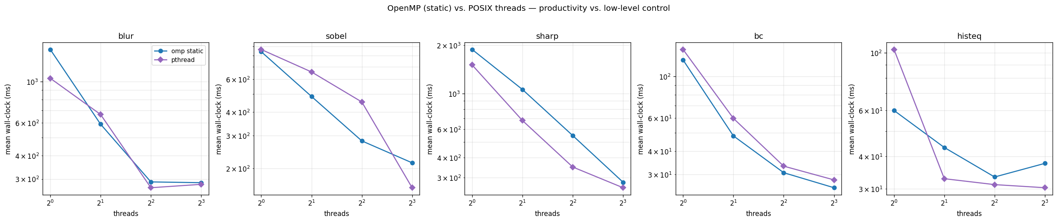
10
OpenMP vs POSIX Threads
Plot 05 — high-level convenience versus low-level mechanics, head to head
Same workload, two implementations: one #pragma vs ~200 lines of pool + task-struct code.
Curves track each other closely
The honest engineering takeaway
On every filter the two paradigms produce essentially the same wall-clock. OpenMP's convenience does not come at a measurable performance cost on this hardware.
OpenMP is the better choice for data-parallel image work. The hand-rolled pthread version exists to demonstrate understanding of what OpenMP is hiding under the hood.
Parallel Image Processing Pipeline • CAT 2
11 / 12

Slide 12
CONCLUSION
Key Findings
01
Provably correct, not just close
All 100 CPU parallel outputs are byte-for-byte identical to the sequential reference.
02
5–6× speedup at 8 threads on a 4-core CPU
Flattening past 4 threads is exactly what Amdahl's Law predicts.
03
OpenMP ≈ POSIX threads on this workload
OpenMP wins on developer productivity; pthread shows you understand the mechanics.
04
GPU economics are dominated by data movement
On the T4, 60–85% of single-filter time is transfer; the L2 cache even lets the naive blur beat the tiled version.
Reproduce end-to-end: bash bench/run_all.sh + re-run the CUDA notebook on Colab

