Slide 1
1: Introduction to
Multi-Agent System
AI6125: Multi-Agent System
Assoc Prof Zhang Jie
Based on “An Introduction to MultiAgent Systems” by Michael Wooldridge, John Wiley & Sons, 2002/2009

Slide 2
Overview
Motivation for agents – natural emergence
Definitions
The future of agents
Views of the field (in comparison to others)
Applications of individual agents and multi-agent systems

Slide 3
Trends
Five ongoing trends have marked the history of computing:
  ubiquity;
  interconnection;
  intelligence;
  delegation; and
  human-orientation

Slide 4
Ubiquity (Pervasiveness)
The continual reduction in cost of computing capability has made it possible to introduce processing power into places and devices that would have once been uneconomic
As processing capability spreads, sophistication (and intelligence of a sort) becomes ubiquitous
What could benefit from having a processor embedded in it…?
Notes:
Since I took my degree, things have changed.
I got my first mobile phone in my final year of University.
Cars : ~80 processors
Clothes : also

Slide 5
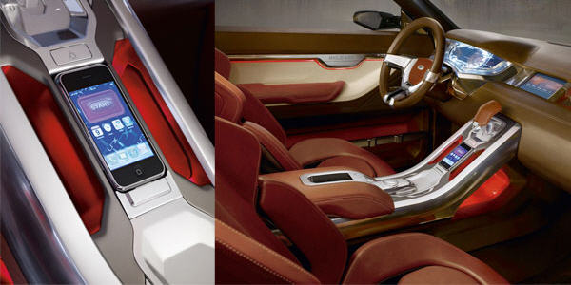
Ubiquity (Pervasiveness)
Notes:
Since I took my degree, things have changed.
I got my first mobile phone in my final year of University.
Cars : ~80 processors
Clothes : also

Slide 6
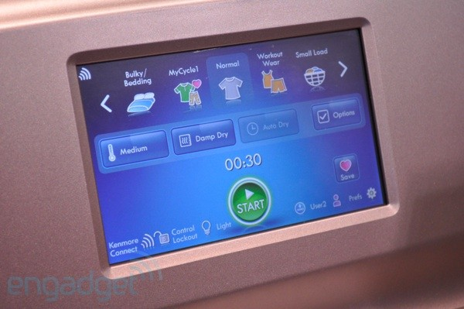
Ubiquity (Pervasiveness)
Notes:
Since I took my degree, things have changed.
I got my first mobile phone in my final year of University.
Cars : ~80 processors
Clothes : also

Slide 7
Interconnection
Computer systems today no longer stand alone, but are networked into large distributed systems
The internet is an obvious example, but networking is spreading its ever-growing tentacles…
Since distributed and concurrent systems have become the norm, some researchers are putting forward theoretical models that portray computing as primarily a process of interaction
Notes:
Bluetooth and wireless
Think of email : now the most common form of communication

Slide 8

Interconnection
Notes:
Bluetooth and wireless
Think of email : now the most common form of communication

Slide 9
Intelligence
By Intelligence we mean:
  The complexity of tasks that we are capable of automating and delegating to computers has grown steadily
If you don’t feel comfortable with this definition of “intelligence”, it’s probably because you are a human
Notes:
Automated stock ordering systems for business, maintain inventory
Flying aircraft – Stealth bomber, needs computers to fly
Numerical calculations for accountants, etc.

Slide 10
Delegation
Computers are doing more for us – without our intervention (this ties in with Intelligence)
We are giving control to computers, even in safety critical tasks
One example: fly-by-wire aircraft, where the machine’s judgment may be trusted more than an experienced pilot
Next on the agenda: fly-by-wire cars (done), intelligent braking systems, cruise control that maintains distance from car in front…
Notes:
Ebay – bidding agents
Online – news bots
Advertisitng bots – giving us directed adverts

Slide 11
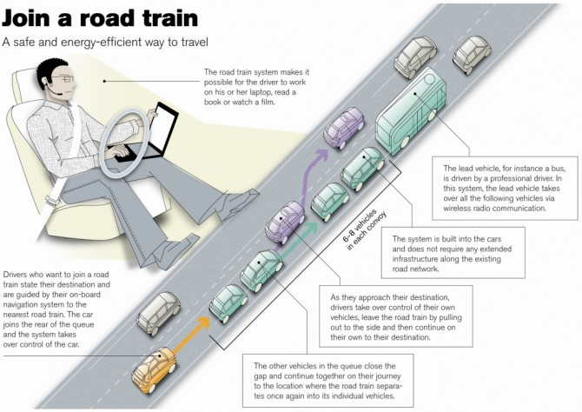
Delegation
Notes:
Ebay – bidding agents
Online – news bots
Advertisitng bots – giving us directed adverts

Slide 12
Human Orientation
The movement away from machine-oriented views of programming toward concepts and metaphors that more closely reflect the way we ourselves understand the world
Programmers (and users!) relate to the machine differently
Programmers conceptualize and implement software in terms of higher-level – more human-oriented – abstractions
Notes:
1948 : 60 years ago… (not a long time in science), compare with Physics or Biology.
Head of Computer Science – first program on punch cards.

Slide 13
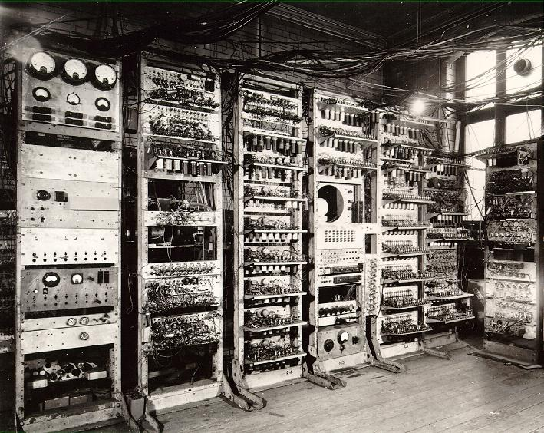
Human Orientation
Notes:
1948 : 60 years ago… (not a long time in science), compare with Physics or Biology.
Head of Computer Science – first program on punch cards.

Slide 14
Programming Progression…
Programming has progressed through:
  machine code;
  assembly language;
  machine-independent programming languages;
  sub-routines;
  procedures & functions;
  abstract data types;
  objects;
to agents.

Slide 15
Global Computing
What techniques might be needed to deal with systems composed of 10¹⁰ processors?
Don’t be deterred by its seeming to be “science fiction”
Hundreds of millions of people connected by email once seemed to be “science fiction”…
Let’s assume that current software development models can’t handle this…

Slide 16
Where does it Bring us?
Delegation and Intelligence imply the need to build computer systems that can act effectively on our behalf
This implies:
  The ability of computer systems to act independently
  The ability of computer systems to act in a way that represents our best interests while interacting with other humans or systems

Slide 17
Interconnection and Distribution
Interconnection and Distribution have become core motifs in Computer Science
But Interconnection and Distribution, coupled with the need for systems to represent our best interests, implies systems that can cooperate and reach agreements (or even compete) with other systems that have different interests (much as we do with other people)

Slide 18
So Computer Science Expands…
These issues were not studied in Computer Science until recently
All of these trends have led to the emergence of a new field in Computer Science: multiagent systems

Slide 19
Agents, a Definition(s)
An agent is a computer system that is capable of independent action on behalf of its user or owner (figuring out what needs to be done to satisfy design objectives, rather than constantly being told).
An agent is a computer system that is situated in some environment, and that is capable of autonomous action in the environment in order to meet its delegated objectives.

Slide 20
Agents, Definition(s) … a caveat.
One embarrassing issue for the agent community (for many years) is the lack of a standardized definition.
Agent means many things to many people.
Recommended Reading:
  ‘Is it an Agent, or Just a Program?’ (Franklin and Graesser 1997).

Slide 21
Multi-agent Systems, a Definition
A multi-agent system is one that consists of a number of agents, which interact with one-another
In the most general case, agents will be acting on behalf of users with different goals and motivations
To successfully interact, they will require the ability to cooperate, coordinate, and negotiate with each other, much as people do

Slide 22
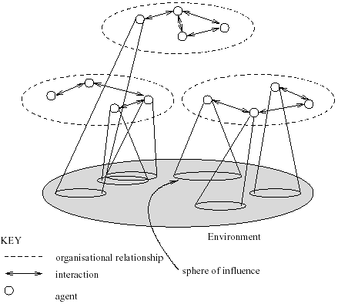
What are Multiagent Systems?

Slide 23
Multiagent Systems
Thus a multiagent system contains a number of agents…
…which interact through communication…
…are able to act in an environment…
…have different “spheres of influence” (which may coincide)…
…will be linked by other (organizational) relationships

Slide 24
Agent Design, Society Design
The course covers two key problems:
  How do we build agents capable of independent, autonomous action, so that they can successfully carry out tasks we delegate to them?
  How do we build agents that are capable of interacting (cooperating, coordinating, negotiating) with other agents in order to successfully carry out those delegated tasks, especially when the other agents cannot be assumed to share the same interests/goals?
The first problem is agent design, the second is society design (micro/macro)

Slide 25
Multiagent Systems
While these questions are all addressed in part by other disciplines (notably economics and social sciences), what makes the multi-agent systems field unique is that it emphasizes that the agents in question are computational, information processing entities.

Slide 26
Multiagent Systems is Interdisciplinary
The field of Multiagent Systems is influenced and inspired by many other fields:
  Economics
  Philosophy
  Game Theory
  Logic
  Ecology
  Social Sciences
This can be a strength
  Infusing well-founded methodologies into the field

Slide 27
The Views/Visions
This can also be a weakness
  Many different views as to what the field is about
  Different researchers have different visions
  The amalgamation of these visions (and research directions, and methodologies, and interests, and…) define the field
  But the researchers clearly have enough in common to consider each other’s work relevant to their own
This has analogies with artificial intelligence itself

Slide 28
Some Views of the Field
Agents as a paradigm for software engineering:
Software engineers have derived a progressively better understanding of the characteristics of complexity in software. It is now widely recognized that interaction is probably the most important single characteristic of complex software
Over the last two decades, a major Computer Science research topic has been the development of tools and techniques to model, understand, and implement systems in which interaction is the norm

Slide 29
Some Views of the Field
Agents as a tool for understanding human societies:
Multiagent systems provide a novel new tool for simulating societies, which may help shed some light on various kinds of social processes.
This has analogies with the interest in “theories of the mind” explored by some artificial intelligence researchers

Slide 30
Some Views of the Field
Multiagent Systems is primarily a search for appropriate theoretical foundations:
We want to build systems of interacting, autonomous agents, but we don’t yet know what these systems should look like
You can take a “neat” or “scruffy” approach to the problem, seeing it as a problem of theory or a problem of engineering
This, too, has analogies with artificial intelligence research

Slide 31
Objections to MAS
Isn’t it all just Distributed/Concurrent Systems?
There is much to learn from this community, but:
Agents are assumed to be autonomous, capable of making independent decision – so they need mechanisms to synchronize and coordinate their activities at run time
Agents are (can be) self-interested, so their interactions are “economic” encounters

Slide 32
Objections to MAS
Isn’t it all just AI?
We don’t need to solve all the problems of artificial intelligence (i.e., all the components of intelligence) in order to build really useful agents
Classical AI ignored social aspects of agency. These are important parts of intelligent activity in real-world settings

Slide 33
Objections to MAS
Isn’t it all just Economics/Game Theory?
These fields also have a lot to teach us in multiagent systems, but:
Insofar as game theory provides descriptive concepts, it doesn’t always tell us how to compute solutions; we’re concerned with computational, resource-bounded agents
Some assumptions in economics/game theory (such as a rational agent) may not be valid or useful in building artificial agents

Slide 34
Objections to MAS
Isn’t it all just Social Science?
We can draw insights from the study of human societies, but there is no particular reason to believe that artificial societies will be constructed in the same way
Again, we have inspiration and cross-fertilization, but hardly subsumption

Slide 35
Applications – Individual Agents
Individual/single agents are indicated for domains where autonomous action is required.
  Agents (and their physical instantiation in robots) have a role to play in high-risk situations, unsuitable or impossible for humans
    Spacecraft control
  Personal software assistants: Play the role of proactive assistants to users working on some applications
    Interface agents; Internet agents; E-commerce agents
The degree of autonomy will differ depending on the situation (human intervention may be an alternative, but not always)

Slide 36
Spacecraft Control
When a space probe makes its long flight from Earth to the outer planets, a ground crew is usually required to continually track its progress, and decide how to deal with unexpected eventualities. This is costly and, if decisions are required quickly, it is simply not practical. For these reasons, organizations like NASA are seriously investigating the possibility of making probes more autonomous — giving them richer decision making capabilities and responsibilities.
This is not fiction: NASA’s DS1 has done it!

Slide 37
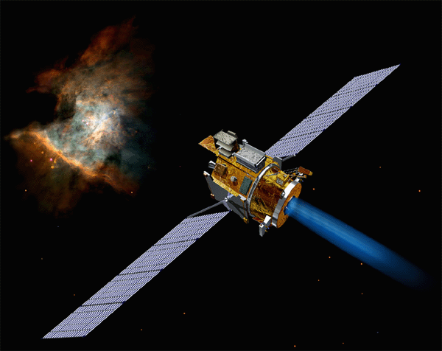
Example: Deep Space 1
http://nmp.jpl.nasa.gov/ds1/
“Deep Space 1
launched from Cape
Canaveral on October 24,
1998. During a highly
successful primary mission,
it tested 12 advanced, high-risk technologies in space. In an extremely successful extended mission, it encountered comet Borrelly and returned the best images and other science data ever from a comet. During its fully successful hyperextended mission, it conducted further technology tests. The spacecraft was retired on December 18, 2001.” – NASA Web site

Slide 38
Interface Agents
The idea is to move away from the direct manipulation paradigm that has dominated for so long.
Agents sit ‘over’ applications, watching, learning, and eventually doing things without being told — taking the initiative.
Pioneering work at MIT Media Lab (Pattie Maes):
  news reader;
  web browsers;
  mail readers.

Slide 39
Nicholas Negroponte’s Vision
‘The ‘agent’ answers the phone, recognises the callers, disturbs you when
appropriate, and may even tell a white lie on your behalf. The same agent is well trained in timing, versed in finding opportune moments, and respectful of
idiosyncracies. ’ (p150)
‘If you have somebody who knows you well and shares much of your
information, that person can act on your behalf very effectively. If your secretary falls ill, it would make no difference if the temping agency could send you Albert Einstein. This issue is not about IQ. It is shared knowledge and the practice of using it in your best interests.’ (p151)
‘Like an army commander sending a scout ahead . . . you will dispatch agents to collect information on your behalf. Agents will dispatch agents. The process multiplies. But [this process] started at the interface where you delegated your desires.’ (p158)
(From Being Digital, 1995.)

Slide 40
Example: Email Reading Assistants
MAXIMS (Pattie Maes, 1994) ‘learns to prioritize, delete, forward, sort, and archive mail messages on behalf of a user . . . ’.
Works by ‘looking over the shoulder’ of a user, and learning about how they deal with email.
Each time a new event occurs (e.g., email arrives), MAXIMS records the situation -> action pairs generated
Situation characterised by features of event:
  sender of email; recipients; subject line; etc.
When new situation occurs, MAXIMS matches it against previously recorded rules.

Slide 41
Email Reading Assistants
Predicts user action, and generates a confidence level
Confidence level compared against two threshholds: “tell me” and “do it”:
  confidence < “tell me”: agent gets feedback
  “tell me” < confidence < “do it”: agent makes suggestion
  confidence > “do it”: agent acts
Rules can be “hard coded”; even get help from other users.
MAXIMS has a simple ‘personality’, (a face icon), communicating its ‘mental state’ to the user.

Slide 42
Internet Agents
It is not easy to find the right information (even with the help of search engines).
Systematic searches by human users are difficult:
  human factors: we get bored by slow response times, find it difficult to read the WWW rigorously, get tired, miss things easily, misunderstand, get sidetracked;
  organizational factors: structure on the net is superficial — no standards for home pages, not (yet) semantic markup to tell you what a page contains;
The sheer amount of information presented to us leads to ‘information overload’.

Slide 43
Internet Agents
What we want is a kind of ‘secretary’: someone who understood the things we were interested in, (and the things we are not interested in), who can act as ‘proxy’, hiding information that we are not interested in, and bringing to our attention information that is of interest.
We cannot afford human agents to do these kinds of tasks (and in any case, humans get suffer from the drawbacks we mentioned above). So we write an agent to do these tasks.
The agent would typically be given a query that would require synthesizing pieces of information from various different Internet information sources. Failure would occur when a particular resource was unavailable, (perhaps due to network failure), or where results could not be obtained.

Slide 44
Example: Tour guides
The idea here is to have agents that help to answer the question ‘where do I go next’ when browsing the WWW.
Such agents can learn about the user’s preferences in the same way that MAXIMS does, and rather than just providing a single, uniform type of hyperlink actually indicate the likely interest of a link.

Slide 45
Agents for E-Commerce
Another important rationale for internet agents is the potential for electronic commerce.
Most commerce is currently done manually. But there is no reason to suppose that certain forms of commerce could not be safely delegated to agents.
Examples:
  find the cheapest copy of MS Office from online stores;
  flight from Manchester to Dusseldorf with veggie meal, window seat, plus hotel, taxis, entertainment, restaurants.

Slide 46
Agents for E-Commerce
First & Second Generation E-Commerce Systems
  First generation: comparison shopping agents.
  Examples:
    1995: Bargain Finder from Andersen;
    1997: Jango from NETBOT.
    2003: Froogle from GOOGLE
Second-generation: negotiation, brokering, ...

Slide 47
Example: Jango
Jango (Doorenbos et al, Agents 97) is a good example of e-commerce agent.
Long-term goals:
  Help user decide what to buy.
  Finding specs and reviews of products.
  Make recommendations.
  Comparison shopping for best buy.
  Monitoring “what’s new” lists.
  Watching for special offers & discounts.

Slide 48
Jango
Isn’t comparison shopping impossible? WWW pages all different!
Jango exploits several regularities in merchant WWW sites:
  navigation regularity: sites designed so that products easy to find
  corporate regularity: sites designed so that pages have same look’n’feel;
  vertical separation: merchants use whitespace to separate products.
Two key components of Jango:
  learning vendor descriptions;
  comparison shopping;

Slide 49
What if the agents become better?
Personal assistant agents need not simply search
They can plan, arrange, buy, negotiate – carry out arrangements of all sorts that would normally be done by their human user
As more can be done electronically, software agents theoretically have more access to systems that affect the real-world
But new research problems arise just as quickly…

Slide 50
Research Issues
How do you state your preferences to your agent?
How can your agent compare different deals from different vendors? What if there are many different parameters?
What algorithms can your agent use to negotiate with other agents (to make sure you get a good deal)?
These issues aren’t frivolous – automated procurement could be used massively by (for example) government agencies
The Trading Agents Competition…

Slide 51
Applications – Multi-Agent Systems
Multiagent systems are indicated for domains where:
  Control, data, expertise are distributed;
  Centralized control is impossible or impractical;
  Processing nodes have competing/conflicting viewpoints or objectives.
Some applications of multi agents:
  Air Traffic Control System
  Agents for workflow and business process management

Slide 52
Air Traffic Control
“A key air-traffic control system…suddenly fails, leaving flights in the vicinity of the airport with no air-traffic control support. Fortunately, autonomous air-traffic control systems in nearby airports recognize the failure of their peer, and cooperate to track and deal with all affected flights.”
Systems taking the initiative when necessary
Agents cooperating to solve problems beyond the capabilities of any individual agent

Slide 53
Agents for Workflow and Business Process Management
Workflow and business process control systems
  Automate the processes of a business
  Ensure that different business tasks are expedited by the appropriate people at the right time
ADEPT (Jennings et al., 1996)
  A business organization is modelled as a society of negotiating, service providing agents
  Providing customers with a quote for installing a network to deliver a particular type of telecommunications service.
    The process involves different British Telecom departments: the Customer Service Division, the Legal Division, and so on.

Slide 54
Agents for Workflow and Business Process Management
ADEPT (Jennings et al., 1996)
  If the service requested by the customer is bespoke
    Customer service division further analyses the requirements
    Legal division checks the legality
    If legal, then the Design division designs the service
  Each department becomes an agent, each individual within a department becomes an agent
  Each agent needs to achieve its individual objectives, and interacts with each other, in the form of negotiations about which services the agents would provide to one another, under different terms and conditions

Slide 55
What Will be Covered
In Multiagent Systems, we address questions:
  How does an individual agent make decision?
  What kinds of languages can agents use to communicate?
  How can autonomous agents coordinate their activities so as to cooperatively achieve goals?
  How can self-interested agents recognize conflict, and how can they (nevertheless) reach agreement?
  How can cooperation emerge in societies of self-interested agents?

Slide 56
Summary
Understand 5 reasons for the emergence of the field.
Why these have led to Multi-Agent Systems
Definitions of Agents, multi-agent systems: difficulty in definition
Know the related research fields
Understand the differences and similarities between agents and other fields
Applications of individual agent and multi-agent system
Some research issues in the agents field

