Slide 1
Summary of Module 1
Understand 5 reasons for the emergence of the field.
Why these have led to Multi-Agent Systems
Definitions of Agents, multi-agent systems: difficulty in definition
Know the related research fields
Understand the differences and similarities between agents and other fields
Applications of individual agent and multi-agent system
Some research issues in the agents field

Slide 2
2.1: Agent Decision Making
AI6125 : Multi-Agent System
Assoc Prof Zhang Jie
Based on “An Introduction to MultiAgent Systems” by Michael Wooldridge, John Wiley & Sons, 2002/2009
“Artificial Intelligence: A Modern Approach” by S. Russell and P. Norvig.. Prentice-Hall, third edition, 2010

Slide 3
Overview
What is Agent and Agent Abstraction
Make Simple Decisions
Make Complex Decisions
  Sequential decision making
  Agent’s utility depends on a sequence of decisions
  Based on Chapters 16 & 17 in reference book: “Artificial Intelligence: A Modern Approach” by S. Russell and P. Norvig. Prentice-Hall, third edition, 2010

Slide 4
What is an Agent?
The main point about agents is they are autonomous: capable of acting independently, exhibiting control over their internal state
Thus: an agent is a computer system capable of autonomous action in some environment in order to meet its design objectives
SYSTEM
input
output
ENVIRONMENT

Slide 5
What is an Agent?
Trivial (non-interesting) agents:
  thermostat
  UNIX daemon (e.g., biff)
An intelligent agent is a computer system capable of flexible autonomous action in some environment
By flexible, we mean:
  reactive
  pro-active
  social

Slide 6
Reactivity
If a program’s environment is guaranteed to be fixed, the program need never worry about its own success or failure – program just executes blindly
  Example of fixed environment: compiler
The real world is not like that: things change, information is incomplete. Many (most?) interesting environments are dynamic
Software is hard to build for dynamic domains: program must take into account possibility of failure – ask itself whether it is worth executing!
A reactive system is one that maintains an ongoing interaction with its environment, and responds to changes that occur in it (in time for the response to be useful)

Slide 7
Proactiveness
Reacting to an environment is easy (e.g., stimulus → response rules)
But we generally want agents to do things for us
Hence goal directed behavior
Pro-activeness = generating and attempting to achieve goals; not driven solely by events; taking the initiative
Recognizing opportunities

Slide 8
Balancing Reactive and Goal-Oriented Behavior
We want our agents to be reactive, responding to changing conditions in an appropriate (timely) fashion
We want our agents to systematically work towards long-term goals
These two considerations can be at odds with one another
Designing an agent that can balance the two remains an open research problem

Slide 9
Social Ability
The real world is a multi-agent environment: we cannot go around attempting to achieve goals without taking others into account
Some goals can only be achieved with the cooperation of others
Similarly for many computer environments: witness the Internet
Social ability in agents is the ability to interact with other agents (and possibly humans) via some kind of agent-communication language, and perhaps cooperate with others

Slide 10
Other Properties
Other properties, sometimes discussed in the context of agency:
mobility: the ability of an agent to move around an electronic network
veracity: an agent will not knowingly communicate false information
benevolence: agents do not have conflicting goals, and that every agent will therefore always try to do what is asked of it
rationality: agent will act in order to achieve its goals, and will not act in such a way as to prevent its goals being achieved — at least insofar as its beliefs permit
learning/adaption: agents improve performance over time

Slide 11
Agents and…
Objects (as in OOP)
A.I.
Expert Systems
  Environments
Intentional Systems

Slide 12
Agents and Objects
Are agents just objects by another name?
Object:
  encapsulates some state
  communicates via message passing
  has methods, corresponding to operations that may be performed on this state

Slide 13
Agents and Objects
Main differences:
  agents are autonomous:
  agents embody stronger notion of autonomy than objects, and in particular, they decide for themselves whether or not to perform an action on request from another agent
  agents are smart:
  capable of flexible (reactive, pro-active, social) behavior, and the standard object model has nothing to say about such types of behavior
  agents are active:
  a multi-agent system is inherently multi-threaded, in that each agent is assumed to have at least one thread of active control

Slide 14
Objects do it for free…
agents do it because they want to
agents do it for money

Slide 15
Intelligent Agents and AI
Aren’t agents just the AI project?
Isn’t building an agent what AI is all about?
AI aims to build systems that can (ultimately) understand natural language, recognize and understand scenes, use common sense, think creatively, etc. — all of which are very hard
So, don’t we need to solve all of AI to build an agent…?

Slide 16
Intelligent Agents and AI
When building an agent, we simply want a system that can choose the right action to perform, typically in a limited domain
We do not have to solve all the problems of AI to build a useful agent:
a little intelligence goes a long way!
Oren Etzioni, speaking about the commercial experience of NETBOT, Inc:
“We made our agents dumber and dumber and dumber…until finally they made money.”

Slide 17
Agents and Expert Systems
Aren’t agents just expert systems by another name?
Expert systems are typically disembodied ‘expertise’ about some (abstract) domain of discourse (e.g., blood diseases)
Example: MYCIN knows about blood diseases in humans
  It has a wealth of knowledge about blood diseases, in the form of rules
  A doctor can obtain expert advice about blood diseases by giving MYCIN facts, answering questions, and posing queries

Slide 18
Agents and Expert Systems
Main differences:
  agents situated in an environment:
  MYCIN is not aware of the world — only information obtained is by asking the user questions
  agents act:
  MYCIN does not operate on patients
Some real-time (typically process control) expert systems are agents

Slide 19
Agents as Intentional Systems Intentional Stance
Dennett gives three levels:
  1. Physical stance : At this level, we are concerned with such things as mass, energy, velocity, and chemical composition. When we predict where a ball is going to land based on its current trajectory, we are taking the physical stance
  2. Design stance : At this level, we are concerned with such things as purpose, function and design. When we predict that a bird will fly when it flaps its wings on the basis that wings are made for flying, we are taking the design stance.
  3. Intentional stance : At this level, we are concerned with such things as belief, thinking and intent. When we predict that the bird will fly away because it knows the cat is coming and is afraid of getting eaten, we are taking the intentional stance.
More Abstract

Slide 20
Agents as Intentional Systems
When explaining human activity, it is often useful to make statements such as the following:
Janine took her umbrella because she believed it was going to rain.
Michael worked hard because he wanted to possess a PhD.
These statements make use of a folk psychology, by which human behavior is predicted and explained through the attribution of attitudes, such as believing and wanting (as in the above examples), hoping, fearing, and so on
The attitudes employed in such folk psychological descriptions are called the intentional notions

Slide 21
Agents as Intentional Systems
The philosopher Daniel Dennett coined the term intentional system to describe entities ‘whose behavior can be predicted by the method of attributing belief, desires and rational acumen’
Dennett identifies different ‘grades’ of intentional system:
‘A first-order intentional system has beliefs and desires (etc.) but no beliefs and desires about beliefs and desires. …A second-order intentional system is more sophisticated; it has beliefs and desires (and no doubt other intentional states) about beliefs and desires (and other intentional states) — both those of others and its own’

Slide 22
Agents as Intentional Systems
Is it legitimate or useful to attribute beliefs, desires, and so on, to computer systems?

Slide 23
Agents as Intentional Systems
McCarthy argued that there are occasions when the intentional stance is appropriate:
‘To ascribe beliefs, free will, intentions, consciousness, abilities, or wants to a machine is legitimate when such an ascription expresses the same information about the machine that it expresses about a person. It is useful when the ascription helps us understand the structure of the machine, its past or future behavior, or how to repair or improve it. It is perhaps never logically required even for humans, but expressing reasonably briefly what is actually known about the state of the machine in a particular situation may require mental qualities or qualities isomorphic to them. Theories of belief, knowledge and wanting can be constructed for machines in a simpler setting than for humans, and later applied to humans. Ascription of mental qualities is most straightforward for machines of known structure such as thermostats and computer operating systems, but is most useful when applied to entities whose structure is incompletely known’.

Slide 24
Agents as Intentional Systems
What objects can be described by intentional stance?
As it turns out, more or less anything can. . . consider a light switch:
But most adults would find such a description absurd!
Why is this?
‘It is perfectly coherent to treat a light switch as a (very cooperative) agent with the capability of transmitting current at will, who invariably transmits current when it believes that we want it transmitted and not otherwise; flicking the switch is simply our way of communicating our desires’. (Yoav Shoham)

Slide 25
Agents as Intentional Systems
The answer seems to be that while the intentional stance description is consistent,
‘. . . it does not buy us anything, since we essentially understand the mechanism sufficiently to have a simpler, mechanistic description of its behavior.’ (Yoav Shoham)
Put crudely, the more we know about a system, the less we need to rely on animistic, intentional explanations of its behavior
But with very complex systems, a mechanistic, explanation of its behavior may not be practicable
As computer systems become ever more complex, we need more powerful abstractions and metaphors to explain their operation — low level explanations become impractical. The intentional stance is such an abstraction

Slide 26
Agents as Intentional Systems
The intentional notions are thus abstraction tools, which provide us with a convenient and familiar way of describing, explaining, and predicting the behavior of complex systems
Remember: most important developments in computing are based on new abstractions:
  procedural abstraction
  abstract data types
  objects
Agents, and agents as intentional systems, represent a further, and increasingly powerful abstraction
So agent theorists start from the (strong) view of agents as intentional systems: one whose simplest consistent description requires the intentional stance

Slide 27
Agents as Intentional Systems
This intentional stance is an abstraction tool — a convenient way of talking about complex systems, which allows us to predict and explain their behavior without having to understand how the mechanism actually works
Now, much of computer science is concerned with looking for abstraction mechanisms (witness procedural abstraction, ADTs, objects,…)
So why not use the intentional stance as an abstraction tool in computing — to explain, understand, and, crucially, program computer systems?
This is an important argument in favor of agents

Slide 28
Agents as Intentional Systems
Other 3 points in favor of this idea:
Characterizing Agents:
  It provides us with a familiar, non-technical way of understanding & explaining agents
Nested Representations:
  It gives us the potential to specify systems that include representations of other systems
  It is widely accepted that such nested representations are essential for agents that must cooperate with other agents

Slide 29
Environments – Accessible vs. inaccessible
An accessible environment is one in which the agent can obtain complete, accurate, up-to-date information about the environment’s state
Most moderately complex environments (including, for example, the everyday physical world and the Internet) are inaccessible
The more accessible an environment is, the simpler it is to build agents to operate in it

Slide 30
Environments –
Deterministic vs. non-deterministic
A deterministic environment is one in which any action has a single guaranteed effect — there is no uncertainty about the state that will result from performing an action
The physical world can to all intents and purposes be regarded as non-deterministic
Non-deterministic environments present greater problems for the agent designer

Slide 31
Environments - Episodic vs. non-episodic
In an episodic environment, the performance of an agent is dependent on a number of discrete episodes, with no link between the performance of an agent in different scenarios
Episodic environments are simpler from the agent developer’s perspective because the agent can decide what action to perform based only on the current episode — it need not reason about the interactions between this and future episodes

Slide 32
Environments - Static vs. dynamic
A static environment is one that can be assumed to remain unchanged except by the performance of actions by the agent
A dynamic environment is one that has other processes operating on it, and which hence changes in ways beyond the agent’s control
Other processes can interfere with the agent’s actions (as in concurrent systems theory)
The physical world is a highly dynamic environment

Slide 33
Environments – Discrete vs. continuous
An environment is discrete if there are a fixed, finite number of actions and percepts in it
Russell and Norvig give a chess game as an example of a discrete environment, and taxi driving as an example of a continuous one
Continuous environments have a certain level of mismatch with computer systems
Discrete environments could in principle be handled by a kind of “lookup table”

Slide 34
Agents as Intentional Systems
Post-Declarative Systems:
  This view of agents leads to a kind of post-declarative programming:
    In procedural programming, we say exactly what a system should do
    In declarative programming, we state something that we want to achieve, give the system general info about the relationships between objects, and let a built-in control mechanism (e.g., goal-directed theorem proving) figure out what to do
    With agents, we give a very abstract specification of the system, and let the control mechanism figure out what to do, knowing that it will act in accordance with some built-in theory of agency (e.g., the well-known Cohen-Levesque model of intention)

Slide 35



Abstract Architecture for Agents
Assume the environment may be in any of a finite set E of discrete, instantaneous states:
Agents are assumed to have a repertoire of possible actions available to them, which transform the state of the environment:
A run, r, of an agent in an environment is a sequence of interleaved environment states and actions:

Slide 36
Abstract Architecture for Agents
Let:
  R be the set of all such possible finite sequences (over E and Ac)
  R^{Ac} be the subset of these that end with an action
  R^{E} be the subset of these that end with an environment state

Slide 37
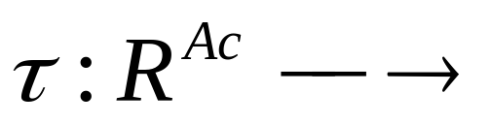

State Transformer Functions
A state transformer function represents behavior of the environment:
Note that environments are…
  history dependent
  non-deterministic
If τ(r)=∅, then there are no possible successor states to r. In this case, we say that the system has ended its run
Formally, we say an environment Env is a triple Env =⟨E,e₀,τ⟩ where: E is a set of environment states, e₀∈ E is the initial state, and τ is a state transformer function
Notes:
In order to represent the effect of agent’s actions on environment use state transformer.
State transformer maps a run (assumed to end with an action) to a set of possible environment states (that could result from performing the actions)
History dependent : next state of environment not depends solely on current action and current state.
Non-determinism : this is not prohibited by definition

Slide 38
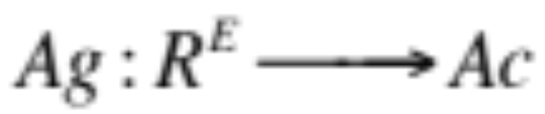
Agents
Agent is a function which maps runs to actions:
An agent makes a decision about what action to perform based on the history of the system that it has witnessed to date. Let AG be the set of all agents

Slide 39
Systems
A system is a pair containing an agent and an environment
Any system will have associated with it a set of possible runs; we denote the set of runs of agent Ag in environment Env by R(Ag, Env)
(We assume R(Ag, Env) contains only terminated runs)

Slide 40

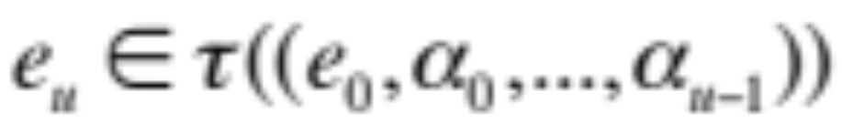
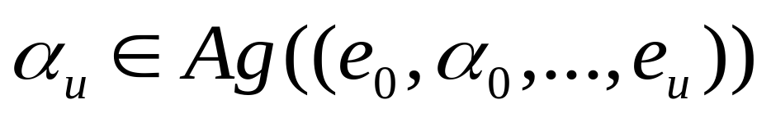
Systems
Formally, a sequence
represents a run of an agent Ag in environment Env =⟨E,e₀,τ⟩ if:
  e₀ is the initial state of Env
  α₀ = Ag(e₀); and
  For u > 0,
    and…

Slide 41


Purely Reactive Agents
Some agents decide what to do without reference to their history — they base their decision making entirely on the present, with no reference at all to the past
We call such agents purely reactive:
A thermostat is a purely reactive agent

Slide 42
Perception
Now introduce perception system:
see
action
Agent
Environment

Slide 43
Perception
The see function is the agent’s ability to observe its environment, whereas the action function represents the agent’s decision making process
Output of the see function is a percept:
see : E → Per
which maps environment states to percepts, and action is now a function
action : Per* → A
which maps sequences of percepts to actions

Slide 44
Example
Tic-tac-toe
  see(board) -> [ , ,O,X,X, , ,O,O]
  action([ , ,O,X,X, , ,O,O]) -> put(X, (3,2))

Slide 45
Agents with State
We now consider agents that maintain state:
Agent
see
action
next
state
Environment

Slide 46
Agents with State
These agents have some internal data structure, which is typically used to record information about the environment state and history.
Let I be the set of all internal states of the agent.
The perception function see for a state-based agent is unchanged:
see : E → Per
The action-selection function action is now defined as a mapping
action : I → Ac
from internal states to actions. An additional function next is introduced, which maps an internal state and percept to an internal state:
next : I × Per → I

Slide 47
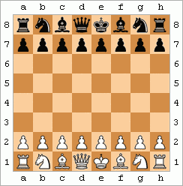
Example : Chess playing agent
Tic-tac-toe: does a state based agent make sense?
  The move at any time depends on the current state of the board
Chess playing agent may remember previous board states to predict strategy of player.
  next : I × Per → I
  I is a list of board configurations

Slide 48
Agent Control Loop
Agent starts in some initial internal state i₀
Observes its environment state e, and generates a percept see(e)
Internal state of the agent is then updated via next function, becoming next(i₀, see(e))
The action selected by the agent is action(next(i₀, see(e)))
Goto 2

Slide 49
Tasks for Agents
We build agents in order to carry out tasks for us
The task must be specified by us…
But we want to tell agents what to do without telling them how to do it

Slide 50
Utility Functions over States
One possibility: associate utilities with individual states — the task of the agent is then to bring about states that maximize utility
A task specification is a function
u : E → ℝ
which associates a real number with every environment state

Slide 51
Utility Functions over States
But what is the value of a run…
  minimum utility of state on run?
  maximum utility of state on run?
  sum of utilities of states on run?
  average?
Disadvantage: difficult to specify a long term view when assigning utilities to individual states
(One possibility: a discount for states later on.)

Slide 52
Utilities over Runs
Another possibility: assigns a utility not to individual states, but to runs themselves:
u : R → ℝ
Such an approach takes an inherently long term view
Other variations: incorporate probabilities of different states emerging
Difficulties with utility-based approaches:
  where do the numbers come from?
  we don’t think in terms of utilities!
  hard to formulate tasks in these terms

Slide 53

Utility in the Tileworld
Simulated two dimensional grid environment on which there are agents, tiles, obstacles, and holes
An agent can move in four directions, up, down, left, or right, and if it is located next to a tile, it can push it
Holes have to be filled up with tiles by the agent. An agent scores points by filling holes with tiles, with the aim being to fill as many holes as possible
TILEWORLD changes with the random appearance and disappearance of holes
Utility function defined as follows:

Slide 54
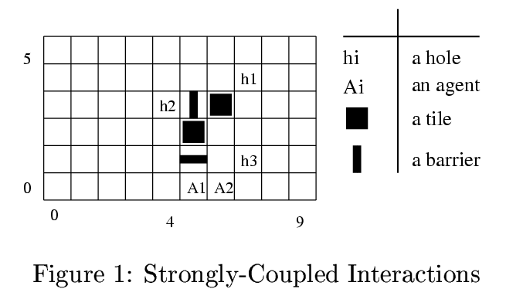
The Tileworld, Some Examples
From Goldman and Rosenschein, AAAI-94:

Slide 55
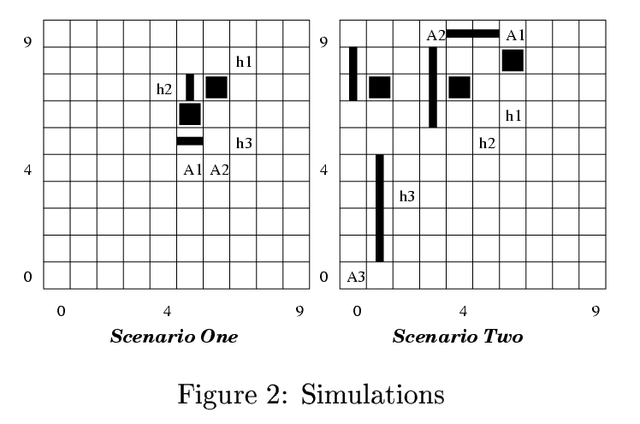
The Tileworld, Some Examples
From Goldman and Rosenschein, AAAI-94:

Slide 56


Expected Utility & Optimal Agents
Write P(r | Ag, Env) to denote probability that run r occurs when agent Ag is placed in environment Env
Note:
Then optimal agent Ag_{opt} in an environment Env is the one that maximizes expected utility:

Slide 57

Bounded Optimal Agents
Some agents cannot be implemented on some computers
(A function Ag : R^{E} → Ac may need more than available memory to implement)
Write AG_{m} to denote the agents that can be implemented on machine (computer) m:
We can replace equation (1) with the following, which defines the bounded optimal agent Ag_{opt}:

Slide 58
Predicate Task Specifications
A special case of assigning utilities to histories is to assign 0 (false) or 1 (true) to a run
If a run is assigned 1, then the agent succeeds on that run, otherwise it fails
Call these predicate task specifications
Denote predicate task specification by Ψ.
Thus Ψ : R → {0, 1}.

Slide 59
Task Environments
A task environment is a pair ⟨Env, Ψ⟩ where Env is an environment,
Ψ : R → {0, 1}
is a predicate over runs.
Let TE be the set of all task environments.
A task environment specifies:
  the properties of the system the agent will inhabit
  the criteria by which an agent will be judged to have either failed or succeeded

Slide 60

Task Environments
Write R_{Ψ}(Ag, Env) to denote set of all runs of the agent Ag in environment Env that satisfy Ψ:
We then say that an agent Ag succeeds in task environment ⟨Env, Ψ⟩ if

Slide 61

The Probability of Success
Let P(r | Ag, Env) denote probability that run r occurs if agent Ag is placed in environment Env
Then the probability P(Ψ | Ag, Env) that Ψ is satisfied by Ag in Env would then simply be:

Slide 62
Achievement & Maintenance Tasks
Two most common types of tasks are achievement tasks and maintenance tasks:
  Achievement tasks are those of the form “achieve state of affairs φ”
  Maintenance tasks are those of the form “maintain state of affairs ψ”

Slide 63
Achievement & Maintenance Tasks
An achievement task is specified by a set G of “good” or “goal” states: G ⊆ E
The agent succeeds if it is guaranteed to bring about at least one of these states (we do not care which one — they are all considered equally good).
A maintenance goal is specified by a set B of “bad” states: B ⊆ E
The agent succeeds in a particular environment if it manages to avoid all states in B — if it never performs actions which result in any state in B occurring

Slide 64

Agent Synthesis
Agent synthesis is automatic programming: goal is to have a program that will take a task environment, and from this task environment automatically generate an agent that succeeds in this environment:
(Think of ⊥ as being like null in Java.)
Synthesis algorithm is:
  sound if, whenever it returns an agent, then this agent succeeds in the task environment that is passed as input
  complete if it is guaranteed to return an agent whenever there exists an agent that will succeed in the task environment given as input

Slide 65
Agent Synthesis
Synthesis algorithm syn is sound if it satisfies the following condition:
and complete if:

Slide 66
Summary
Properties of agent clarify definition
Reactive vs Proactive, Social – and others.
Agents in relation to other systems: Objects, AI, Expert Systems, Intentional Systems
Environment types.
Abstraction of agents

