Slide 1
2.2: Agent Decision Making
AI6125 : Multi-Agent System
Assoc Prof Zhang Jie
Based on “An Introduction to MultiAgent Systems” by Michael Wooldridge, John Wiley & Sons, 2002/2009
“Artificial Intelligence: A Modern Approach” by S. Russell and P. Norvig.. Prentice-Hall, third edition, 2010

Slide 2
Overview
Make Simple Decisions
Make Complex Decisions
  Sequential decision making
  Agent’s utility depends on a sequence of decisions
  Based on Chapters 16 & 17 in reference book: “Artificial Intelligence: A Modern Approach” by S. Russell and P. Norvig. Prentice-Hall, third edition, 2010

Slide 3
Making Simple Decisions
Utility Theory
Multi-Attribute Utility Functions
Decision Networks
The Value of Information

Slide 4
Beliefs and Uncertainty
Utility Function
Expected
Utility
Outcome
Probabilities

Slide 5
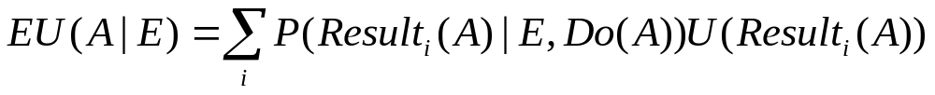

Maximum Expected Utility
Expected Utility
Principle of Maximum Expected Utility
  Choose action A with highest

Slide 6
Example
Robot
Turn Right
Turn Left
Hits wall (P = 0.1; U = 0)
Finds target (P = 0.9; U = 10)
Fall water (P = 0.3; U = 0)
Finds target (P = 0.7; U = 10)
Choose action “Turn Right”

Slide 7





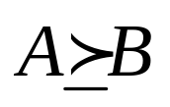
Rational preference
  Preference of rational agent obey constraints
  Behavior describable as maximization of expected utility
Notation
  Lottery(L): a complex decision making scenario
    Different outcomes are determined by chance
  : A is preferred to B
  : indifference between A and B
  : B is not preferred to A

Slide 8
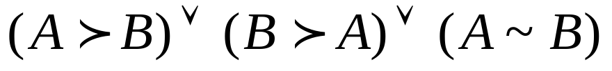
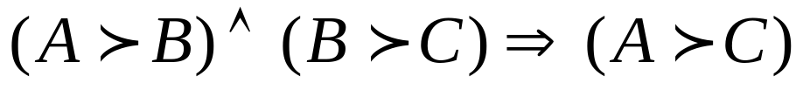
Constraints
  Orderability
  Transitivity
  Continuity

Slide 9

Constraints (cont.)
  Substitutability
  Monotonicity
  Decomposability

Slide 10

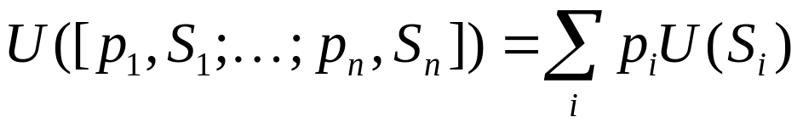
Utility Principle
Maximum Expected Utility principle
Utility Function
  Represents that the agent’s actions are trying to achieve
  Can be constructed by observing agent’s preferences

Slide 11



Utility
  Mapping state to real numbers
  Approach
    Compare A to standard lottery
      u : best possible prize with prob. p
      u : worst possible catastrophe with prob. 1-p
    Adjust p until
    $30 ~ L
0.9
continue
0.1
death

Slide 12
Utility Scales
  Positive linear transform
  Normalized utility
  u = 1.0, u = 0.0
  Micromort
    one-millionth chance of death
    russian roulette, insurance
  QALY
  quality-adjusted life years

Slide 13


Money: does NOT behave as a utility function
  Given a lottery L
  risk-averse
  risk-seeking
U
0
$

Slide 14

Multi-Attribute Utility Theory (MAUT)
  Outcomes are characterized by 2 or more attributes.
  Site a new airport
    disruption by construction, cost of land, noise,….
Approach
  Identify regularities in the preference behavior

Slide 15
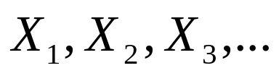
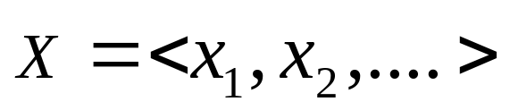
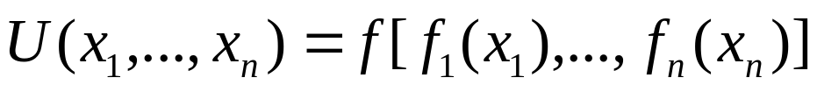
Notation
  Attributes
  Attribute value vector
  Utility Fn.

Slide 16
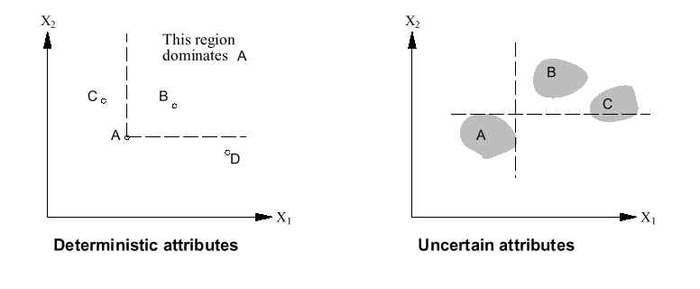
Dominance
  Certain (strict dominance, Fig.1)
    airport site S1 cost less, less noise, safer than S2: strict dominance of S1 over S2
  Uncertain(Fig. 2)
Fig. 1 Fig.2

Slide 17
Dominance(cont.)
  Stochastic dominance
    In real world problem
    S1 : avg $3.7billion,
    standard deviation : $0.4billion
    S2 : avg $4.0billion,
    standard deviation : $0.35billion
      S1 stochastically dominates S2

Slide 18
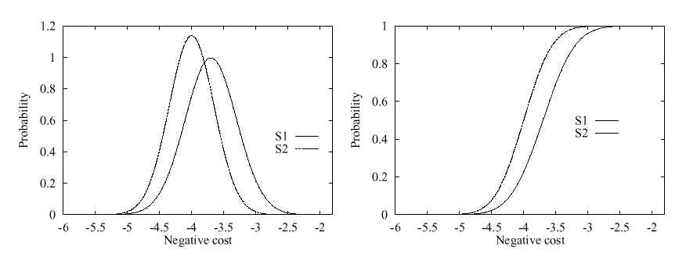
Dominance(cont.)

Slide 19


Preferences without Uncertainty
  Preferences between concrete outcome values.
  Preference structure
    X1 & X2 preferentially independent of X3 iff
    Preference between
    Does not depend on
    Airport site : <Noise, Cost, Safety>
    <20,000 suffer, $4.6billion, 0.06deaths/mpm>
    vs. <70,000 suffer, $4.2billion, 0.06deaths/mpm>

Slide 20
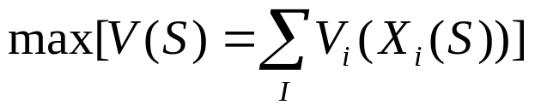
Preferences without Uncertainty (cont.)
  Mutual preferential independence (MPI)
    Every pair of attributes is P.I of its complements.
    Airport site : <Noise, Cost, Safety>
      Noise & Cost P.I Safety
      Noise & Safety P.I Cost
      Cost & Safety P.I Noise
      : <Noise,Cost,Safety> exhibits MPI
    Agent’s preference behavior

Slide 21

Preferences with Uncertainty
  Preferences btw. Lotteries’ utility
  Utility Independence (UI)
    X is utility-independent of Y iff preferences over lotteries’ attribute set X do not depend on particular values of a set of attribute Y.
  Mutual U.I(MUI)
    Each subset of attributes is U.I of the remaining attributes
    agent’s behavior (for 3 attributes): multiplicative Utility Function

Slide 22

Simple formalism for expressing & solving decision problem
Belief networks + decision & utility nodes
Nodes
  Chance nodes
  Decision nodes
  Utility nodes

Slide 23

Decision node
Airport Site
utility table
Air Traffic
Death
U
litigation
Noise
Cost
Construction
Utility node
CPT

Slide 24

Airport Site
Action-utility table
Air Traffic
U
litigation
Construction

Slide 25
Umbrella Network
take/don’t take
P(rain) = 0.4
Take Umbrella
rain
umbrella
P(umb|take) = 1.0
P(~umb|~take)=1.0
happiness
U(~umb, ~rain) = 100
U(~umb, rain) = -100
U(umb,~rain) = 0
U(umb,rain) = -25

Slide 26
Evaluating Decision Networks
Set the evidence variables for current state
For each possible value of the decision node:
  Set decision node to that value
  Calculate the posterior probability of the parent nodes of the utility node, using BN inference
  Calculate the resulting utility for action
return the action with the highest utility

Slide 27
Umbrella Network
take/don’t take
P(rain) = 0.4
Take Umbrella
rain
umbrella
#1
P(umb|take) = 1.0
P(~umb|~take)=1.0
umb | rain | P(umb,rain | take)
0 | 0
0 | 1
1 | 0
1 | 1
happiness
U(~umb, ~rain) = 100
U(~umb, rain) = -100
U(umb,~rain) = 0
U(umb,rain) = -25
#2: EU(take)

Slide 28
Umbrella Network
take/don’t take
P(rain) = 0.4
Take Umbrella
rain
umbrella
#1
P(umb|take) = 1.0
P(~umb|~take)=1.0
umb | rain | P(umb,rain | ~take)
0 | 0
0 | 1
1 | 0
1 | 1
happiness
U(~umb, ~rain) = 100
U(~umb, rain) = -100
U(umb,~rain) = 0
U(umb,rain) = -25
#2: EU(~take)

Slide 29
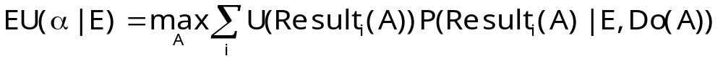
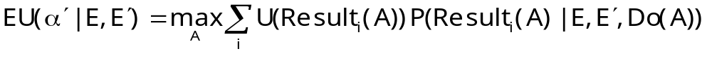
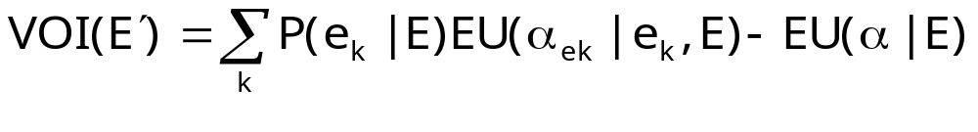
Value of Information (VOI)
Suppose agent’s current knowledge is E. The value of the current best action α is
The value of the new best action (after new evidence E’ is obtained):
the value of information for E’ is:

Slide 30
Umbrella Network
take/don’t take
P(rain) = 0.4
Take Umbrella
rain
umbrella
P(umb|take) = 1.0
P(~umb|~take)=1.0
forecast
happiness
R | F | P(F|R)
0 | 0 | 0.8
0 | 1 | 0.2
1 | 0 | 0.3
1 | 1 | 0.7
U(~umb, ~rain) = 100
U(~umb, rain) = -100
U(umb,~rain) = 0
U(umb,rain) = -25

Slide 31
VOI
VOI(forecast)=
P(rainy)EU(α_{rainy}) +
P(~rainy)EU(α_{~rainy}) –
EU(α)

Slide 32
Umbrella Network
P(F=rainy) = 0.4
F | R | P(R|F)
0 | 0 | 0.8
0 | 1 | 0.2
1 | 0 | 0.3
1 | 1 | 0.7
take/don’t take
P(rain) = 0.4
Take Umbrella
rain
umbrella
P(umb|take) = 1.0
P(~umb|~take)=1.0
forecast
happiness
R | F | P(F|R)
0 | 0 | 0.8
0 | 1 | 0.2
1 | 0 | 0.3
1 | 1 | 0.7
U(~umb, ~rain) = 100
U(~umb, rain) = -100
U(umb,~rain) = 0
U(umb,rain) = -25

Slide 33
umb | rain | P(umb,rain | take, rainy)
0 | 0
0 | 1
1 | 0
1 | 1
umb | rain | P(umb,rain | take, ~rainy)
0 | 0
0 | 1
1 | 0
1 | 1
#1: EU(take|rainy)
#3: EU(take|~rainy)
umb | rain | P(umb,rain | ~take, rainy)
0 | 0
0 | 1
1 | 0
1 | 1
umb | rain | P(umb,rain |~take, ~rainy)
0 | 0
0 | 1
1 | 0
1 | 1
#2: EU(~take|rainy)
#4: EU(~take|~rainy)

Slide 34
Making Complex Decisions
Make a sequence of decisions
  Agent’s utility depends on a sequence of decisions
  Sequential Decision Making
Markov Property
  Transition properties depend only on the current state, not on previous history (how that state was reached)
  Markov Decision Processes

Slide 35
Markov Decision Processes
Components:
  States s, beginning with initial state s₀
  Actions a
    Each state s has actions A(s) available from it
  Transition model P(s’ | s, a)
    Markov assumption: the probability of going to s’ from s depends only on s and a and not on any other past actions or states
  Reward function R(s)
Policy π(s): the action that an agent takes in any given state
  The “solution” to an MDP

Slide 36
Game Show
A series of questions with increasing level of difficulty and increasing payoff
Decision: at each step, take your earnings and quit, or go for the next question
  If you answer wrong, you lose everything
$100 question
$1,000 question
$10,000 question
$50,000 question
Correct:
$61,100
Q1
Correct
Q2
Correct
Q3
Correct
Q4
Incorrect:
$0
Incorrect:
$0
Incorrect:
$0
Incorrect:
$0
Quit:
$100
Quit:
$1,100
Quit:
$11,100

Slide 37
Game Show
Consider $50,000 question
  Probability of guessing correctly: 1/10
  Quit or go for the question?
What is the expected payoff for continuing?
  0.1 * 61,100 + 0.9 * 0 = 6,110
What is the optimal decision?
$100 question
$1,000 question
$10,000 question
$50,000 question
Correct:
$61,100
Q1
Correct
Q2
Correct
Q3
Correct
Q4
Incorrect:
$0
Incorrect:
$0
Incorrect:
$0
Incorrect:
$0
Quit:
$100
Quit:
$1,100
Quit:
$11,100

Slide 38
Game Show
What should we do in Q3?
  Payoff for quitting: $1,100
  Payoff for continuing: 0.5 * $11,100 = $5,550
What about Q2?
  $100 for quitting vs. $4,162 for continuing
What about Q1?
U = $3,746
U = $4,162
U = $5,550
U = $11,100
$100 question
$1,000 question
$10,000 question
$50,000 question
1/10
9/10
3/4
1/2
Correct:
$61,100
Q1
Correct
Q2
Correct
Q3
Correct
Q4
Incorrect:
$0
Incorrect:
$0
Incorrect:
$0
Incorrect:
$0
Quit:
$100
Quit:
$1,100
Quit:
$11,100

Slide 39
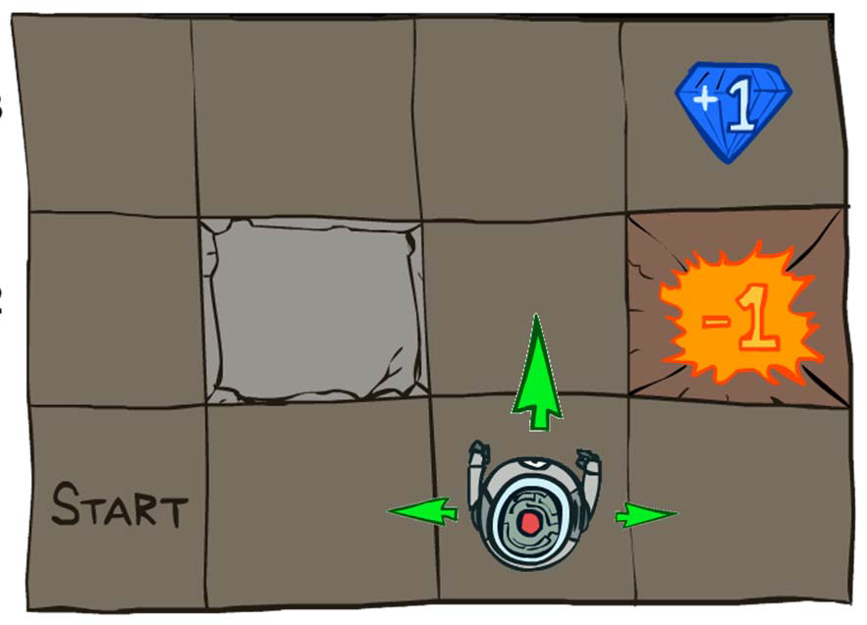
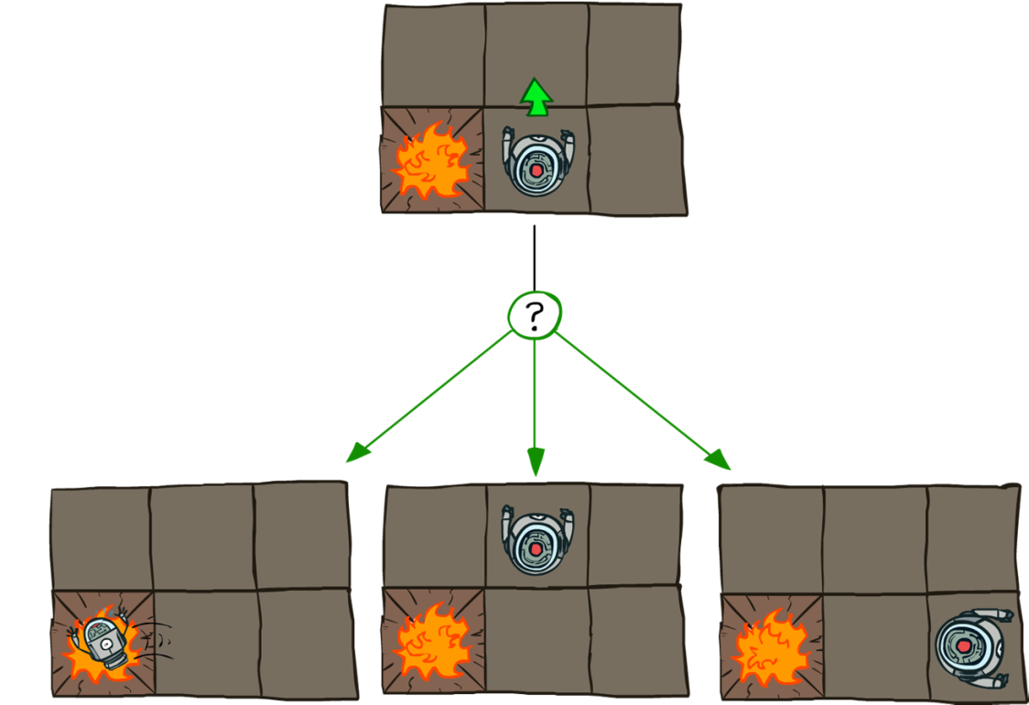
Grid World
Transition model:
0.1
0.8
0.1
R(s) = -0.04 for every non-terminal state
Source: P. Abbeel and D. Klein

Slide 40

Goal: Policy
Source: P. Abbeel and D. Klein

Slide 41
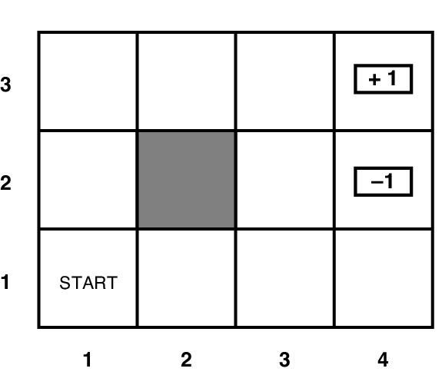
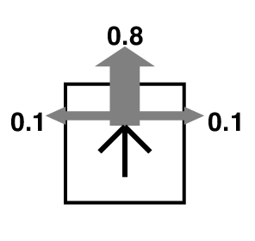
Grid World
Transition model:
R(s) = -0.04 for every non-terminal state

Slide 42
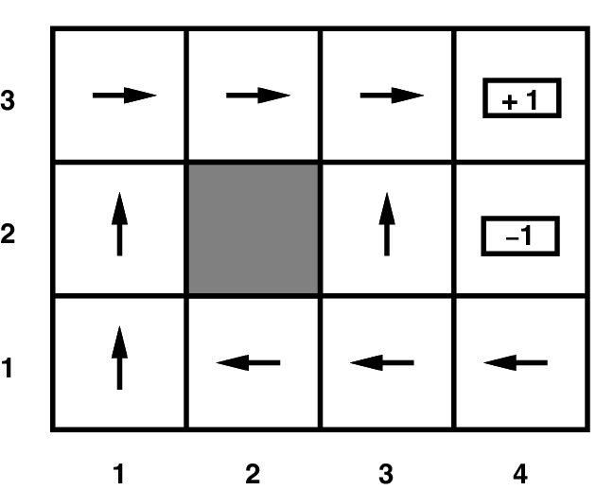
Grid World
Optimal policy when R(s) = -0.04 for every non-terminal state

Slide 43
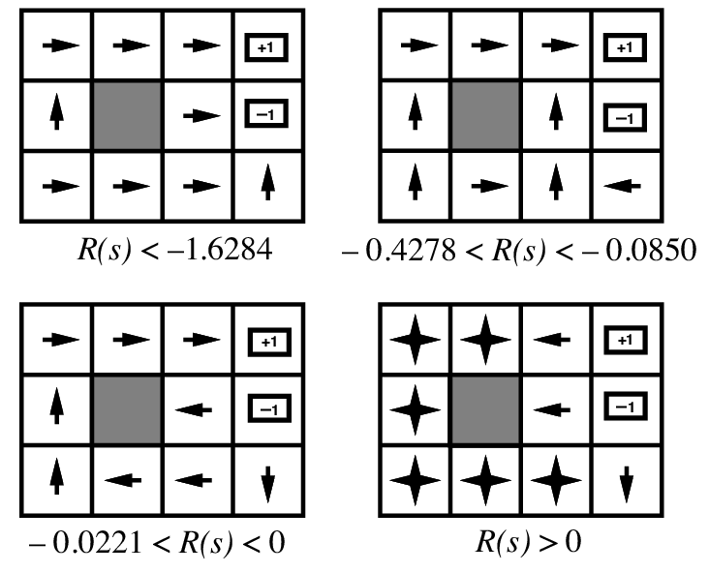
Grid World
Optimal policies for other values of R(s):

Slide 44
Solving MDPs
MDP components:
  States s
  Actions a
  Transition model P(s’ | s, a)
  Reward function R(s)
The solution:
  Policy π(s): mapping from states to actions
  How to find the optimal policy?

Slide 45
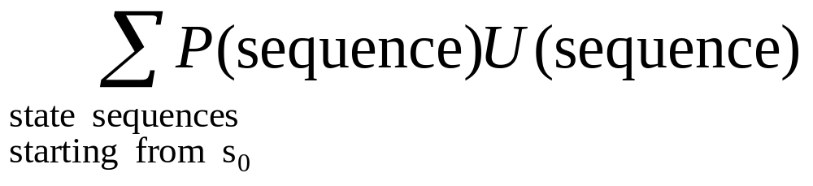
Maximizing Expected Utility
The optimal policy should maximize the expected utility over all possible state sequences produced by following that policy:
How to define the utility of a state sequence?
  Sum of rewards of individual states
  Problem: infinite state sequences

Slide 46
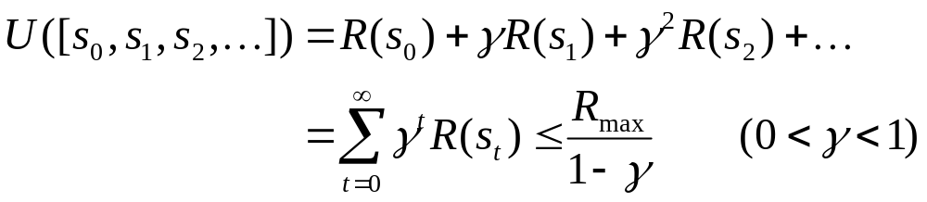
Utilities of State Sequences
Normally, we would define the utility of a state sequence as the sum of the rewards of the individual states
Problem: infinite state sequences
Solution: discount the individual state rewards by a factor γ between 0 and 1:
  Sooner rewards count more than later rewards
  Makes sure the total utility stays bounded
  Helps algorithms converge

Slide 47
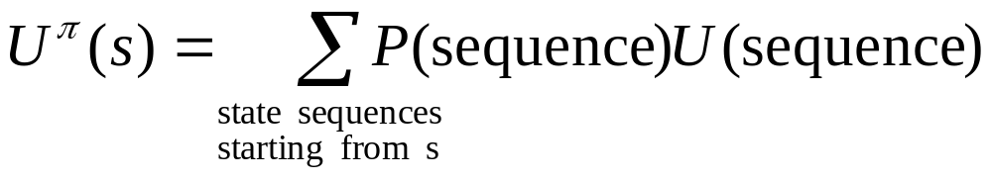
Utilities of States
Expected utility obtained by policy π starting in state s:
The “true” utility of a state, denoted U(s), is the expected sum of discounted rewards if the agent executes an optimal policy starting in state s
Reminiscent of minimax values of states…

Slide 48
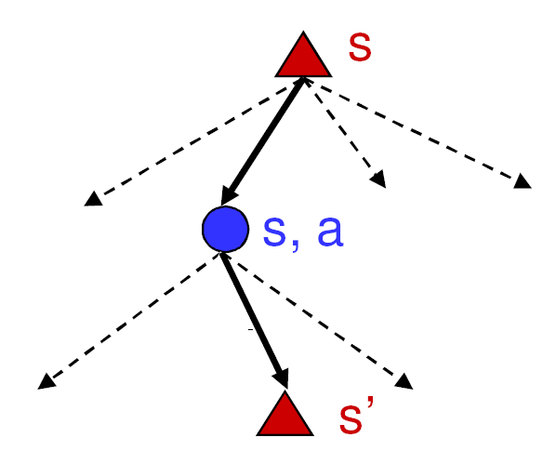
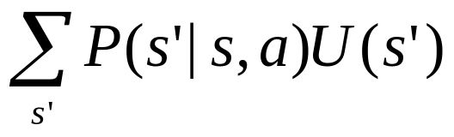
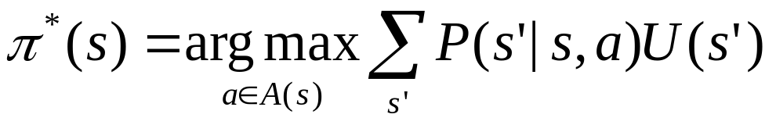
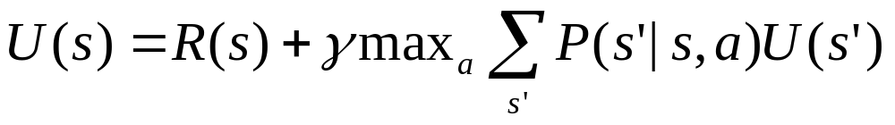
Finding the Utilities of States
Max node
What is the expected utility of taking action a in state s?
How do we choose the optimal action?
Chance node
P(s’ | s, a)
U(s’)
What is the recursive expression for U(s) in terms of the utilities of its successor states?

Slide 49
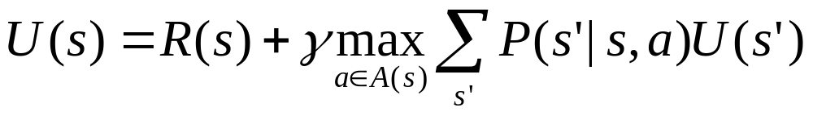
The Bellman Equation
Recursive relationship between the utilities of successive states:
Receive reward R(s)
Choose optimal action a
End up here with P(s’ | s, a)
Get utility U(s’)
(discounted by γ)

Slide 50
The Bellman Equation
Recursive relationship between the utilities of successive states:
For N states, we get N equations in N unknowns
  Solving them solves the MDP
  We could try to solve them through expectimax search, but that would run into trouble with infinite sequences
  Instead, we solve them algebraically
  Two methods: value iteration and policy iteration

Slide 51
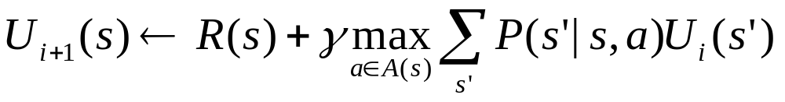
Method 1: Value Iteration
Start out with every U(s) = 0
Iterate until convergence
  During the ith iteration, update the utility of each state according to this rule:
In the limit of infinitely many iterations, guaranteed to find the correct utility values
  In practice, don’t need an infinite number of iterations…

Slide 52
Value Iteration
What effect does the update have?

Slide 53
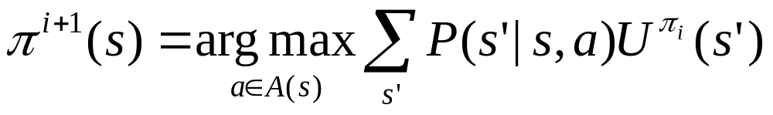
Method 2: Policy Iteration
Start with some initial policy π₀ and alternate between the following steps:
  Policy evaluation: calculate U^{πi}(s) for every state s
  Policy improvement: calculate a new policy π_{i+1} based on the updated utilities

Slide 54
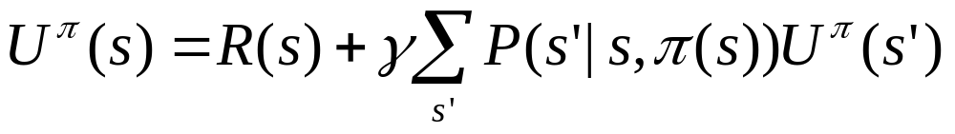
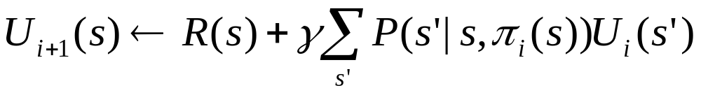
Policy Evaluation
Given a fixed policy π, calculate U^{π}(s) for every state s
The Bellman equation for the optimal policy:
  How does it need to change if our policy is fixed?
  Can solve a linear system to get all the utilities!
  Alternatively, can apply the following update:

Slide 55
Summary
Decision theory combines probability and utility theory
A rational agent chooses the action with maximum expected utility
Multi-attribute utility theory deals with utilities that depend on several attributes
Decision networks extend BBN with additional nodes
Making complex decisions – a sequence of decisions
Markov decision processes assume Markov property
Two methods for computing optimal policy
  Value iteration
  Policy iteration

