Slide 1
3: AGENT ARCHITECTURE
AI6125: Intelligent Agents
Assoc Prof Zhang Jie
Based on “An Introduction to MultiAgent Systems” by Michael Wooldridge, John Wiley & Sons, 2002/2009

Slide 2
Agent Architecture
An agent architecture is a software design for an agent
We have already seen a top-level decomposition (abstract), into:
perception – state – decision – action
An agent architecture defines (concrete):
  Key data structures;
  Operations on data structures;
  Control flow between operations

Slide 3
History of Agent Architectures
Originally (1956-1985), pretty much all agents designed within AI were symbolic reasoning agents
Its purest expression proposes that agents use explicit logical reasoning in order to decide what to do
Problems with symbolic reasoning led to a reaction against this — the so-called reactive agents movement, 1985–present
From 1990-present, a number of alternatives proposed: hybrid architectures, which attempt to combine the best of reasoning and reactive architectures

Slide 4
Symbolic Reasoning Agents
The classical approach to building agents is to view them as a particular type of knowledge-based system, and bring all the associated (discredited?!) methodologies of such systems to bear
This paradigm is known as symbolic AI
We define a deliberative agent or agent architecture to be one that:
  contains an explicitly represented, symbolic model of the world
  makes decisions (for example about what actions to perform) via symbolic reasoning

Slide 5
Symbolic Reasoning Agents
If we aim to build an agent in this way, there are two key problems to be solved:
The transduction problem:
that of translating the real world into an accurate, adequate symbolic description, in time for that description to be useful…vision, speech understanding, learning
The representation/reasoning problem:
that of how to symbolically represent information about complex real-world entities and processes, and how to get agents to reason with this information in time for the results to be useful…knowledge representation, automated reasoning, automatic planning

Slide 6
Symbolic Reasoning Agents
Most researchers accept that neither problem is anywhere near solved
Underlying problem lies with the complexity of symbol manipulation algorithms in general: many (most) search-based symbol manipulation algorithms of interest are highly intractable
Because of these problems, some researchers have looked to alternative techniques for building agents; we look at these later

Slide 7
Deductive Reasoning Agents
How can an agent decide what to do using theorem proving?
Basic idea is to use logic to encode a theory stating the best action to perform in any given situation
Let:
  ρ be this theory (typically a set of rules)
  Δ be a logical database that describes the current state of the world
  Ac be the set of actions the agent can perform
  Δ |-_{ρ}φ mean that φ can be proved from Δ using ρ

Slide 8
Deductive Reasoning Agents
/* try to find an action explicitly prescribed */
for each a ∈ Ac do
if Δ|-_{ρ} Do(a) then
return a
end-if
end-for
/* try to find an action not excluded */
for each a ∈ Ac do
if Δ |-_{ρ} ¬Do(a) then
return a
end-if
end-for
return null /* no action found */

Slide 9
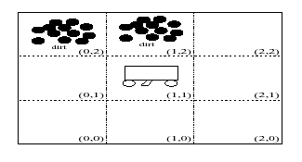
Deductive Reasoning Agents
An example: The Vacuum World
Goal is for the robot to clear up all dirt

Slide 10
Deductive Reasoning Agents
Use 3 domain predicates to solve problem:
  In(x, y) agent is at (x, y)
  Dirt(x, y) there is dirt at (x, y)
  Facing(d) the agent is facing direction d
Possible actions:
  Ac = {turn, forward, suck}
P.S. turn means “turn right”

Slide 11
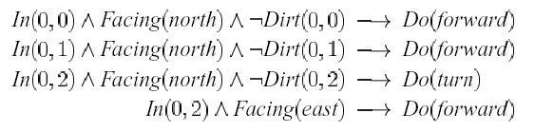
Deductive Reasoning Agents
Rules ρ for determining what to do:
…and so on!
Using these rules (+ other obvious ones), starting at (0, 0) the robot will clear up dirt

Slide 12
Deductive Reasoning Agents
Problems:
  How to convert video camera input to Dirt(0, 1)?
  decision making assumes a static environment: calculative rationality
  decision making using first-order logic is undecidable!
Typical solutions:
  weaken the logic
  use symbolic, non-logical representations
  shift the emphasis of reasoning from run time to design time

Slide 13
AGENT0 and PLACA
Much of the interest in agents from the AI community has arisen from Shoham’s notion of agent oriented programming (AOP)
AOP: ‘a new programming paradigm, based on a societal view of computation’
The key idea that informs AOP is that of directly programming agents in terms of intentional notions like belief, commitment, and intention

Slide 14
AGENT0
AGENT0 is implemented as an extension to LISP
Each agent in AGENT0 has 4 components:
  a set of capabilities (things the agent can do)
  a set of initial beliefs
  a set of initial commitments (things the agent will do)
  a set of commitment rules
The key component, which determines how the agent acts, is the commitment rule set

Slide 15
AGENT0
Each commitment rule contains
  a message condition
  a mental condition
  an action
On each ‘agent cycle’…
  The message condition is matched against the messages the agent has received
  The mental condition is matched against the beliefs of the agent
  If the rule fires, then the agent becomes committed to the action (the action gets added to the agent’s commitment set)

Slide 16
AGENT0
Actions may be
  private:
  an internally executed computation, or
  communicative:
  sending messages
Messages are constrained to be one of three types:
  “requests” to commit to action
  “unrequests” to refrain from actions
  “informs” which pass on information

Slide 17
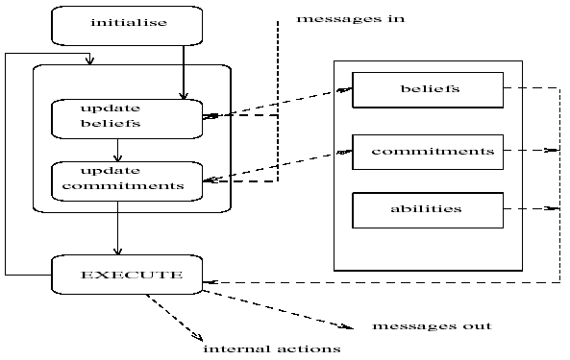
AGENT0

Slide 18
AGENT0
A commitment rule:
COMMIT(
( agent, REQUEST, DO(time, action)
), ;;; msg condition
( B,
[now, Friend agent] AND
CAN(self, action) AND
NOT [time, CMT(self, anyaction)]
), ;;; mental condition
self,
DO(time, action)
)

Slide 19
AGENT0
This rule may be paraphrased as follows:
if I receive a message from agent which requests me to do action at time, and I believe that:
  agent is currently a friend
  I can do the action
  At time, I am not committed to doing any other action
  then commit to doing action at time

Slide 20
AGENT0 and PLACA
AGENT0 provides support for multiple agents to cooperate and communicate, and provides basic provision for debugging…
…it is, however, a prototype, that was designed to illustrate some principles, rather than be a production language
A more refined implementation was developed by Thomas, for her 1993 doctoral thesis
Her Planning Communicating Agents (PLACA) language was intended to address one severe drawback to AGENT0: the inability of agents to plan, and communicate requests for action via high-level goals
Agents in PLACA are programmed in much the same way as in AGENT0, in terms of mental change rules

Slide 21
AGENT0 and PLACA
An example mental change rule:
(((self ?agent REQUEST (?t (xeroxed ?x)))
(AND (CAN-ACHIEVE (?t xeroxed ?x)))
(NOT (BEL (*now* shelving)))
(NOT (BEL (*now* (vip ?agent))))
((ADOPT (INTEND (5pm (xeroxed ?x)))))
((?agent self INFORM
(*now* (INTEND (5pm (xeroxed ?x)))))))
Paraphrased:
if someone asks you to xerox something, and you can, and you don’t believe that they’re a VIP, or that you’re supposed to be shelving books, then
  adopt the intention to xerox it by 5pm, and
  inform them of your newly adopted intention

Slide 22
Practical Reasoning
Practical reasoning is reasoning directed towards actions — the process of figuring out what to do:
  “Practical reasoning is a matter of weighing conflicting considerations for and against competing options, where the relevant considerations are provided by what the agent desires/values/cares about and what the agent believes.” (Bratman)
Practical reasoning is distinguished from theoretical reasoning – theoretical reasoning is directed towards beliefs

Slide 23
Practical Reasoning
Human practical reasoning consists of two activities:
  deliberation
  deciding what state of affairs we want to achieve
  means-ends reasoning
  deciding how to achieve these states of affairs
The outputs of deliberation are intentions

Slide 24
Intentions in Practical Reasoning
Notice that intentions are much stronger than mere desires:
  “My desire to play basketball this afternoon is merely a potential influencer of my conduct this afternoon. It must vie with my other relevant desires [. . . ] before it is settled what I will do. In contrast, once I intend to play basketball this afternoon, the matter is settled: I normally need not continue to weigh the pros and cons. When the afternoon arrives, I will normally just proceed to execute my intentions.” (Bratman, 1990)

Slide 25
What is Means-End Reasoning?
Basic idea is to give an agent:
  representation of goal/intention to achieve
  representation of actions it can perform
  representation of the environment
and have it generate a plan to achieve the goal
Essentially, this is
automatic programming

Slide 26
goal/
intention/
task
state of environment
possible
action
planner
plan to achieve goal

Slide 27
Planning
Question: How do we represent. . .
  goal to be achieved
  state of environment
  actions available to agent
  plan itself

Slide 28

The Blocks World
A
B
C
We’ll illustrate the techniques with reference to the blocks world (like previous module)
Contains a robot arm, 3 blocks (A, B, and C) of equal size, and a table-top

Slide 29
The Blocks World Ontology
To represent this environment, need an ontology
On(x, y) obj x on top of obj y
OnTable(x) obj x is on the table
Clear(x) nothing is on top of obj x
Holding(x) arm is holding x

Slide 30
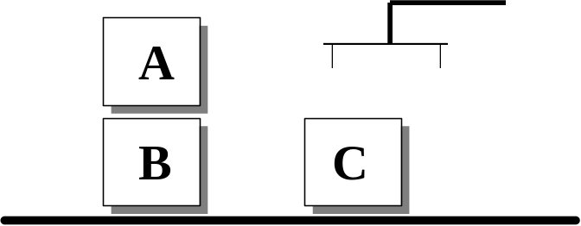
The Blocks World
Here is a representation of the blocks world described above:
Clear(A)
On(A, B)
OnTable(B)
OnTable(C)
Use the closed world assumption: anything not stated is assumed to be false

Slide 31
The Blocks World
A goal is represented as a set of formulae
Here is a goal:
OnTable(A) ∧ OnTable(B) ∧ OnTable(C)
B
A
C

Slide 32
The Blocks World
Actions are represented using a technique that was developed in the STRIPS planner
Each action has:
  a name
  which may have arguments
  a pre-condition list
  list of facts which must be true for action to be executed
  a delete list
  list of facts that are no longer true after action is performed
  an add list
  list of facts made true by executing the action
Each of these may contain variables

Slide 33
The Blocks World Operators
A
B
Example:
The stack action occurs when the robot arm places the object x it is holding is placed on top of object y.
Stack(x, y)
pre Clear(y) ∧ Holding(x)
del Clear(y) ∧ Holding(x)
add ArmEmpty ∧ On(x, y)

Slide 34
A Plan
a142
a1
I
G
a17
What is a plan?
A sequence (list) of actions, with variables replaced by constants.

Slide 35
Implementing Practical Reasoning Agents
A first pass at an implementation of a practical reasoning agent:
(We will not be concerned with stages (2) or (3))
Agent Control Loop Version 1
1. while true
2. observe the world;
3. update internal world model;
4. deliberate about what intention to achieve next;
5. use means-ends reasoning to get a plan for the intention;
6. execute the plan
7. end while

Slide 36
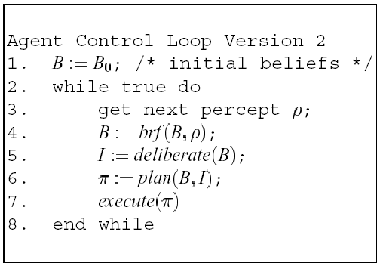
Implementing Practical Reasoning Agents
Let’s make the algorithm more formal:

Slide 37
Deliberation
How does an agent deliberate?
  begin by trying to understand what the options available to you are
  choose between them, and commit to some
Chosen options are then intentions

Slide 38
Deliberation
The deliberate function can be decomposed into two distinct functional components:
  option generation
  in which the agent generates a set of possible alternatives;
  Represent option generation via a function, options, which takes the agent’s current beliefs and current intentions, and from them determines a set of options (= desires)
  filtering
  in which the agent chooses between competing alternatives, and commits to achieving them.
  In order to select between competing options, an agent uses a filter function.

Slide 39
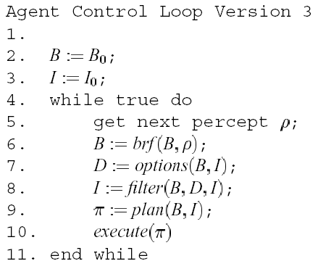
Deliberation

Slide 40
Reactive Architectures
There are many unsolved (some would say insoluble) problems associated with symbolic AI
These problems have led some researchers to question the viability of the whole paradigm, and to the development of reactive architectures
Although united by a belief that the assumptions underpinning mainstream AI are in some sense wrong, reactive agent researchers use many different techniques
We start by reviewing the work of one of the most vocal critics of mainstream AI: Rodney Brooks

Slide 41
Rodney A. Brooks
M.I.T professor
Member of M.I.T.’s Artificial Intelligence Lab
Developed the Subsumption Architecture for robot control in 1986
His goal was to develop artificial, complete creatures capable of inhabiting our world, not a simplified world

Slide 42
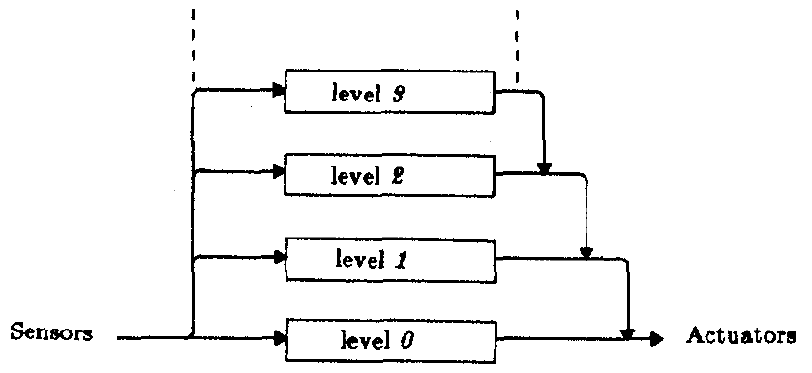
The Subsumption Architecture
The Subsumption Architecture is:
  A layering methodology for robot control systems
  A parallel and distributed method for connecting sensors and actuators in robots

Slide 43
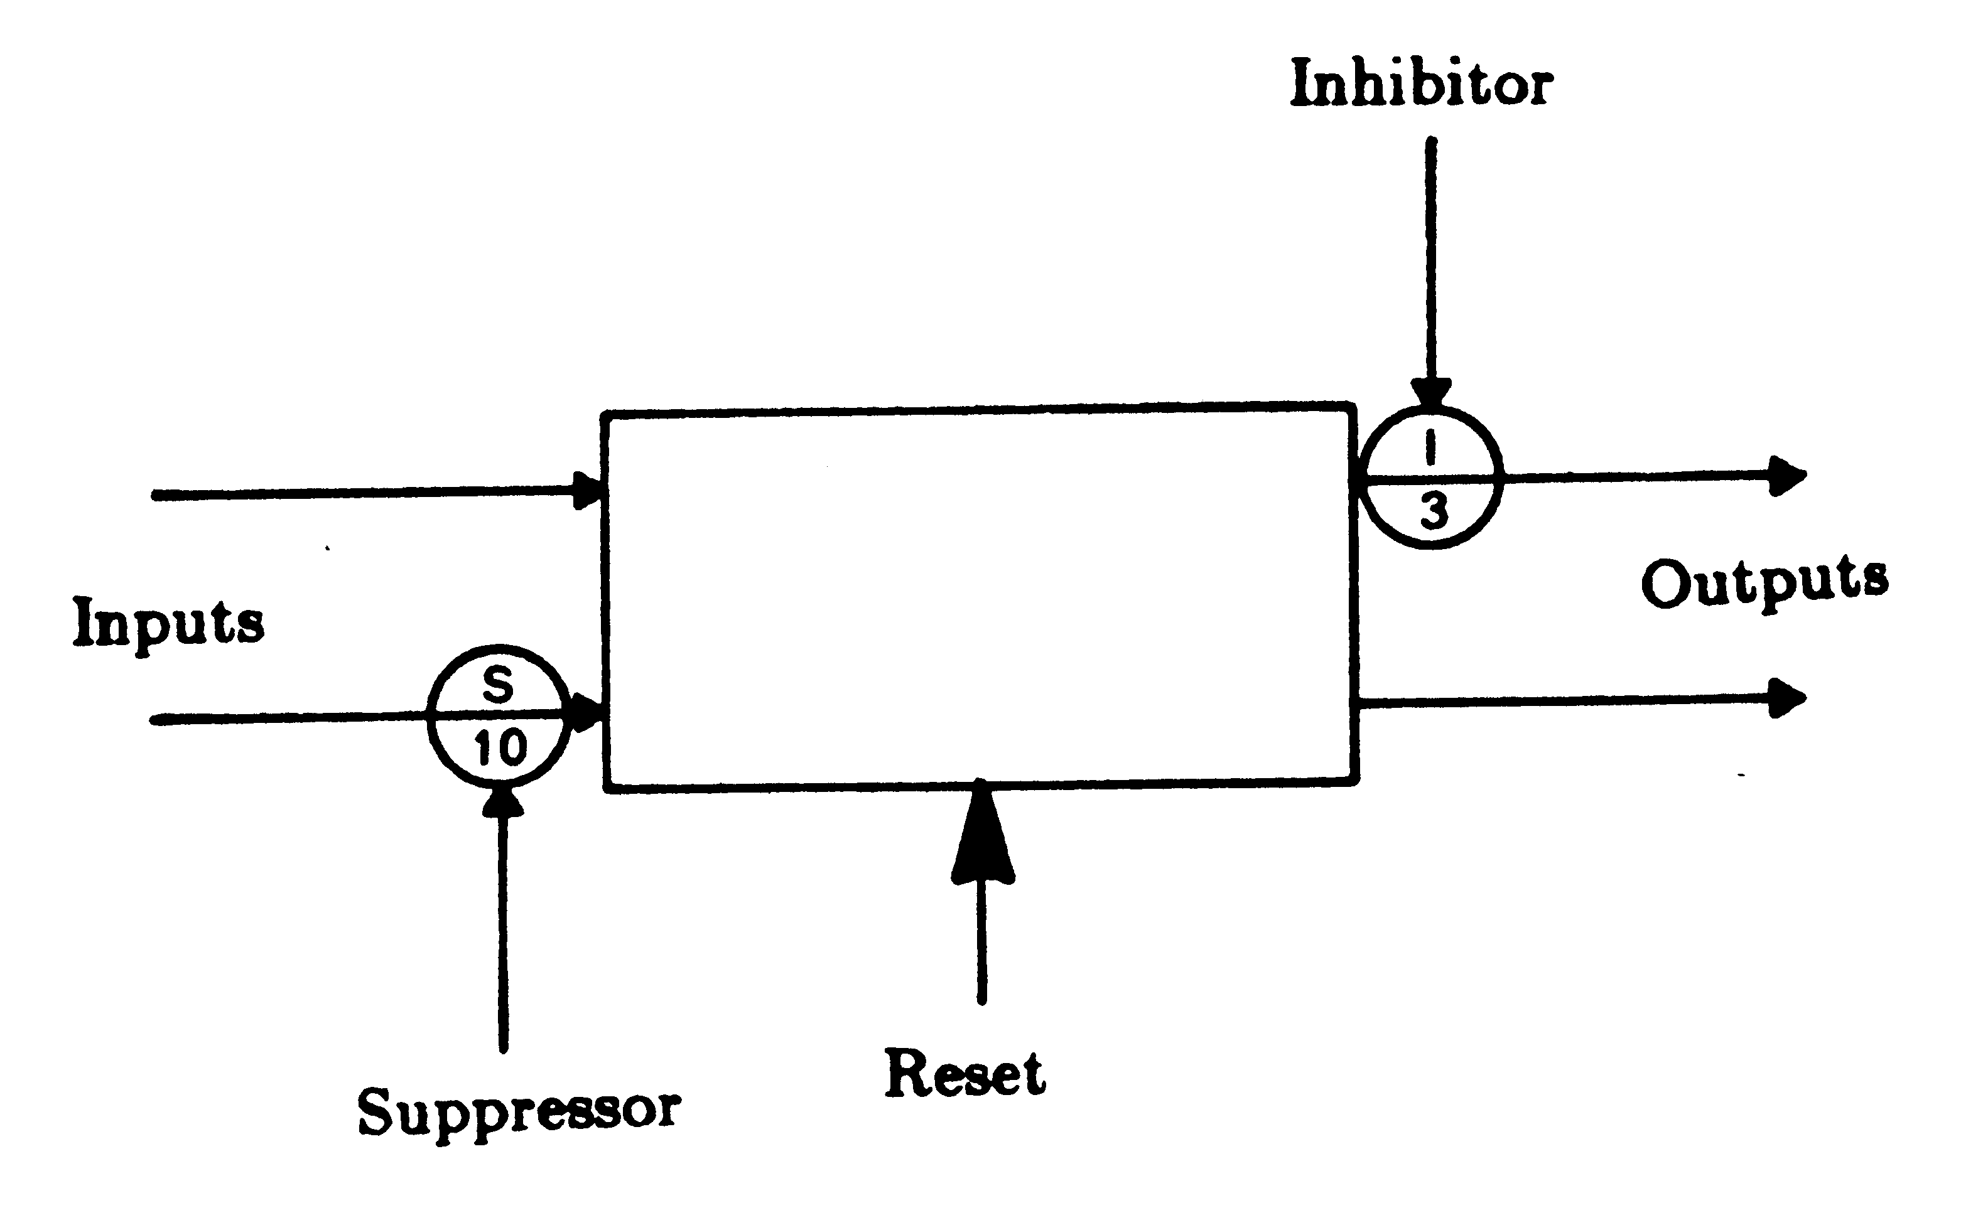
The Subsumption Architecture
Each layer is made up of connected, simple processors: Augmented Finite State Machines

Slide 44
The Subsumption Architecture
The most important aspect of these FSMs
  Outputs are simple functions of inputs and local variables
  Inputs can be suppressed and outputs can be inhibitated
    This function allows higher levels to subsume the function of lower levels
    Lower, therefore, still function as they would without the higher levels

Slide 45

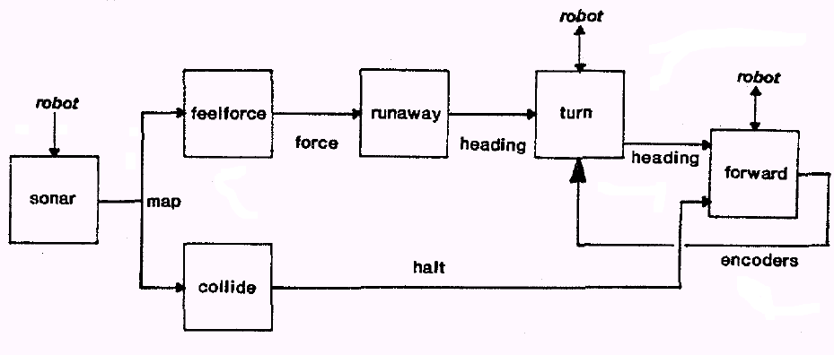
An Example: Allen
Brooks’ first Subsumption robot
Level 0: Runs away if approached, avoids objects

Slide 46
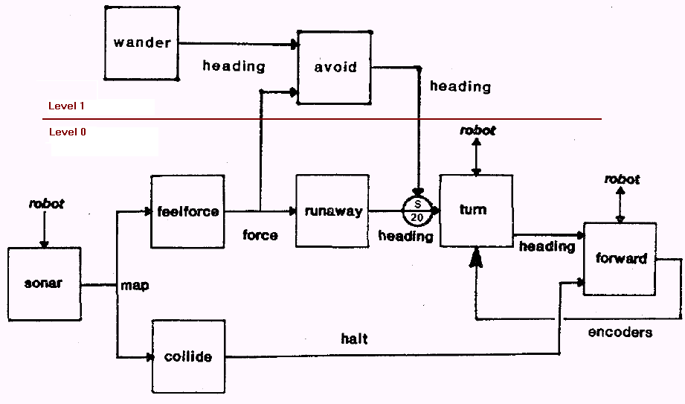
An Example: Allen
Levels 1 and 0: Adds wandering

Slide 47
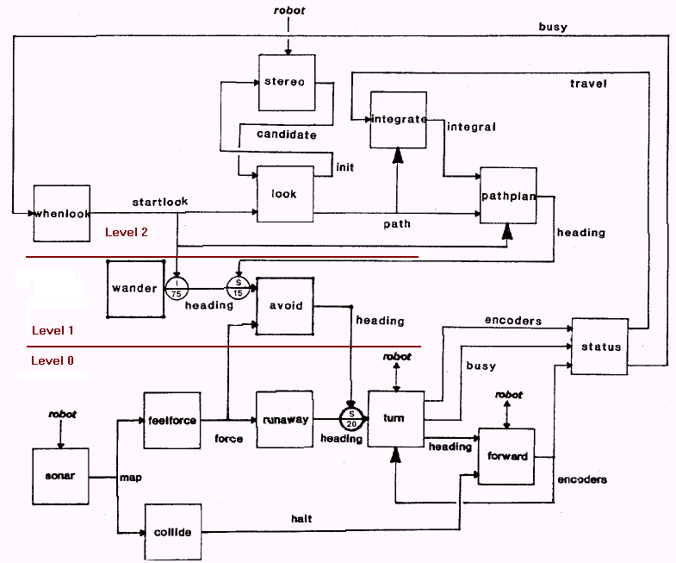
An Example: Allen
Levels 2, 1, and 0: Adds hallway following

Slide 48
Programming Characteristics of Subsumption
No internal model of the real world because:
  No free communication
  No shared memory
So, use real world as the model
  “The world really is a rather good model of itself”¹
  Very accurate
  Never out of date
  No computation needed to keep model up to date
Real world used for sub-system communication
  Instead of direct communication, sub-systems just sense the real world

Slide 49
Brooks – behavior languages
Brooks has put forward three theses:
  Intelligent behavior can be generated without explicit representations of the kind that symbolic AI proposes
  Intelligent behavior can be generated without explicit abstract reasoning of the kind that symbolic AI proposes
  Intelligence is an emergent property of certain complex systems

Slide 50
Brooks – behavior languages
He identifies two key ideas that have informed his research:
  Situatedness and embodiment: ‘Real’ intelligence is situated in the world, not in disembodied systems such as theorem provers or expert systems
  Intelligence and emergence: ‘Intelligent’ behavior arises as a result of an agent’s interaction with its environment. Also, intelligence is ‘in the eye of the beholder’; it is not an innate, isolated property

Slide 51
Brooks – behavior languages
To illustrate his ideas, Brooks built some robots based on his subsumption architecture
A subsumption architecture is a hierarchy of task-accomplishing behaviors
Each behavior is a rather simple rule-like structure
Each behavior ‘competes’ with others to exercise control over the agent
Lower layers represent more primitive kinds of behavior (such as avoiding obstacles), and have precedence over layers further up the hierarchy
The resulting systems are, in terms of the amount of computation they do, extremely simple
Some of the robots do tasks that would be impressive if they were accomplished by symbolic AI systems

Slide 52
Steels’ Mars Explorer
Steels’ Mars explorer system, using the subsumption architecture, achieves near-optimal cooperative performance in simulated ‘rock gathering on Mars’ domain:
The objective is to explore a distant planet, and in particular, to collect sample of a precious rock. The location of the samples is not known in advance, but it is known that they tend to be clustered.

Slide 53
Steels’ Mars Explorer Rules
For individual (non-cooperative) agents, the lowest-level behavior, (and hence the behavior with the highest “priority”) is obstacle avoidance:
if detect an obstacle then change direction (1)
Any samples carried by agents are dropped back at the mother-ship:
if carrying samples and at the base
then drop samples (2)
Agents carrying samples will return to the mother-ship:
if carrying samples and not at the base
then travel up gradient (3)

Slide 54
Steels’ Mars Explorer Rules
Agents will collect samples they find:
if detect a sample then pick sample up (4)
An agent with “nothing better to do” will explore randomly:
if true then move randomly (5)

Slide 55
Advantages of Reactive Agents
Simplicity
Economy
Computational tractability
Robustness against failure
Elegance

Slide 56
Limitations of Reactive Agents
Agents without environment models must have sufficient information available from local environment
If decisions are based on local environment, how does it take into account non-local information (i.e., it has a “short-term” view)
Difficult to make reactive agents that learn
Since behavior emerges from component interactions plus environment, it is hard to see how to engineer specific agents (no principled methodology exists)
It is hard to engineer agents with large numbers of behaviors (dynamics of interactions become too complex to understand)

Slide 57
Hybrid Architectures
Many researchers have argued that neither a completely deliberative nor completely reactive approach is suitable for building agents
They have suggested using hybrid systems, which attempt to marry classical and alternative approaches
An obvious approach is to build an agent out of two (or more) subsystems:
  a deliberative one, containing a symbolic world model, which develops plans and makes decisions in the way proposed by symbolic AI
  a reactive one, which is capable of reacting to events without complex reasoning

Slide 58
Hybrid Architectures
Often, the reactive component is given some kind of precedence over the deliberative one
This kind of structuring leads naturally to the idea of a layered architecture, of which TOURINGMACHINES and INTERRAP are examples
In such an architecture, an agent’s control subsystems are arranged into a hierarchy, with higher layers dealing with information at increasing levels of abstraction

Slide 59
Hybrid Architectures
A key problem in such architectures is what kind of control framework to embed the agent’s subsystems in, to manage the interactions between the various layers
Horizontal layering
Layers are each directly connected to the sensory input and action output.
In effect, each layer itself acts like an agent, producing suggestions as to what action to perform.
Vertical layering
Sensory input and action output are each dealt with by at most one layer each

Slide 60
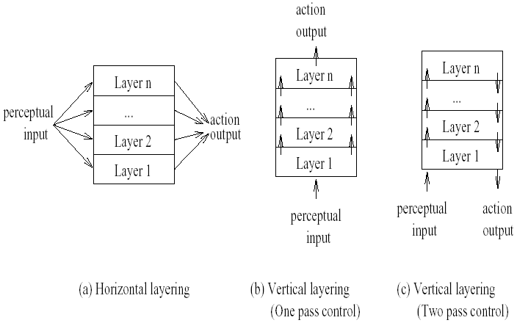
Hybrid Architectures
m possible actions suggested by each layer, n layers
m^{n} interactions
m²(n-1) interactions
Introduces bottleneck
in central control system
Not fault tolerant to layer failure

Slide 61
Summary
Symbolic Reasoning Agents
  Deductive Reasoning Agents
  Agent Oriented Programming (AOP)
  Practical Reasoning Agents
  Problems with symbolic reasoning agents
Reactive Agents
  Limitations of reactive agents
Hybrid Architectures

