Slide 1
5: Multi-Agent Collaboration
AI6125: Multi-Agent System
Assoc Prof Zhang Jie
Based on “An Introduction to MultiAgent Systems” by Michael Wooldridge, John Wiley & Sons, 2002/2009

Slide 2
Working Together
Why and how to agents work together?
Since agents are autonomous, they have to make decisions at run-time, and be capable of dynamic coordination.
Overall they will need to be able to share:
  Tasks
  Information
If agents are designed by different individuals, they may not have common goals.
Important to make a distinction between:
  benevolent agents and
  self-interested agents.

Slide 3
Benevolent Agents
If we “own” the whole system, we can design agents to help each other whenever asked.
In this case, we can assume agents are benevolent: our best interest is their best interest.
Problem-solving in benevolent systems is cooperative distributed problem solving (CDPS).
Benevolence simplifies the system design task enormously!
We will talk about CDSP first.

Slide 4
Self-Interested Agents
If agents represent the interests of individuals or organisations, (the more general case), then we cannot make the benevolence assumption:
Agents will be assumed to act to further their own interests, possibly at expense of others.
Potential for conflict.
May complicate the design task enormously.
Strategic behavior may be required — we will cover some of these aspects in the next module.
  Reaching agreements and Game theory

Slide 5
Coherence and coordination
Criteria for assessing an agent-based system.
Coherence: how well the [multiagent] system behaves as a unit along some dimension of evaluation (Bond and Gasser).
  We can measure coherence in terms of solution quality, how efficiently resources are used, conceptual clarity and so on
Coordination: the degree. . . to which [the agents]. . . can avoid “extraneous” activity [such as] . . . Synchronizing and aligning their activities (Bond and Gasser).
  If the system is perfectly coordinated, agents will not get in each others’ way, in a physical or a metaphorical sense.

Slide 6
Working Together
Cooperative distributed problem solving (CDPS)
How does a group of agents work together to solve problems?
There are three stages:
  Problem decomposition
  Sub-problem solution
  Answer synthesis
Let’s look at these in more detail.

Slide 7
Problem decomposition
The overall problem to be solved is divided into smaller sub-problems.
This is typically a recursive/hierarchical process.
  Subproblems get divided up also.
  In ACTORS, this is done until we are at the level of individual program instructions.
Clearly there is some processing to do the division. How this is done is one design choice.
Another choice is who does the division.
  Is it centralized?
  Which agents have knowledge of task structure?
  Who is going to solve the sub-problems?

Slide 8
Sub-problem solution & Solution synthesis
Sub-problem solution
  The sub-problems derived in the previous stage are solved.
  Agents typically share some information during this process.
  A given step may involve two agents synchronizing their actions.
Solution synthesis
  In this stage solutions to sub-problems are integrated.
  Again this may be hierarchical
    Different solutions at different levels of abstraction.

Slide 9

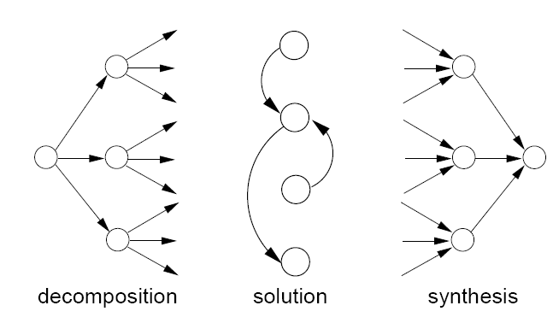
Three Stages

Slide 10
Task Sharing and Result Sharing
Given this model of cooperative problem solving, we have two activities that are likely to be present:
  task sharing:
  components of a task are distributed to component agents; how do we decide how to allocate tasks to agents?
  result sharing:
  information (partial results etc) is distributed. how do we assemble a complete solution from the parts?

Slide 11
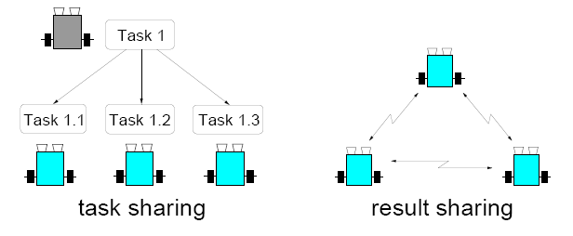
Task Sharing and Result Sharing

Slide 12
The Contract Net
Well known task-sharing protocol for task allocation is the contract net.
The contract net includes five stages:
  1. Recognition;
  2. Announcement;
  3. Bidding;
  4. Awarding;
  5. Expediting.
The textbook describes these stages in procedural terms from the perspective of an individual agent.

Slide 13
Recognition
In this stage, an agent recognises it has a problem it wants help with.
Agent has a goal, and either. . .
  realises it cannot achieve the goal in isolation — does not have capability;
  realises it would prefer not to achieve the goal in isolation (typically because of solution quality, deadline, etc)
As a result, it needs to involve other agents.

Slide 14
Announcement
In this stage, the agent with the task sends out an announcement of the task which includes a specification of the task to be achieved.
Specification must encode:
  description of task itself (maybe executable);
  any constraints (e.g., deadlines, quality constraints).
  meta-task information (e.g., “bids must be submitted by...”)
The announcement is then broadcast.

Slide 15
Bidding
Agents that receive the announcement decide for themselves whether they wish to bid for the task
Factors:
  agent must decide whether it is capable of expediting task
  agent must determine quality constraints & price information (if relevant)
If they do choose to bid, then they submit a tender

Slide 16
Awarding & Expediting
Agent that sent task announcement must choose between bids & decide who to “award the contract” to
The result of this process is communicated to agents that submitted a bid
The successful contractor then expedites the task
May involve generating further manager-contractor relationships: sub-contracting
  May involve another contract net.

Slide 17
Demonstrating Contract Net
The collection of nodes is the “contract net”
Each node on the network can, at different times or for different tasks, be a manager or a contractor
When a node gets a composite task (or for any reason can’t solve its present task), it breaks it into subtasks (if possible) and announces them (acting as a manager), receives bids from potential contractors, then awards the job (example domain: network resource management, printers, …)

Slide 18
Node Issues Task Announcement
Task Announcement
Manager

Slide 19
Idle Node Listening to Task Announcements
Manager
Potential
Contractor
Manager
Manager

Slide 20
Node Submitting a Bid
Bid
Manager
Potential
Contractor

Slide 21
Manager listening to bids
Bids
Potential
Contractor
Manager
Potential
Contractor

Slide 22
Manager Making an Award
Award
Manager
Contractor

Slide 23
Contract Established
Contract
Manager
Contractor

Slide 24
Issues for Implementing Contract Net
How to…
  …specify tasks?
  …specify quality of service?
  …decide how to bid?
  …select between competing offers?
  …differentiate between offers based on multiple criteria?

Slide 25
Deciding how to bid
At time t a contractor i is scheduled to carry out Ti
Contractor i also has resources e
Then i receives an announcement of task specification ts, which is for a set of tasks T(ts)
These will cost i c(T(ts)) to carry out
The marginal cost of carrying out T(ts) will be:
u(T(ts) | Ti) = c(Ti U T(ts)) – c(Ti)
that is the difference between carrying out what it has already agreed to do and what it has already agreed plus the new tasks.

Slide 26
Deciding how to bid
Due to synergies, this is often not just: c(T(ts))
in fact, it can be zero — the additional tasks can be done for free.
Think of the cost of giving another person a ride to work.
As long as u(T(ts) | Ti) < e then the agent can afford to do the new work, then it is rational for the agent to bid for the work.
Otherwise not.

Slide 27
Result Sharing
In results sharing, agents provide each other with information as they work towards a solution.
It is generally accepted that results sharing improves problem solving by:
  Independent pieces of a solution can be cross-checked.
  Combining local views can achieve a better overall view.
  Shared results can improve the accuracy of results.
  Sharing results allows the use of parallel resources on a problem.
  By sharing results, the result could be derived more quickly

Slide 28
Result Sharing in Blackboard Systems
A group of specialists are seated in a room with a large blackboard. They work as a team to brainstorm a solution to a problem, using the blackboard as the workplace for cooperatively developing the solution. The session begins when the problem specifications are written onto the blackboard. The specialists all watch the blackboard, looking for an opportunity to apply their expertise to the developing solution. When someone writes something on the blackboard that allows another specialist to apply their expertise, the second specialist records their contribution on the blackboard, hopefully enabling other specialists to then apply their expertise. This process of adding contributions to the blackboard continues until the problem has been solved.

Slide 29
Result Sharing in Blackboard Systems
The first scheme for cooperative problem solving: the blackboard system
Results shared via shared data structure (BB)
Multiple agents (KSs/KAs) can read and write to BB
Agents write partial solutions to BB
BB may be structured into hierarchy
Mutual exclusion over BB required ⇒ bottleneck
Not concurrent activity
Compare: LINDA tuple spaces, JAVASPACES

Slide 30
Result Sharing in Subscribe/Notify Pattern
Common design pattern in OO systems: subscribe/notify
An object subscribes to another object, saying “tell me when event e happens”
When event e happens, original object is notified
Information pro-actively shared between objects
Objects required to know about the interests of other objects ⇒ inform objects when relevant information arises

Slide 31
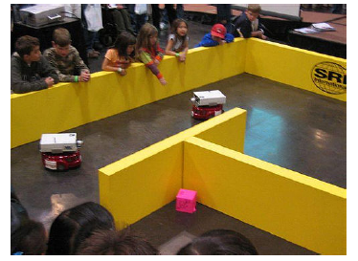
Result Sharing
The Centibots robots collaborate to map a space and find objects.

Slide 32
Combing Task and Result Sharing
Example: FELINE system
  Cooperating expert system (MAS).
  Deductive problem-solving
Agents have distinct knowledge and “expertise”
Agents cooperate by sharing knowledge and distributing subtasks.
Agent: Rule-based system (database with facts and rules); Furthermore: database with beliefs about self and environment (environment model)

Slide 33
Combing Task and Result Sharing
Environment model: Contains for every agent the representation of
  Skills: Hypotheses which agent is able to establish or deny
  Interests: Hypotheses for which agent requires truth value
Three message types:
  Request: Sender wants receiver to determine truth value of contained hypothesis
  Response: (to request) Contains correspondent truth value
  Inform: Contains hypothesis and truth value. For agents that are assumed to be interested.

Slide 34
Combing Task and Result Sharing
Task sharing
  If agent cannot determine truth, other agents with skills corresponding to the hypothesis are asked
Result sharing
  Every new fact derived in the iterative process is communicated to all agents who have the fact as interest

Slide 35
Handling inconsistency
A group of agents may have inconsistencies in their:
  Beliefs
  Goals or intentions
Inconsistent beliefs arise because agents have different views of the world.
  May be due to sensor faults or noise or just because they can’t see everything.
Inconsistent goals may arise because agents are built by different people with different objectives.

Slide 36
Handling inconsistency
Three ways to handle inconsistency
Do not allow it
  For example, in the contract net the only view that matters is that of the manager agent.
Resolve inconsistency
  Agents discuss the inconsistent information/goals until the inconsistency goes away (argumentation).
Build systems that degrade gracefully in the face of inconsistency.

Slide 37
Handling inconsistency
Design system that can behave robustly in the presence of inconsistency
  FA/C system (Functionally accurate/cooperative)
  Agent’s problem solving is structured so that its local knowledge bases need not be complete, consistent, and up-to-date in order to make progress on its problem-solving tasks
Characteristics of FA/C system
  Problem solving is not constrained to a particular sequence of events – it progresses opportunistically and incrementally

Slide 38
Handling inconsistency
Characteristics of FA/C system
  Agents exchange high-level intermediate results, not raw data
  Uncertainty and inconsistency are implicitly resolved when partial results are exchanged and compared with other partial solutions. Thus, they are resolved as problem solving progresses, not at the beginning or end
  The solution is not constrained to a single solution route
    Many ways of arriving at a solution, if one fails, there are other ways of achieving the same end

Slide 39
Coordination
Coordination is managing dependencies between agents
Example
  We both want to leave the room through the same door. we are walking such that we will arrive at the door at the same time. What do we do to ensure we can both get through the door?
  We both arrive at the copy room with a stack of paper to photocopy. who gets to use the machine first?

Slide 40
Coordination
Von Martial suggested that positive coordination is:
  Requested (explicit)
  Non-requested (implicit)
Non-requested coordination relationships can be as follows.
  Action equality: we both plan to do something, and by recognizing this one of us can be saved the effort.
  Consequence: What I plan to do will have the side-effect of achieving something you want to do.
  Favor: What I plan to do will make it easier for you to do what you want to do.

Slide 41
Social norms
Societies are often regulated by (often unwritten) rules of behavior.
Example:
  A group of people is waiting at the bus stop. The bus arrives. Who gets on the bus first?
Another example:
  On 34th Street, which side of the sidewalk do you walk along?
In an agent system, we can design the norms and program agents to follow them, or let norms evolve.

Slide 42


Social laws
Agents can be described as
Ag : R^{E} -> Ac
a function which, given a run ending in a state, gives us an action
A constraint is then a pair:
<E’, α>
where E ’ E and α Ac
This constraint says that α cannot be done in any state in E’
A social law is a set of constraints

Slide 43
Social laws
We can refine our view of an environment.
Focal states, F E are the states we want our agent to be able to get to.
From any focal state e F it should be possible to get to any other focal state e’ F (though not necessarily right away).
A useful social law is then one that does not prevent agents from getting from one focal state to another.

Slide 44
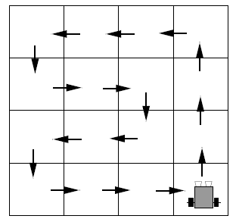
Social laws: example
A useful social law that prevents collisions:
Not necessarily efficient (On² steps to get to a specific square).

Slide 45
Emergence
We can also design systems in which social laws emerge.
T-shirt game (Shoham and Tennenholtz):
  Agents have both a red t-shirt and a blue t-shirt and wear one. Goal is for everyone to end up with the same color on. In each round, each agent meets one other agent, and decides whether or not to change their shirt. During the round they only see the shirt their pair is wearing
  — they don’t get any other information.
What strategy update function should they use?
  Efficiency of strategy update function measured e.g. by convergence time in t-shirt game

Slide 46
Emergence-Strategy Update Functions
Simple majority:
  Agents pick the shirt they have seen the most.
Simple majority with types:
  Agents come in two types. When they meet an agent of the same type, agents pass their memories. Otherwise they act as simple majority.
Simple majority with communication on success:
  When agent has reached certain success-level with current shirt -> communicate memory related to successful shirtto other agents (only successful shirts are communicated)
Highest cumulative reward:
  Agents can “see” how often other agents (some subset of all the agents) have matched their pair. They pick the shirt with the largest number of matches.

Slide 47
Joint intentions
Just as we have individual intentions, we can have joint intentions for a team of agents.
Levesque defined the idea of a joint persistent goal (JPG).
A group of agents have a collective commitment to bring about some goal G, “move the couch”.
Also have motivation M, “Simon wants the couch moved”.
The mental states of agents mirror those in BDI agents.

Slide 48
Joint intentions
Agents don’t believe that _x001e_G is satisfied, but believe it is possible.
Agents maintain the goal _x001e_G until a termination condition is reached.
The terminations condition is that it is mutually believed that:
  goal G is satisfied; or
  goal G is impossible; or
  the motivation M is no longer present.

Slide 49
Joint intentions
The termination condition is achieved when an agent realises that, the goal is satisfied, impossible and so on.
But it doesn’t drop the goal right away.
Instead it adopts a new goal — to make this new knowledge mutually believed.
This ensures that the agents are coordinated.
They don’t stop working towards the goal until they are all appraised of the situation.
Mutual belief is achieved by communication.

Slide 50
Mutual modeling
Having model of other agents (beliefs, intentions, goals) and of cooperative conventions enables coordination without communication
Example: Man and woman approach door -> resource conflict -> possible solution: both wait -> waste of resource -> knowing usual convention and having a model of each other (“other agent is conservatively polite”) -> woman will go first
Model could be induced by game-theoretic payoff-matrix -> agents will know rational action
Example system: MACE in the textbook

Slide 51
Multiagent planning
Another approach to coordinate is to explicitly plan what all the agents do.
For example, come up with a large STRIPS plan for all the agents in a system.
Could have:
  Centralized planning for distributed plans: One agent comes up with a plan for everybody
  Distributed planning: A group of agents come up with a centralized plan for another group of agents.
  Distributed planning for distributed plans: Agents build up plans for themselves, but take into account the actions of others.

Slide 52
Multiagent planning
In general, the more decentralized it is, the harder it is.
Georgeff proposed a distributed version of STRIPS.
New list: during
Specifies what must be true while action is carried out.
This places constraints on when other agents can do things.
Different agents plan to achieve their goals using these operators and then do:
  Interaction analysis: do different plans affect one another?
  Safety analysis: which interactions are problematic?
  Interaction resolution: treat the problematic interactions as critical sections and enforce mutual exclusion.

Slide 53
Summary
This module has discussed how to get agents working together to do things.
We discussed a number of ways of having agents decide what to do, and make sure that their work is coordinated.
A typical system will need to use a combination of these ideas.

