Slide 1
4: Agent Communication
AI6125: Multi-Agent System
Assoc Prof Zhang Jie
Based on “An Introduction to MultiAgent Systems” by Michael Wooldridge, John Wiley & Sons, 2002/2009

Slide 2
Agent Communication
In this lecture, we cover macro-aspects of intelligent agent technology: those issues relating to the agent society, rather than the individual:
  communication;
  speech acts; KQML & KIF; FIPA ACL
  cooperation:
  what is cooperation; prisoner’s dilemma; cooperative versus non-cooperative encounters; the contract net
8-<number>

Slide 3
Speech Acts
Most treatments of communication in (multi-) agent systems borrow their inspiration from speech act theory
Speech act theories are pragmatic theories of language, i.e., theories of language use: they attempt to account for how language is used by people every day to achieve their goals and intentions
The origin of speech act theories are usually traced to Austin’s 1962 book, How to Do Things with Words
8-<number>

Slide 4
Speech Acts
Austin noticed that some utterances are rather like ‘physical actions’ that appear to change the state of the world
Paradigm examples would be:
  declaring war
  christening
  ‘I now pronounce you man and wife’ :-)
But more generally, everything we utter is uttered with the intention of satisfying some goal or intention
A theory of how utterances are used to achieve intentions is a speech act theory
8-<number>

Slide 5
Different Aspects of Speech Acts
From “A Dictionary of Philosophical Terms and Names”:
“Locutionary act: the simple speech act of generating sounds that are linked together by grammatical conventions so as to say something meaningful. Among speakers of English, for example, ‘It is raining’ performs the locutionary act of saying that it is raining, as ‘Grablistrod zetagflx dapu’ would not.”
8-<number>

Slide 6
Different Aspects of Speech Acts
“Illocutionary act: the speech act of doing something else – offering advice or taking a vow, for example – in the process of uttering meaningful language. Thus, for example, in saying ‘I will repay you this money next week,’ one typically performs the illocutionary act of making a promise.”
8-<number>

Slide 7
Different Aspects of Speech Acts
“Perlocutionary act: the speech act of having an effect on those who hear a meaningful utterance. By telling a ghost story late at night, for example, one may accomplish the cruel perlocutionary act of frightening a child.”
8-<number>

Slide 8
Speech Acts
Searle (1969) identified various different types of speech act:
  representatives:
  such as informing, e.g., ‘It is raining’
  directives:
  attempts to get the hearer to do something e.g., ‘please make the tea’
  commisives:
  which commit the speaker to doing something, e.g., ‘I promise to… ’
  expressives:
  whereby a speaker expresses a mental state, e.g., ‘thank you!’
  declarations:
  such as declaring war or christening
8-<number>

Slide 9
Speech Acts
There is some debate about whether this (or any!) typology of speech acts is appropriate
In general, a speech act can be seen to have two components:
  a performative verb:
  (e.g., request, inform, promise, … )
  propositional content:
  (e.g., “the door is closed”)
8-<number>

Slide 10
Speech Acts
Consider:
  performative = request
  content = “the door is closed”
  speech act = “please close the door”
  performative = inform
  content = “the door is closed”
  speech act = “the door is closed!”
  performative = inquire
  content = “the door is closed”
  speech act = “is the door closed?”
8-<number>

Slide 11
Plan Based Semantics
How does one define the semantics of speech acts? When can one say someone has uttered, e.g., a request or an inform?
Cohen & Perrault (1979) defined semantics of speech acts using the precondition-delete-add list formalism of planning research
Note that a speaker cannot (generally) force a hearer to accept some desired mental state
In other words, there is a separation between the illocutionary act and the perlocutionary act
8-<number>

Slide 12
Plan-Based Semantics
Here is their semantics for request:
request(s, h, φ)
pre:
  s believe h can do φ
  (you don’t ask someone to do something unless you think they can do it)
  s believe h believe h can do φ
  (you don’t ask someone unless they believe they can do it)
  s believe s want φ
  (you don’t ask someone unless you want it!)
post:
  h believe s believe s want φ
  (the effect is to make them aware of your desire)
8-<number>

Slide 13
KQML and KIF
We now consider agent communication languages (ACLs) — standard formats for the exchange of messages
The best known ACL is KQML, developed by the ARPA knowledge sharing initiative
KQML is comprised of two parts:
  the knowledge query and manipulation language (KQML)
  the knowledge interchange format (KIF)
8-<number>

Slide 14
KQML and KIF
KQML is an ‘outer’ language, that defines various acceptable ‘communicative verbs’, or performatives
Example performatives:
  ask-if (‘is it true that. . . ’)
  perform (‘please perform the following action. . . ’)
  tell (‘it is true that. . . ’)
  reply (‘the answer is . . . ’)
KIF is a language for expressing message content
8-<number>

Slide 15
KIF – Knowledge Interchange Format
Used to state:
Properties of things in a domain (e.g., “Noam is chairman”)
Relationships between things in a domain (e.g., “Amnon is Yael’s boss”)
General properties of a domain (e.g., “All students are registered for at least one course”)
8-<number>

Slide 16
KIF – Knowledge Interchange Format
“The temperature of m1 is 83 Celsius”:
(= (temperature m1) (scalar 83 Celsius))
“An object is a bachelor if the object is a man and is not married”:
(defrelation bachelor (?x) :=
(and (man ?x) (not (married ?x))))
“Any individual with the property of being a person also has the property of being a mammal”:
(defrelation person (?x) :=> (mammal ?x))
8-<number>

Slide 17
KQML and KIF
In order to be able to communicate, agents must have agreed on a common set of terms
A formal specification of a set of terms is known as an ontology
The knowledge sharing effort has associated with it a large effort at defining common ontologies — software tools like ontolingua for this purpose
Example KQML/KIF dialogue…
A to B: (ask-if (> (size chip1) (size chip2)))
B to A: (reply true)
B to A: (inform (= (size chip1) 20))
B to A: (inform (= (size chip2) 18))
8-<number>

Slide 18
FIPA
More recently, the Foundation for Intelligent Physical Agents (FIPA) started work on a program of agent standards — the centerpiece is an ACL
Basic structure is quite similar to KQML:
  performative
  20 performative in FIPA
  housekeeping
  e.g., sender, etc.
  content
  the actual content of the message
8-<number>

Slide 19
FIPA
Example:
(inform
:sender agent1
:receiver agent5
:content (price good200 150)
:language sl
:ontology hpl-auction
)
8-<number>

Slide 20
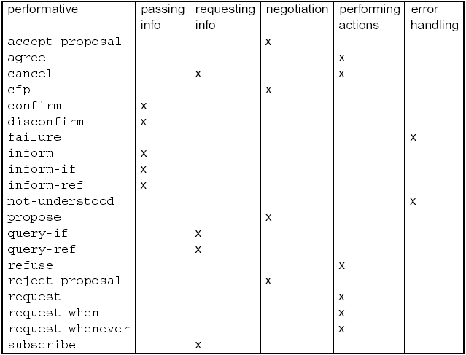
FIPA
8-<number>

Slide 21
“Inform” and “Request”
“Inform” and “Request” are the two basic performatives in FIPA. All others are macro definitions, defined in terms of these.
The meaning of inform and request is defined in two parts:
  pre-condition
  what must be true in order for the speech act to succeed
  “rational effect”
  what the sender of the message hopes to bring about
8-<number>

Slide 22
“Inform” and “Request”
For the “inform” performative…
The content is a statement.
Pre-condition is that sender:
  holds that the content is true
  intends that the recipient believe the content
  does not already believe that the recipient is aware of whether content is true or not
8-<number>

Slide 23
“Inform” and “Request”
For the “request” performative…
The content is an action.
Pre-condition is that sender:
  intends action content to be performed
  believes recipient is capable of performing this action
  does not believe that receiver already intends to perform action
8-<number>

