Slide 1
6.1: Game Theory – Multi-Agent Interaction
AI6125: Multi-Agent System
Assoc Prof Zhang Jie
Based on “An Introduction to MultiAgent Systems” by Michael Wooldridge, John Wiley & Sons, 2002/2009

Slide 2
Topics in this Module
This module focuses on the issue of reaching agreement among self-interested agents
5.1. Multiagent Interaction
  Basic concepts on multiagent encounters; how to model agents’ decision making, how cooperation can be facilitated
5.2. Allocating Scarce Recourses
  Auctions
5.3. Making Group Decisions (if time permits)
  Social choice, or voting
6-<number>

Slide 3
5.1: MULTIAGENT INTERACTION
AI6125: Multi-Agent System
Assoc Prof Zhang Jie
Based on “An Introduction to MultiAgent Systems” by Michael Wooldridge, John Wiley & Sons, 2002/2009.

Slide 4



Utilities and Preferences
Assume we have just two agents: Ag = {i, j}
Agents are assumed to be self-interested: they have preferences over how the environment is
Assume Ω = {ω₁, ω₂, …}is the set of “outcomes” that agents have preferences over
We capture preferences by utility functions:
u_{i} = Ω →
u_{j} = Ω →
Utility functions lead to preference orderings over outcomes:
ω _{i} ω’ means u_{i}(ω) ≥ u_{i}(ω’)
ω  _{i} ω’ means u_{i}(ω) > u_{i}(ω’)

Slide 5
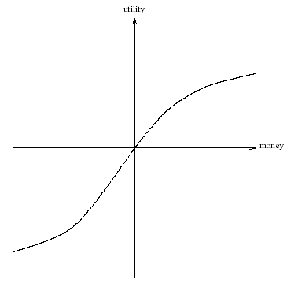
What is Utility?
Utility is not money (but it is a useful analogy)
Typical relationship between utility & money:

Slide 6

Multiagent Encounters
We need a model of the environment in which these agents will act…
  agents simultaneously choose an action to perform, and as a result of the actions they select, an outcome in Ω will result
  the actual outcome depends on the combination of actions
  assume each agent has just two possible actions that it can perform, C (“cooperate”) and D (“defect”)
Environment behavior given by state transformer function:

Slide 7
Multiagent Encounters
Here is a state transformer function:
(This environment is sensitive to actions of both agents.)
Here is another:
(Neither agent has any influence in this environment.)
And here is another:
(This environment is controlled by j.)

Slide 8


Rational Action
Suppose we have the case where both agents can influence the outcome, and they have utility functions as follows:
With a bit of abuse of notation:
Then agent i’s preferences are:
“C” is the rational choice for i.
(Because i prefers all outcomes that arise through C over all outcomes that arise through D.)

Slide 9
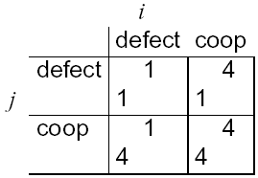
Payoff Matrices
We can characterize the previous scenario in a payoff matrix:
Agent i is the column player
Agent j is the row player

Slide 10
Solution Concepts
How will a rational agent behave in any given scenario?
Answered in solution concepts:
  dominant strategy;
  Nash equilibrium strategy;
  Pareto optimal strategies;
  strategies that maximise social welfare.

Slide 11
Dominant Strategies
Given any particular strategy (either C or D) of agent i, there will be a number of possible outcomes
We say s₁ dominates s₂ if every outcome possible by i playing s₁ is preferred over every outcome possible by i playing s₂
A rational agent will never play a dominated strategy
So in deciding what to do, we can delete dominated strategies
Unfortunately, there isn’t always a unique undominated strategy

Slide 12
Nash Equilibrium
In general, we will say that two strategies s₁ and s₂ are in Nash equilibrium if:
  under the assumption that agent i plays s₁, agent j can do no better than play s₂; and
  under the assumption that agent j plays s₂, agent i can do no better than play s₁.
Neither agent has any incentive to deviate from a Nash equilibrium
Unfortunately:
  Not every interaction scenario has a Nash equilibrium
  Some interaction scenarios have more than one Nash equilibrium

Slide 13
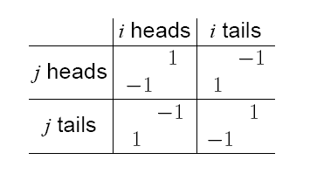
Matching Pennies
Players i and j simultaneously choose the face of a coin, either “heads” or “tails”.
If they show the same face, then i wins, while if they show different faces, then j wins.
The Payoff Matrix:

Slide 14
Mixed Strategies for Matching Pennies
NO pair of strategies forms a pure strategy NE: whatever pair of strategies is chosen, somebody will wish they had done something else.
The solution is to allow mixed strategies:
  play “heads” with probability 0.5
  play “tails” with probability 0.5.
This is a NE strategy.

Slide 15
Mixed Strategies
A mixed strategy has the form
– play 1 with probability p₁
– play 2 with probability p₂
– . . .
– play k with probability p_{k}.
such that p₁ + p₂ + … + p_{k} = 1.
Nash proved that every finite game has a Nash equilibrium in mixed strategies.

Slide 16

Nash’s Theorem
John Forbes Nash
Nash proved that every finite game has a Nash equilibrium in mixed strategies. (Unlike the case for pure strategies.)
So this result overcomes the lack of solutions; but there still may be more than one Nash equilibrium...

Slide 17
Pareto Optimality
An outcome is said to be Pareto optimal (or Pareto efficient) if there is no other outcome that makes one agent better off without making another agent worse off.
If an outcome is Pareto optimal, then at least one agent will be reluctant to move away from it (because this agent will be worse off).
If an outcome ω is not Pareto optimal, then there is another outcome ω’ that makes everyone as happy, if not happier, than ω.
“Reasonable” agents would agree to move to ω’ in this case. (Even if I don’t directly benefit from ω’, you can benefit without me suffering.)

Slide 18
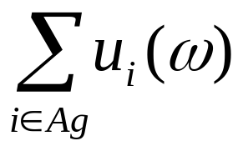
Social Welfare
The social welfare of an outcome ω is the sum of the utilities that each agent gets from ω:
Think of it as the “total amount of money in the system”.
As a solution concept, may be appropriate when the whole system (all agents) has a single owner (then overall benefit of the system is important, not individuals).

Slide 19

Competitive and Zero-Sum Interactions
Where preferences of agents are diametrically opposed we have strictly competitive scenarios
Zero-sum encounters are those where utilities sum to zero:
u_{i}(ω) + u_{j}(ω) = 0 for all ω Ω
Zero sum implies strictly competitive
The best outcome for me is the worst for you!
Zero sum encounters in real life are very rare … but people tend to act in many scenarios as if they were zero sum

Slide 20
The Prisoner’s Dilemma
Two men are collectively charged with a crime and held in separate cells, with no way of meeting or communicating. They are told that:
  if one confesses and the other does not, the confessor will be freed, and the other will be jailed for three years
  if both confess, then each will be jailed for two years
Both prisoners know that if neither confesses, then they will each be jailed for one year

Slide 21
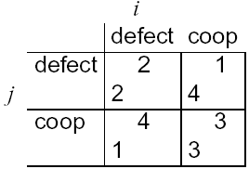
The Prisoner’s Dilemma
Payoff matrix for
prisoner’s dilemma:
Top left: If both defect, then both get punishment for mutual defection
Top right: If i cooperates and j defects, i gets sucker’s payoff of 1, while j gets 4
Bottom left: If j cooperates and i defects, j gets sucker’s payoff of 1, while i gets 4
Bottom right: Reward for mutual cooperation

Slide 22
The Prisoner’s Dilemma
The individual rational action is defect
This guarantees a payoff of no worse than 2, whereas cooperating guarantees a payoff of at most 1
So defection is the best response to all possible strategies: both agents defect, and get payoff = 2
But intuition says this is not the best outcome:
Surely they should both cooperate and each get payoff of 3!
  D is a dominant strategy
  (D;D) is the only Nash equilibrium.
  All outcomes except (D;D) are Pareto optimal.
  (C;C) maximises social welfare.

Slide 23
The Prisoner’s Dilemma
This apparent paradox is the fundamental problem of multi-agent interactions.
It appears to imply that cooperation will not occur in societies of self-interested agents.
Real world examples:
  nuclear arms reduction (“why don’t I keep mine. . . ”)
The prisoner’s dilemma is ubiquitous.
Can we recover cooperation?

Slide 24
Arguments for Recovering Cooperation
Conclusions that some have drawn from this analysis:
  the game theory notion of rational action is wrong!
  somehow the dilemma is being formulated wrongly
Arguments to recover cooperation:
  We are not all Machiavelli!
  The other prisoner is my twin!
  Program equilibria and mediators
  The shadow of the future…

Slide 25
Program Equilibria
The strategy you really want to play in the prisoner’s dilemma is:
I’ll cooperate if he will.
Program equilibria provide one way of enabling this.
Each agent submits a program strategy to a mediator which jointly executes the strategies. Crucially, strategies can be conditioned on the strategies of the others.

Slide 26
Program Equilibria
Consider the following program:
IF HisProgram == ThisProgram THEN
DO(C);
ELSE
DO(D);
END-IF.
Here == is textual comparison.
The best response to this program is to submit the same program, giving an outcome of (C;C)!
You can’t get the sucker’s payoff by submitting this program.

Slide 27
The Iterated Prisoner’s Dilemma
One answer: play the game more than once
If you know you will be meeting your opponent again, then the incentive to defect appears to evaporate
Cooperation is the rational choice in the infinititely repeated prisoner’s dilemma
(Hurrah!)

Slide 28
Backwards Induction
But…suppose you both know that you will play the game exactly n times
On round n - 1, you have an incentive to defect, to gain that extra bit of payoff…
But this makes round n – 2 the last “real”, and so you have an incentive to defect there, too.
This is the backwards induction problem.
Playing the prisoner’s dilemma with a fixed, finite, pre-determined, commonly known number of rounds, defection is the best strategy

Slide 29
Axelrod’s Tournament
Suppose you play iterated prisoner’s dilemma against a range of opponents…
What strategy should you choose, so as to maximize your overall payoff?
Axelrod (1984) investigated this problem, with a computer tournament for programs playing the prisoner’s dilemma

Slide 30
Strategies in Axelrod’s Tournament
ALLD:
  “Always defect” — the hawk strategy;
TIT-FOR-TAT:
  On round u = 0, cooperate
  On round u > 0, do what your opponent did on round u – 1
TESTER:
  On 1st round, defect. If the opponent retaliated, then play TIT-FOR-TAT. Otherwise intersperse cooperation and defection.
JOSS:
  As TIT-FOR-TAT, except periodically defect

Slide 31
Recipes for Success in Axelrod’s Tournament
Axelrod suggests the following rules for succeeding in his tournament:
  Don’t be envious:
  Don’t play as if it were zero sum!
  Be nice:
  Start by cooperating, and reciprocate cooperation
  Retaliate appropriately:
  Always punish defection immediately, but use “measured” force — don’t overdo it
  Don’t hold grudges:
  Always reciprocate cooperation immediately

Slide 32
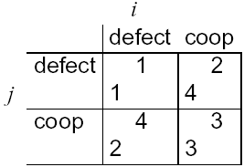
Game of Chicken
Consider another type of encounter — the game of chicken:
Difference to prisoner’s dilemma:
Mutual defection is most feared outcome.
There is no dominant strategy (in our sense).
Strategy pairs (C;D)) and (D;C)) are Nash equilibriums.
All outcomes except (D;D) are Pareto optimal.
All outcomes except (D;D) maximise social welfare.

