Slide 1
6.3: Game Theory – Making Group Decisions
AI6125: Multi-Agent System
Assoc Prof Zhang Jie
Based on “An Introduction to MultiAgent Systems” by Michael Wooldridge, John Wiley & Sons, 2002/2009

Slide 2
Social Choice
In the previous sub-module, we learned how agents make decisions in two-agent games
  Nash Equilibrum
In this sub-module, we will learn about how a group of agents make decisions
  Social choice theory is concerned with group decision making.
  Classic example of social choice theory: voting.
  Formally, the issue is combining preferences to derive a social outcome.

Slide 3
Components of a Social Choice Model
Assume a set Ag = {1, . . . , n} of voters.
These are the entities who will be expressing preferences.
Voters make group decisions wrt a set
Ω = {ω₁, ω₂, . . .} of outcomes.
Think of these as the candidates.
If | Ω | = 2, we have a pairwise election.

Slide 4


Preferences
Each voter has preferences over Ω: an ordering over the set of possible outcomes Ω.
Example. Suppose
Ω = {gin, rum, brandy, whisky}
then we might have agent mjw with preference order:
_{mjw} = (brandy; rum; gin; whisky)
meaning
brandy _{mjw} rum _{mjw} gin _{mjw} whisky

Slide 5
Preference Aggregation
The fundamental problem of social choice theory:
given a collection of preference orders, one for each voter, how do we combine these to derive a group decision, that reflects as closely as possible the preferences of voters?
Two variants of preference aggregation:
  social welfare functions;
  social choice functions.

Slide 6
Social Welfare Functions
Let π(Ω) be the set of preference orderings over Ω.
A social welfare function takes the voter preferences and produces a social preference order:
f: π(Ω) x … x π(Ω) → π(Ω)
n times
We let * denote to the outcome of a social welfare function
Example: beauty contest.

Slide 7
Social Choice Functions
Sometimes, we just want to select one of the possible candidates, rather than a social order.
This gives social choice functions:
f: π(Ω) x … x π(Ω) → Ω
n times
Example: presidential election.

Slide 8
Voting Procedures: Plurality
Social choice function: selects a single outcome.
Each voter submits preferences.
Each candidate gets one point for every preference order that ranks them first.
Winner is the one with largest number of points.
Example: Political elections in UK.
If we have only two candidates, then plurality is a simple majority election.

Slide 9
Anomalies with Plurality
Suppose |Ag| = 100 and Ω = {ω₁, ω₂, ω₃} with:
40% voters voting for ω₁
30% of voters voting for ω₂
30% of voters voting for ω₃
With plurality, ω₁ gets elected even though a clear majority (60%) prefer another candidate!

Slide 10
Strategic Manipulation by Tactical Voting
Suppose your preferences are
ω₁ ω₂ ω₃
while you believe 49% of voters have preferences
ω₂ ω₁ ω₃
and you believe 49% have preferences
ω₃ ω₂ ω₁
You may do better voting for ω₂, even though this is not your true preference profile.
This is tactical voting: an example of strategic manipulation of the vote.

Slide 11
Condorcet’s Paradox
Suppose Ag = {1; 2; 3} and Ω = {ω₁, ω₂, ω₃} with:
ω₁ ₁ ω₂ ₁ ω₃
ω₃ ₂ ω₁ ₂ ω₂
ω₂ ₃ ω₃ ₃ ω₁
For every possible candidate, there is another candidate that is preferred by a majority of voters!
This is Condorcet’s paradox: there are situations in which, no matter which outcome we choose, a majority of voters will be unhappy with the outcome chosen.

Slide 12
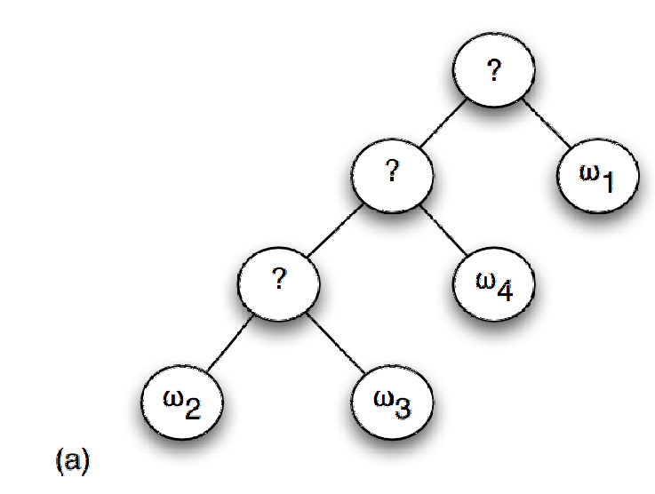
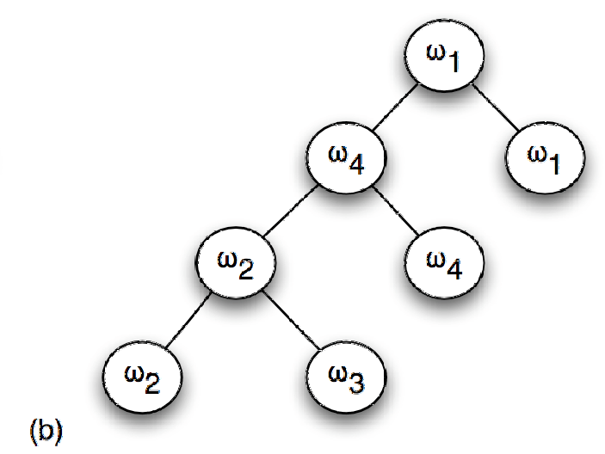
Sequential Majority Elections
A variant of plurality, in which players play in a series of rounds: either a linear sequence or a tree (knockout tournament).

Slide 13

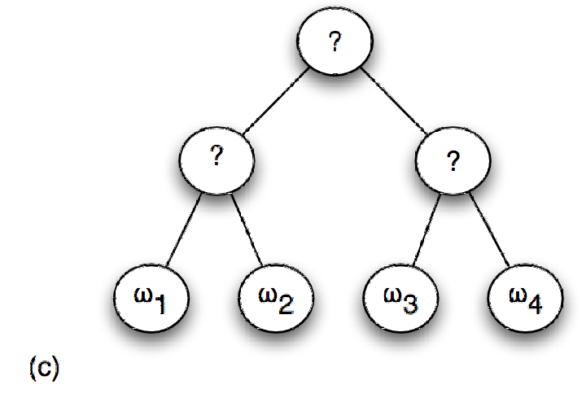
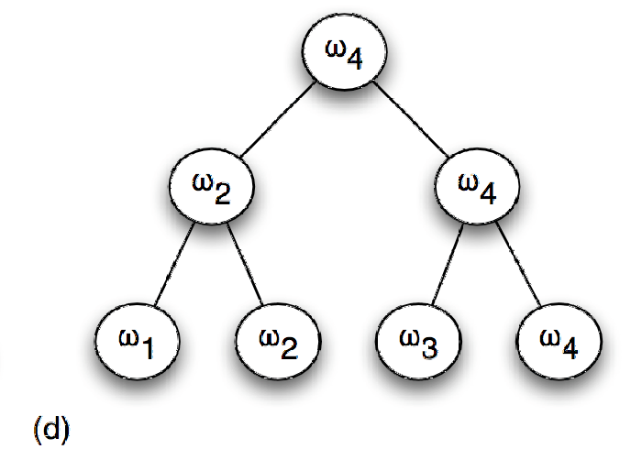
Sequential Majority Elections

Slide 14
Linear Sequential Pairwise Elections
Here, we pick an ordering of the outcomes – the agenda – which determines who plays against who.
For example, if the agenda is:
ω₂ , ω₃ , ω₄ , ω₁
then the first election is between ω₂ and ω₃, and the winner goes on to an election with ω₄, and the winner of this election goes in an election with ω₁.

Slide 15
Anomalies with Sequential Pairwise Elections
Suppose:
33 voters have preferences
ω₁ ω₂ ω₃
33 voters have preferences
ω₃ ω₁ ω₂
33 voters have preferences
ω₂ ω₃ ω₁
Then for every candidate, we can fix an agenda for that candidate to win in a sequential pairwise election!

Slide 16
Majority Graphs
This idea is easiest to illustrate by using a majority graph.
A directed graph with:
vertices = candidates
an edge (i, j) if i would beat j is a simple majority election.
A compact representation of voter preferences.

Slide 17
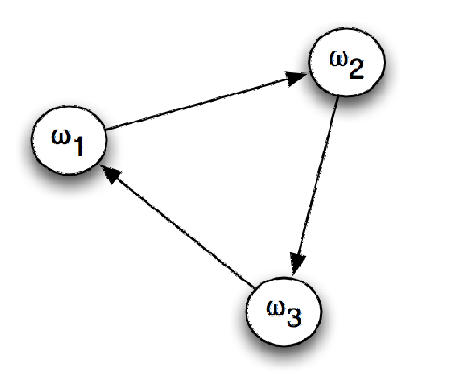
Majority Graph for the Previous Example
with agenda (ω₃ , ω₂ , ω₁), ω₁ wins
with agenda (ω₁ , ω₃ , ω₂), ω₂ wins
with agenda (ω₁ , ω₂ , ω₃), ω₃ wins

Slide 18
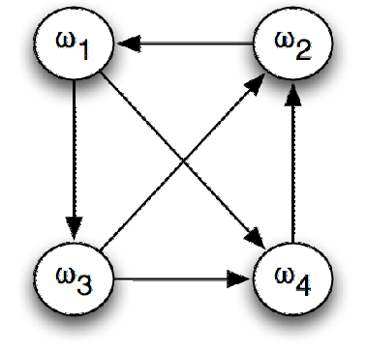
Another Majority Graph
Give agendas for each candidate to win with the following majority graph.

Slide 19
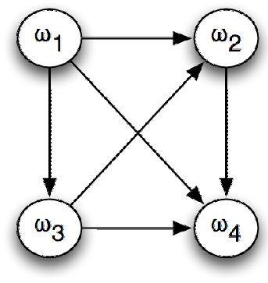
Condorcet Winners
A Condorcet winner is a candidate that would beat every other candidate in a pairwise election.
Here, ω₁ is a Condorcet winner.

Slide 20
Voting Procedures: Borda Count
One reason plurality has so many anomalies is that it ignores most of a voter’s preference orders: it only looks at the top ranked candidate.
The Borda count takes whole preference order into account.
For each candidate, we have a variable, counting the strength of opinion in favour of this candidate.
If ω_{i} appears first in a preference order, then we increment the count for ω_{i} by k-1; we then increment the count for the next outcome in the preference order by k-2, …, until the final candidate in the preference order has its total incremented by 0.
After we have done this for all voters, then the totals give the ranking.

Slide 21
Desirable Properties of Voting Procedures
Can we classify the properties we want of a “good” voting procedure?
Two key properties:
The Pareto property;
  If everybody prefers ω_{i} over ω_{j}, then ω_{i} should be ranked over ω_{j} in the social outcome.
Independence of Irrelevant Alternatives (IIA).
  Whether ω_{i} is ranked above ω_{j} in the social outcome should depend only on the relative orderings of ω_{i} and ω_{j} in voters profiles.

Slide 22
Arrow’s Theorem
For elections with more than 2 candidates, the only voting procedure satisfying the Pareto condition and IIA is a dictatorship, in which the social outcome is in fact simply selected by one of the voters.
This is a negative result: there are fundamental limits to democratic decision making!

Slide 23
Strategic Manipulation
We already saw that sometimes, voters can benefit by strategically misrepresenting their preferences, i.e., lying – tactical voting.
Are there any voting methods which are non-manipulable, in the sense that voters can never benefit from misrepresenting preferences?

Slide 24
The Gibbard-Satterthwaite Theorem
The answer is given by the Gibbard-Satterthwaite theorem:
The only non-manipulable voting method satisfying the Pareto property for elections with more than 2 candidates is a dictatorship.
In other words, every “realistic” voting method is prey to strategic manipulation . . .

Slide 25
Computationally Complexity to the Rescue!
Gibbard-Satterthwaite only tells us that manipulation is possible in principle.
It does not give any indication of how to misrepresent preferences.
Bartholdi, Tovey, and Trick showed that there are elections that are prone to manipulation in principle, but where manipulation was computationally complex.
“Single Transferable Vote” is NP-hard to manipulate!

