Slide 1
DCAITI-Project: Implementation of a Traffic Light Service on an (Android) Smartphone
Oday Kabha your_mail@tu-berlin.de
Yiyang Song yiyang.song@campus.tu-berlin.de
Yuanheng Mu johanmu1994@mailbox.tu-berlin.de
Supervisor: Birgit Kwella

Slide 2
Overview
Background
Develop Framework
Tasks
Milestone

Slide 3
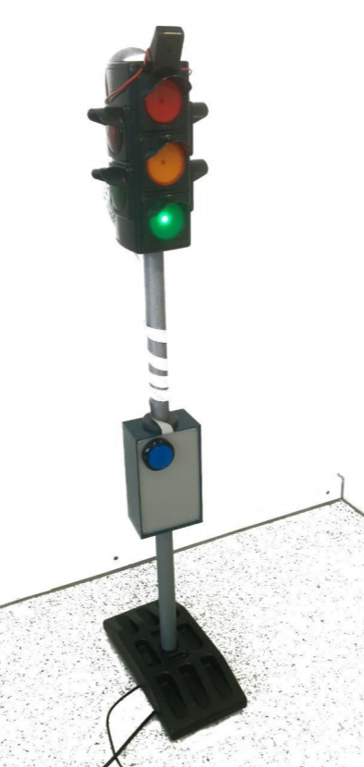
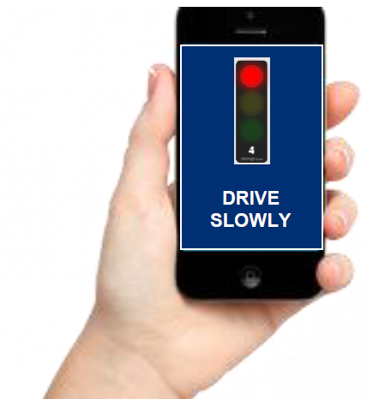
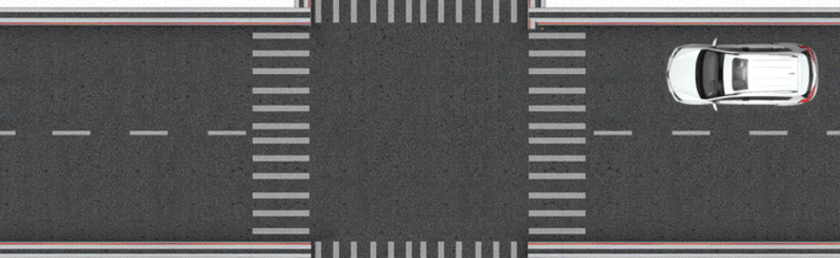
Background
GLOSA (Green Light Optimized Speed Advisory)
suggests speeds to vehicles to pass through an intersection
RSU (Roadside unit)
SPaT (Signal Phase and Time)
FOKUS Traffic Light Service
MAP (Map data)
Topology of the intersection
Road Users
car/ bicycle/ pedestrian
receive recommendation for action
RSU
SPaT & MAP
via automotive WiFi

Slide 4
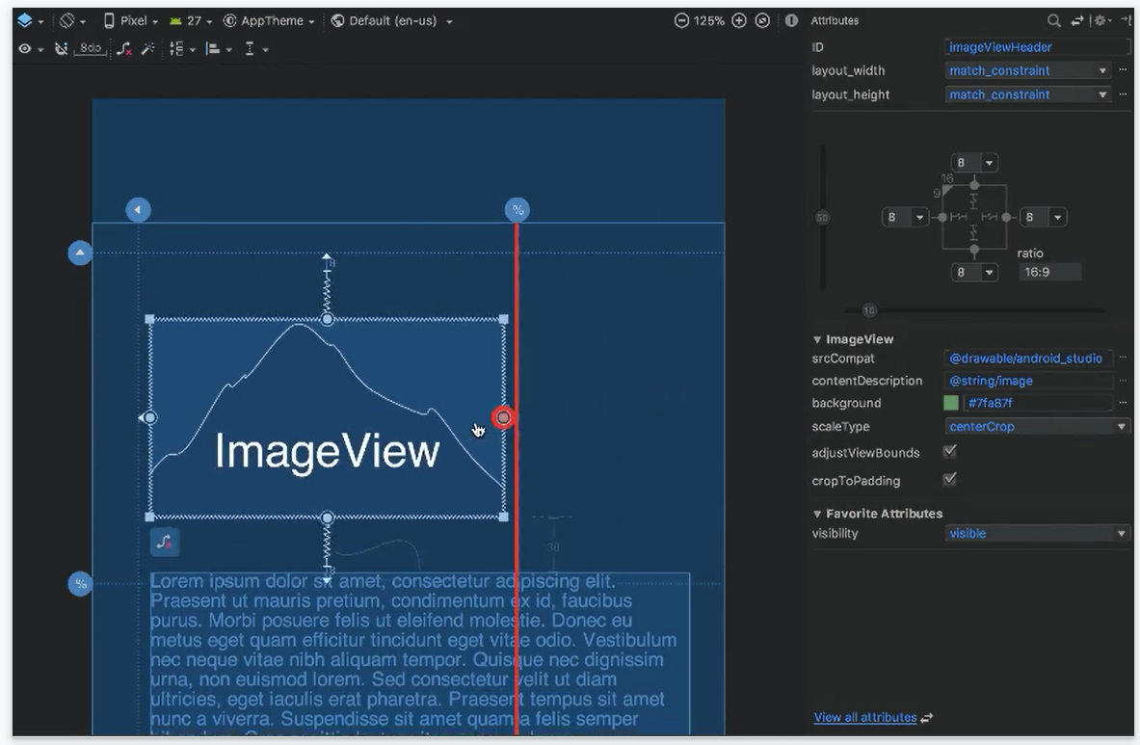
Develop Framework
Android Studio
1. Visual layout editor
build layouts by dragging UI elements instead of writing layout XML by hand
Source: https://developer.android.com/studio

Slide 5
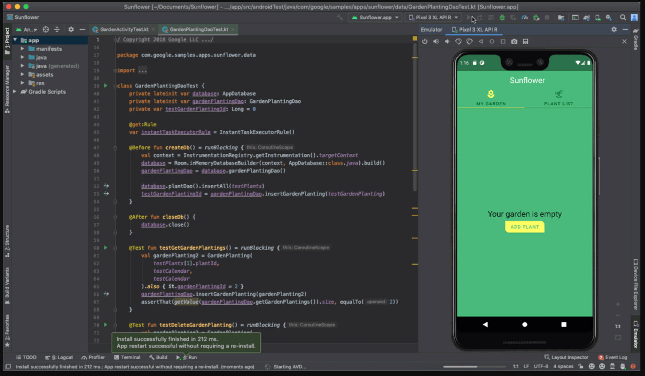
Develop Framework
Android Studio
2. APK Analyzer
3. Fast emulator
run apps on the Android Emulator
Source: https://developer.android.com/studio

Slide 6
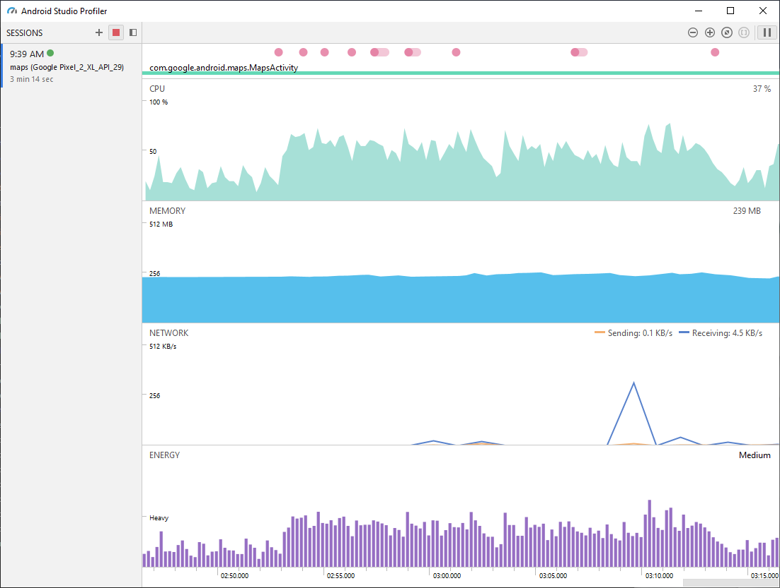
Develop Framework
Android Studio
4. Intelligent code editor
based on IntelliJ IDEA
5. Flexible build system
6. Realtime profilers
measure app performance
Source: https://developer.android.com/studio

Slide 7
Tasks
Request, analysis and visualization of traffic lights information
Decision of driving strategy
Simulation and evaluation

Slide 8
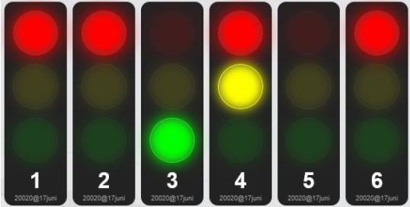
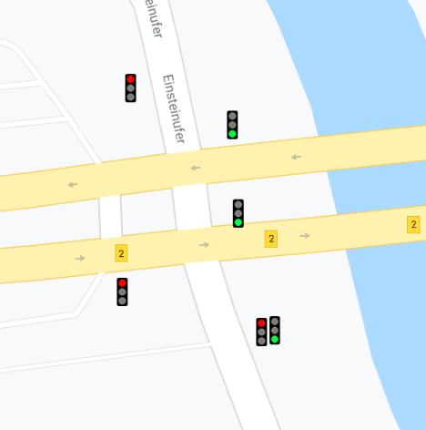
Request, analysis and visualization of traffic lights information
GUI
REST-API
Https Request
Client
(e.g. Volley, Retrofit)
SPaT Parser
JSON
Traffic Lights Phase
Https Post
Map Resource
(csv, kml)
Google Maps Android API
Map Information

Slide 9
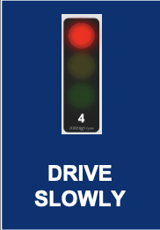
Decision of of driving strategy
Strategy
Advice
Signal Phase
User Info
Strategy Definition
Position, Speed, Direction
Signal Group
Signal, Position, Speed

Slide 10
Simulation and evaluation
Testcases with different signal plans of traffic lights, random users (different position, direction and speed) and assertion of driving strategies
Signal plans
Strategy
Advice
Dev-App
Generated User Info

Slide 11
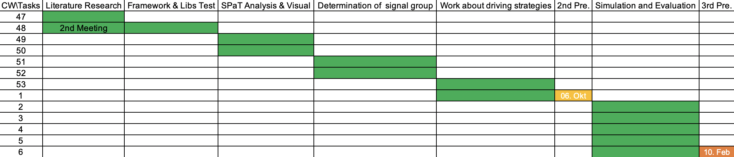
Milestone

Slide 12
Thanks for your attention!
Oday Kabha your_mail@tu-berlin.de
Yiyang Song yiyang.song@campus.tu-berlin.de
Yuanheng Mu johanmu1994@mailbox.tu-berlin.de

