Slide 1
Hero Brawler
Ian Albuquerque Raymundo da Silva
Maurício Pedro Vieira

Slide 2
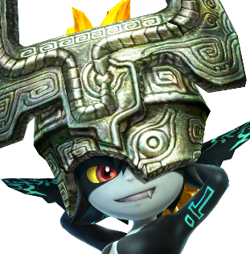




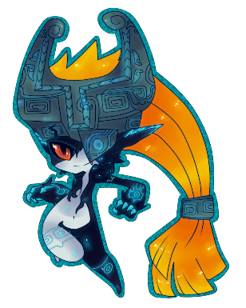


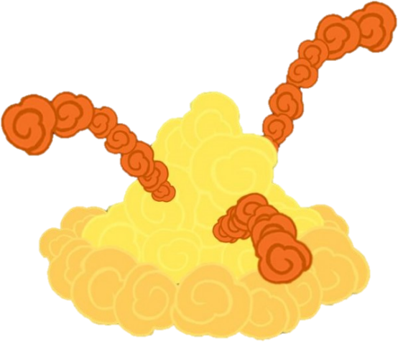



350 / 350 HP
12s
120 / 120 MP
Q
W
E
R
P4
Midna
P2
P1
P3

Slide 3
Features
4 PLAYER ONLINE MULTIPLAYER
TONS OF UNLOCKABLE CHARACTERS
STAGE EDITOR
SURVIVAL MODE
ITEMS AND HERO CUSTOMIZATION
ACHIEVEMENTS
STORY MODE
BOSS MODE

Slide 4
Features
2 PLAYER LOCAL MULTIPLAYER (lan)
SOME UNLOCKABLE CHARACTERS
STAGE EDITOR
SURVIVAL MODE
ITEMS AND HERO CUSTOMIZATION
ACHIEVEMENTS
STORY MODE
BOSS MODE

Slide 5
TO-DO LIST
PHYSICS ENGINE
GRAVITY
COLLISION DETECTION
HERO AND SKILLS TEMPLATE
UI AND HP/MP DYNAMICS
KEYBOARD INPUT
STAGE READER (Read Files.stg)
LAN COMMUNICATION AND PROTOCOLS

Slide 6
350 / 350 HP
12s
120 / 120 MP
Q
W
E
R
P4
Midna
P2
P1
P3

Slide 7
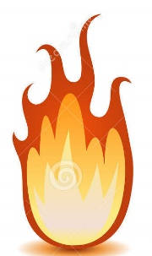
350 / 350 HP
12s
120 / 120 MP
Q
W
E
R
P4
Midna
P2
P1
P3

Slide 8


Slide 9



Slide 10


