Slide 1
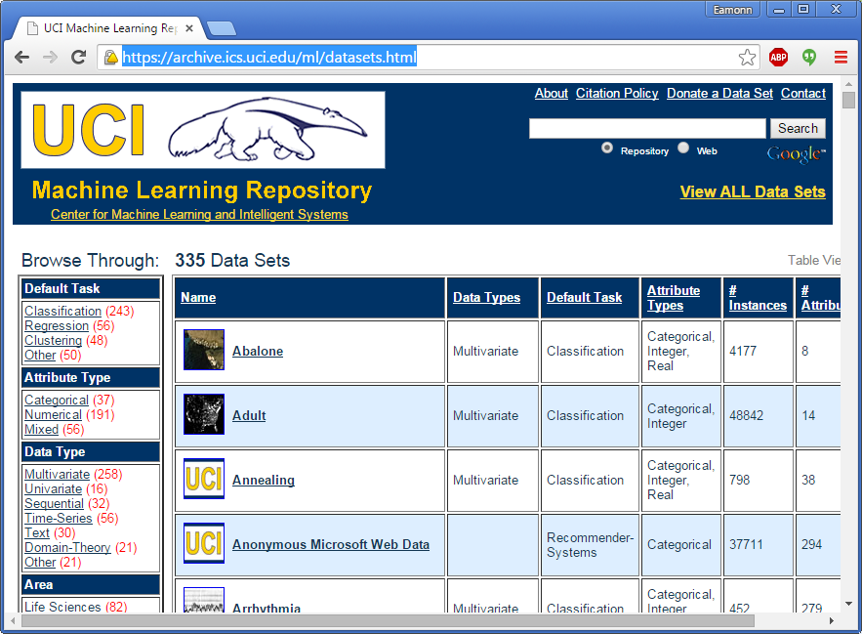
Extra Credit Possibility
https://archive.ics.uci.edu/ml/datasets.html
Also do search on a UCI dataset, and explain why the result is intuitive.
Don’t do this, unless the rest of your project is perfect!

Slide 2
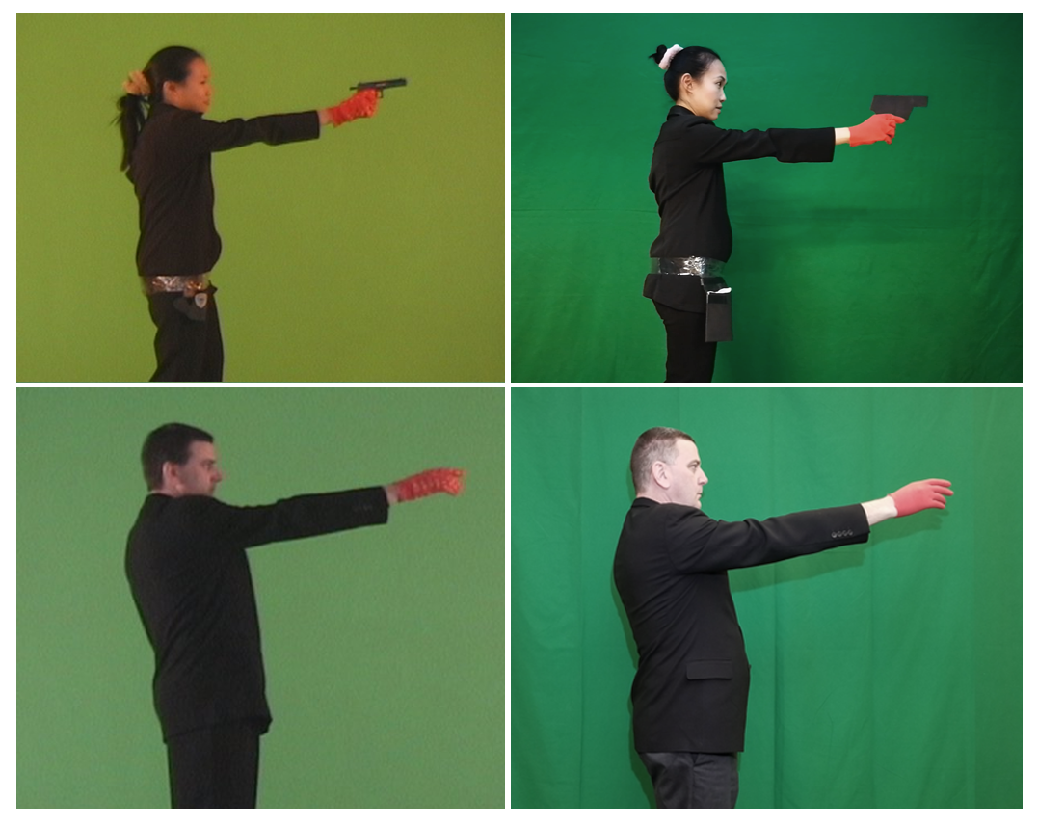

Slide 3
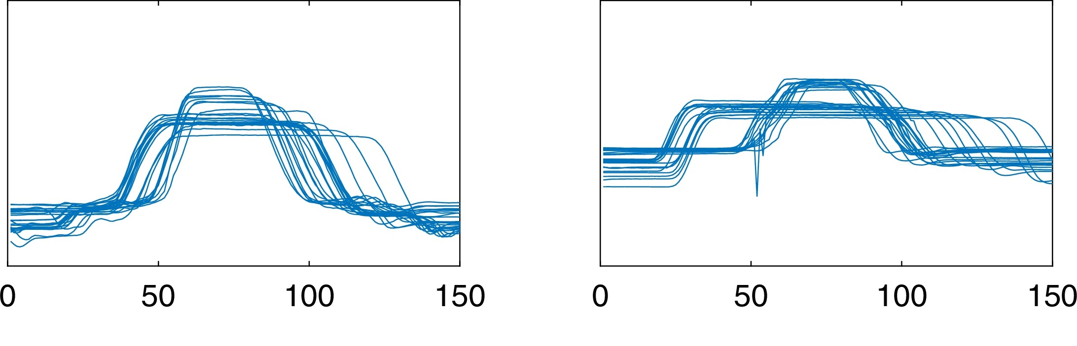
Examples of Gun
Examples of Point
Loc 48 | Loc 149 | Loc 150 | Class
8.0 | 1.9 | 6.1 | Gun
0.9 | 6.6 | 0.5 | Point
1.1 | 1.0 | 8.3 | Gun
5.4 | 1.1 | 3.1 | Gun
2.9 | 5.4 | 8.5 | Point
6.1 | 2.9 | 1.9 | Gun
0.5 | 6.1 | 6.6 | Point
8.5 | 0.5 | 1.0 | Gun
1.9 | 8.3 | 6.6 | Point
2.3 | 8.1 | 4.7 | Point
Insect ID | Abdomen Length | Antennae Length | Insect Class
1 | 2.7 | 5.5 | Grasshopper
2 | 8.0 | 9.1 | Katydid
3 | 0.9 | 4.7 | Grasshopper
4 | 1.1 | 3.1 | Grasshopper
5 | 5.4 | 8.5 | Katydid
6 | 2.9 | 1.9 | Grasshopper
7 | 6.1 | 6.6 | Katydid
8 | 0.5 | 1.0 | Grasshopper
9 | 8.3 | 6.6 | Katydid
10 | 8.1 | 4.7 | Katydids

Slide 4
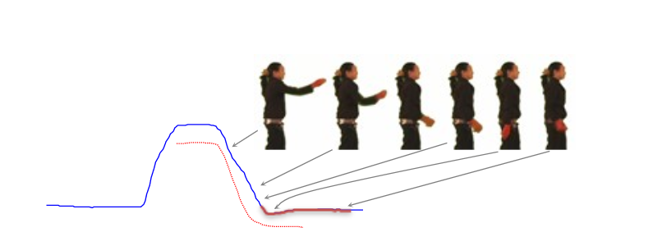
After Feature Search, we find the red highlighted features are most important, why?

Slide 5
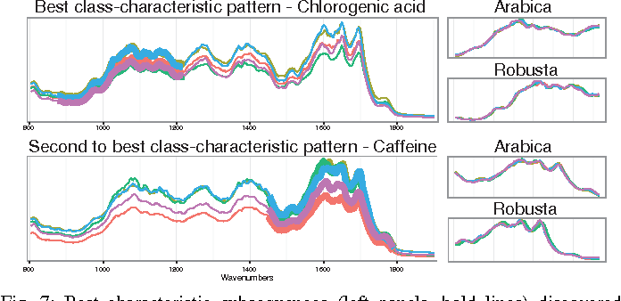
The Gun-Point example is silly, but the same idea can be used on coffee spectrographs….
Key Takeaway: Feature selection is not just about improving accuracy, it can sometimes tell you something you did not know.

Slide 6
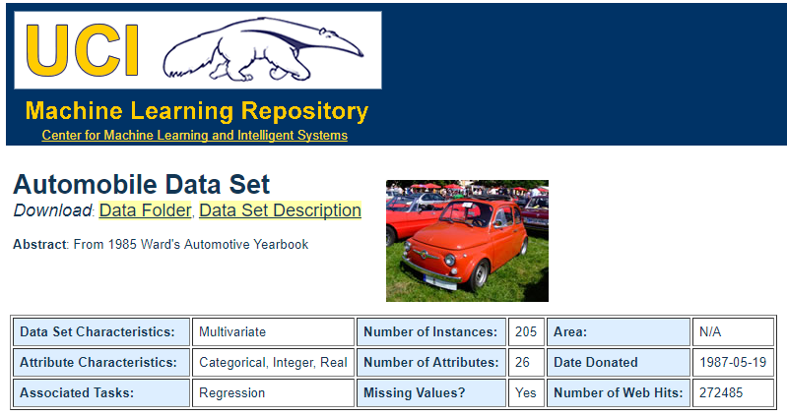
Extra Credit
Class assigned insurance risk rating
A value of +3 indicates that the auto is risky, -3 that it is probably pretty safe.
Features
3. make:
alfa-romero, audi, bmw, chevrolet, dodge, honda,
isuzu, jaguar, mazda, mercedes-benz, mercury,
mitsubishi, nissan, peugot, plymouth, porsche,
renault, saab, subaru, toyota, volkswagen, volvo
4. fuel-type: diesel, gas.
5. aspiration: std, turbo.
6. num-of-doors: four, two.
7. body-style: hardtop, wagon, sedan, hatchback, convertible.
8. drive-wheels: 4wd, fwd, rwd.
9. engine-location: front, rear.
10. wheel-base: continuous from 86.6 120.9.
11. length: continuous from 141.1 to 208.1.
12. width: continuous from 60.3 to 72.3.
13. height: continuous from 47.8 to 59.8.
14. curb-weight: continuous from 1488 to 4066.
15. engine-type: dohc, dohcv, l, ohc, ohcf, ohcv, rotor.
16. num-of-cylinders: eight, five, four, six, three, twelve, two.
17. engine-size: continuous from 61 to 326.
18. fuel-system: 1bbl, 2bbl, 4bbl, idi, mfi, mpfi, spdi, spfi.
19. bore: continuous from 2.54 to 3.94.
20. stroke: continuous from 2.07 to 4.17.
21. compression-ratio: continuous from 7 to 23.
22. horsepower: continuous from 48 to 288.
23. peak-rpm: continuous from 4150 to 6600.
24. city-mpg: continuous from 13 to 49.
25. highway-mpg: continuous from 16 to 54.
26. price: continuous from 5118 to 45400.
Go to the UCI Archive
Download a dataset, ideally one for which you have some knowledge.
Run feature search
Write an explanation as to why you think some features are selected, and/or why some features are dropped. For example
The number of doors was selected as a good feature. This makes sense, becase 2-door cars tend to be sports cars, and 4-doors tend to be family cars. Sports cars are bigger insurance risk.
The horsepower was also selected, this makes sense because powerful engines suggest…

Slide 7
Useful Trick
Sometimes it is useful to remap class labels and/or features.
For example. Here the class was originally seven valued, from -3 to 3. But I remapped it to a three class problem {-3,-2,-1} {0} {1, 2, 3}
Here there are 20 possible values for make, I remapped them to 2 classes {foreign} {USA}
Likewise, if you have some ideas or domain knowledge, you can process the data anyway you want. For example, maybe replacing the horsepower with the log of the horsepower.
Class assigned insurance risk rating
A value of +3 indicates that the auto is risky, -3 that it is probably pretty safe.
Features
3. make:
alfa-romero, audi, bmw, chevrolet, dodge, honda,
isuzu, jaguar, mazda, mercedes-benz, mercury,
mitsubishi, nissan, peugot, plymouth, porsche,
renault, saab, subaru, toyota, volkswagen, volvo
4. fuel-type: diesel, gas.
5. aspiration: std, turbo.
6. num-of-doors: four, two.
7. body-style: hardtop, wagon, sedan, hatchback, convertible.
8. drive-wheels: 4wd, fwd, rwd.
9. engine-location: front, rear.
10. wheel-base: continuous from 86.6 120.9.
11. length: continuous from 141.1 to 208.1.
12. width: continuous from 60.3 to 72.3.
13. height: continuous from 47.8 to 59.8.
14. curb-weight: continuous from 1488 to 4066.
15. engine-type: dohc, dohcv, l, ohc, ohcf, ohcv, rotor.
16. num-of-cylinders: eight, five, four, six, three, twelve, two.
17. engine-size: continuous from 61 to 326.
18. fuel-system: 1bbl, 2bbl, 4bbl, idi, mfi, mpfi, spdi, spfi.
19. bore: continuous from 2.54 to 3.94.
20. stroke: continuous from 2.07 to 4.17.
21. compression-ratio: continuous from 7 to 23.
22. horsepower: continuous from 48 to 288.
23. peak-rpm: continuous from 4150 to 6600.
24. city-mpg: continuous from 13 to 49.
25. highway-mpg: continuous from 16 to 54.
26. price: continuous from 5118 to 45400.

Slide 8
Important
For many datasets, you will probably need to normalize the features first.
For each column..
X= X-mean(X)/STD(X)
Or
X= X – min(X)
X = X /max(X)
Class assigned insurance risk rating
A value of +3 indicates that the auto is risky, -3 that it is probably pretty safe.
Features
3. make:
alfa-romero, audi, bmw, chevrolet, dodge, honda,
isuzu, jaguar, mazda, mercedes-benz, mercury,
mitsubishi, nissan, peugot, plymouth, porsche,
renault, saab, subaru, toyota, volkswagen, volvo
4. fuel-type: diesel, gas.
5. aspiration: std, turbo.
6. num-of-doors: four, two.
7. body-style: hardtop, wagon, sedan, hatchback, convertible.
8. drive-wheels: 4wd, fwd, rwd.
9. engine-location: front, rear.
10. wheel-base: continuous from 86.6 120.9.
11. length: continuous from 141.1 to 208.1.
12. width: continuous from 60.3 to 72.3.
13. height: continuous from 47.8 to 59.8.
14. curb-weight: continuous from 1488 to 4066.
15. engine-type: dohc, dohcv, l, ohc, ohcf, ohcv, rotor.
16. num-of-cylinders: eight, five, four, six, three, twelve, two.
17. engine-size: continuous from 61 to 326.
18. fuel-system: 1bbl, 2bbl, 4bbl, idi, mfi, mpfi, spdi, spfi.
19. bore: continuous from 2.54 to 3.94.
20. stroke: continuous from 2.07 to 4.17.
21. compression-ratio: continuous from 7 to 23.
22. horsepower: continuous from 48 to 288.
23. peak-rpm: continuous from 4150 to 6600.
24. city-mpg: continuous from 13 to 49.
25. highway-mpg: continuous from 16 to 54.
26. price: continuous from 5118 to 45400.

Slide 9
The following “hints” may be too basic for many of you
However, in my experience, ¼ of the students struggle with this step, these notes should solve that.

Slide 10
I am assuming you saw me present: Project_2_Briefing.pptx
Last time we saw how to build the search algorithm, by using a “stub” to replace the leave_one_out_cross_validation function
Now, lets us replace the stub with the real function, and we are done!
As you will see, I tested my coded on a smaller, hand-built dataset. I recommend you do this too.

Slide 11

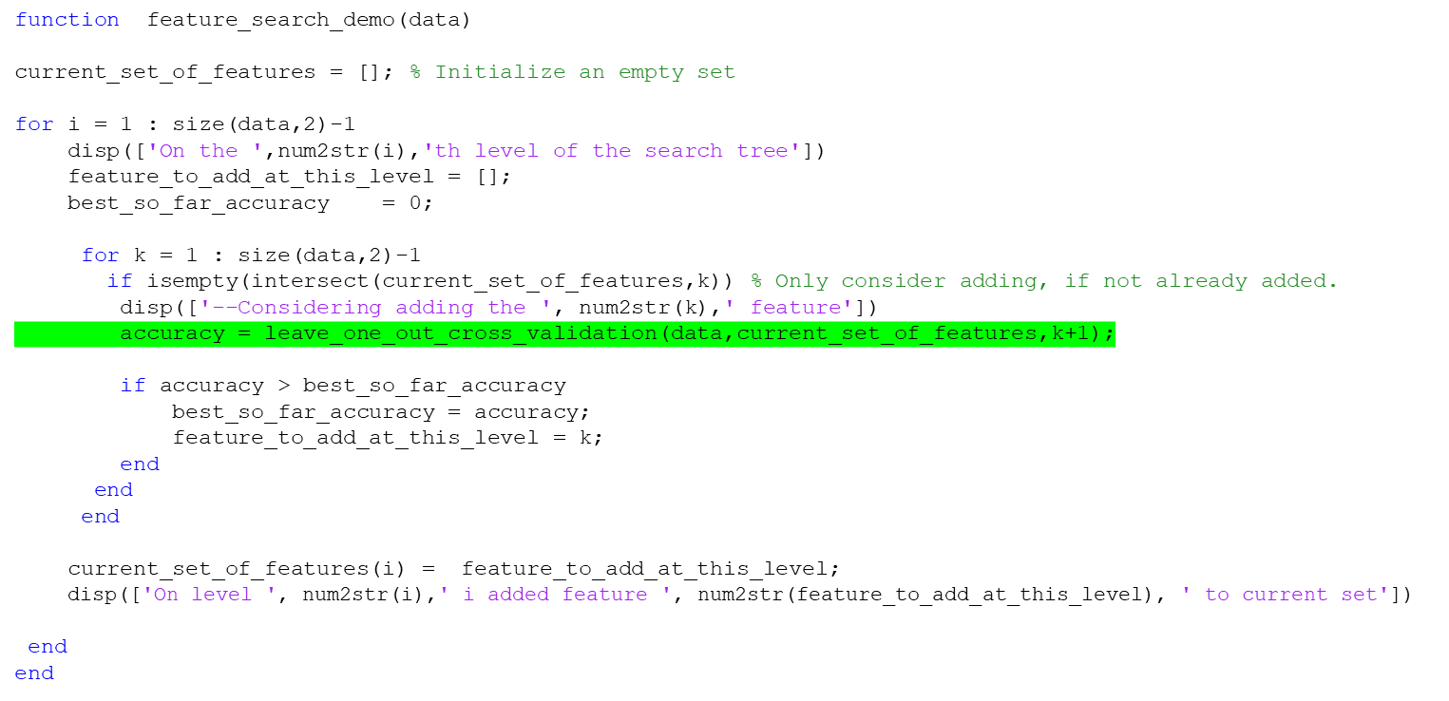
EDU>> feature_search_demo(mydata)
On the 1th level of the search tree
--Considering adding the 1 feature
--Considering adding the 2 feature
--Considering adding the 3 feature
--Considering adding the 4 feature
On level 1 i added feature 4 to current set
On the 2th level of the search tree
--Considering adding the 1 feature
--Considering adding the 2 feature
--Considering adding the 3 feature
On level 2 i added feature 2 to current set
On the 3th level of the search tree
--Considering adding the 1 feature
--Considering adding the 3 feature
On level 3 i added feature 1 to current set
On the 4th level of the search tree
--Considering adding the 3 feature
On level 4 i added feature 3 to current set
…We need an IF statement in the inner loop that says “only consider adding this feature, if it was not already added”

Slide 12
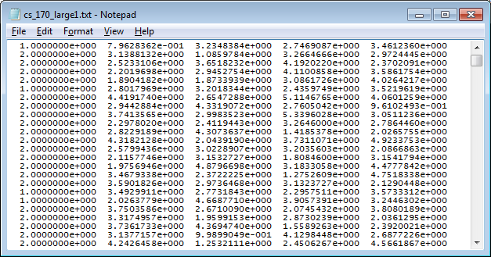
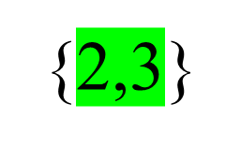



accuracy = leave_one_out_cross_validation(data,current_set_of_features,k+1);
What are the input arguments?
  The data
  The current set
  The feature you are thinking of adding to the current set
1
2
3
4
2
1,2
1,3
2,3
1,4
2,4
3,4
1,2,3
1,2,4
1,3,4
2,3,4
1,2,3
1,2,3,4

Slide 13
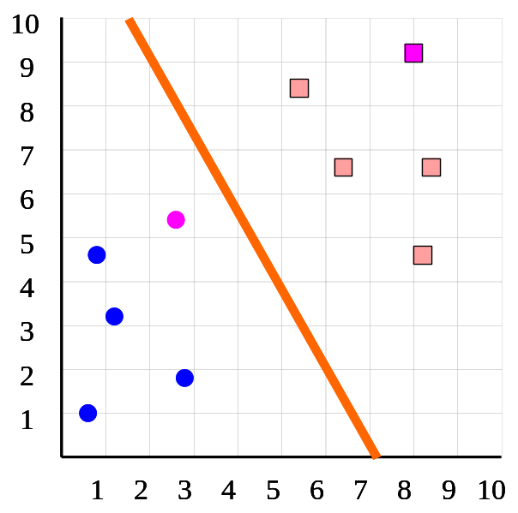
Predictive Accuracy I
How do we estimate the accuracy of our classifier?
  We can use K-fold cross validation
We divide the dataset into K equal sized sections. The algorithm is tested K times, each time leaving out one of the K section from building the classifier, but using it to test the classifier instead
Number of correct classifications
Number of instances in our database
Accuracy =
K = 5
Insect ID | Abdomen Length | Antennae Length | Insect Class
1 | 2.7 | 5.5 | Grasshopper
2 | 8.0 | 9.1 | Katydid
3 | 0.9 | 4.7 | Grasshopper
4 | 1.1 | 3.1 | Grasshopper
5 | 5.4 | 8.5 | Katydid
6 | 2.9 | 1.9 | Grasshopper
7 | 6.1 | 6.6 | Katydid
8 | 0.5 | 1.0 | Grasshopper
9 | 8.3 | 6.6 | Katydid
10 | 8.1 | 4.7 | Katydids

Slide 14

How do we estimate the accuracy of our classifier?
  We can use K-fold cross validation
We divide the dataset into K equal sized sections. The algorithm is tested K times, each time leaving out one of the K section from building the classifier, but using it to test the classifier instead
Number of correct classifications
Number of instances in our database
Accuracy =
K = 10
Insect ID | Abdomen Length | Antennae Length | Insect Class
1 | 2.7 | 5.5 | Grasshopper
2 | 8.0 | 9.1 | Katydid
3 | 0.9 | 4.7 | Grasshopper
4 | 1.1 | 3.1 | Grasshopper
5 | 5.4 | 8.5 | Katydid
6 | 2.9 | 1.9 | Grasshopper
7 | 6.1 | 6.6 | Katydid
8 | 0.5 | 1.0 | Grasshopper
9 | 8.3 | 6.6 | Katydid
10 | 8.1 | 4.7 | Katydids

Slide 15
Let us find the distance between the exemplar, and item 2
Distance = sqrt( (2.7 – 8.0)² + (5.5 – 9.1)² )
Which is 6.4070
Visually, that seems about right….
K = 10
Insect ID | Abdomen Length | Antennae Length | Insect Class
1 | 2.7 | 5.5 | Grasshopper
2 | 8.0 | 9.1 | Katydid
3 | 0.9 | 4.7 | Grasshopper
4 | 1.1 | 3.1 | Grasshopper
5 | 5.4 | 8.5 | Katydid
6 | 2.9 | 1.9 | Grasshopper
7 | 6.1 | 6.6 | Katydid
8 | 0.5 | 1.0 | Grasshopper
9 | 8.3 | 6.6 | Katydid
10 | 8.1 | 4.7 | Katydids

Slide 16
Let us find the distance between the exemplar, and item 3
Distance = sqrt( (2.7 – 0.9)² + (5.5 – 4.7)² )
Which is 1.9698
Visually, that seems about right….
K = 10
Insect ID | Abdomen Length | Antennae Length | Insect Class
1 | 2.7 | 5.5 | Grasshopper
2 | 8.0 | 9.1 | Katydid
3 | 0.9 | 4.7 | Grasshopper
4 | 1.1 | 3.1 | Grasshopper
5 | 5.4 | 8.5 | Katydid
6 | 2.9 | 1.9 | Grasshopper
7 | 6.1 | 6.6 | Katydid
8 | 0.5 | 1.0 | Grasshopper
9 | 8.3 | 6.6 | Katydid
10 | 8.1 | 4.7 | Katydids

Slide 17
data =
1.0000 2.7000 5.5000
0 8.0000 9.1000
1.0000 0.9000 4.7000
1.0000 1.1000 3.2000
0 5.4000 8.5000
1.0000 2.9000 1.9000
0 6.1000 6.6000
1.0000 0.5000 1.0000
0 8.3000 6.6000
0 8.1000 4.7000

Slide 18
function Accuracy = leave_one_out(data)
end

Slide 19
function Accuracy = leave_one_out(data)
for i = 1 : size(data,1)
disp(['i am looping over the rows ', num2str(i)])
end
end
>> leave_one_out(data)
i am looping over the rows 1
i am looping over the rows 2
i am looping over the rows 3
i am looping over the rows 4
i am looping over the rows 5
i am looping over the rows 6
i am looping over the rows 7
i am looping over the rows 8
i am looping over the rows 9
i am looping over the rows 10

Slide 20
function Accuracy = leave_one_out(data)
for i = 1 : size(data,1)
disp(['i am looping over the rows ', num2str(i)])
for j = 1 : size(data,1)
disp(['for exmplar ',num2str(i),' i am comparing to ', num2str(j)])
end
end
end
>> leave_one_out(data)
i am looping over the rows 1
for exmplar 1 i am comparing to 1
for exmplar 1 i am comparing to 2
for exmplar 1 i am comparing to 3
for exmplar 1 i am comparing to 4
for exmplar 1 i am comparing to 5
for exmplar 1 i am comparing to 6
for exmplar 1 i am comparing to 7
for exmplar 1 i am comparing to 8
for exmplar 1 i am comparing to 9
for exmplar 1 i am comparing to 10
i am looping over the rows 2
for exmplar 2 i am comparing to 1
for exmplar 2 i am comparing to 2
for exmplar 2 i am comparing to 3
for exmplar 2 i am comparing to 4
for exmplar 2 i am comparing to 5
for exmplar 2 i am comparing to 6
for exmplar 2 i am comparing to 7
for exmplar 2 i am comparing to 8
for exmplar 2 i am comparing to 9
for exmplar 2 i am comparing to 10
i am looping over the rows 3
for exmplar 3 i am comparing to 1
for exmplar 3 i am comparing to 2
for exmplar 3 i am comparing to 3
for exmplar 3 i am comparing to 4
for exmplar 3 i am comparing to 5
Problem: I am comparing each item to itself!

Slide 21
function Accuracy = leave_one_out(data)
for i = 1 : size(data,1)
disp(['i am looping over the rows ', num2str(i)])
for j = 1 : size(data,1)
if i ~= j
disp(['for exmplar ',num2str(i),' i am comparing to ', num2str(j)])
end
end
end
end
>> leave_one_out(data)
i am looping over the rows 1
for exmplar 1 i am comparing to 2
for exmplar 1 i am comparing to 3
for exmplar 1 i am comparing to 4
for exmplar 1 i am comparing to 5
for exmplar 1 i am comparing to 6
for exmplar 1 i am comparing to 7
for exmplar 1 i am comparing to 8
for exmplar 1 i am comparing to 9
for exmplar 1 i am comparing to 10
i am looping over the rows 2
for exmplar 2 i am comparing to 1
for exmplar 2 i am comparing to 3
for exmplar 2 i am comparing to 4
for exmplar 2 i am comparing to 5
for exmplar 2 i am comparing to 6
for exmplar 2 i am comparing to 7
for exmplar 2 i am comparing to 8
for exmplar 2 i am comparing to 9
for exmplar 2 i am comparing to 10
i am looping over the rows 3
for exmplar 3 i am comparing to 1
for exmplar 3 i am comparing to 2
for exmplar 3 i am comparing to 4

Slide 22
function Accuracy = leave_one_out(data)
for i = 1 : size(data,1)
disp(['i am looping over the rows ', num2str(i)])
for j = 1 : size(data,1)
if i ~= j
disp(['for exmplar ',num2str(i),' i am comparing to ', num2str(j)]);
distance = sqrt((data(i,2) -data(j,2))^2 + (data(i,3)-data(j,3))^2)
end
end
end
end
>> leave_one_out(data)
i am looping over the rows 1
for exmplar 1 i am comparing to 2
distance =
6.4070
for exemplar 1 i am comparing to 3
distance =
1.9698
for exemplar 1 i am comparing to 4
Compare these numbers to the numbers we worked out by hand!

Slide 23
function Accuracy = leave_one_out(data)
for i = 1 : size(data,1)
best_so_far = inf;
best_so_far_loc = NaN;
for j = 1 : size(data,1)
if i ~= j
distance = sqrt((data(i,2) -data(j,2))^2 + (data(i,3)-data(j,3))^2);
if distance < best_so_far
best_so_far = distance;
best_so_far_loc = j;
end
end
end
disp(['for exemplar ',num2str(i),' i think its nearest neigbour is ', num2str(best_so_far_loc )]);
end
end
>> leave_one_out(data)
for exemplar 1 i think its nearest neighbor is 3
for exemplar 2 i think its nearest neighbor is 9
for exemplar 3 i think its nearest neighbor is 4
for exemplar 4 i think its nearest neighbor is 3
for exemplar 5 i think its nearest neighbor is 7
for exemplar 6 i think its nearest neighbor is 4
for exemplar 7 i think its nearest neighbor is 5
for exemplar 8 i think its nearest neighbor is 4
for exemplar 9 i think its nearest neighbor is 10
for exemplar 10 i think its nearest neighbor is 9
I need to remember who was my nearest neighbor

Slide 24
function Accuracy = leave_one_out(data)
num_correct = 0;
for i = 1 : size(data,1)
best_so_far = inf;
best_so_far_loc = NaN;
for j = 1 : size(data,1)
if i ~= j
distance = sqrt((data(i,2) -data(j,2))^2 + (data(i,3)-data(j,3))^2);
if distance < best_so_far
best_so_far = distance;
best_so_far_loc = j;
end
end
end
disp(['for exemplar ',num2str(i),' i think its nearest neighbor is ', num2str(best_so_far_loc )]);
if data(i,1) == data(best_so_far_loc ,1)
disp([' i got exemplar ', num2str(i), ' correct'])
end
end
end
>> leave_one_out(data)
for exemplar 1 i think its nearest neighbor is 3
i got exemplar 1 correct
for exemplar 2 i think its nearest neighbor is 9
i got exemplar 2 correct
for exemplar 3 i think its nearest neighbor is 4
i got exemplar 3 correct
I need to test if my nearest neighbor has the same class label

Slide 25
function Accuracy = leave_one_out(data)
num_correct = 0;
for i = 1 : size(data,1)
best_so_far = inf;
best_so_far_loc = NaN;
for j = 1 : size(data,1)
if i ~= j
distance = sqrt((data(i,2) -data(j,2))^2 + (data(i,3)-data(j,3))^2);
if distance < best_so_far
best_so_far = distance;
best_so_far_loc = j;
end
end
end
if data(i,1) == data(best_so_far_loc ,1)
disp([' i got exemplar ', num2str(i), ' correct'])
num_correct = num_correct + 1;
end
end
Accuracy = num_correct/size(data,1);
end
>> leave_one_out(data)
i got exemplar 1 correct
i got exemplar 2 correct
i got exemplar 3 correct
i got exemplar 4 correct
i got exemplar 5 correct
i got exemplar 6 correct
i got exemplar 7 correct
i got exemplar 8 correct
i got exemplar 9 correct
i got exemplar 10 correct
ans = 1
I need to compute the accuracy.
We are done! However, we should test more..

Slide 26
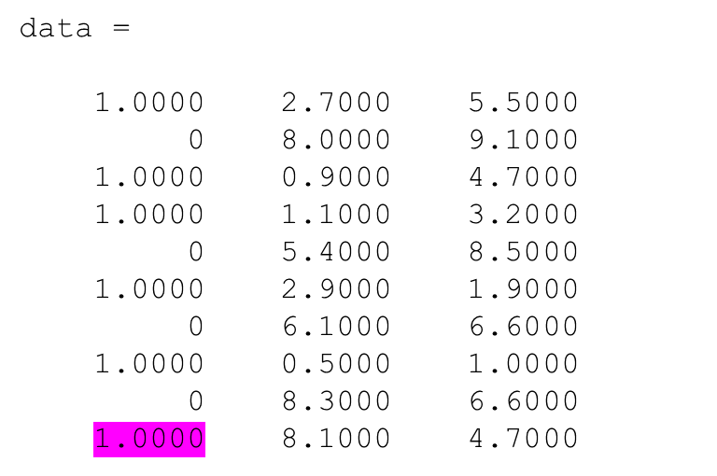
data =
1.0000 2.7000 5.5000
0 8.0000 9.1000
1.0000 0.9000 4.7000
1.0000 1.1000 3.2000
0 5.4000 8.5000
1.0000 2.9000 1.9000
0 6.1000 6.6000
1.0000 0.5000 1.0000
0 8.3000 6.6000
0 8.1000 4.7000
Let us change the class label of the last item, item 10
Now I should get two wrong
The last item, and item 9, which previously used item 10 as its correct nearest neighbor.

Slide 27
>> leave_one_out(data)
i got exemplar 1 correct
i got exemplar 2 correct
i got exemplar 3 correct
i got exemplar 4 correct
i got exemplar 5 correct
i got exemplar 6 correct
i got exemplar 7 correct
i got exemplar 8 correct
ans =
0.8000
I now have high confidence that my code works!

Slide 28
I am around today
I am around tomorrow before 3:30pm
I am around Saturday
I am around Sunday (by request)
I am around M/Tu/W of next week

