Slide 1
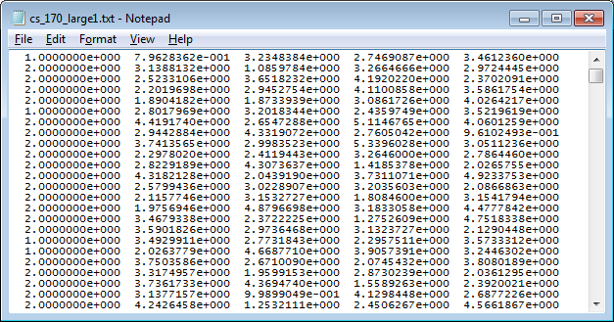
The second column up to the last column are the features
Class labels are in the first column
Either a 1 or 2

Slide 2
These numbers are in standard IEEE 754-1985, single precision format (space delimited)
You can use an off-the-shelf package to read them into your program.

Slide 3
EDU>> feature_search_demo(mydata)
On the 1th level of the search tree
--Considering adding the 1 feature
--Considering adding the 2 feature
--Considering adding the 3 feature
--Considering adding the 4 feature
On level 1 i added feature 4 to current set
On the 2th level of the search tree
--Considering adding the 1 feature
--Considering adding the 2 feature
--Considering adding the 3 feature
On level 2 i added feature 2 to current set
On the 3th level of the search tree
--Considering adding the 1 feature
--Considering adding the 3 feature
On level 3 i added feature 1 to current set
On the 4th level of the search tree
--Considering adding the 3 feature
On level 4 i added feature 3 to current set
This is what project 2 search “looks” like.
I just want the printout, the figure is for your ref only.
(I should have printed out the accuracy at each step, below you will see why I did not do that here)
1
2
3
4
1,2
1,3
2,3
1,4
2,4
3,4
1,2,3
1,2,4
1,3,4
2,3,4
1,2,3,4

Slide 4
I have a key for all the datasets.
For example, I know that
On large dataset 120 the error rate can be 0.916 when using only features 91 79 95
In other words all the features are irrelevant, except for features 91 79 and 95
And I know that if you use ONLY those features, you can get an accuracy of about 0.916
You don’t have this key! So it is your job to do the search to find that subset of features.
Everyone will have a different subset and a different achievable accuracy

Slide 5
To finish this project, I recommend that you completely divorce the search part, from the leave-one-out-cross-validation part.
To do this, I wrote a stub function that just returns a random number
I will use this in my search algorithm, and only when I am 100% sure that search works, will I “fill in” the full leave-one-out-cross-validation code.
function accuracy= leave_one_out_cross_validation(data,current_set,feature_to_add)
accuracy = rand; % This is a testing stub only
end

Slide 6
function feature_search_demo(data)
for i = 1 : size(data,2)-1
disp(['On the ',num2str(i),'th level of the search tree'])
end
end
I began by creating a for loop that can “walk” down the search tree.
I carefully tested it…
1
2
3
4
EDU>> feature_search_demo(mydata)
On the 1th level of the search tree
On the 2th level of the search tree
On the 3th level of the search tree
On the 4th level of the search tree
1,2
1,3
2,3
1,4
2,4
3,4
1,2,3
1,2,4
1,3,4
2,3,4
1,2,3,4

Slide 7
function feature_search_demo(data)
for i = 1 : size(data,2)-1
disp(['On the ',num2str(i),'th level of the search tree'])
for k = 1 : size(data,2)-1
disp(['--Considering adding the ', num2str(k),' feature'])
end
end
end
EDU>> feature_search_demo(mydata)
On the 1th level of the search tree
--Considering adding the 1 feature
--Considering adding the 2 feature
--Considering adding the 3 feature
--Considering adding the 4 feature
On the 2th level of the search tree
--Considering adding the 1 feature
--Considering adding the 2 feature
--Considering adding the 3 feature
--Considering adding the 4 feature
On the 3th level of the search tree
--Considering adding the 1 feature
--Considering adding the 2 feature
--Considering adding the 3 feature
--Considering adding the 4 feature
On the 4th level of the search tree
--Considering adding the 1 feature
--Considering adding the 2 feature
--Considering adding the 3 feature
--Considering adding the 4 feature
Now, inside the loop that “walks” down the search tree, I created a loop that considers each feature separately…
I carefully tested it…
1
2
3
4

Slide 8
function feature_search_demo(data)
for i = 1 : size(data,2)-1
disp(['On the ',num2str(i),'th level of the search tree'])
for k = 1 : size(data,2)-1
disp(['--Considering adding the ', num2str(k),' feature'])
end
end
end
We are making great progress!
These nested loops are basically all we need to traverse the search space.
However at this point we are not measuring the accuracy of leave_one_out_cross_validation and recording it, so lets us do that (next slide).

Slide 9
feature_search_demo(mydata)
On the 1th level of the search tree
--Considering adding the 1 feature
--Considering adding the 2 feature
--Considering adding the 3 feature
--Considering adding the 4 feature
On level 1 i added feature 2 to current set
On the 2th level of the search tree
--Considering adding the 1 feature
--Considering adding the 2 feature
--Considering…
The code below almost works, but, once you add a feature, you should not add it again…
function feature_search_demo(data)
current_set_of_features = []; % Initialize an empty set
for i = 1 : size(data,2)-1
disp(['On the ',num2str(i),'th level of the search tree'])
feature_to_add_at_this_level = [];
best_so_far_accuracy = 0;
for k = 1 : size(data,2)-1
disp(['--Considering adding the ', num2str(k),' feature'])
accuracy = leave_one_out_cross_validation(data,current_set_of_features,k+1);
if accuracy > best_so_far_accuracy
best_so_far_accuracy = accuracy;
feature_to_add_at_this_level = k;
end
end
disp(['On level ', num2str(i),' i added feature ', num2str(feature_to_add_at_this_level), ' to current set'])
end
end
We need an IF statement in the inner loop that says “only consider adding this feature, if it was not already added” (next slide)
1
2
3
4
1,2
2,3
2,4

Slide 10
EDU>> feature_search_demo(mydata)
On the 1th level of the search tree
--Considering adding the 1 feature
--Considering adding the 2 feature
--Considering adding the 3 feature
--Considering adding the 4 feature
On level 1 i added feature 4 to current set
On the 2th level of the search tree
--Considering adding the 1 feature
--Considering adding the 2 feature
--Considering adding the 3 feature
On level 2 i added feature 2 to current set
On the 3th level of the search tree
--Considering adding the 1 feature
--Considering adding the 3 feature
On level 3 i added feature 1 to current set
On the 4th level of the search tree
--Considering adding the 3 feature
On level 4 i added feature 3 to current set
…We need an IF statement in the inner loop that says “only consider adding this feature, if it was not already added”
function feature_search_demo(data)
current_set_of_features = []; % Initialize an empty set
for i = 1 : size(data,2)-1
disp(['On the ',num2str(i),'th level of the search tree'])
feature_to_add_at_this_level = [];
best_so_far_accuracy = 0;
for k = 1 : size(data,2)-1
if isempty(intersect(current_set_of_features,k)) % Only consider adding, if not already added.
disp(['--Considering adding the ', num2str(k),' feature'])
accuracy = leave_one_out_cross_validation(data,current_set_of_features,k+1);
if accuracy > best_so_far_accuracy
best_so_far_accuracy = accuracy;
feature_to_add_at_this_level = k;
end
end
end
current_set_of_features(i) = feature_to_add_at_this_level;
disp(['On level ', num2str(i),' i added feature ', num2str(feature_to_add_at_this_level), ' to current set'])
end
end

Slide 11
EDU>> feature_search_demo(mydata)
On the 1th level of the search tree
--Considering adding the 1 feature
--Considering adding the 2 feature
--Considering adding the 3 feature
--Considering adding the 4 feature
On level 1 i added feature 4 to current set
On the 2th level of the search tree
--Considering adding the 1 feature
--Considering adding the 2 feature
--Considering adding the 3 feature
On level 2 i added feature 2 to current set
On the 3th level of the search tree
--Considering adding the 1 feature
--Considering adding the 3 feature
On level 3 i added feature 1 to current set
On the 4th level of the search tree
--Considering adding the 3 feature
On level 4 i added feature 3 to current set
We are done with the search!
The code is the previous slide is all you need.
You just have to replace the stub function leave_one_out_cross_validation with a real function, and echo the numbers it returned to the screen.
1
2
3
4
1,2
1,3
2,3
1,4
2,4
3,4
1,2,3
1,2,4
1,3,4
2,3,4
1,2,3,4

Slide 12
I will review the leave_one_out_cross_validation part another time.
However, as you can see from these notes, you can work on the search, and completely code it up now!
I strongly recommend that you do so.

Slide 13
Feature Search: Wrap Up
Practical Issues:
About 30% of the students have come to me to check their answers. I recommend everyone does this, but will not enforce this.
If you are shy, below are answers for two datasets.
I count as a perfect success if, on the small dataset.
For at least one of your algorithms…
You find at least two true features, and at most one wrong feature.
Your reported error rate is within a few percent of the ground truth.
(The large dataset is a little harder, I count as a perfect success if you find at least one true feature, and at have most 3 wrong features.)
Note that forward and backward selection can give different answers (if that was not true, why do both?). If they give different answers, the one with the highest accuracy is most likely to be correct.
As is happens, on the datasets I gave, forward selection is most likely to be best, if you had datasets with highly correlated features, backward selection might be better.
On large dataset 119 the error rate can be 0.89667 when using only features 42 68 56
On large dataset 120 the error rate can be 0.91667 when using only features 91 79 95
On small dataset 119 the error rate can be 0.91667 when using only features 3 4 1
On small dataset 120 the error rate can be 0.93667 when using only features 10 2 7
Changed nov 25th

Slide 14
Feature Search: Wrap Up
Why do feature search?
(minor) Nearest Neighbor Classification will be faster with less features.
We want to have the highest possible accuracy, and irrelevant features can only reduce accuracy.
It may be that some features are expensive to collect, say blood sugar level. If feature search suggests is it useless, we can tell the doctors, that at least for the task-at-hand, we don’t need to collect it.
We want to know about the domain.
For example, suppose we have hundreds of features in a medical record, height, weight, blood sugar level, age, temperature, blood-pressure etc.
Further suppose we are interest in classifying diabetes vs no- diabetes.
If we find that blood-pressure is a useful classification feature, we have learned something new, that might be medically interesting.
Why not just measure to correlation between diabetes and blood-pressure? It is possible that things can be related, but not correlated.

Slide 15
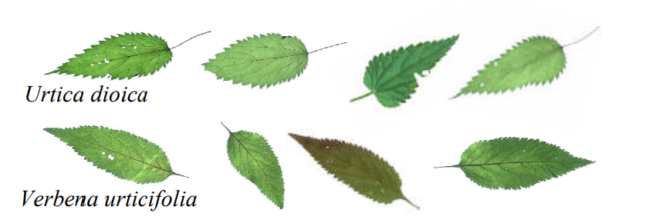
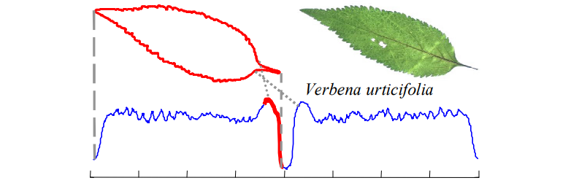

Slide 16
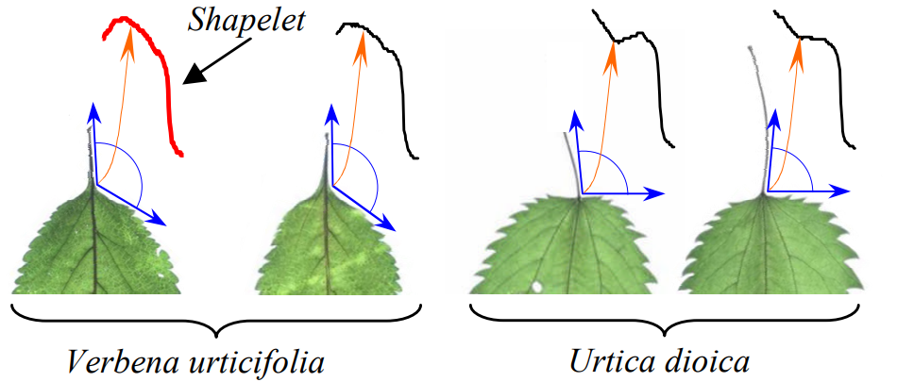

Slide 17
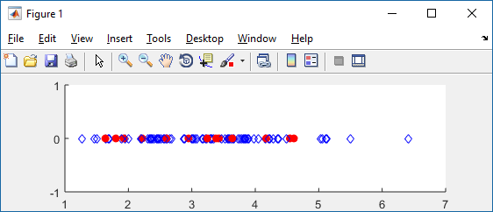
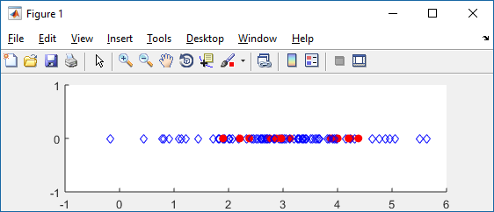
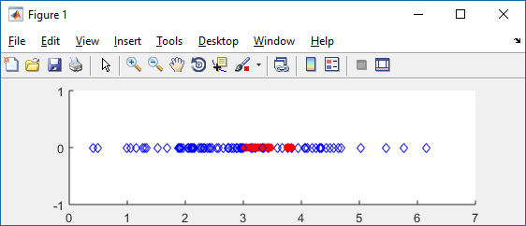
>> create_170_datasets
On large dataset 1 the error rate can be 0.92
when using only features 49 30 21
***************************
An irrelevant feature
A weak feature
A strong feature

Slide 18
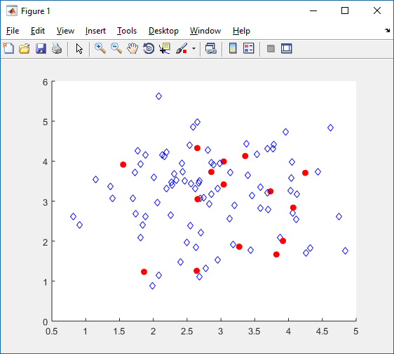
Two irrelevant features

Slide 19
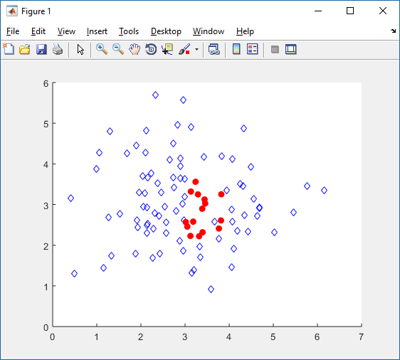
Two strong features

Slide 20
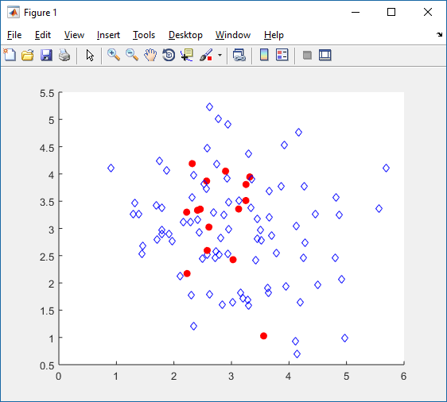
A strong feature (in the x-axis) with an irrelevant feature (y-axis)

Slide 21
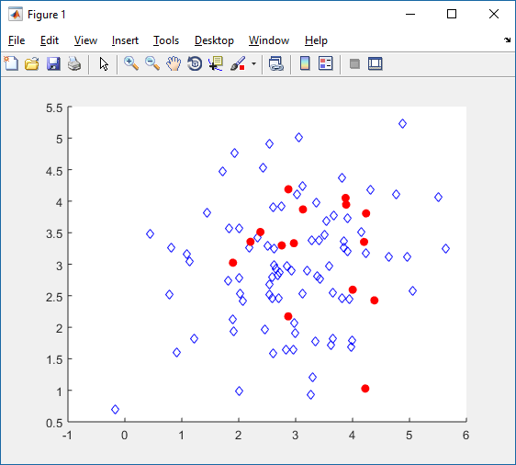
A weak feature (in the x-axis) with an irrelevant feature (y-axis)

Slide 22
>> create_170_datasets
On large dataset 1 the error rate can be 0.92
when using only features 49 30 21
***************************
In the test datasets I provided there are two strong and one weak feature.
In general, we can easily find the two strong features, however:
We may find it hard to find the weak feature
We may find spurious features
Thus some people reported finding something like this:
The best features are 49 21 7 10 30
Why do we find spurious features?
Why do we not find the weak feature?
To be clear, you do NOT need to do this for your project. I am just showing you this for context.
(note, this is review, I showed you this before)

Slide 23
Why do we find spurious features?
In our search algorithm we will add and keep a new feature, even if it only gets one more instance correct.
However, we have dozens of irrelevant features. It is very likely that one or two of the them will classify one or two extra data points by random chance.
This is bad! While the spurious features happened to help a tiny bit on these 100 objects, they will hurt a bit on the unseen data we will see in the future.

Slide 24
Why do we find spurious features?
In our search algorithm we will add and keep a new feature, even if it only gets one more instance correct.
However, we have dozens of irrelevant features. It is very likely that one or two of the them will classify one or two extra data points by random chance.
This is bad! While the spurious features happened to help a tiny bit on these 100 objects, they will hurt a bit on the unseen data we will see in the future.
How can we fix this?
Suppose instead of giving you one dataset with 100 instances, I had given you three datasets with 100 instances (from exactly the same problem).
Lets look at the three traces of forward selection on these 3 datasets.
The best features are 49 21 7 10 30
The best features are 21 49 22 30 11
The best features are 49 21 30 10 4
We can see that the two good features show up (perhaps in a different order) in all three runs, but the spurious features do not.
However we do not have three different versions of this dataset!

Slide 25
However we do not have three different versions of this dataset!
We can (sort of) make three different versions of this dataset!
We begin by making three copies of the dataset
Then, in each copy, we randomly delete say 5% of the data.
Now each of the three copies is very similar to the true dataset, but if a spurious feature happen to look good in one copy, it is very unlikely to look good in the other two copies.
This idea is called resampling.
Of course, if we have time, we can make even more copies.

Slide 26
>> create_170_datasets
On large dataset 1 the error rate can be 0.92
when using only features 49 30 21
***************************
Why do we not find the weak feature?
The same trick can be used to find the weak features. Let look at the three runs again..
Lets look at the three traces of forward selection
The best features are 49 21 7 10 30
The best features are 21 49 22 30 11
The best features are 49 21 30 10 4
The weak feature will tend to show up a lot more than we might expect by chance.
There is another trick we can do to find the weak features…

Slide 27
Suppose we are feature searching on a dataset.
The best features are 2 7 22 8 34
The best features are 2 76 3 19 5
The best features are 2 21 33 7 56
The best features are 2 1 7 82 12
Based on this resampling, we are confident that 2 is a good feature, but what about 7?

Slide 28

We can temporarily delete the strong feature, and rerun the search
The best features are 7 12 14 54
The best features are 7 3 13 8
The best features are 7 39 1 83
The best features are 9 7 22 52
Based on this it really looks like 7 is a true feature.
By analogy. Suppose I wanted to find out if you are a good basketball player.
However, Lebron James is on you team!
Your team wins a lot, but because Lebron is so strong, I don’t know if you are any good. If I take Lebron off the team and they still win, then maybe you are good.

Slide 29
Making the search faster
For most of you, depending on the computer language you used, you machine etc, you can do feature search on the “large” dataset in under one minute.
However, for some real problems, we might have millions of instances, and (more importantly) thousands of features. Then the same code might take decades.
Can we speed things up?
There are many ways to speed things up, indexing, sampling, caching and reusing calculations etc.
However, I am just going to show you one simple trick.
It requires you to add 5 to 10 lines of simple code, but should give you a 10 to 50 times speed up!

Slide 30
Making the search faster
This idea is similar in spirit to Alpha-Beta pruning. If a possibility is bad, you don’t need to find out exactly how bad it is.
Suppose we are beginning our search, our best-so-far is initialize to 0.
… we evaluate feature 1, getting 90% accuracy, so we set our best-so-far to be 90%
Now, as we are doing leave-one-out on feature 2, we get one instance wrong, then another, then another..
If we get 11 instances wrong, why bother to continue? Instead, just return zero!
1
2
3
4
90%

Slide 31
Making the search faster
If we get 11 instances wrong, why bother to continue? Instead, just return zero!
Now we move on to feature 3, we only get five wrong, so we update the best-so-far to 95%
Now we move on to feature 4, we get one instance wrong, then another, then another.. As soon as we get 6 instances wrong, why bother to continue? Instead, just return zero!
More generally
For the leave-one-out subroutine, pass in the best-so-far.
Keep track of how many mistakes you have made so far. If you have made too many mistakes to be better than the best-so-far, break out of loop, and return zero.
1
2
3
4
90%
0%
95%
0%

Slide 32
How I score the results

Slide 33
(made up numbers, these are not the true answers for this class)
1
2
3
4
1,2
1,3
2,3
1,4
2,4
3,4
1,2,3
1,2,4
1,3,4
2,3,4
On the small dataset
Two are strongly related to the class (and to each other)
One is weakly related to the class
The rest are random.
Thus for say, 65, the answer should be…
[4 7 9] accuracy 0.89
You might have gotten
[4 9] accuracy 0.94 or [4 9 2] accuracy 0.95 etc
This counts as a success, the small size of the training data, means you might have missed the weak feature, and you might have added a random feature that adds a tiny bit of spurious accuracy. So long as you got the two strong features, all is good.
1,2,3,4

Slide 34
(made up numbers, these are not the true answers for this class)
1
2
3
4
1,2
1,3
2,3
1,4
2,4
3,4
1,2,3
1,2,4
1,3,4
2,3,4
On the big dataset
Two are strongly related to the class (and to each other)
One is weakly related to the class
The rest are random.
Thus for say, 65, the answer should be…
[50 91 16] accuracy 0.91
Here many people will get something like…
[50 91 2 7 55 95 7 22] accuracy 0.99
What is going on? With so many extra features to search thru, some random features will look good by chance.
1,2,3,4

Slide 35
Greedy Forward Section
Initial state: Empty Set: No features
Operators: Add a feature.
Evaluation Function: K-fold cross validation.
1
2
3
4
100
80
1,2
1,3
2,3
1,4
2,4
3,4
60
40
1,2,3
1,2,4
1,3,4
2,3,4
20
0
{}
{3}
{3,4}
{1,3,4}
1,2,3,4

Slide 36
I want to see a plot like this!
1
91
2
7
0.9
0.8
50
0.7
0.6
0.5
0.4
0.3
0.2
[50 91 2 7 55 95 7 22] accuracy 0.99
0.1
0
0
5
10
15
20
25
Default rate

Slide 37
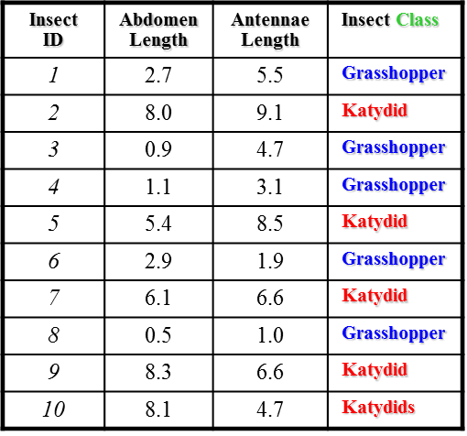
A simple trick to test for “real features”
Make several copies of your dataset.
In each copy randomly delete a small faction of the instances, say 5%
Run you search algorithm on each of these datasets
Look at the results….
[91 50 2 7 55 95 7 22] accuracy 0.99
[50 91 1 18 95 16 29] accuracy 0.98
[50 91 19 22 33 45 18] accuracy 0.93
[50 91 43 2 56 32 11 23] accuracy 0.99
[91 50 36 56 79 16 12] accuracy 0.94
[50 91 16 2 12 67 23 45] accuracy 0.98

