Slide 1
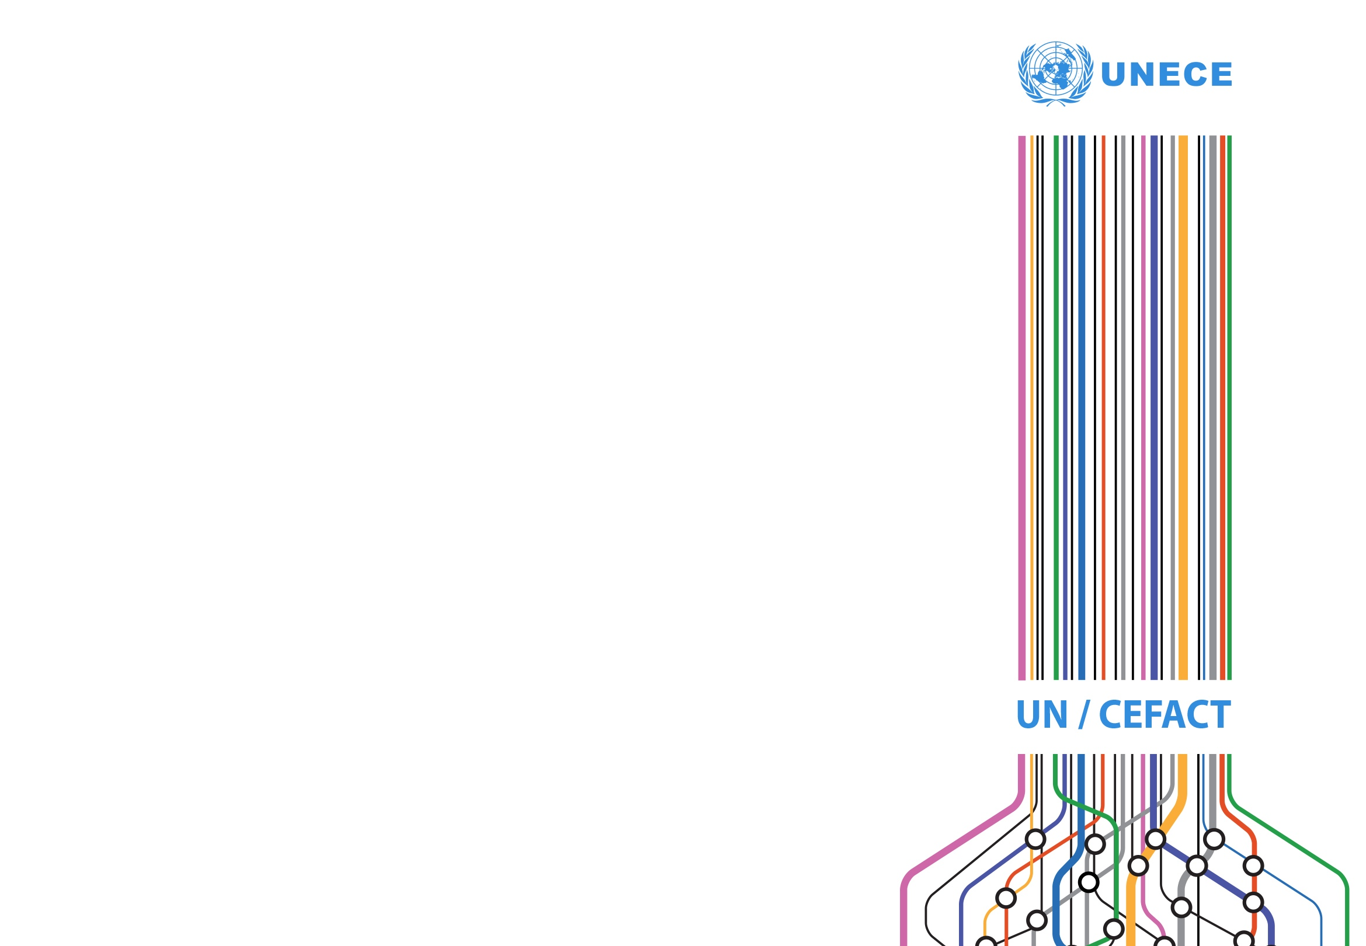
UN/CEFACT API Projects
RDM2API
API Town Plan
Steve Capell
steve.capell@gmail.com

Slide 2
Why is UN/CEFACT into this?
Because APIs in the trade & transport domain are popping up everywhere.
https://docs.tradelens.com/reference/api_documentation/
https://www.shipmate.co.uk/guides/api
https://developer.bring.com/api/tracking/
https://example.metapack.net/api.html
https://scurri.docs.apiary.io/#reference/consignments
https://github.com/NxtPort/API
https://docs.vendhq.com/reference/0/spec/consignments/newconsignment
https://api.ingotportal.com/
And hundreds more…. (this is just the first page google hits for ”consignment API”
And they are all different. Not because they want to be but because there wasn’t anywhere to find common standards. Web developers who build these things have generally never heard of UN/CEFACT and would be unlikely to make sense of the current outputs anyway.
So we have kicked off some projects to help.
Maybe some of you are here because of this.

Slide 3
We are the right place for this work.
UN/CEFACT
Has been the international trade standard authority for decades.
Has a rich library of standard semantics and processes.
Is a trusted and safe place to collaborate.
We just haven’t published our work in a format suitable for web developers.
Se we’ve started two projects:
RDM2API – A methodology to deliver API specifications and JSON-LD dictionaries with existing UN/CEFACT reference data models (RDMs) as the starting point.
https://uncefact.unece.org/display/uncefactpublic/RDM2API
API Town Plan – An architectural framework and governance model for the delivery of APIs and JSON-LD dictionaries by subject matter experts in business domains.
https://uncefact.unece.org/display/uncefactpublic/API+Town+Plan
In short – the tools and the rules for our work.

Slide 4
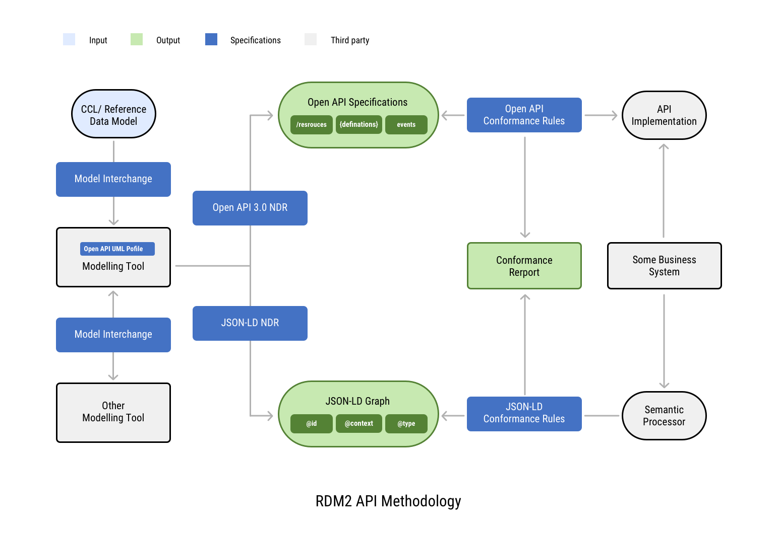
RDM2API Project Scope
Will deliver a suite of simple specifications (the blue boxes in the diagram below).

Slide 5
RDM2API Project – use cases
A UN/CEFACT business expert would use conformant modelling tools as follows.
Import reference libraries such as UN/CEFACT RDM from a shared repository.
Define web resources and their state lifecycles using simple UML class and state-chart diagrams.
Link relevant semantic definitions from the imported RDMs to the web resources.
Generate Open API 3.0 reference specifications and publish them to any platform that is readily accessible to web developers (eg github).
Generate JSON-LD dictionaries for use by any semantic processor
A web developer that is charged with implementing web APIs that comply with UN/CEFACT standards would use the published specifications as follows.
Import the Open API 3.0 reference specification into their preferred web development tool.
Implement an API in accordance with the specification, including any non-breaking extensions.
Run the open source test harness against their implementation and publish the conformance report.

Slide 6
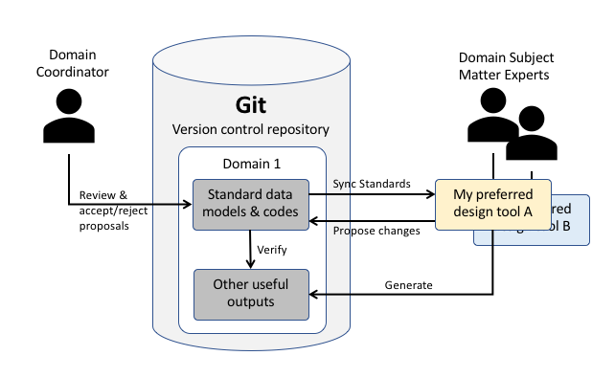
RDM2API Project – Model Interchange
A core deliverable is the model interchange specification that delivers
A tool independent (but simple & human readable) format for the maintenance of library content (data models, state lifecycle models, code lists, etc)
At least two implementations (eg starUML & Gefeg) that support the specification.

Slide 7
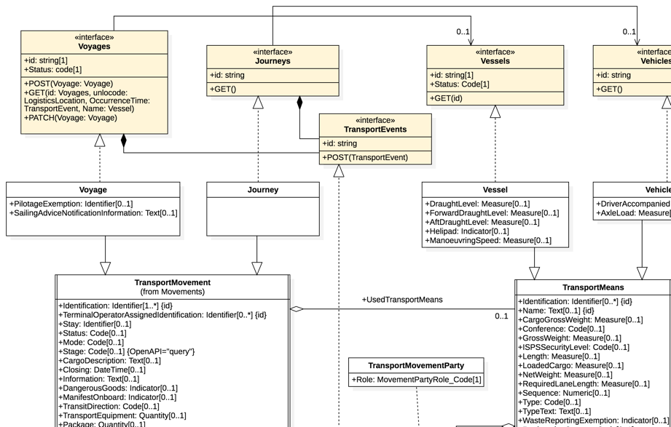
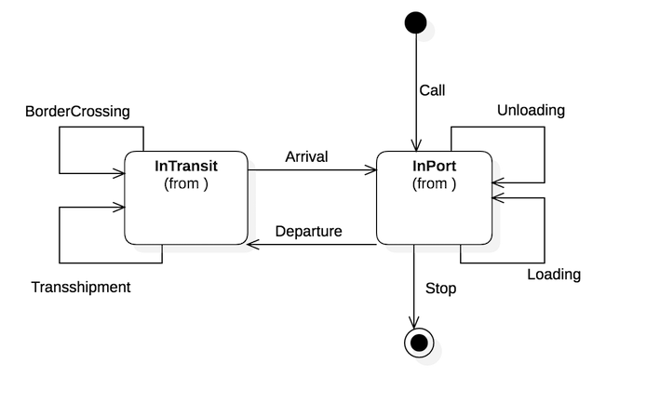
RDM2API Project – OpenAPI / JSON-LD
Another deliverable is the set of conventions for mapping models to technical outputs
Generating Open API 3.0 specifications from data & state models.
Generating JSON-LD dictionaries from the same models.
Information models
State lifecycle models
Open API specifications / JSON-LD dictionaries

Slide 8
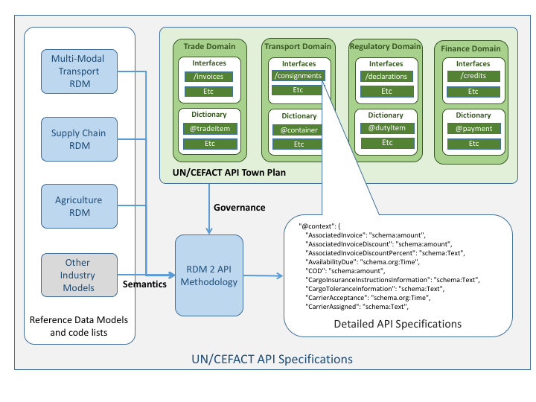
The API Town Plan Project
As more and more UN/CEFACT business domains publish API standards, there is a risk of confusion and overlaps/gaps unless there is a well-managed architecture where every domain knows where they fit and all users can easily navigate the plan to find the APIs they need. This project will establish a high level “API town plan” and associated governance and publishing framework for all UN/CEFACT APIs.
This project will be complete and proven successful when:
A first draft API town plan is published: As a clickable map covering Trade, Transport, Regulatory, and Financial domains as well as agriculture, tourism and other domains.
A town plan governance framework is established: That defines how the town plan is managed and how new APIs are added.
Conformant API Implementations are published: At least two domains have each followed the RDM2API methodology and have published at least one API that aligns with the town plan.

Slide 9
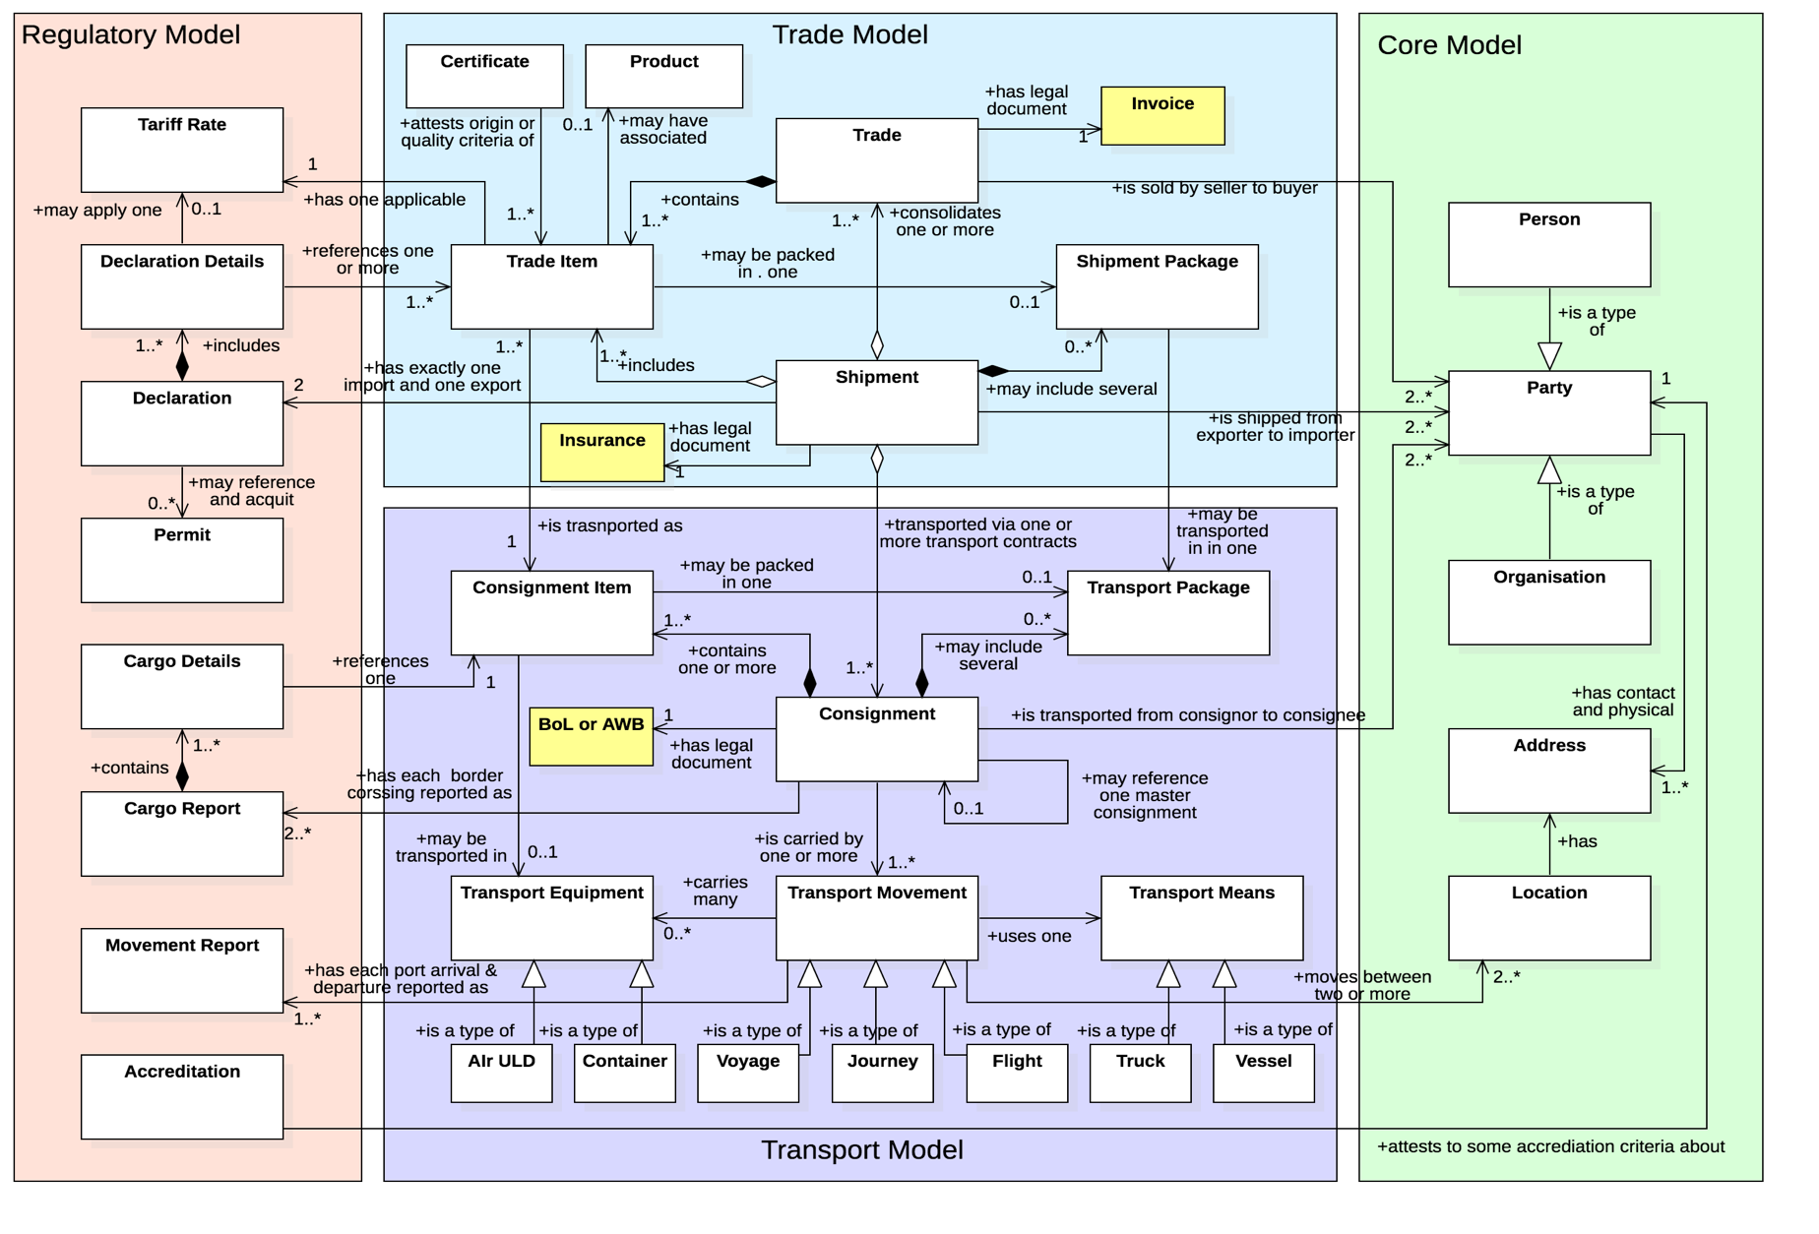
The API Town Plan Project – early draft
API Domains (suburbs)
API Resources (buildings)

Slide 10
Invitation – Join the effort!
RDM2API - A more technical stream – needs people with
a good knowledge of existing UN/CEFACT RDMs
a good understanding of RESTful API design
a good understanding of UML based data & state lifecycle modelling.
API Town Plan - A more business focussed stream – needs people with
Good business domain knowledge in Trade/Transport/Regulatory/Finance
Willingness to apply the RDM2API tools to their domain models and generate API / JSON-LD outputs.

Slide 11
Thanks for listening
Feel free to contact me
Steve.capell@gmail.com
edi3.org

