Slide 1
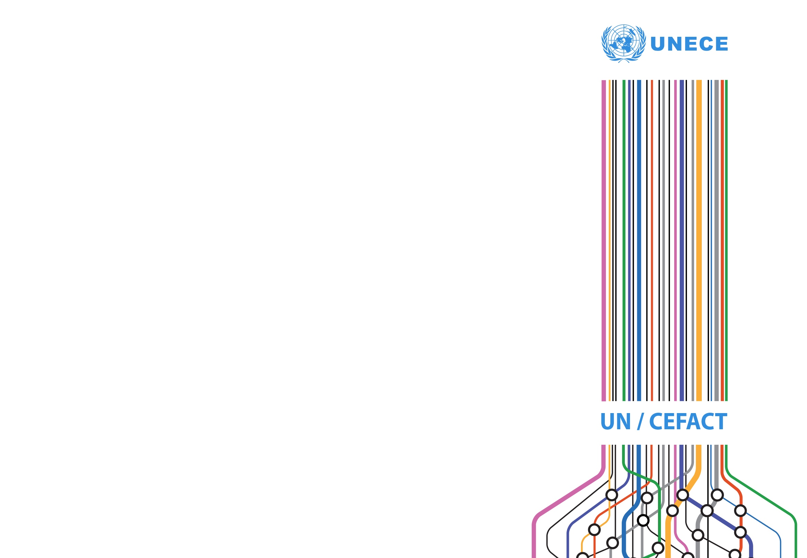
What is a Web API?
A primer for non-technical people
Steve Capell
steve.capell@gmail.com

Slide 2
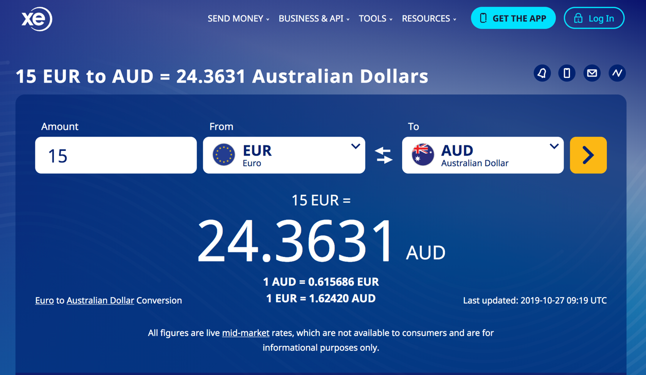
Here’s a pretty website
Types www.xe.com
Enters amount
Chooses From/to currency
Hits go
Pretty familiar experience. It’s obvious what it does.

Slide 3
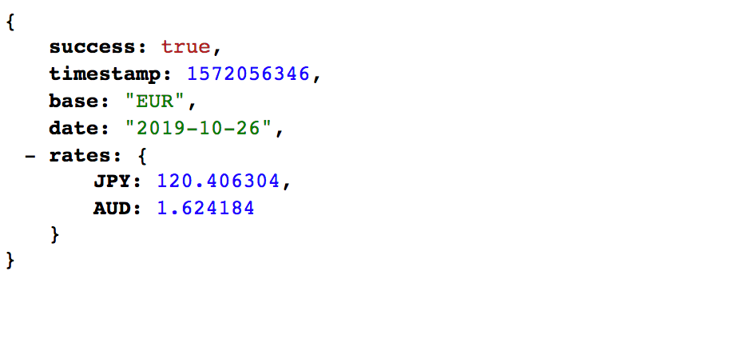
Here’s a similar thing with just the data
Types:
http://data.fixer.io/api/latest?access_key=89aae4bb97079f6e159730ad3f000538&base=EUR&symbols=JPY,AUD
It’s doing the same job. It’s not as pretty for humans but it’s excellent for machines.
This is a web API. API means “Application Programming Interface”. Web means the protocol is “just use the web”. More on that later.

Slide 4
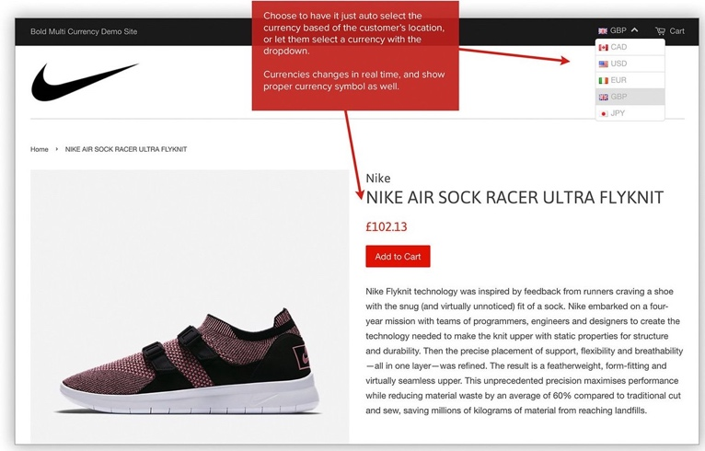
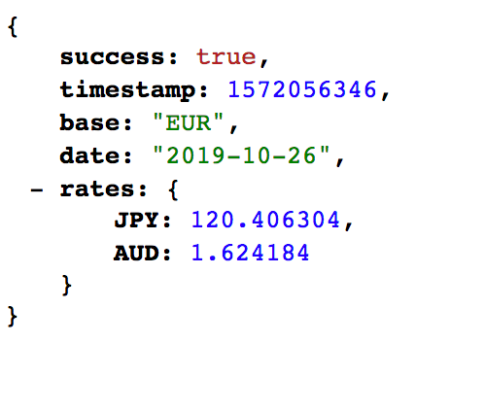
That’s really cool because you can do this
Types www.shoes.com
The online shop application doesn’t have to maintain a database of exchange rates and update them daily. It just calls a web API to do that.

Slide 5
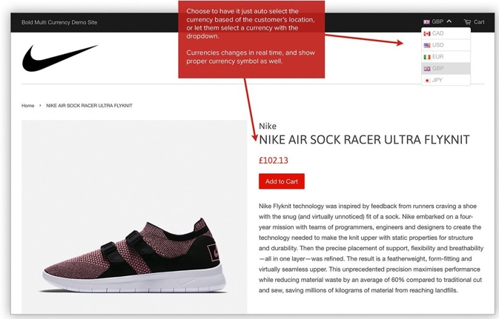
In fact, most websites do this
APIs
facebook.com/oauth
login
currencies
api.fixer.io
pay
api.stripe.com
show map
Types www.shoes.com
maps.googleapis.com
APIs are the building blocks of every modern website.

Slide 6
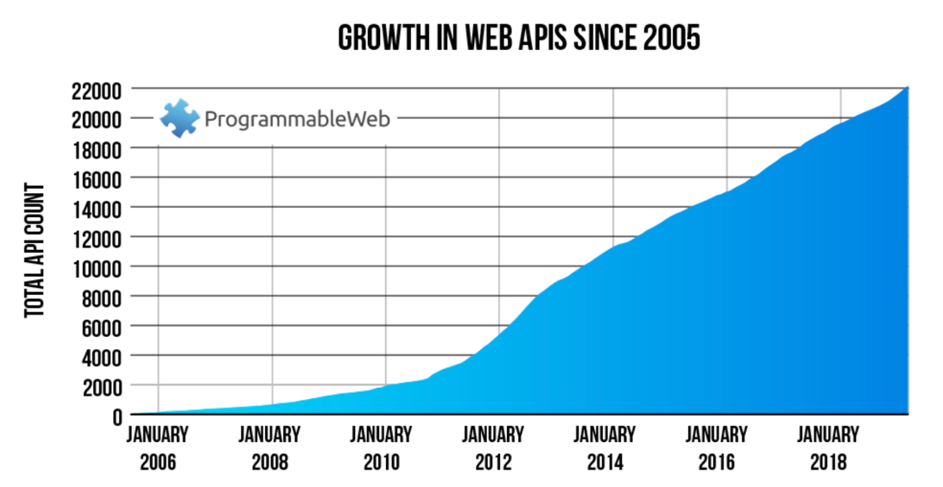
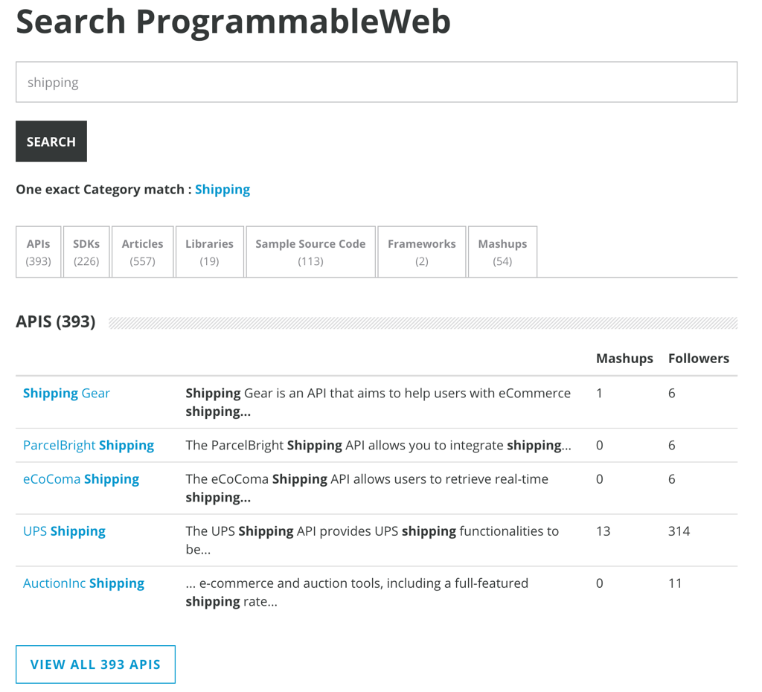
And there’s thousands of cool APIs
And many many more that aren’t listed here.

Slide 7
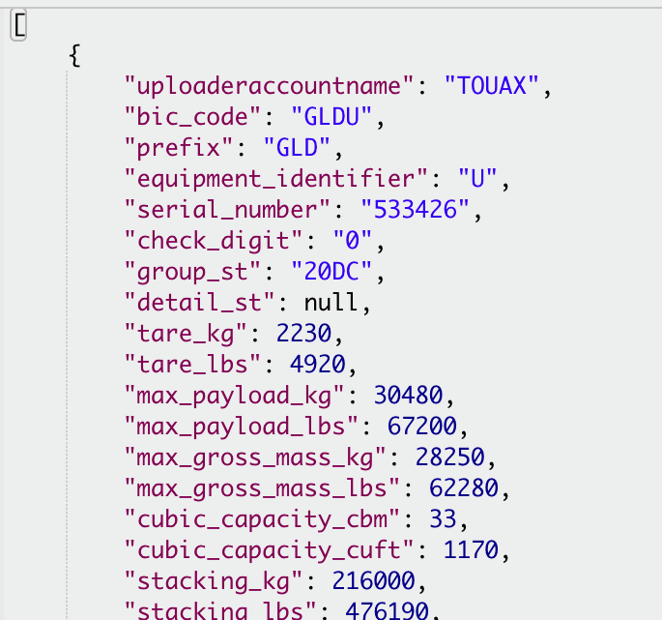
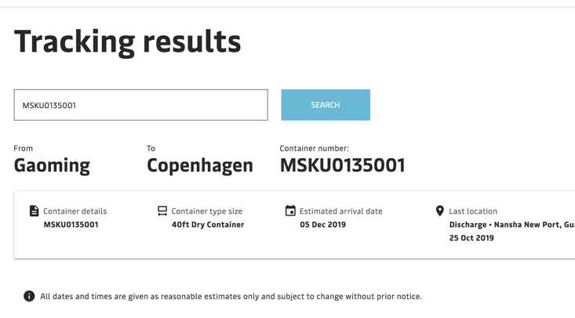
And here’s a nice API from closer to home
Tracker site
Types www.tracker.com
As a carrier, or a port authority, or a regulator – just tell me the container number and I’ll go to the source of truth to get details.

Slide 8
Lets do some “Imagineering”
Here’s a consignment resource
https://api.3plcompany.com/consignments/12345
abr.gov.au/businesses/99887
business
consignor
companies.gov.uk/businesses/22349
company
consignee
consignment
xero.com/invoices/554432
shipment
invoice
boxtech.com/containers/MSK33456
transport_equipment
container
sensor
Max_temperature
transport_movement
IoTsensors.com/sensors/22334/temp
voyage
transport_means
vessel
carrier.com/voyages/D123S
imo.com/vessels/99862
Its really a set of links to sources of truth. A paradigm shift from document exchange to linked data discovery. This is a different business model, not just a different technology

Slide 9
And lets clear up some terminology
REST = “Representational State Transfer”. A mouthful – but it just means a best-practice style for building high quality web APIs
REST Resource
Microservice
http Verbs
Events
Transport Domain
Voyage
GET
Created
GET
Lodged
POST
Event Hub
API Gateway
PUT
Cleared
Data
PATCH
Held
DELETE
Lifecycle
POST https://api.transport.border.gov.au/v1/voyages/{new voyage_data}
PATCH https://api.transport.border.gov.au/v1/voyages/V1234S/{updated voyage_data}
GET https://api.transport.border.gov.au/v1/voyages?Port=AUBNE

Slide 10
But what about security?
As an API consumer that is following links to a distributed web of resources, how do I identify myself to each one and how does the API provider decide whether to grant access?
Here’s a consignment resource
https://api.3plcompany.com/consignments/12345
business
abr.gov.au/businesses/99887
consignor
companies.gov.uk/businesses/22349
These are all different web resources
company
consignment
consignee
xero.com/invoices/554432
shipment
invoice
boxtech.com/containers/MSK33456
transport_equipment
container
Max_temperature
sensor
transport_movement
IoTsensors.com/sensors/22334/temp
voyage
transport_means
vessel
carrier.com/voyages/D123S
imo.com/vessels/99862
It wont scale well if every provider needs to register, verify identity, and issue tokens to every consumer.

Slide 11
Federated Identity using OIDC
Fortunately the web has already solved this problem by separating the job of verifying identity from the job of providing a service. The standard protocol is called “Open ID Connect” (OIDC) but you all probably know it as “sign-in with FaceBook / Google / etc”. It works just as well for web APIs that return data as for websites that return pages.
Get token
API consumer
Identity Provider
Present token
verify token
API provider
“Relying Party”
Tokens carry “claims”
Google knows this user as steve.capell@gmail.com
Convenient for users but not much identity integrity.

Slide 12
Remaining challenges
Semantics
how to make consistent sense of the data in all these APIs?
stay tuned for the presentation on UN/CEFACT API Town Plan and RDM2API
Identity Assurance
How to increase the integrity of identity claims so that providers can trust them?
stay tuned for the presentation on regulator APIs

Slide 13
Thanks for listening
Feel free to contact me
Steve.capell@gmail.com
edi3.org

