Slide 1


Slide 2

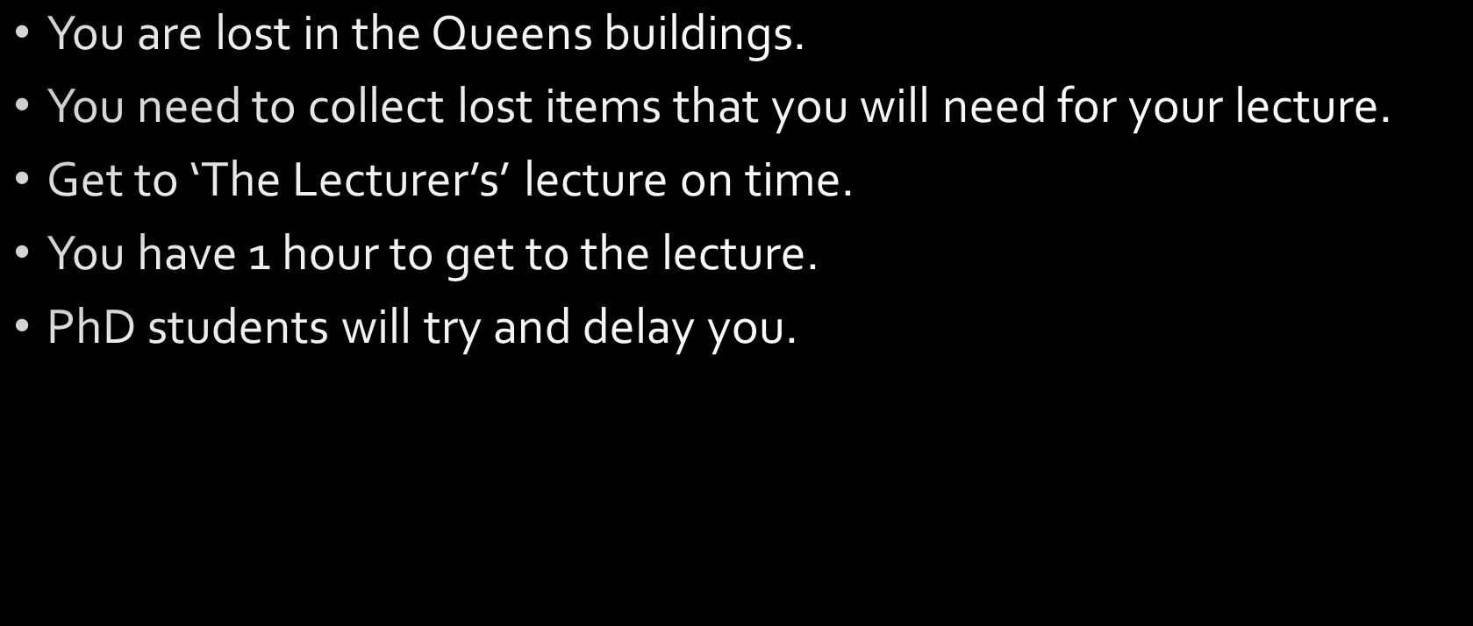

Slide 3

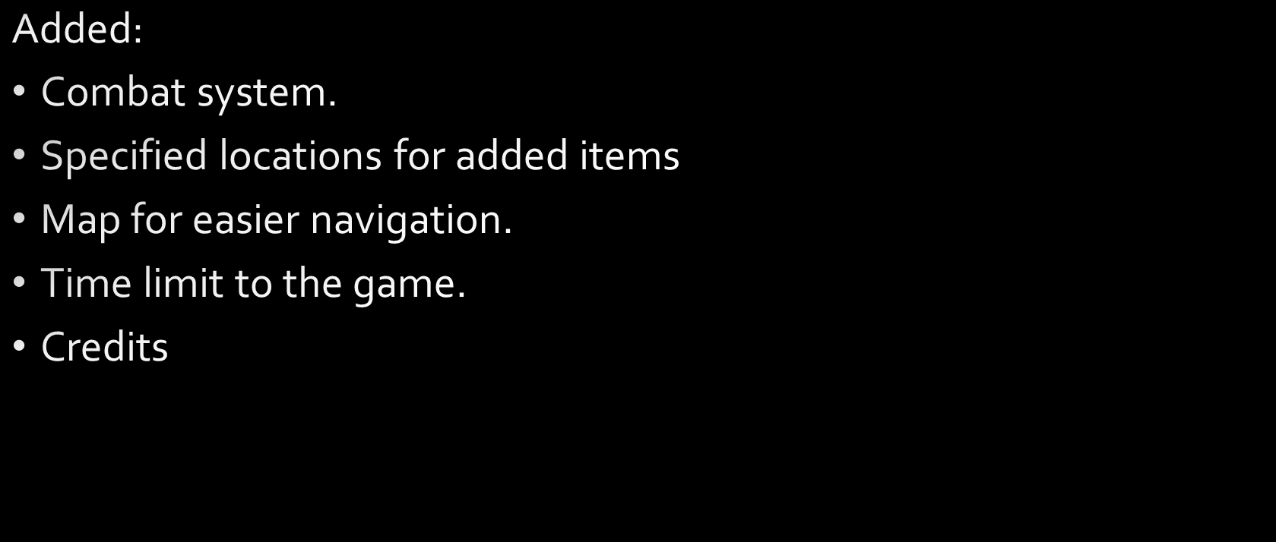
Notes:
Combat: ‘Enemies’ attack the player to delay them, player must use attacks to lower enemy health, enemy attacks player to lower their health.
Map: Uses pygame to display an image whilst the item ‘map’ is in the players inventory dictionary
Time Limit: Every move increases a counting variable, when the counter reaches the 1 hour mark you can no longer pick up items and are instrucrted to get to your lecture.
Credits: Small function to run on game completion.

Slide 4

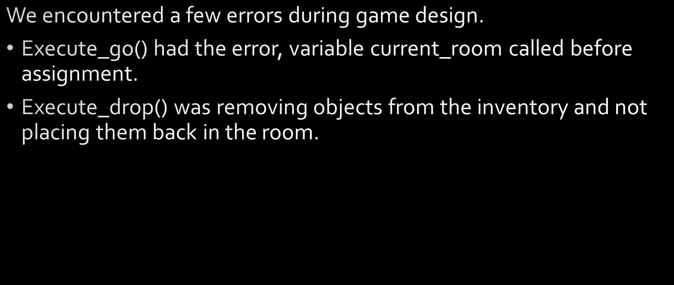
Notes:
Presenter will explain how we fixed said problems.
Execute_go() was fixed by calling the global variable current_room instead of the local variable.
Execute_drop() was fixed by using the append() function to add the dropped item to the rooms item dictionary

Slide 5

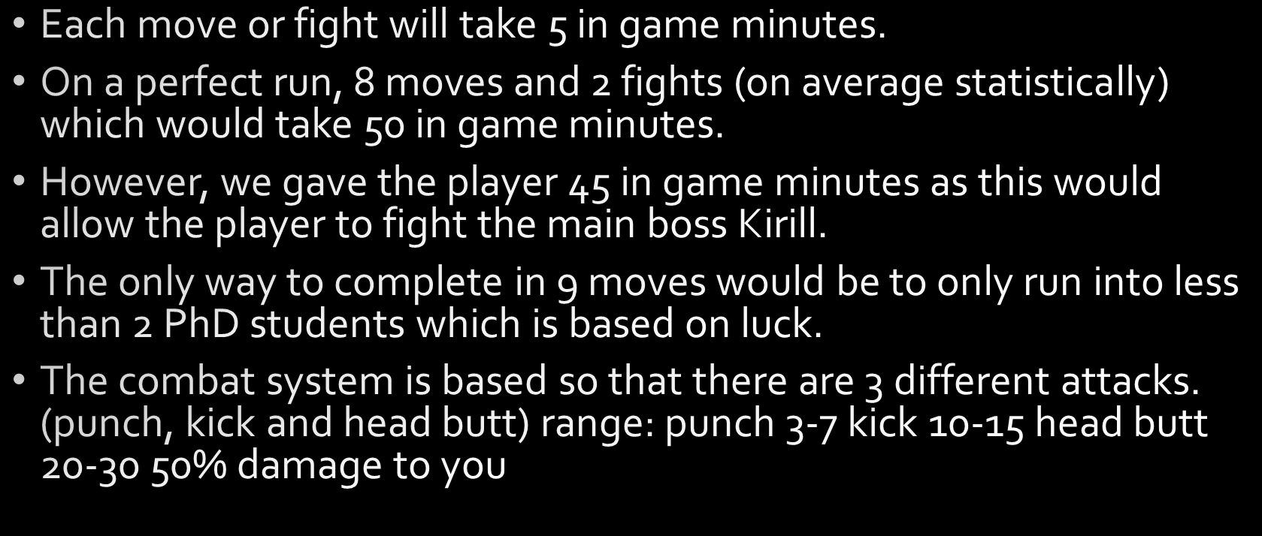

Slide 6


Slide 7
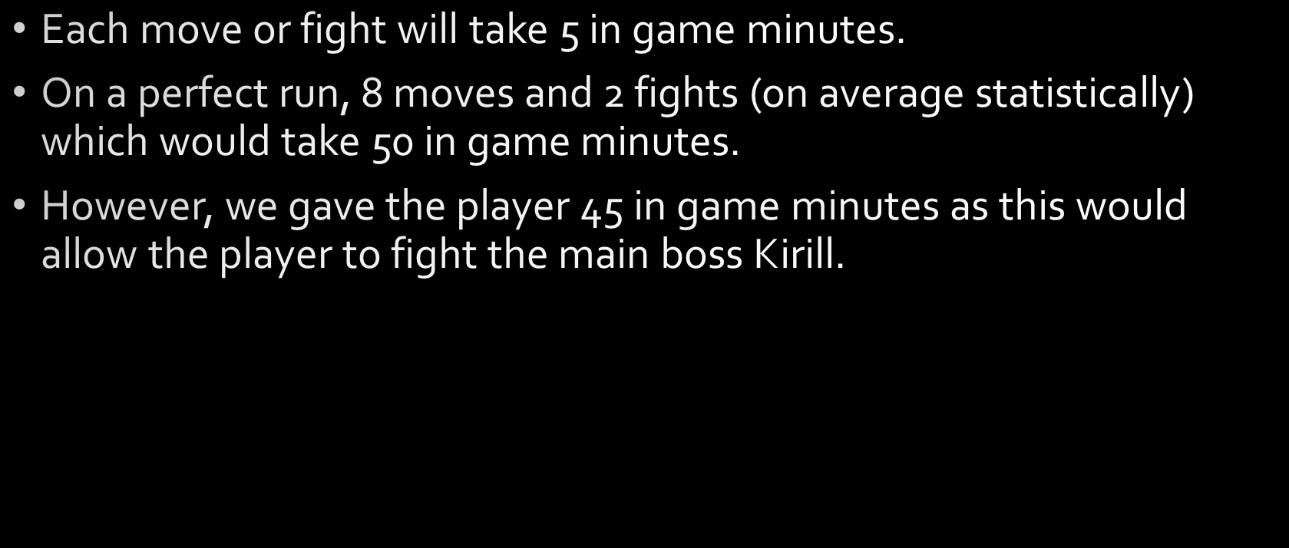

Slide 8

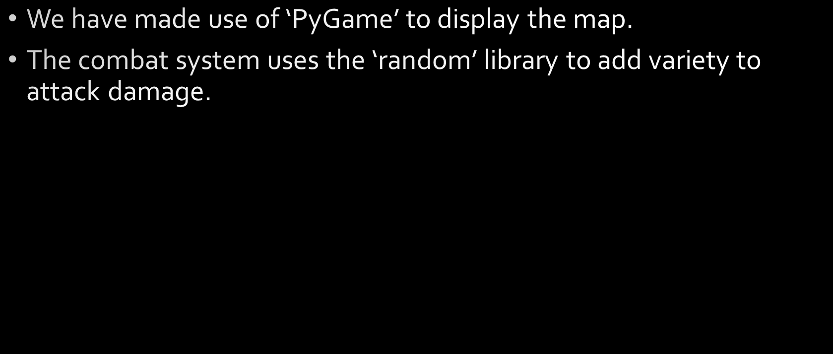
Notes:
Explain why we choose pygame, namely issue with Pillow meaning the program wouldn’t continue without closing the map.

Slide 9



Slide 10


