Slide 1
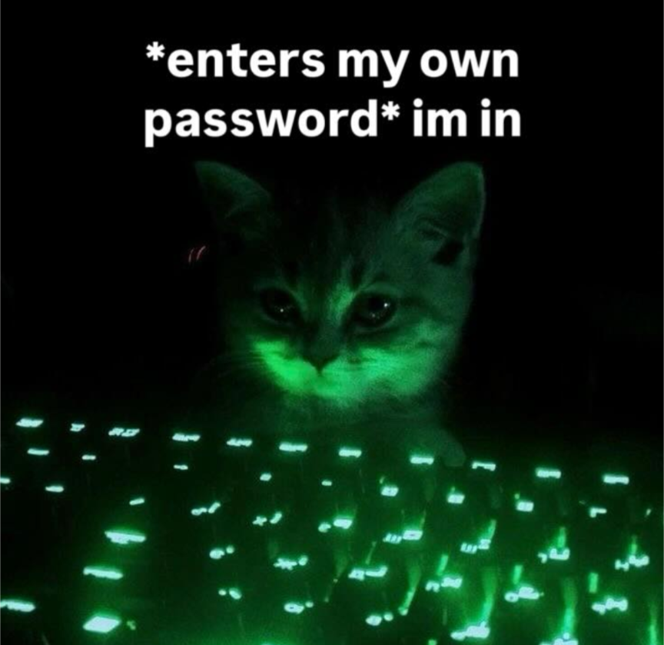
Git & Terminal Commands
Ian Collins

Slide 2

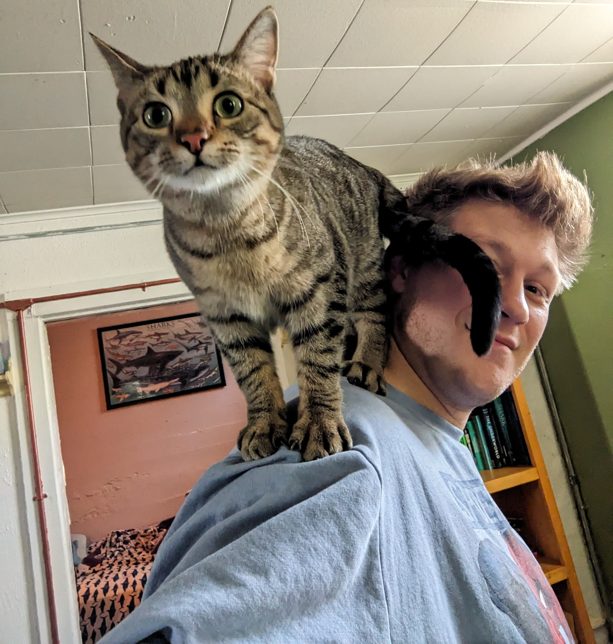

Who am I?
Born in Springfield, MO. Grew up in Wichita, KS.
First, I wanted to be Spider-Man
Became interested in computing during COVID
Undergrad in Applied Computing and Biology from the University of Kansas in Lawrence, KS
Currently, apart of the F&F lab doing my thesis with Dr. Jonathan Smart

Slide 3
Important Vocabulary
Hardware — Components in your computer which uses electricity and transistors to do math i.e. we taught rocks to think, and we have to deal with the consequences
Software — Prewritten list of instructions which tells the computer hardware what to do and how (.exe, .iso, .sys)
Operating System — A software that is a Graphical User Interface (GUI) between you and your computer. Tells the hardware to complete the tasks you give it
Directory — Folder on your computer. Everything in your computer including your OS is in a directory
File — Formatted data which can be read, written to, and deleted (.txt, .csv, .docx, .odp)

Slide 4
What is the Terminal?
Most direct interaction with your computer’s hardware
90% of commands used navigates directories; makes, edits, deletes, and finds files; and runs programs
Every OS has a terminal which can perform these tasks
Terminals can be run as administrator or “super user” to perform tasks like installing software, changing permissions on a file, or edit system files
Most intimidating part of computers is the terminal, not the hardest to learn

Slide 5
Basic Commands
Command | Description | Notes
cd <path> | Change dir | ‘cd’ returns to home dir; ‘cd ..’ moves back one dir
mkdir <name> | Make dir | Paths can be included ex. ‘mkdir Docs/NewDir’
pwd | Print working dir | Can be piped ‘|’ into other commands
ls | List files/dirs | ‘ls -r’ lists items in subdirectories; ‘ls -l’ lists permissions of each files
mv <src> <dest> | Move files/dirs | Multiple files can be moved to dest. Renaming files uses ‘mv old_name new_name’
rm | Remove files/dirs | ‘rm -r’ deletes directory and files within
cp <src> <dest> | Copy files/dirs | ‘cp file1 file2 … /dest/path’ copies multiples files
chmod <perm> <file> | Change permissions | Octal numbers can be used. Read=4, write=2, exe=1. ‘chmod 777 file’ grants all perms to all groups
man <func> | Manual | Every function comes with an instructions manual

Slide 6


Using git & GitHub
Git is a version control tool which creates and saves a history of the changes
  The changes can be reverted back to a later point
  A version can be duplicated and worked on independantly. Versions from a parallel ‘branch’ can be merged back into the main branch.
GitHub is an online database of git repositories
  This allows multiple people to work on the same projects remotely
  ‘Repos’ can be cloned to one’s device for use of the scripts or editting to commit the changes to the repo on GitHub
  Unless you are the owner, changes will need to be approved in ‘pull requests’ usually from another branch

Slide 7
git Commands
Command - git | Description | Notes
init | Initialize repo | Creates a repo locally
remote add <remote> <url> | Link repo to GitHub | Create GitHub repo before linking. <remote> is typically named origin
add <file(s)> | Adds changes | ‘git add .’ adds all changes in current directory
commit -m “message” | Commits changes | Message should describe the changes or work to be done next “TODO: fix the bugs pls”
push -u <remote> <branch> | Syncs GitHub w/ repo | Branches must exist before pushing. By default, the branch is ‘main’
pull <remote> <branch> | Syncs repo w/ GitHub | Combination of ‘fetch’ and ‘merge’. May cause issues if local repo is out of sync with GitHub
status | Lists adds and commits | Useful tool to check what changes have been committed before pushing to GitHub

Slide 8
Troubleshooting git
Creating Tokens:
  On GitHub, click on your profile and select ‘Settings’ from the drop down
  At the bottom of the tabs on the left side, select ‘Developer Settings’
  Once there, select ‘Personal access tokens’ & select ‘Tokens (classic)’
  Hit the generate new tokens tab and add a title and description of the token you would like to create. NOTE: Recommended to create tokens that expire
  Save this token somewhere outside of the repo or on a seperate drive like a flash drive possibly with password protection
  Tokens are your passwords to sync your local repo with GitHub. Keep it safe!

Slide 9
R Projects and git repos
R Projects are GUIs within Rstudio that makes and handles changes to repos
Create R Project by clicking the tab in the top right corner either in new directory or in an existing folder
A Git tab will appear in the environment window where changes can be added and committed
Adding the remote and branch will still need to be done in the terminal
The git window has options to push and pull from the linked GitHub repo
NOTE: Some settings may need to be adjusted within ‘Tools>Project Options>Git/SVN>Set remote’

Slide 10
Open Source: A Philosophy
Open Source software is a type of development of tools that allows for all of the ‘source code’ is available to be read, use, reuse, study, and contribute to by anyone given the guidelines of the project
“The everything is built upon open source software”
  Linux, GNU, VLC, OBS, LibreOffice, Audacity, R, Python, CRAN, TypeScript
Science is collaborative and replicatable
Open Source and git go hand in hand
If you want to use AI, building good habitats in software development will prevent many of the pitfalls inherit in script generation from LLMs like ChatGPT & Claude

Slide 11
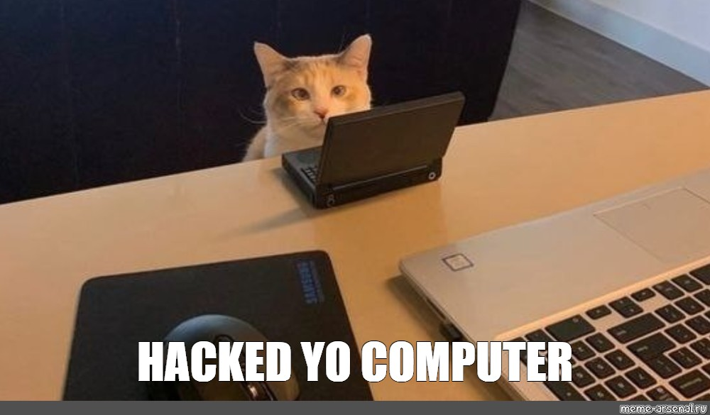
Thank you!
Questions & Tech Support

