Slide 1

MPhys Project Week 4
Ian & Aathavan

Slide 2
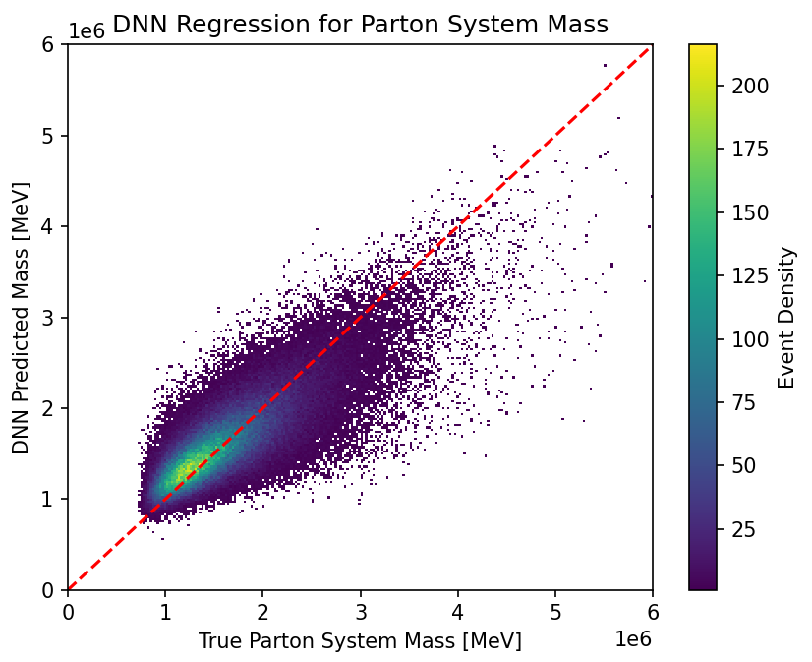
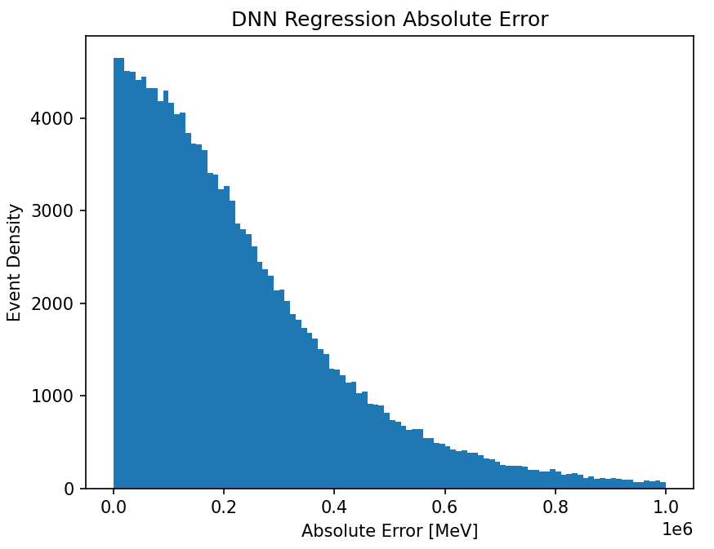
4-Top Invariant Mass DNN
RMS Error =
0.33 TeV
Loss: 0.3577
Figure 1: 2D Histogram of DNN Predicted Mass against the True Parton Mass
Figure 2: 1D histogram of the absolute error between the data and the model

Slide 3
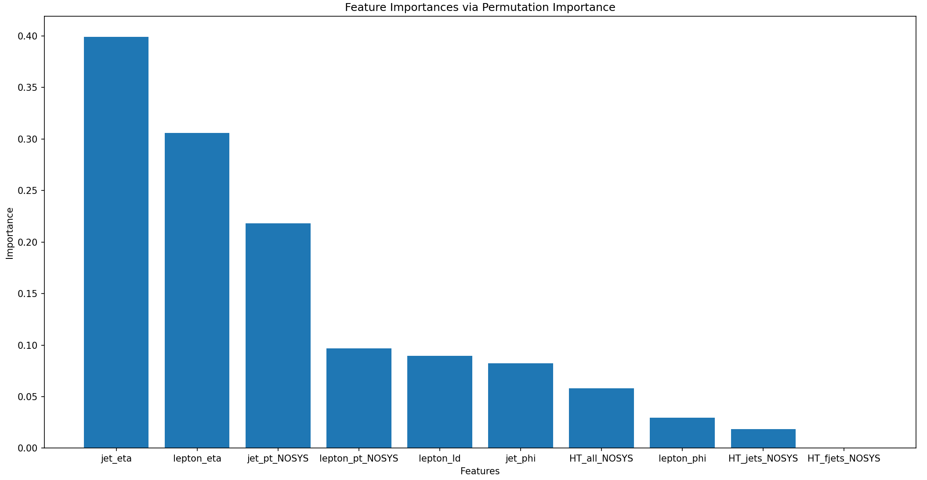
4-Top Invariant Mass DNN
Figure 3: Bar chart of relative importances of different variables used (Note that the two etas are actually cosine values)
Questions
Need a bit of help with using the CSF

