Slide 1

MPhys Project Week 5
Ian & Aathavan

Slide 2
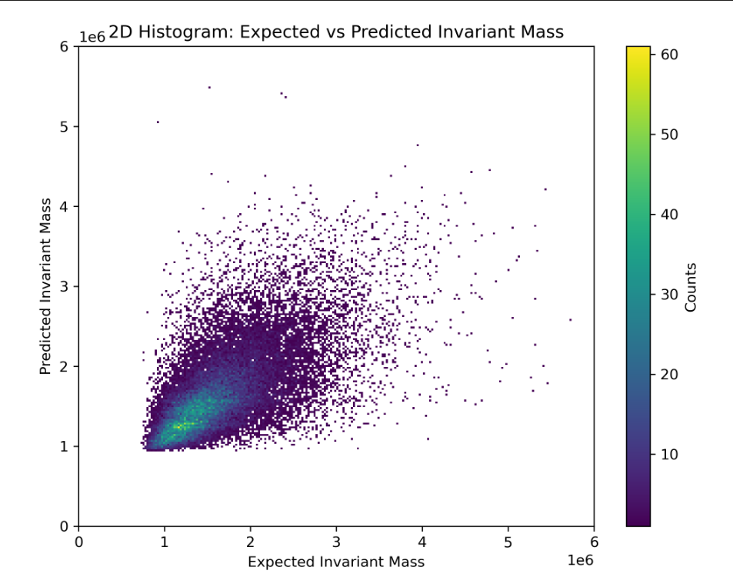
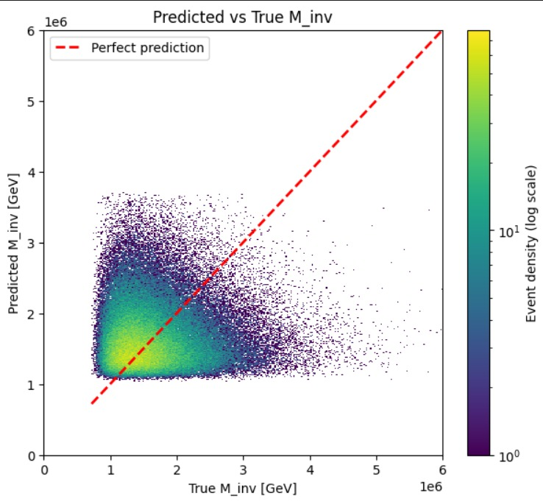
4-Top Invariant Mass Transformer
We’re both noticing that there’s what appears to be a very clear cut off, greater than that of the DNN, and are trying to work out what’s causing it (was a ReLU in the DNN but we don’t have one here)
Figure 1: 2D Histogram of Transformer Predicted Mass against the True Parton Mass (Ian’s model after 100 epochs)
Figure 2: 2D Histogram of Transformer Predicted Mass against the True Parton Mass (Aathavan’s model after 3 epochs)

