Slide 1

MPhys Project Week 2
Ian & Aathavan

Slide 2
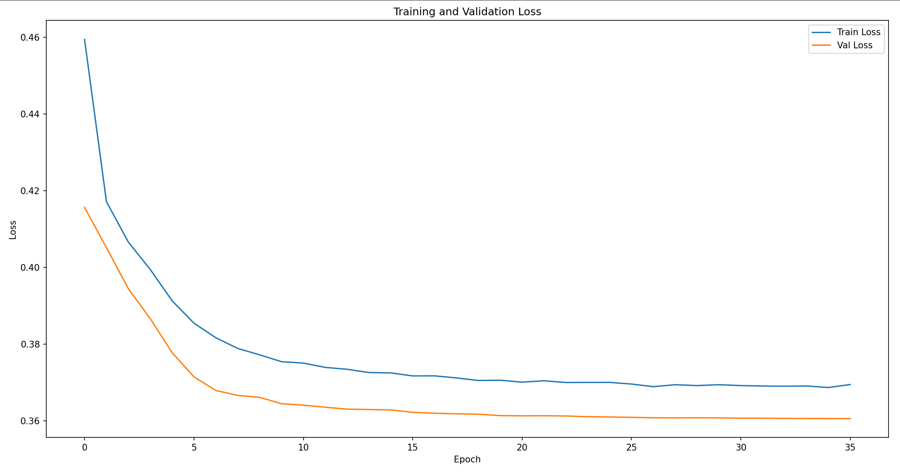
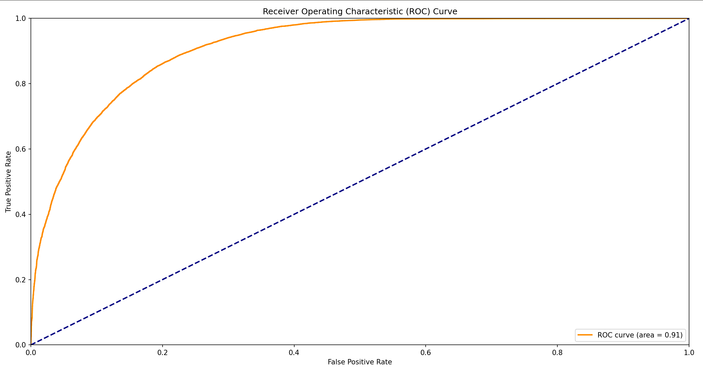
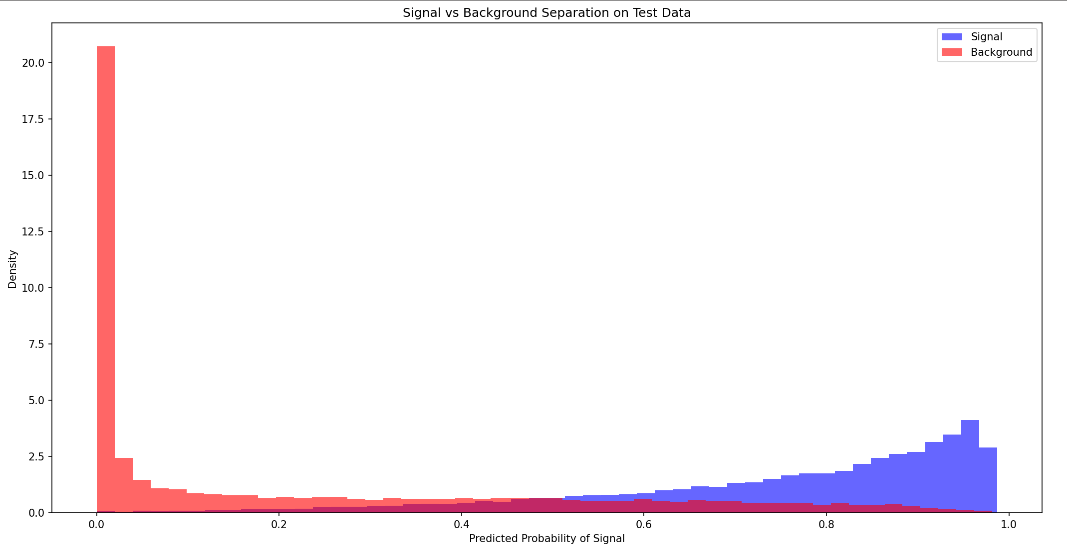
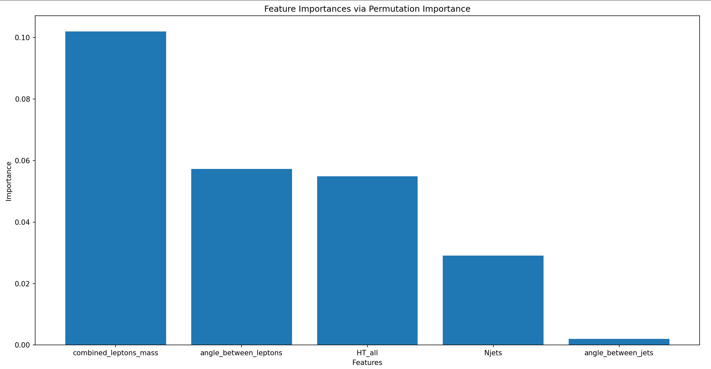
DNN4HEP
Figure 1: Training & Validation Loss
Figure 3: ROC Curve
Figure 2: Signal vs Background
Figure 4: Feature importance curve

