Slide 1

Complexity in Convolutional Neural Networks
Image classification using Python and TensorFlow
Packages include
  Keras
  Matplotlib
  sklearn
PRESENTED BY:
Ian Daugherty
Galvanize, October DSI
Creative Commons licenses are good.

Slide 2
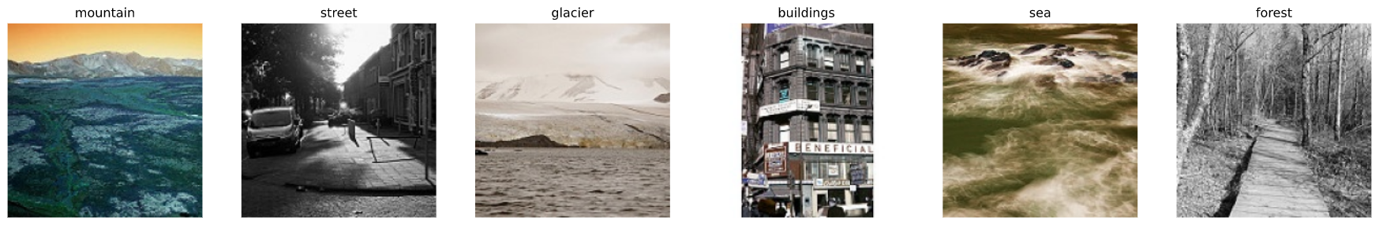
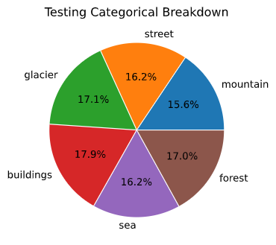
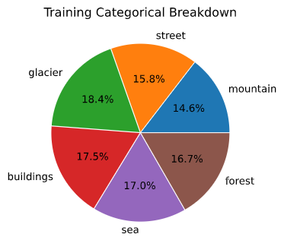
Intel Image Dataset
21,000 environment images
14,034 training images
3000 testing images
7000 non-labeled
-resized to 150x150
-rescaled for normalization

Slide 3
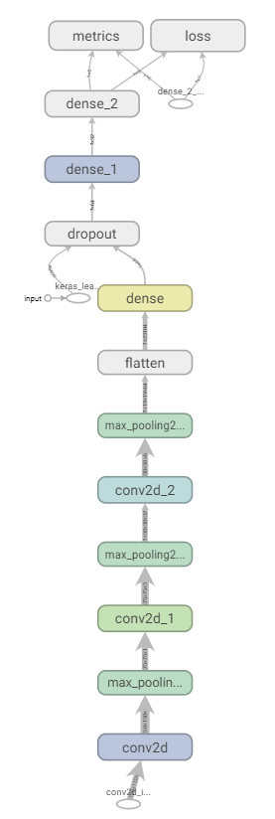
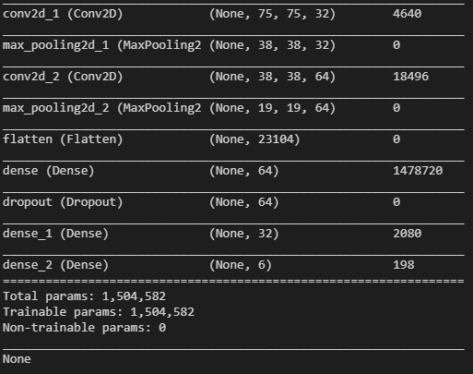
TensorFlow and Keras
Initial exploration
Simple models exploring differing effects
  Activation function
  Loss
  Optimizers
  Initializations
Iterated through a model, changing one parameter at a time
  To many variables to try
  Concentrated on complexity

Slide 4
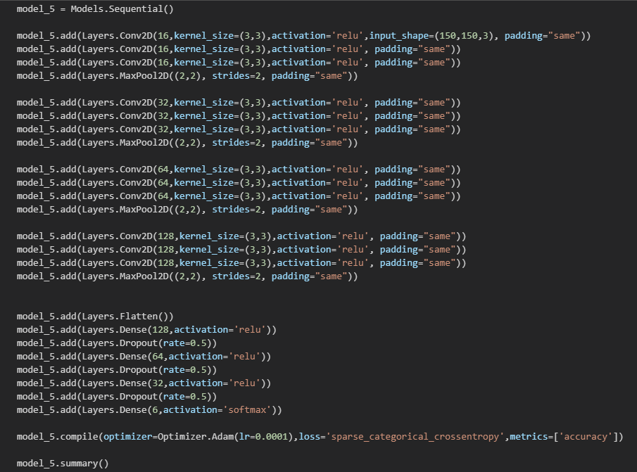
Expanding complexity
Model depth and Layer size
  Changing trainable parameters through number of filters and layers
  Systematically increased complexity
    New dense and dropout layers when new number of filters is added
    Kept total options to a minimum
      Activation
      Loss
      Optimizer

Slide 5
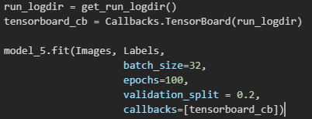
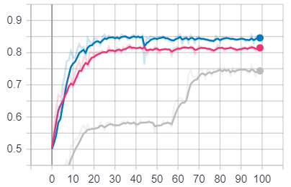
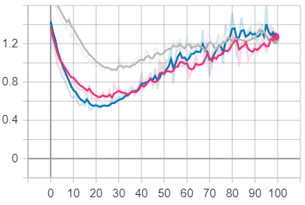
Training results with Tensorboard
Validation accuracy
4x3 2.1mil param
4 groupings of 2 Conv2D
128 max filters/nodes
val_loss:1.8;val_acc:0.84
3x3 1.6mil param
3 groupings of 2 Conv2D
64 max filters/nodes
val_loss:1.34;val_acc:0.82
4x2 1.9mil param
4 grouping of 2 Conv2D
128 max filters/nodes
val_loss:1.23;val_acc:0.75
Models run holding
-Batchsize =32
-Epochs = 100
-Learning rate = 0.0001
Tensorboard used for creating logs, visualizing training, and network maps
Validation loss

Slide 6
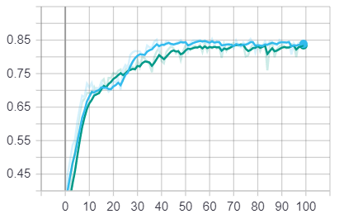
Another layer
5x2 2.8mil param
5 grouping of 2 Conv2D
256 max filters/nodes
val_loss:1.44;val_acc:0..83
5x3 3.6mil param
5 groupings of 2 Conv2D
256 max filters/nodes
val_loss:0.61;val_acc:0.81
Validation accuracy
Training tending to take longer with larger models
-Still gaining accuracy going 50 epochs
-over accuracy is relatively similar
-validation loss curiously low on larger network

Slide 7
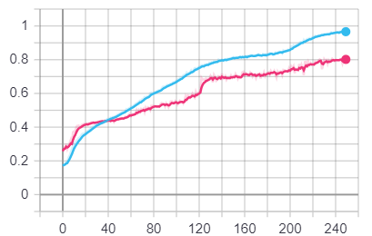
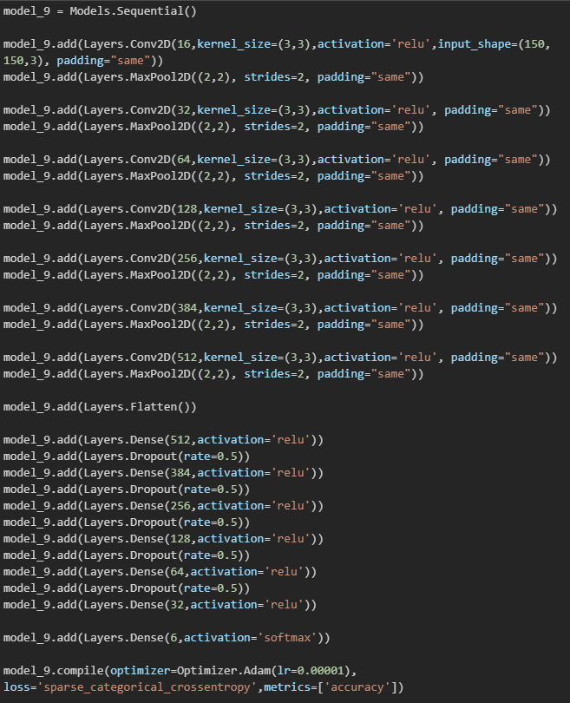
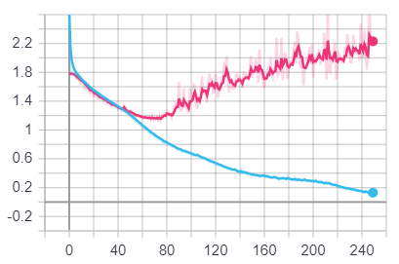
More complexity
Train vs Testing Accuracy
Adding a few parameters required more time to train, without giving any measurable benefit
At what level of complexity do we start to see gains?
Is it worth it?
7x1 4.4mil param
7groupings of 1 Conv2D
512 max filters/nodes
val_loss:2.16;val_acc:0.80
250 epochs and its not enough
Decreased learning rate
Would it have done better?
Train vs Testing Loss

Slide 8
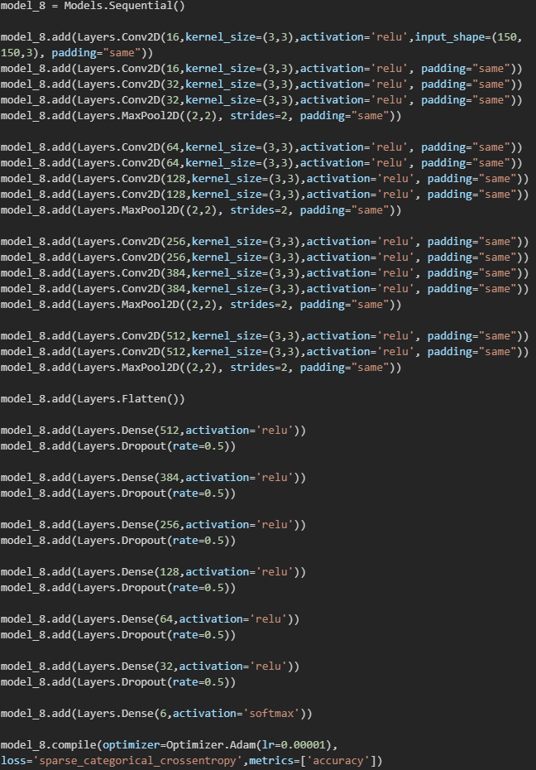
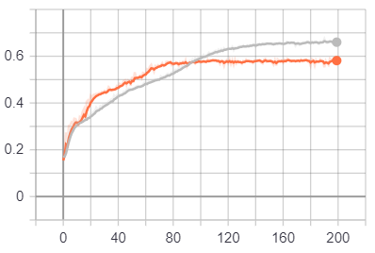
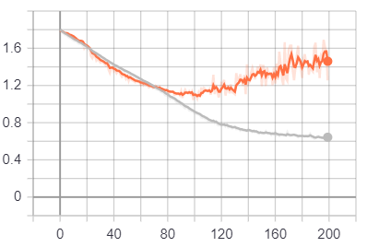
Further increase
Train vs Testing Accuracy
14 layers 34mil param
4groupings of various Conv2D
512 max filters/nodes
Double and removed dropouts of 7x1
val_loss:1.25;val_acc:0.57
200 epochs, but seems to have stopped
Error’d out multiple times loading
Had to used smaller batch size:16
Failed to save
Train vs Testing Loss

Slide 9
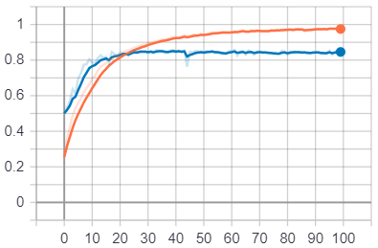

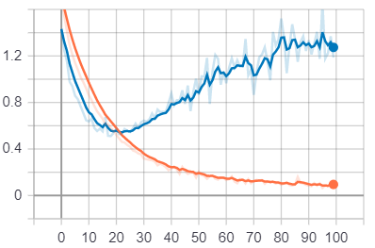

Overfitting and Loss
Train vs Testing Accuracy
No matter the size, overfitting is a potential problem
When left alone to train well past the optimum point
Early on, the model works better on testing than training
The longer we leave to train, the more progress we loose in trying to minimize our loss
  Does it matter?
Train vs Testing Loss

Slide 10
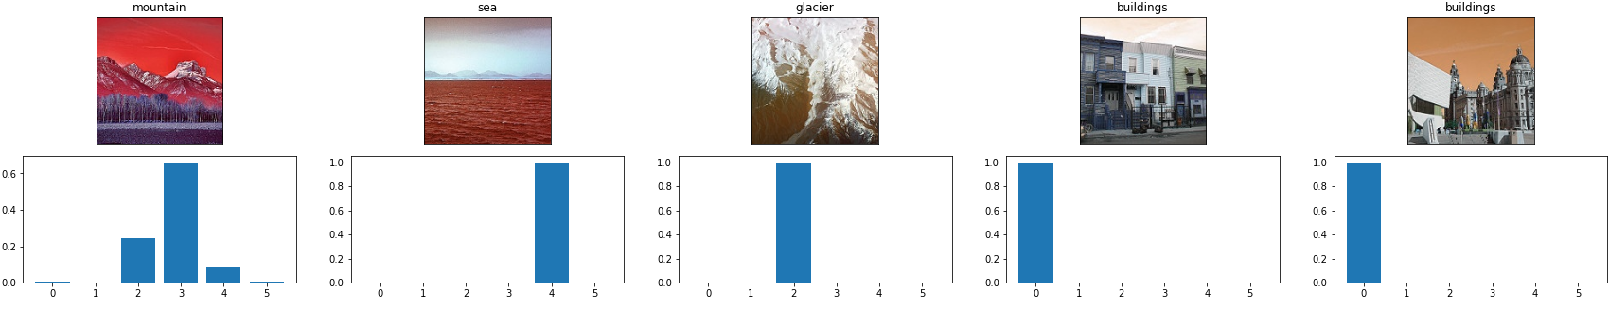
Thoughts and predictions
Reasonable accuracy can be achieved with modest training times in the order of magnitude that we can comfortably handle with personal equipment
Changing different parameters would likely give better results before increased size
Selu Dense, ImageDataGenerator, Initialization, learning rate
Lets look at what one of our models sees
0-Buildings
1-Forest
2-Glacier
3-Mountain
4-Sea
5-Street
Model 4 4x3 2.1Mil predictions

Slide 11
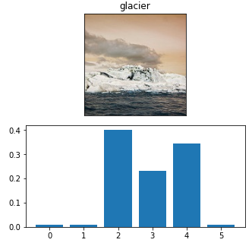
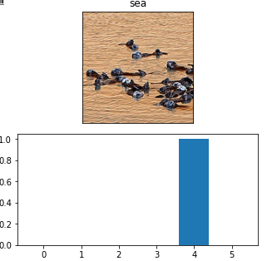
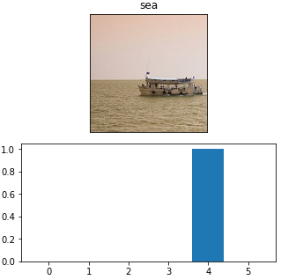
Troubles at Sea
When initially inspecting the ‘sea’ images, it was obvious that many pictures of water have some form of wild life or vehicle in them
Do we detect boats and animals as much as water?
Further exploration:Removing ‘sea’ and retraining
0-Buildings
1-Forest
2-Glacier
3-Mountain
4-Sea
5-Street
Some confusion is understandable

Slide 12
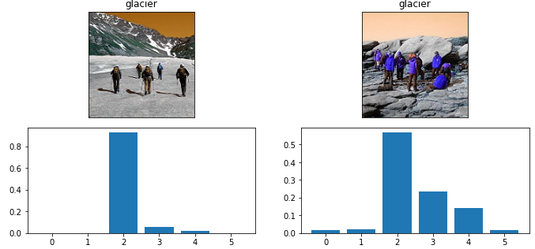
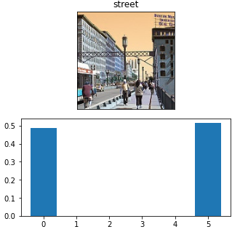
People on the street
It actually does surprisingly well on images that might give a human pause. Images of streets and buildings often contain one another
What about the people?
0-Buildings
1-Forest
2-Glacier
3-Mountain
4-Sea
5-Street
Telling a glacier from a mountain would be for most. The small likely hood of street on the right could be due to the persons, or the large amounts of grey

Slide 13
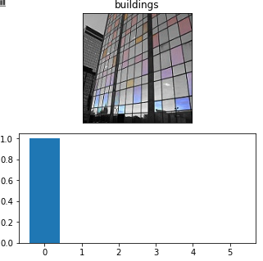
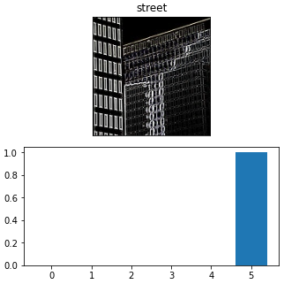
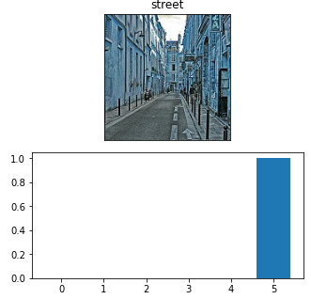
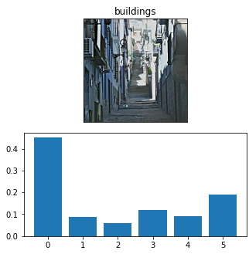
Confusion
Some images are understandably confused for other, while others make you wonder just what our data set is trained on in the first place.
0-Buildings
1-Forest
2-Glacier
3-Mountain
4-Sea
5-Street

Slide 14
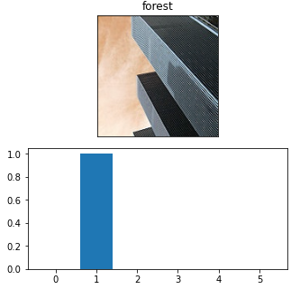
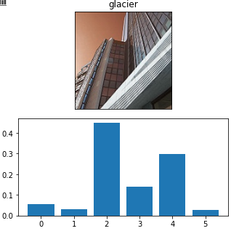
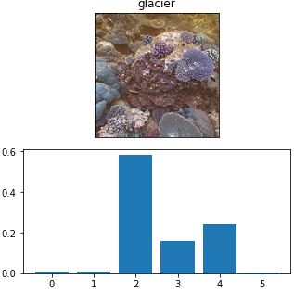
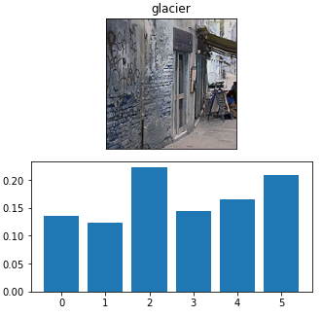
A ways to go
0-Buildings
1-Forest
2-Glacier
3-Mountain
4-Sea
5-Street
We can convince ourselves that there’s an order in the misinterpretation, but…

