Slide 1
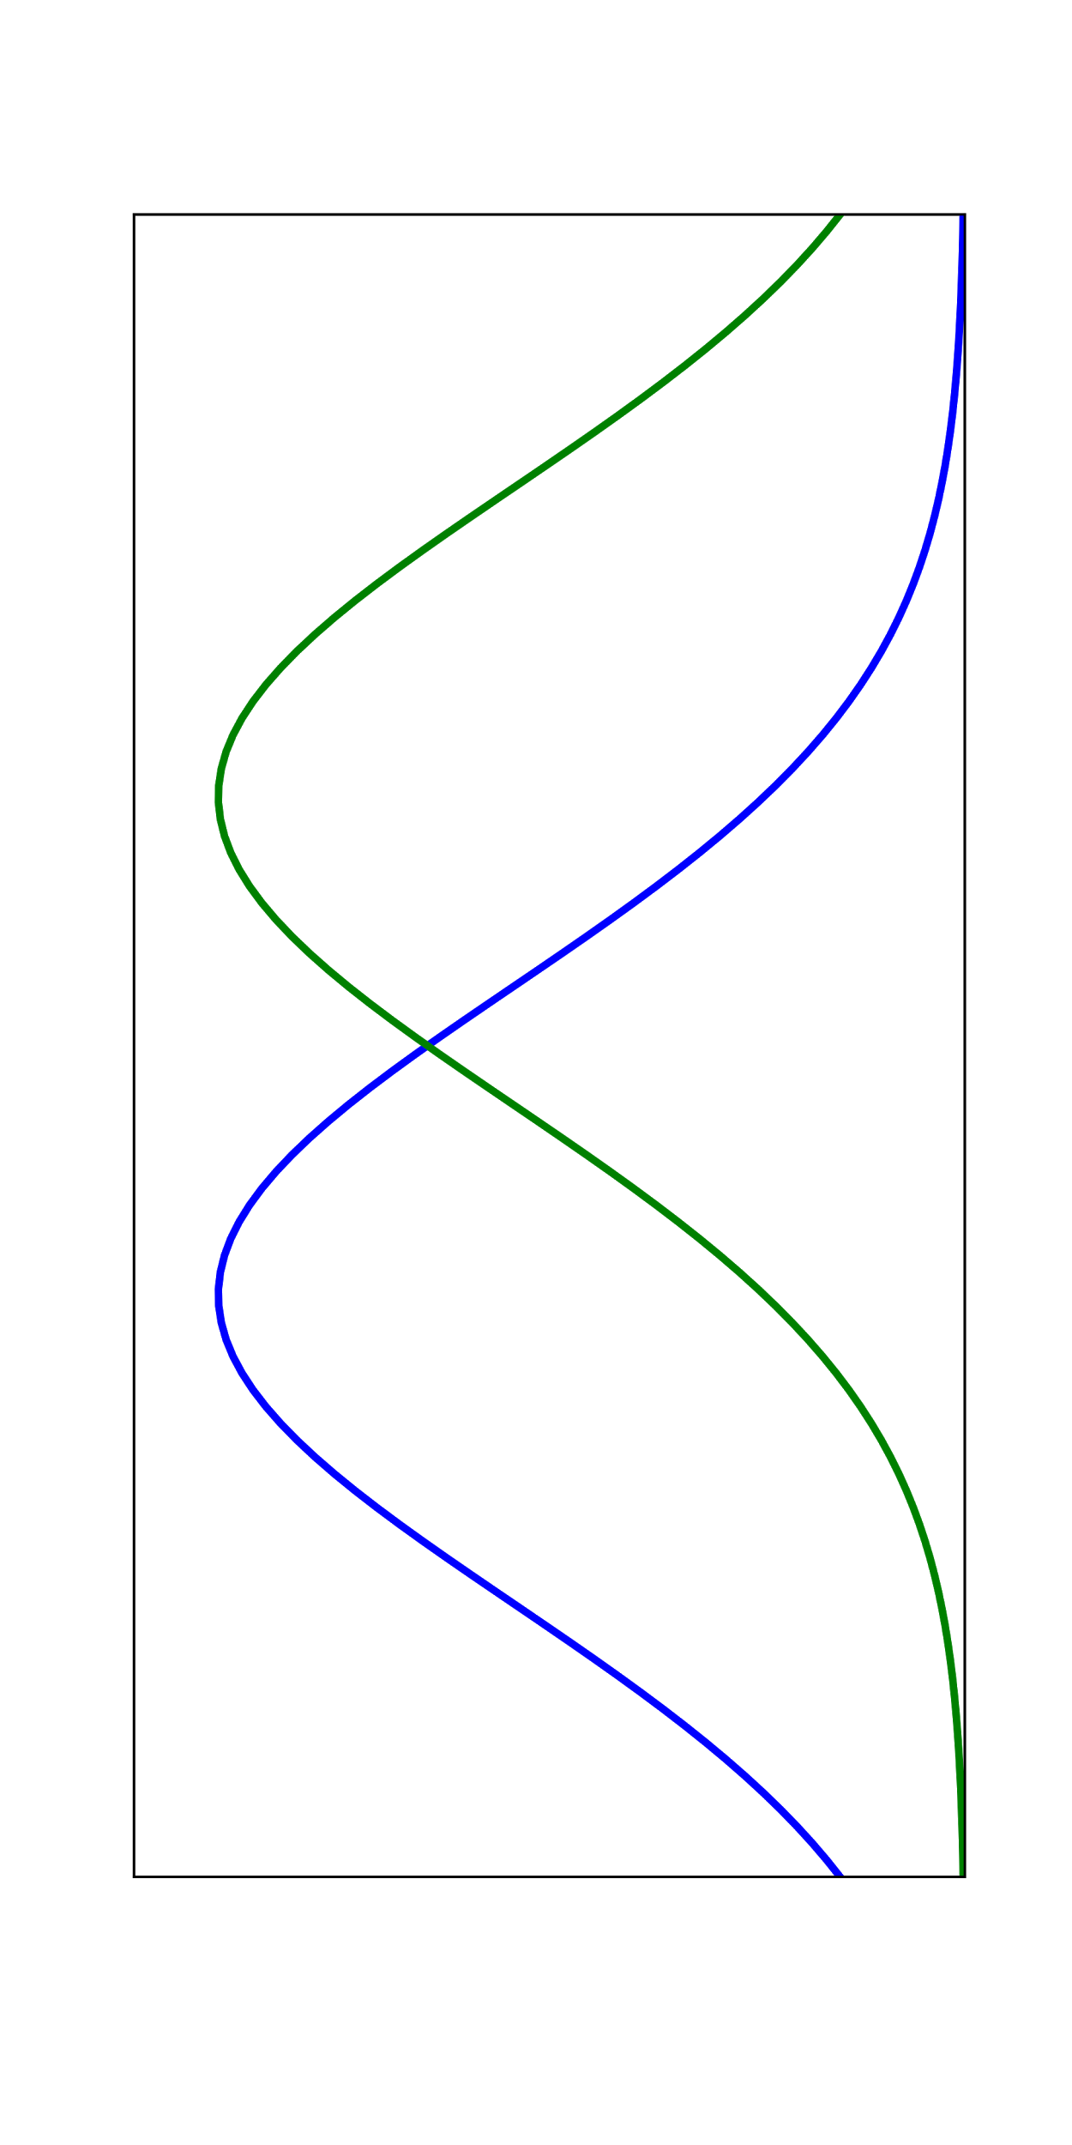
Training
Vertical Position
<1.5 s
.5 s
STS
Correct Response
Time
(trials)
Square Key
Stim
+1
3-3.5 s
STS
Response
Test
Red Key
Stim
<1.5 s
CTS
Visible
Hidden
Circle key
Stim
2-2.5 s

