Slide 1

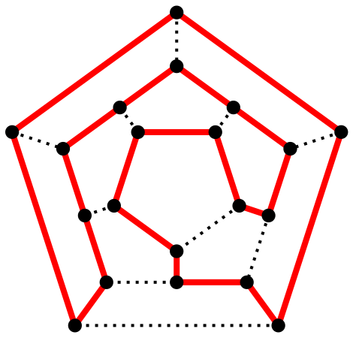
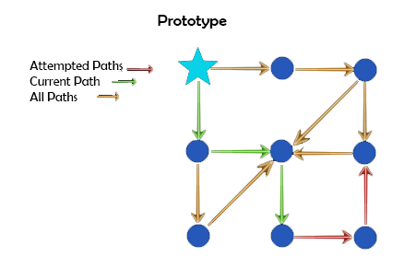

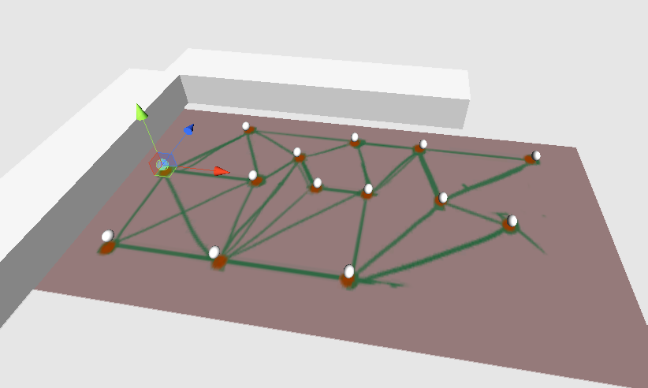
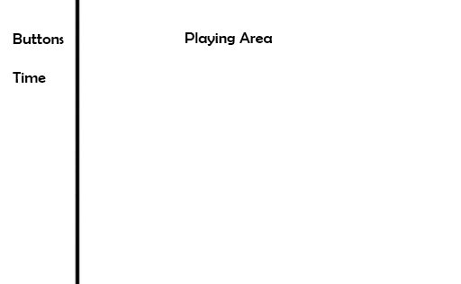
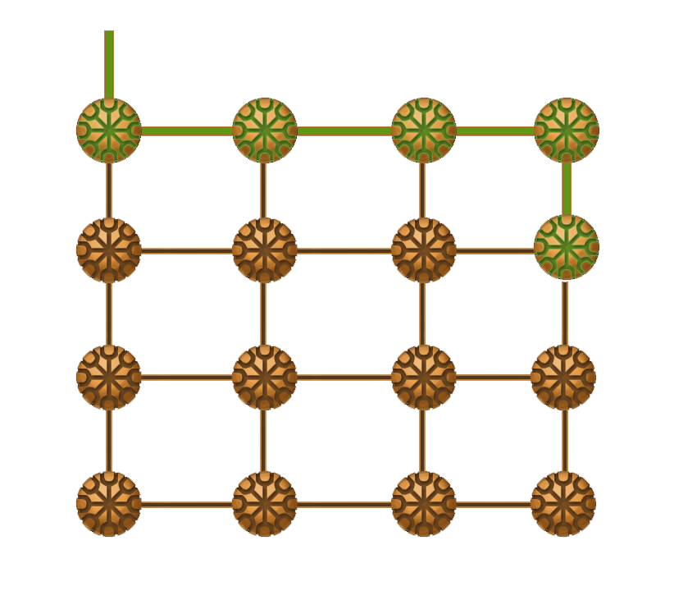
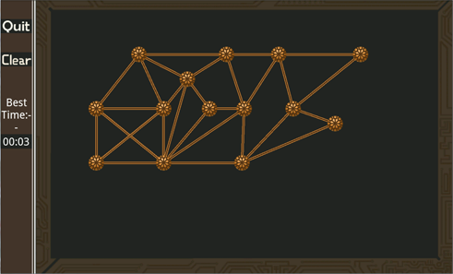

Human Vs. Computer: Comparison of Performance
In Solving An NP-Complete problem
Samuel Arutyunyan — Department of Computer Science, University of Mary Washington
Abstract
Despite the fact that computers can solve many problems very quickly, there are certain problems, called NP-complete, that cannot be solved in a reasonable amount of time by a computer for large input sizes. The topic of my research this summer was to determine how quickly a human can solve a particular NP-complete problem called the Hamiltonian path problem. A Hamiltonian path (Fig.1) consists of a path through a graph which visits every node in the graph exactly once. I developed a game for Android devices in which players can attempt to find Hamiltonian paths in graphs of increasing complexity. When a path is found, the name of the user and the time it took for them to complete the path will be sent to a web page where we will be able to view the results. Initial comparisons of a human player vs. a computer algorithm show that as the paths get larger, computers can take a very large amount of time to solve the problem, to the point where a human solving the problem is actually faster. Over time, we will continue to obtain data from more users as people try out the game on Google Play.
Logarithmic Scale
Algorithm
The algorithm for searching a path was written in C++ because it can perform faster than Java. It operates by performing a permutation of all possible paths and then checking if the path is valid for that particular puzzle. Because the paths in the puzzles are cycles, there was a risk of the program running a lot more permutations than it really had to, so an optimization was implemented which only considered each path once. The following is an example of how this optimization works:
During the first set of iterations of the permutation function, the following paths would be considered in this order. All paths starting with A, then B, then C, then D …
Time (seconds)
ABCD
ABDC
ACDB
ACBD
ADBC
ADCB
Then:
BCDA
BDCA
BACD
BDAC
BCAD
BADC
And so on..
Because the paths are cycles, we can shift over the letters however we want. If we did that, we could can make it so that A is at the start of the sequence, and the function already checked all paths starting with A. Therefore only the first set of permutations needs to be calculated which starts with the Letter A.
Fig. 1. A Hamiltonian Cycle
Visits every node and ends where it starts.
Results
In order to fit the entire time range and still show the subtle differences in time, the chart is in logarithmic scale. After 16 nodes the algorithm would start taking days to solve and it became impractical to continue testing the computer’s time at that point.
There is also the possibility that a graph with less nodes has more complicated connections and will still be difficult for a human to solve. This can be seen in 17 nodes and 29 nodes, where 17 took longer. For a human to solve. But in either case the computer will still take much longer.
Design
The game is written for Android (Fig.2) in the Java programming language. After learning these technologies, I began designing the game. In consideration of different screen sizes, the largest portion of the screen forms the playing area while control buttons and other information is on the left (Fig.3).
Number of Nodes
Implementation
In order to read in a puzzle into the Android device, a text file was made which contained the information for all the nodes and edges. At first all of the information was hand written into a text file, but as the puzzles became larger, that approach was less viable. To speed up workflow, an editor was created that allowed for graphs to be made quickly. The editor was made in the Unity game engine which provides a lot of the graphical interface options. The editor works by placing a set of spheres across a plane (Fig. 6.). After all spheres are placed, the game simulation is ran and it is possible to interactively connect all the spheres with edges and then export the information as a text file.
Conclusion
Computers have an upper hand in that they don't have to physically move. Even a very simple graph, if large enough will take time for the human to connect all the nodes. It can be seen by looking at the chart that after 14 nodes computers begin to take an amount of time that humans do not reach.
These results are still preliminary and we will data from a wider range of users to make a more accurate conclusion.
Fig. 2. An Android device was used to create a game where users could solve Hamiltonian cycles.
Fig. 4. Color coded edges.
One of the first design decisions that was made was to have color coding in the game that would help players stay informed on where their current path was (Fig.4). At first there was going to be a distinct starting node (the blue star). But as the development proceeded, the design had to be tweaked in order to make it more convenient for the player. In order to compare a human and computer in a fair manner, the human players must be able to draw the paths as fast as they possibly can. In the end, the final design allowed for the player to start on any node, and the nodes as well as the paths were color coded for clarity (Fig. 5).
Future Work
Obtaining data from more users will provide a better idea of how people compare to computers.
The algorithm can be improved. It is possible to get a slightly more efficient algorithm than the permutation method.
The experiment can be done using a directed graph to see if it produces different results.
Fig. 6. A picture of the puzzle was drawn in Photoshop placed over a 2d plane.
Fig. 3. First
design plan.
The text file is then interpreted by the Android device into a puzzle on the screen (Fig 7. ).
References
Keeley, J. 2010. Protein-folding game taps power of worldwide audience to solve difficult puzzles. http://www.eurekalert.org/pub_releases/2010-08/hhmi- pgt080310.php
Robertson, S., Vojnovic, M., Weber, I. 2009. Rethinking the ESP Game.
research.microsoft.com/apps/pubs/default.aspx?id=70638
Sipser, M. 2012. Introduction to the Theory of Computation.
Von Ahn, L., Dabbish, L. 2008. Designing Games With a Purpose. Communications of the ACM, Vol. 51 No. 8, Pages 58-67.
cacm.acm.org/magazines/2008/8/5341-designing-games-with-a- purpose/fulltext
Fig. 5. A node will light up green when there is a connecting a path. It will light up Red when there are too many incoming edges (which breaks the rule of it being Hamiltonian). And the edges are color coded so that the green edges represent the current path.
Scan this for more information.
Fig. 7. The graph when loaded into the game.

