Slide 1
Spring Phone
A Personalized App Store Backend Built with Spring Boot
Browse it. Love it. Buy it. Keep it.
Spring Boot
MySQL
REST API
◡
Brooks

Slide 2
Product Vision
What Problem Are We Solving?
A tiny app store experience that feels personal, friendly, and organized.
Explore apps easily
Purchase apps smoothly
See what you already own
After a user buys an app, that app disappears from that user's available list.

Slide 3
User Journey
Meet Brooks
One cute user story guides the whole project.
◡
Browse
Brooks opens the store and looks around.
Filter
He narrows apps by name or category.
Purchase
He buys one app He really likes. Say TravelMap.
My Apps
He now sees it in her purchased list.
→
→
→
Brooks

Slide 4
Business Logic
What Changes After Purchase?
The store view becomes personal for Brooks.
◡
Before
TravelMap appears in available apps.
Buy
Brooks purchases TravelMap.
After
TravelMap moves into her owned apps.
Result
It no longer appears in her available list.
→
→
→
Brooks

Slide 5
Architecture
Three-Layer Architecture
A classic structure, organized around the user journey.
Controller Layer
Handles HTTP requests and responses
↓
Service Layer
Contains business rules and core logic
↓
Repository Layer
Reads and writes data
↓
MySQL Database
Stores apps, users, and purchases

Slide 6
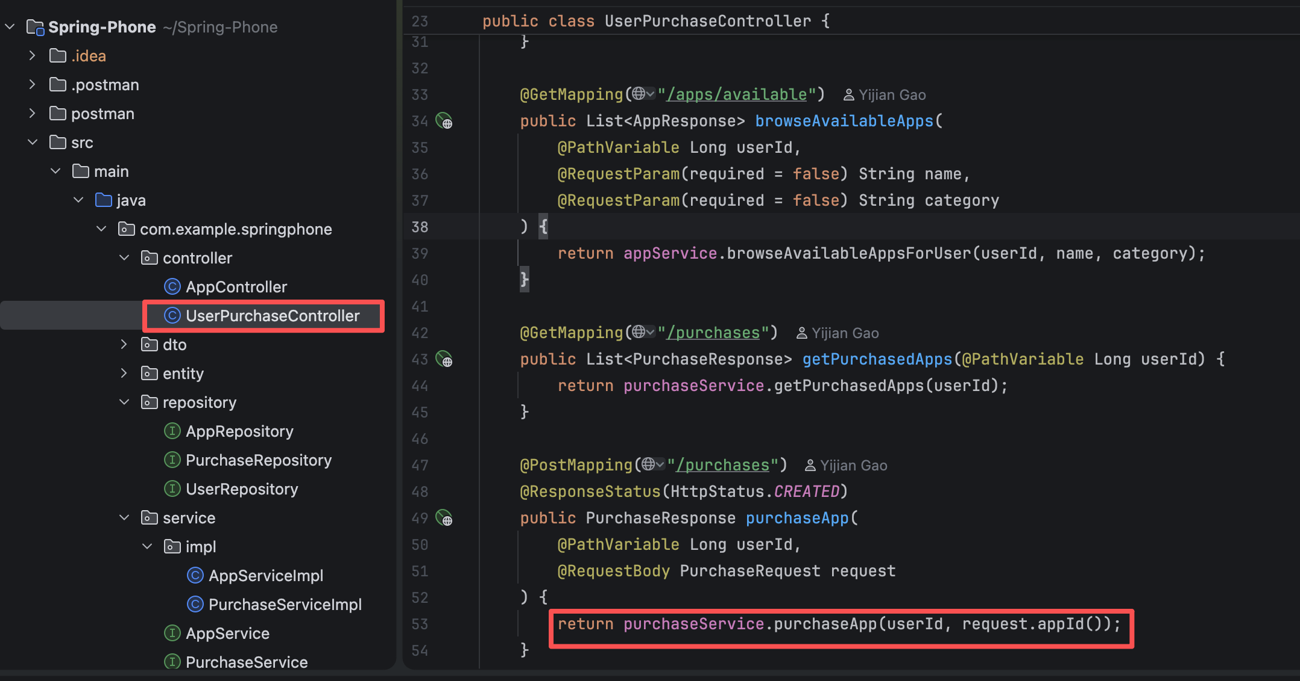

Slide 7
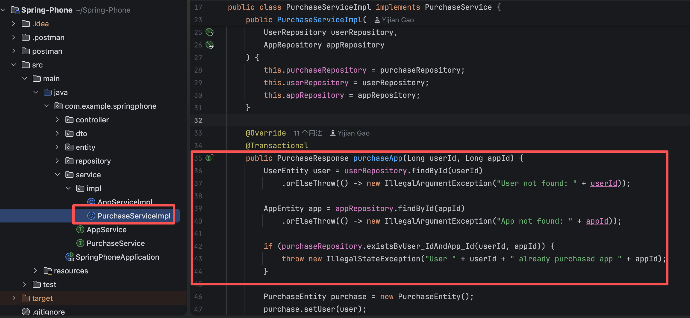

Slide 8
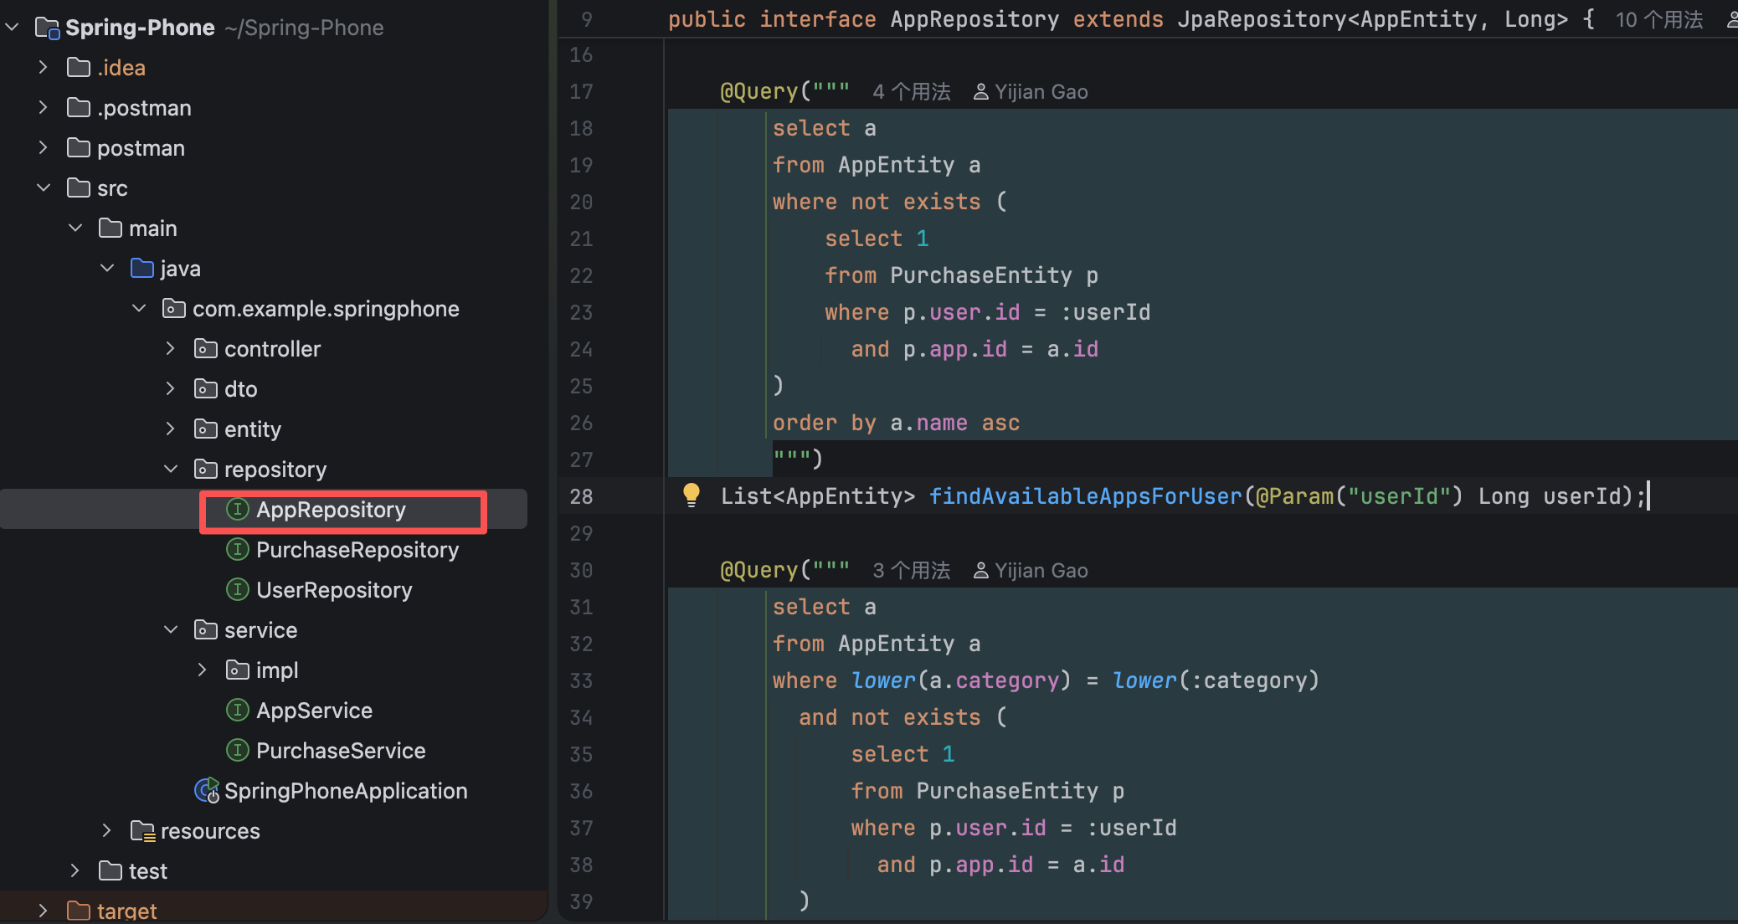

Slide 9
Design Choice
Why Three Layers?
It keeps the system simple for today and flexible for tomorrow.
• Clear responsibilities
• Easier maintenance
• Cleaner code
• Controllers expose APIs
• Services enforce rules
• Repositories access MySQL
Benefits
What It Means Here

Slide 10
Domain Model
Our Core Data Model
Three simple entities build the whole app store story.
App
id, name, category, price, description
User
id, username, email
Purchase
id, user, app, purchaseTime
User ↔ Purchase ↔ App
Purchase is the key entity because it records ownership.

Slide 11
Personalization
What Makes the Store Personal?
Available apps are calculated for each user.
All Apps - Purchased Apps = Available Apps
• An app does not disappear from the whole store
• It only disappears for the user who already bought it
• Each user gets a personalized store view
◡
Brooks

Slide 12
Request Flow
Example Flow: Brooks Buys TravelMap
One request moving through all three layers.
POST /api/users/1/purchases
Controller receives the request
Service checks the user and app
Service validates duplicate purchase rules
Repository saves the purchase
TravelMap appears in My Apps and disappears from Available Apps

Slide 13
REST API
Browse and Discover APIs
The first part of the journey is exploration.
GET /api/apps
Browse all apps
GET /api/apps?name=...&category=...
Search and filter apps
GET /api/users/{userId}/apps/available
Show apps available to one user

Slide 14
REST API
Purchase and Ownership APIs
The second part of the journey is ownership.
POST /api/users/{userId}/purchases
Purchase an app
GET /api/users/{userId}/purchases
List purchased apps

Slide 15
Service Design
Where the Business Rules Live
Our services are the brain of the system.
• Browse all apps
• Search by name
• Filter by category
• Validate user and app
• Prevent duplicate purchase
• Return purchased apps
AppService
PurchaseService

Slide 16
Persistence
How Data Lives Between Runs
We connect the backend to MySQL so data stays safe after restart.
• mobile_app
• store_user
• purchase
• Real persistence
• Realistic demo data
• Reliable hackathon showcase
Stored Tables
Why It Matters

Slide 17
Testing
How We Tested the Project
We covered both happy paths and edge cases.
• Browse apps
• Filter by name and category
• Successful purchase
• Purchased list retrieval
• Duplicate purchase
• Missing user
• Missing app
• Empty result cases
Happy Paths
Edge Cases

Slide 18
Future Ideas
If We Had More Time...
A small project with room to grow.
• Ratings and reviews
• Recommendations
• Authentication
• Admin dashboard
• Local cache for repeated purchase checks
• Pagination and sorting
• Global exception handling
• Integration tests
Product Ideas
Technical Ideas

Slide 19
Closing
Thank You
From discovery to ownership, every step is simple, personal, and structured.
• We designed Spring Phone around a user journey
• We implemented it with a clean three-layer Spring architecture
• We built a backend that is small, clear, and ready to grow
◡
Thank you!
Brooks

