Slide 1
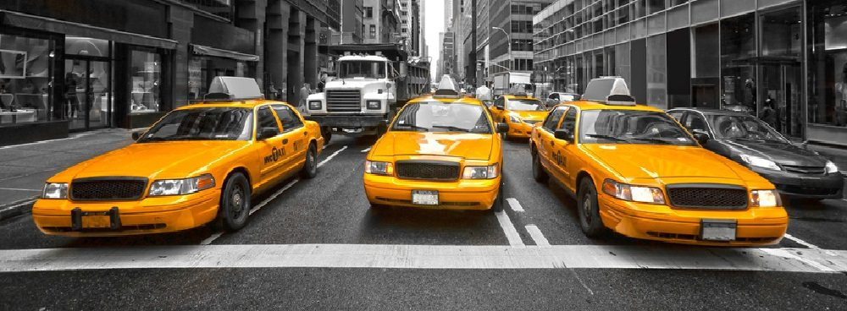
NYC Transportation Weather Study
Data Science - Group 5
By Ian Gross, Diana Edwards, Stephen Notley, Jianhui Lu, Animesh Tripathy

Slide 2
Agenda
Investigation
Goals
Sources
Formats Used
Data Management Plan
Data Analysis
Overview
Tools
Storage
Validation
Data Visualization
Conclusive Analysis
Lessons Learned
Conclusions

Slide 3
Investigation
Examine the relationship between weather and taxi usage statistics in NYC.
NYC was chosen because of :
convenient and detailed information
pickup and dropoff times
distances
number of passengers, trip duration in seconds

Slide 4
Goals
How do various weather conditions affect taxi trip durations in New York City?
How do various weather conditions affect the amount of people using taxis in New York City?

Slide 5


Sources
Notes:
Obtained from Kaggle competition
Weather Under ground measured at JFK International Airport
After briefly exploring a condensed version of the
yellow line data found in a Kaggle competition (found here) and nding no statistically-relevant
correlations between this data and various statistics, the team decided to focus on the green line
data, as stronger correlations were found here for reasons that will be discussed later.

Slide 6
Data Management Plan
Security
Data is publicly hosted by Ian Gross and uses Github’s security platform.
Data Ownership
NYC TLC owns the taxi data. The weather data is operated under IBM.
Persistence
The processed versions all datasets GitHub public repository hosted by Ian Gross.
Discovery
The data can be discovered from Ian’s GitHub and access can be requested to Ian’s Google drive for relevant data.
Dissemination
A project description and appropriate topics will be provided to create connections between interested parties and our datasets.

Slide 7
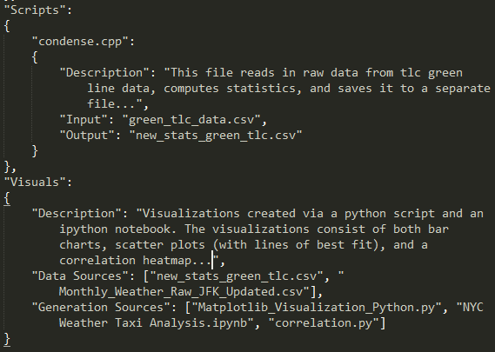
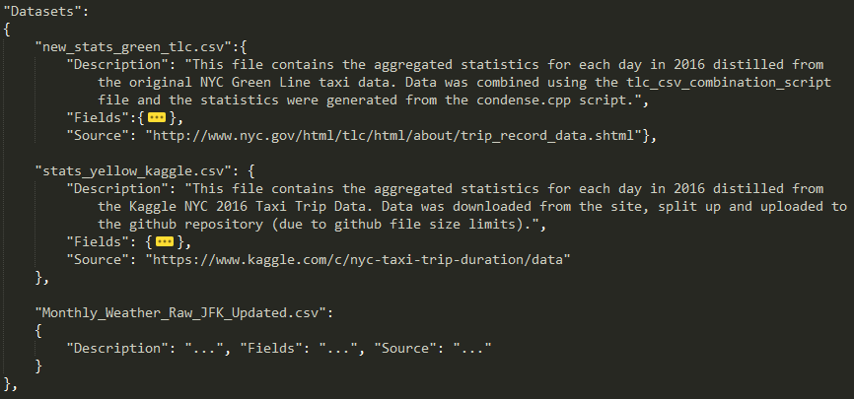
Logical Collections & Metadata
new_stats_green_tlc.csv
Date | Total Passenger | Avg Passenger | Total Trips | Total Dist (mi) | Avg Dist (mi) | Avg Speed (mi/h) | Avg Duration (s)
1/1/2016 | 90227 | 1.41615 | 63713 | 205514 | 3.22563 | 17.2715 | 764.513
1/2/2016 | 64156 | 1.37733 | 46580 | 132882 | 2.85277 | 16.972 | 730.154
1/3/2016 | 60168 | 1.36998 | 43919 | 128878 | 2.93444 | 17.0585 | 711.582
metadata.json
Notes:
Statistics derived from original raw data and aggregated together and ordered by date

Slide 8







Physical Data Handling & Interoperability Support
Notes:
The files containing each individual dataset were stored in close proximity using hierarchical file-folder layout to enable interoperability. All scripts, python notebooks, and python files could access the appropriate dataset files with ease due to standardized naming conventions and single storage location within a GitHub repository.

Slide 9
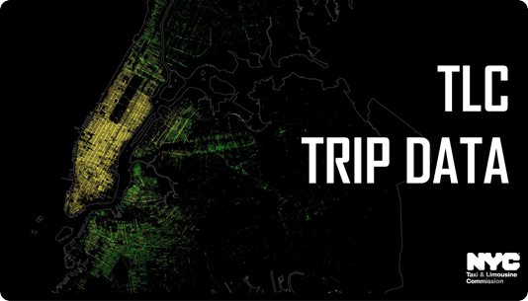
Data Analysis Overview
Began by reformatting data and distilling taxi data to daily view
Generated correlation heatmap to look for statistical relations
2 Taxi lines
Yellow: no statistically-significant correlations
Green: some correlations
Notes:
We hypothesized that this was because the yellow line primarily services manhattan, where traffic is too congested for weather to have much effect on duration.
The green line runs outside of Manhattan

Slide 10




Tools
Notes:
Scraper : duplicate column headers were removed and a month column was added manually in excel.

Slide 11
Storage
Google drive contains the 2GB file of green line taxi data.
Github has file size limitations (1GB per repo, 100MB per file)
New results added to GitHub for team discussion
All scripts mentioned can be found in the scripts folder of the GitHub.
Description in metadata.json

Slide 12
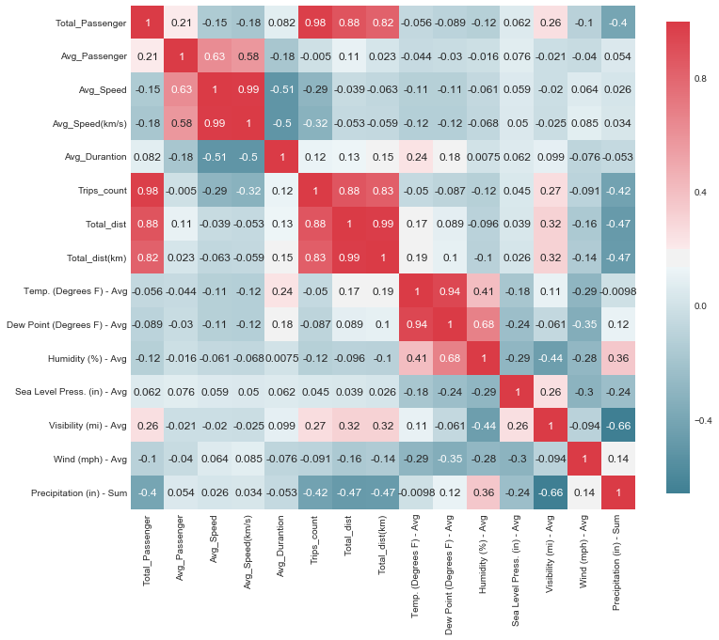
Correlation Heatmap - Yellow Line

Slide 13
Validation
Team used data and real world to explain result
Manhattan very congested, makes sense weather would not have much impact
Green line has higher speeds but still averages ~15mph, too low for much speed effect
Usage stats make sense- inclement weather causes slight spike in usage.

Slide 14
Data Visualization
We started off with csv data...
Converted into a form that the two data sources can be compared with one another
Data Flow:
Input: JFK Weather data, TLC Taxi Green Line
Data Points: days in 2016
Output: Seaborn correlation map, Matplotlib scatter plots and bar charts

Slide 15
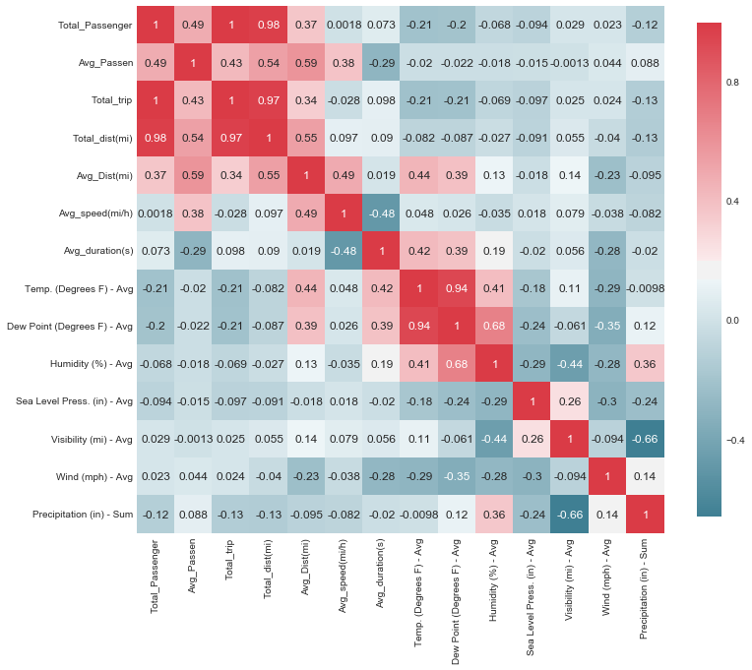
Correlation Heatmap - Green Line
Standout correlations, in comparison to taxi statistics:
Average Temperature
Total Precipitation
Wind Speed

Slide 16
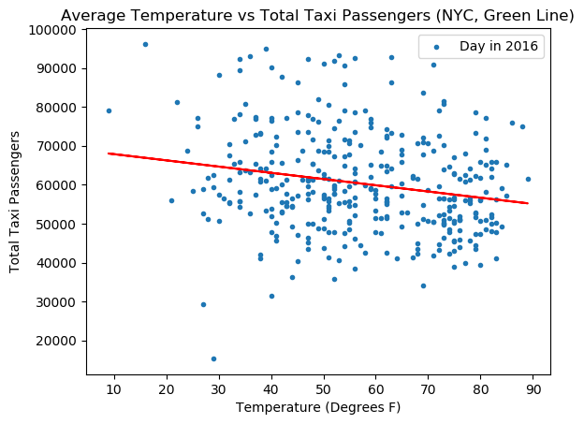
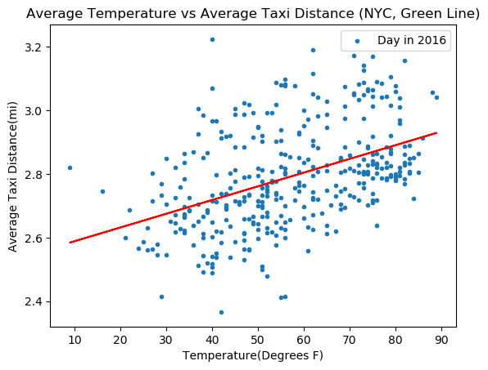
Featured Scatter Plots: Avg Temp vs Passengers & Distance
More people tend to take taxis when the temperature is colder
Small but noticeable difference
Temperature has a minimal effect on trip distance and duration (only a few minutes on average)

Slide 17
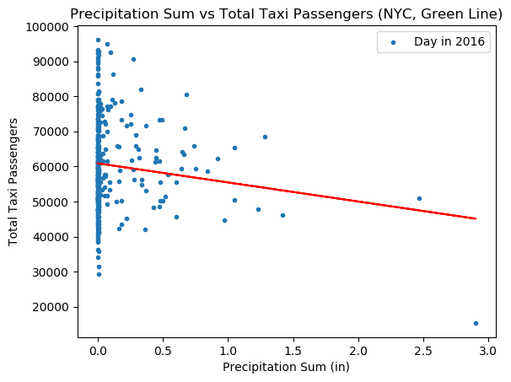
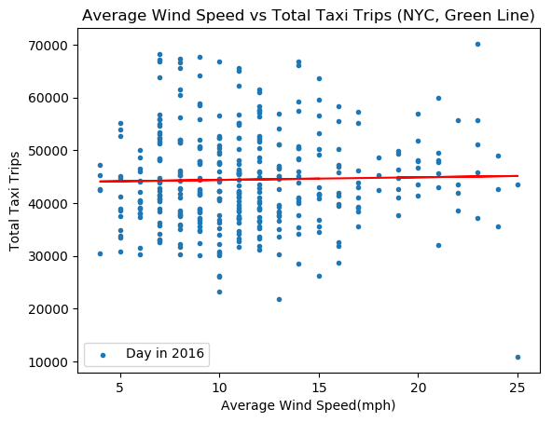
Featured Scatter Plots: Weather Conditions
Correlation suggests that less people take taxis during heavy inclement weather (results are inconsistent)
Number of taxi trips are unaffected by wind speed

Slide 18
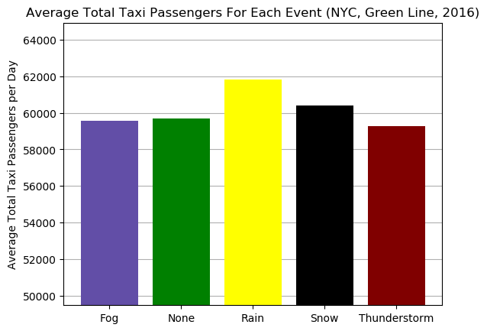
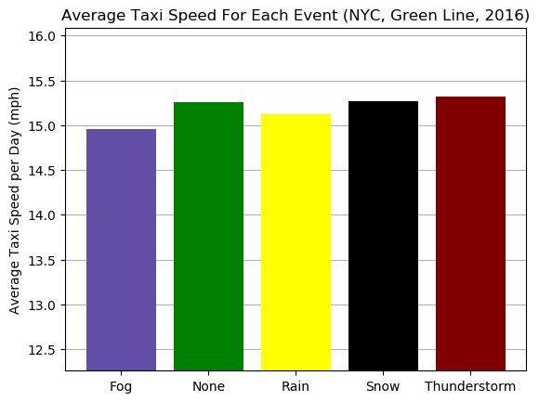
Bar Charts: Weather Events
On average, inclement weather, regardless of severity, causes more people to take taxis
Weather events have little effect on average taxi speed, as predicted from the Yellow Line correlations
Notes:
INCLEMENT WEATHER, COLD AND RAIN, CAUSE MORE PEOPLE TO TAKE TAXIS IN NEW YORK CITY.

Slide 19
Conclusive Analysis
Inclement weather causes slightly more taxi usage but very minimal difference in taxi speed and trip duration
There are no significant correlations between weather and taxi usage in NYC
Weather delay calculations are often a big part of travel logistics calculations
Our results contradict common logic
Notes:
jen-wei
there is more room for effect thanin the Manhattan-based yellow line data, average speeds are
still low for this data, which means that w eather likely would not have as much impact as on
roads with higher speeds such as highways.
This information could potentially prove quite useful in business logistics and planning in terms of taxi companies.

Slide 20
Lessons Learned
Make sure there is enough data to support analysis.
Obvious answers may be disproved by data analysis.
Start research broad, then go to specifics.
No correlation may end up being significant
Finding public transportation data is not as simple as initially designed

Slide 21
Conclusions
Overall, the effect of weather or Taxi transport in NYC is minimal
This is somewhat counterintuitive
Could be due to low avg speed
More effect on usage but still not a large impact
This information could be useful
Weather regarded as significant source of delay, data shows otherwise

