Slide 1
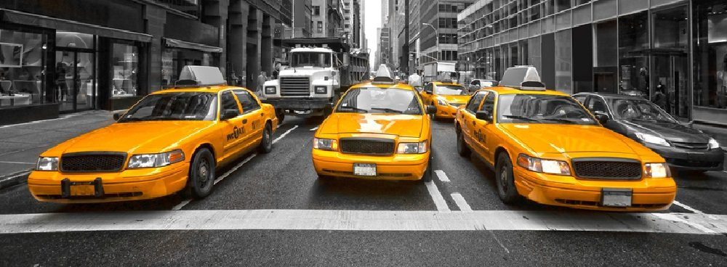
NYC Transportation Weather Study
By Ian Gross, Diana Edwards, Stephen Notley, Jianhui Lu, Animesh Tripathy
Notes:
Animated picture pans in window with fade-in captions
(Advanced)
Tip: For best results, select a high-resolution, vertically oriented picture, where the picture height is larger than the slide height. The picture in the example above is 15” high and 10” wide. (Normal slide dimensions are 7.5” high and 10” wide.)
To reproduce the picture effects on this slide, do the following:
On the Home tab, in the Slides group, click Layout, and then click Blank.
On the Insert tab, in the Images group, click Picture. In the Insert Picture dialog box, select a picture, and then click Insert.
Select the picture. Under Picture Tools, on the Format tab, in the Size group, click the Size and Position dialog box launcher. In the Format Picture dialog box, resize or crop the image so that the height is set to 15” and the width is set to 10”. To crop the picture, click Crop in the left pane, and in the right pane, under Crop position, enter values into the Height, Width, Left, and Top boxes. To resize the picture, click Size in the left pane, and in the right pane, under Size and rotate, enter values into the Height and Width boxes.
On the Home tab, in the Drawing group, click Arrange, point to Align, and then do the following:
Click Align to Slide.
Click Align Top.
Click Align Center.
The remainder of picture will extend beyond the bottom edge of the slide area. You may need to zoom out to view your slide. To zoom out, on the View tab, in the Zoom group, click Zoom. In the Zoom dialog box, select 33%.
To reproduce the shape effects on this slide, do the following:
On the Home tab, in the Drawing group, click Shapes, and then under Rectangles click Rounded Rectangle (second option from the left). On the slide, drag to draw a rounded rectangle.
Select the rounded rectangle. Under Drawing Tools, on the Format tab, in the Size group, do the following:
In the Shape Height box, enter 2.5”.
In the Shape Width box, enter 8”.
Also on the Format tab, in the Shape Styles group, do the following:
Click the arrow next to Shape Fill, and then click No Fill.
Click the arrow next to Shape Outline, and then under Theme Colors click White, Background 1 (first row, first option from the left).
Also on the Format tab, in the bottom right corner of the Shape Styles group, click the Format Shape dialog box launcher. In the Format Shape dialog box, in the left pane, click Line Style. In the Line Style pane, in the Width box, enter 12.5 pt.
Also in the Format Shape dialog box, in the left pane, click 3-D Format, and then do the following in the 3-D Format pane:
Under Bevel, click the button next to Top, and then under Bevel click Circle (first row, first option from the left).
Under Surface, click the button next to Material, and then under Standard click Warm Matte (second option from the left). Click the button next to Lighting, and then under Cool click Freezing (second option from the left).
On the Home tab, in the Drawing group, click Arrange, point to Align, and then do the following:
Click Align to Slide.
Click Align Middle.
Click Align Center.
On the Home tab, in the Drawing group, click Shapes, and then under Rectangles click Rectangle (first option from the left). On the slide, drag to draw a rectangle.
Select the rectangle. Under Drawing Tools, on the Format tab, in the Size group, do the following:
In the Shape Height box, enter 2.51”.
In the Shape Width box, enter 10”.
Also on the Format tab, in the Shape Styles group, click the arrow next to Shape Outline, and then click No Outline.
Also on the Format tab, in the Shape Styles group, click the arrow next to Shape Fill, point to Gradient, and then click More Gradients.
In the Format Shape dialog box, click Fill in the left pane, select Gradient fill in the Fill pane, and then do the following:
In the Type list, select Linear.
Click the button next to Direction, and then click Linear Down (first row, second option from the left).
Under Gradient stops, click Add gradient stops or Remove gradient stops until two stops appear in the slider.
Also under Gradient stops, customize the gradient stops as follows:
Select the first stop from the left in the slider, and then do the following:
In the Position box, enter 0%.
Click the button next to Color, and then under Theme Colors click Black, Text 1 (first row, second option from the left).
In the Transparency box, enter 0%.
Select the second stop from the left in the slider, and then do the following:
In the Position box, enter 100%.
Click the button next to Color, and then under Theme Colors click Black, Text 1, Lighter 25% (fourth row, second option from the left).
In the Transparency box, enter 0%.
On the Home tab, in the Drawing group, click Arrange, point to Align, and then do the following:
Click Align to Slide.
Click Align Top.
Click Align Center.
Select the rectangle. On the Home tab, in the Clipboard group, click the arrow next to Copy, and then click Duplicate.
On the Home tab, in the Drawing group, click Arrange, point to Rotate, and then click Flip Vertical.
Also on the Home tab, in the Drawing group, click Arrange, point to Align, and then do the following:
Click Align to Slide.
Click Align Bottom.
Click Align Center.
Also on the Home tab, in the Drawing group, click Shapes, and then under Rectangles click Rectangle (first option from the left). On the slide, drag to draw a rectangle.
Select the rectangle. Under Drawing Tools, on the Format tab, in the Size group, do the following:
In the Shape Height box, enter 2.55”.
In the Shape Width box, enter 1.06”.
Under Drawing Tools, on the Format tab, in the bottom right corner of the Shape Styles group, click the Format Shape dialog box launcher. In the Format Shape dialog box, in the left pane, click Line Color. In the Line Color pane, select No line.
Also in the Format Shape dialog box, in the left pane, click Fill. In the Fill pane, select Solid fill, click the button next to Color, and then under Theme Colors click Black, Text 1, Lighter 25% (fourth row, second option from the left).
On the Home tab, in the Drawing group, click Arrange, point to Align, and then do the following:
Click Align to Slide.
Click Align Right.
Click Align Middle.
Select the rectangle. On the Home tab, in the Clipboard group, click the arrow next to Copy, and then click Duplicate.
Select the duplicate rectangle. On the Home tab, in the Drawing group, click Arrange, point to Align, and then do the following:
Click Align to Slide.
Click Align Left.
Click Align Middle.
On the Home tab, in the Editing group, click Select, and then click Selection Pane. In the Selection and Visibility pane, select the rounded rectangle.
On the Home tab, in the Drawing group, click Arrange, and then click Bring to Front.
In the Selection and Visibility pane, press and hold CTRL, and then select the rounded rectangle and four rectangles.
On the Home tab, in the Drawing group, click Arrange, and then click Group.
To reproduce the text effects on this slide, do the following:
On the Insert tab, in the Text group, click Text Box. On the slide, drag to draw a text box.
Type the text you want to appear in the text box, and then select the text. Format the text in the textbox using the following steps:
On the Home tab, in the Font group, choose the Calibri font and a font size of 26.
Click the arrow next to Font Color, and then under Theme Colors click White, Background 1 (first row, first option from the left).
In the Paragraph group, click Align Text Left.
Drag the text box to the lower left part of the rounded rectangle.
To reproduce the animation effects for the picture on this slide, do the following:
On the slide, select the picture.
On the Animations tab, in the Advanced Animation group, click Add Animation, and then, under Entrance, click Fade.
Also on the Animations tab, in the Timing group, in the Start list, select With Previous.
Also on the Animations tab, in the Timing group, in the Duration box, type 2.
On the Animations tab, in the Advanced Animation group, click Add Animation, and then click More Motion Paths.
In the Add Motion Paths dialog box, under Lines and Curves, click Up.
Also on the Animations tab, in the Timing group, in the Start list, select With Previous.
Also on the Animations tab, in the Timing group, in the Duration box, type 20.
On the slide, select the Up motion path, and then do the following:
Press and hold SHIFT, and then drag the end point (red arrow) of the motion path to the top edge of the slide.
Press and hold Shift, and then drag the starting point (green arrow) of the motion path to the bottom edge of the slide.
To reproduce the animation effects for the text on this slide, do the following:
On the slide, select the text box.
On the Animations tab, in the Advanced Animation group, click Add Animation, and then, under Entrance, click Fade.
Also on the Animations tab, in the Timing group, in the Start list, select With Previous.
Also on the Animations tab, in the Timing group, in the Duration box, type .5.
Also on the Animations tab, in the Timing group, in the Delay box, type 3.0.
Also on the Animations tab, in the Advanced Animation group, click Add Animation, and then, under Exit, click Fade.
Also on the Animations tab, in the Timing group, in the Start list, select With Previous.
Also on the Animations tab, in the Timing group, in the Duration box, type .5.
Also on the Animations tab, in the Timing group, in the Delay box, type 8.0.
On the slide, select the text box. On the Home tab, in the Clipboard group, click the arrow next to Copy, and then click Duplicate.
On the slide, click in the second text box and edit the text.
On the Animations tab, in the Advanced Animation group, click Animation Pane.
In the Animation Pane, do the following:
Select the entrance animation on the second text box. Click the arrow to the right of the effect, and then click Timing. In the Fade dialog box, on the Timing tab, in the Delay box, enter 8.5, and then click OK.
Select the exit animation on the second text box. Click the arrow to the right of the effect, and then click Timing. In the Fade dialog box, on the Timing tab, in the Delay box, enter 13.0, and then click OK.
On the slide, select the second text box. On the Home tab, in the Clipboard group, click the arrow next to Copy, and then click Duplicate.
On the slide, click in the third text box and edit the text.
In the Animation Pane, do the following:
Select the entrance animation on the third text box. Click the arrow to the right of the effect, and then click Timing. In the Fade dialog box, on the Timing tab, in the Delay box, enter 13.5, and then click OK.
Select the exit animation on the third text box. Click the arrow to the right of the effect, and then click Timing. In the Fade dialog box, on the Timing tab, in the Delay box, enter 19.5, and then click OK.
On the slide, press and hold CTRL, and then select the three text boxes. On the Home tab, in the Drawing group, click Arrange, point to Align, and then do the following:
Click Align Selected Objects.
Click Align Middle.
Click Align Center.
To reproduce the animation effects for the shapes on this slide, do the following:
On the slide, select the rounded rectangle and the group of shapes that form the background of the slide.
On the Animations tab, in the Advanced Animation group, click Add Animation, and then click More Emphasis Effects. In the Add Emphasis Effect dialog box, under Basic, click Grow/Shrink.
Also on the Animations tab, in the Timing group, in the Start list, select After Previous.
Also on the Animations tab, in the Timing group, in the Duration box, type 2.
On the Animations tab, in the Animation group, click Effect Options, and then click Horizontal.
On the Animations tab, in the Advanced Animation group, click Add Animation, and then click More Exit Effects. In the Add Emphasis Effect dialog box, under Basic, click Fade.
Also on the Animations tab, in the Timing group, in the Start list, select With Previous.
Also on the Animations tab, in the Timing group, in the Duration box, type 1.

Slide 2
Investigation

Slide 3
Investigate
Examine the relationship between weather and taxi usage statistics in NYC.
NYC was chosen because of :
convenient and detailed information
pickup and dropoff times
distances
number of passengers, trip duration in seconds

Slide 4
Identify Sources
Data was sourced from several websites:
NYC Taxi and Limousine Commission
Green Taxis
Kaggle:
Yellow Taxis
Weather Underground contained daily metrics of :
Temperature
Wind speed
Visibility
Conditions
And more
Notes:
Weather Under ground measured at JFK International Airport
After briefly exploring a condensed version of the
yellow line data found in a Kaggle competition (found here) and nding no statistically-relevant
correlations between this data and various statistics, the team decided to focus on the green line
data, as stronger correlations were found here for reasons that will be discussed later.

Slide 5
Formats Used
NYC TLC Green stored in a csv file:
Each trip sheet data is stored by Year, Month, and the taxi line (Yellow, Green or FHV).
Metadata stored in a describe each dataset's Field Name.
Weather Underground data was scraped into a csv.
Column names as metadata.
Also collected metadata: JFK International Airport.
Kaggle Yellow line taxi data came in a zipped csv file.
Each row representing one trip and each column representing various statistics about each trip
Metadata was a plain text file
Pairing system of column title and an explanation of what it meant in plain English with units.

Slide 6
Standards Used
The unwieldy individual taxi trip data was aggregated into a statistics csv file. Consisting of :
A datapoint for each day
The total number of taxi passengers that day
The average number of passengers per ride,
The number of rides
The average distance and speed of rides
The average trip duration.
Metadata for these statistics can be found in the metadata.json file found on our GitHub page.
Notes:
The team thought that these aggregated statistics could be used to see meaningful
correlations during analysis.

Slide 7
Data Analysis

Slide 8
Data Analysis - Questions
How do various weather conditions affect taxi trip durations in New York City?
How do various weather conditions affect the amount of people using taxis in New York City?

Slide 9
Data Analysis - Steps
Started locating the data for weather data as well as taxi data which had, at minimum, details on duration, distance, and number of passengers (after aggregation).
The weather data was scraped, then curated by month.
Correlations and graphs were produced in order to determine any effects on the number of rides/passengers or trip duration.
The statistics aggregated from the Kaggle yellow-line taxi data showed no statistically-significant correlations to the weather data.
The green line displayed several statisically-signicant correlations with the weather data and contained a larger sample size.
Notes:
We hypothesized that this was because the yellow line primarily services manhattan, where traffic is too congested for weather to have much effect on duration.
The green line runs outside of Manhattan

Slide 10
Data Analysis - Tools
An extension in Google Chrome called Data Miner was used to scrape weather data into a CSV file.
A python script combined the taxi data files and removed unnecessary columns.
A C++ program was used to distill aggregated statistics from the taxi data to the statistics.csv file.
A Python script was used to create a heatmap (with the Python visualization library: Seaborn)
Further analysis was performed using another python script with the matplotlib package which provided visualizations in the form of bar charts and scatter plots.
Notes:
Scraper : duplicate column headers were removed and a month column was added manually in excel.

Slide 11
Data Analysis - Storage
Data was stored and managed on Github and Google Drive.
Google drive contains the 2GB file of green line taxi data.
The results of the overall project and graphs were stored and managed in folders on Github.
Each new result was pushed to the master branch and reviewed by the team.
All scripts mentioned can be found in the scripts folder of the GitHub.
Descriptions of these scripts are provided in the metadata document of the Github repository.

Slide 12
Data Analysis - Validation
The steps taken to perform the analysis were locating the data relevant to our study, parsing through all the data, splitting up the data, separating the data from the metadata (which is included in a JSON file) and then conducting analysis on the data by using scripts to produce graphs displaying relationships pertinent to the questions posed.
After the data was obtained, it had to be reformatted into a fashion that facilitated analysis to answer the questions posed by the team.
Scripts were written to validate the analysis by reasoning about real-world phenomena in accordance with the results of the study.

Slide 13
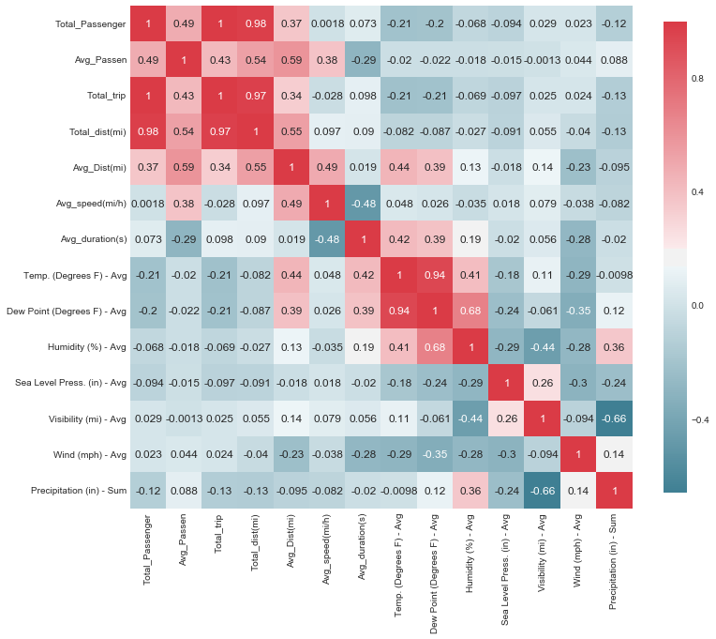
Of these numerical features, temperature and precipitation showed the most correlation with the various taxi data statistics, and so these were chosen for visualization along with the categorical event weather data.

Slide 14
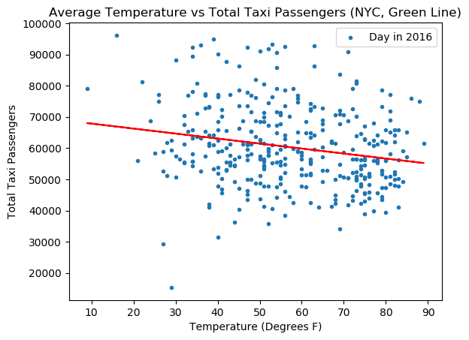
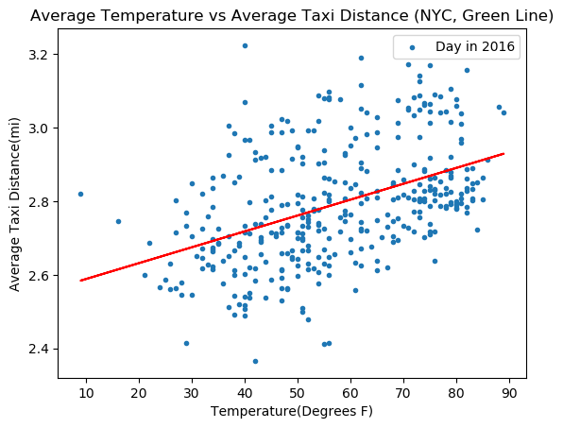
These two images paint a very picture in relation to our questions, showing that more people tend to take taxis when the temperature is lower, but that temperature has a minimal effect on trip
duration (only a few minutes difference on average).

Slide 15
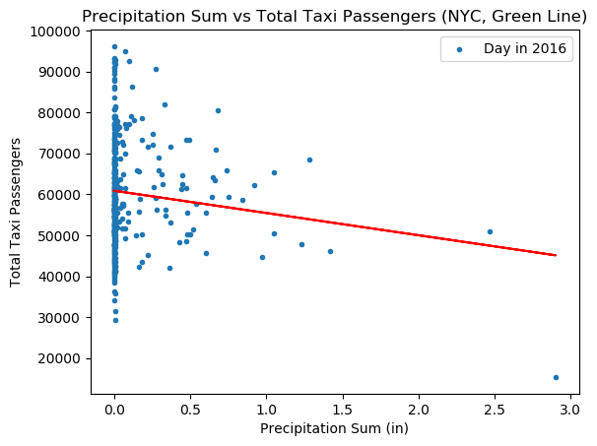
This correlation suggests that far less people take taxis when there is a significant amount of precipitation, likely because people prefer not to travel around the city at all in inclement weather, if avoidable.

Slide 16
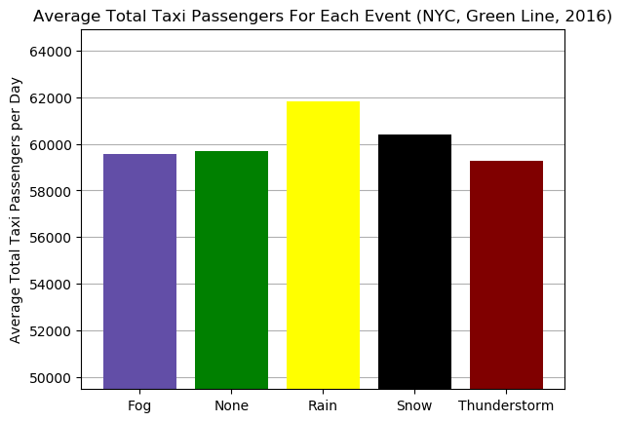
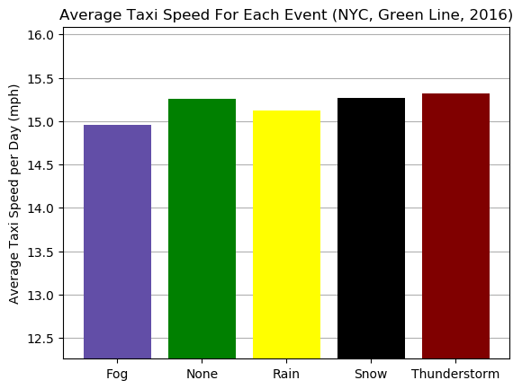
The above visuals show that the most passengers tend to use taxi
services on rainy days and that foggy days cause the biggest decrease in speeds. After analyzing the trends in the data the conclusion is that inclement weather, cold and rain, cause more people to take taxis in New York City. Inclement weather has a very minimal effect on the speed of taxi trips.
Notes:
there is more room for effect than in the Manhattan-based yellow line data, average speeds are
still low for this data, which means that weather likely would not have as much impact as on
roads with higher speeds such as highways.

Slide 17
Further Analysis
The visualizations demonstrate the relationships between weather and taxi trip duration/speed and the number of people using taxis in these varying weather conditions.
Inclement weather causes slightly more taxi usage but very minimal, if any, difference in taxi speed and trip duration.
Weather delay calculations are often a big part of travel logistics calculations and, this study shows that, at least for taxis in New York City, it may not need to be.
This information could potentially prove quite useful in business logistics and planning in terms of taxi companies.

Slide 18
Data Management and Conclusion

Slide 19
Data Management Plan
Logical Collections:
All datasets are named according to their corresponding data source. The columns of each dataset are named to accurately represent the given field, with units included in the name where applicable.
Each row represents one day's worth of aggregate data for the weather and statistics les, while in the raw taxi data each row represents an individual taxi trip.
Physical Data Handling:
There were three datasets that were utilized for the transportation weather study. Green line and Yellow line data were combined and processed through a C++ script. Weather was reformatted to accommodate for the header structure of each month. Both datasets were processed and archived in a CSV with their appropriate dataset names.
Interoperability Support:
The files containing each individual dataset were stored in close proximity using hierarchical file-folder layout to enable interoperability. All scripts, python notebooks, and python files could access the appropriate dataset files with ease due to standardized naming conventions and single storage location within a GitHub repository.
Notes:
all scripts and data filles are encoded in a generic format that should be accessible on a wide variety of software and hardware media.

Slide 20
Security:
Datasets were managed and maintained by outside vendors, more specically, NYC TLC and
The Weather Company. Data is secured and changed on the NYC government and IBM servers, respectively. Data were acquired through an export tool which was processed and stored in a secured GitHub repository. Access to processed data can only be attained by authorized Group 5 members via their GitHub accounts.
Data Ownership:
NYC TLC data has strictly noted that their data collected is not used, sold, or exchanged for
commercial or marketing purposes. Data is automatically collected and quality assured by the NYS government. The Weather Company is operated under IBM with little to no restrictions on access to their data. Data is automatically collected and quality managed from weather devices and applications used by IBM.
Metadata:
Metadata for each dataset were noted within metadata.json. Each file was provided
a description identifying where the data was obtained from and what processes had been taken to refine them and a field’s section noting the column names and appropriate definitions.
Notes:
all scripts and data filles are encoded in a generic format that should be accessible on a wide variety of software and hardware media.

Slide 21
Persistence:
Raw datasets for both NYC TLC and Weather underground are found on their respective websites noted in the metadata. The processed versions of each dataset is published on the NYC Transportation Weather Study GitHub public repository hosted by Ian Gross. Due to the file size of the Green Line Taxi data, it is accessible on Ian Gross's Google Drive via a link provided earlier in the document.
Discovery:
The processed datasets can be found via the NYC Transportation Weather Study GitHub public repository to enable outsiders to gain access to each dataset. Anyone who desires can request access to this from Ian Gross who manages the repository. This also applies to the aggregate Green line taxi data stored on his Google Drive.
Dissemination:
A project description and appropriate topics will be provided to create connections between interested parties and our datasets. GitHub allows for all changes and additions to be publicized to all outside parties and enables them to track via GitHub issues. GitHub enables the team to disseminate and connect external users to our data project management.

Slide 22
Lessons Learned.
Make sure there is enough data to support analysis.
Obvious answers may be disproven by data analysis.
Start research broad, then go to specifics.

