Slide 1
Python Flask
User registration

Slide 2
User Registration
For this application to be able to be used only by users who have registered, and are currently logged in, a registration process is required.
For this, a new route must be created, as well as a new form.
A new model needs to be created, to persist the user forms, with various new validations.

Slide 3
Users Table – Design Considerations
It is at this moment when consideration to the constraints must be made for the new table ‘Users’.
For a registration form, the typical requirements are an email, a password, and a confirmation password.
But, the confirmation password is a duplicate of the password, so there is no need to persist that data.
Therefore, email and password are to be used.

Slide 4
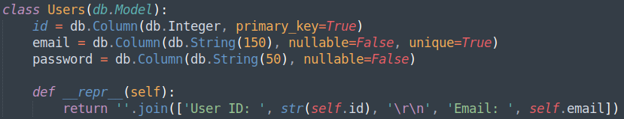
models.py – Users Table
Create a new class model within ‘models.py’, called ‘Users’, including required validations. This includes the special self representation method, ‘__repr__’:
Pay attention to ‘self.id’, as it must be cast to a string for ‘.join’ to work.

Slide 5
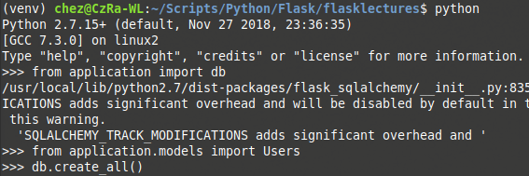
Recreate the Database
As the application is undertaking a new table within ‘site.db’, the database must be instantiated once more, so that the new tables can be built. ‘site.db’ should be deleted resulting in all data being lost.
Stop the application from running with ‘Control + C’ keys, from within the command line interface and executing the following commands will build the database as previously seen:
python
from application import db
db.create_all()

Slide 6
Add a User and Check Persistence
The following commands, very similar to the ‘Post()’ commands seen previously, will add, persist, and validate the existence of posted data:
user1 = Users(email=’chester.gardner@qa.com’, password=’password’)
db.session.add(user1)
db.session.commit()
Users.query.first()

Slide 7
Creating A New Model
Directions
30 minutes
Update your project to include a new Model for Users, rebuild the database and add some data to this table.
Debrief
Discuss why it is necessary to rebuild the database when a new .
<number>

Slide 8
forms.py – Registration Form
The ‘RegistrationForm’ will be very similar to the ‘PostForm’ form, in terms of layout. Although a a new field type isrequired to be imported, the ‘PasswordField’ field.
A few new ‘wtform’ validators are required too, ‘Email’, ‘EqualTo’, and a special validator, ‘ValidationError’.
Finally, the ‘User’ model must be imported from ‘application.models’ so a query can be made, further aiding the validation.

Slide 9
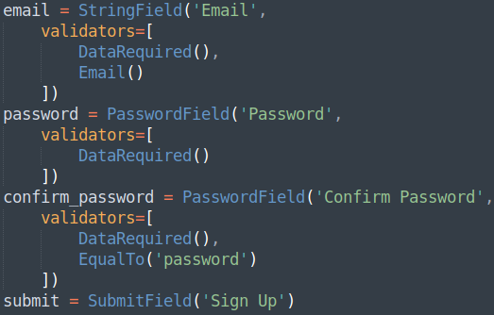
forms.py – Registration Form
As seen in the ‘PostForm’ class, all fields of the form are to be created within the class. The fields and their validators should be equivalent to:
The ‘PasswordField’ will ensure that the data, whilst being typed in to the form, is obfuscated from viewing.
Note the use of the ‘Email()’ validator within the email object, as well as the ‘EqualTo(‘password’)’ validator within the confirm_password object.

Slide 10
forms.py – ValidationError
During the registration process, it must be validated whether the email address has been used to create an account previously, before attempting to add the email to the database.
The ‘ValidationError’ validator comes in to play in a special way, via a function within the ‘RegistrationForm’ class, named ‘validate_<fieldName>(self, <fieldName>)’:
Within this method, a query to the ‘Users’ model must be made, with the query parameter of the email attempting to register:

Slide 11
forms.py – ValidationError Cont.
If the user query returns with a response, then an error should be shown. This is done by raising a validation error with an appropriate message:

Slide 12
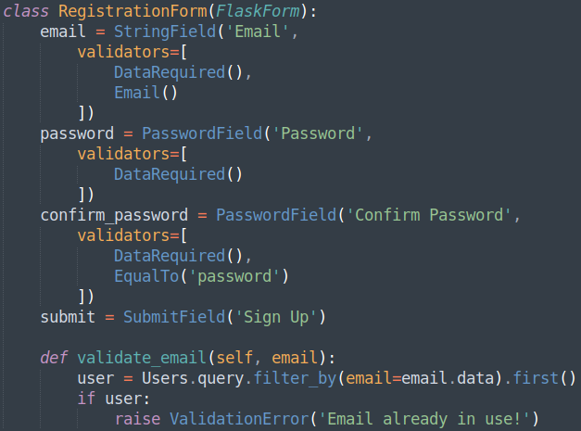
forms.py – Class Overview
The ‘RegistrationForm’ class should now look similar to (left):

Slide 13
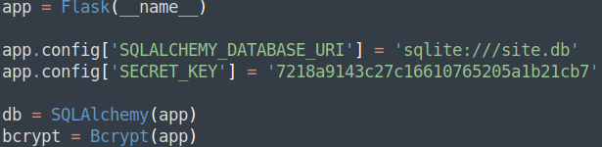
__init__.py – More Libraries
Before submitting any data to a table that will store emails and passwords, that data needs to be encrypted before transport. This will be achieved with the pre-packaged ‘flask_bcrypt’ library.
Below the ‘app’ being created and the ‘config’s being set, a ‘bcrypt’ object should be created with the imported ‘Bcrypt’ method, passing in the ‘app’ object:

Slide 14
routes.py - bcrypt
Within ‘routes.py’, the new ‘bcrypt’ object that is built from ‘application’ must be imported:
The route should look familiar, with a few modifications. However, the first line after ‘if form.validate_on_sumit()’ will hash the password data, before creating a new ‘Users’ object:
The object ‘bcrypt’, which was an instance of ‘Bcrypt(app)’, has a method for generating hashed passwords; all it needs is the password data, and the encoding type.

Slide 15
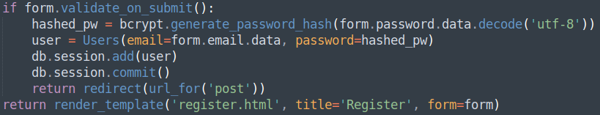
routes.py – if form.validate_on_submit()
The remainder of the route should be familiar, with a few modifications. The biggest to note is the redirect to the ‘post.html’ template. Once the user is registered, they would be allowed to post:
Finally, for the form to be properly passed to the ‘register.html’ template, it will also need importing, along with the ‘Users’ model, so that a record can be created:

Slide 16
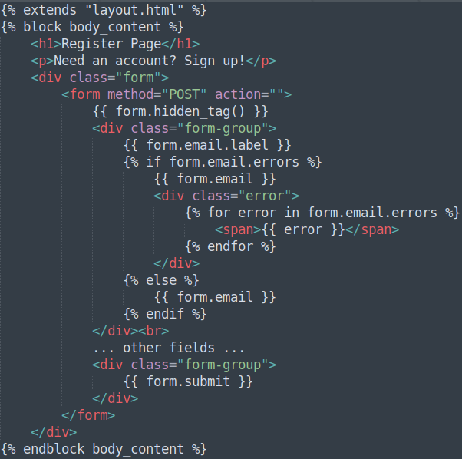
register.html
The ‘register.html’ template is going to look almost identical to the ‘post.html’ template for now, with the only changes being made to the ‘form.<fieldName>’ lines, reflecting:
email
password
confirm_password

Slide 17
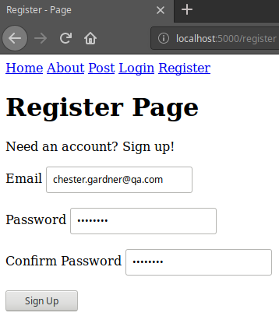
Checking the Application
Navigating to the register page, and filling in the details already in the database:
Will throw the ValidationError that was raised, stating the email already exists within this web application:

Slide 18
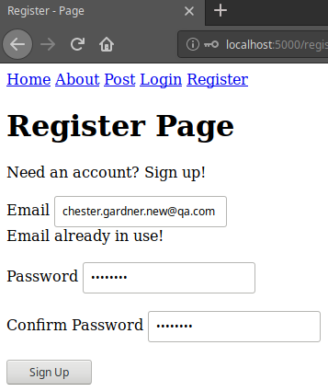
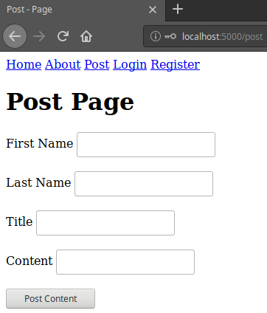
Checking the Application
Entering a new email address this time, should be accepted by the application, and redirect the user to the ‘post.html’ template:

Slide 19
Creating A Registration Form
Directions
60 - 90 minutes
Update your project to include a ‘RegistrationForm’ form, and have the form passed to the ‘register.html’ template. Include any relevant field validation and constraints.
Debrief
Discuss why the registration form still doesn’t protect the ‘post.html’ page from non-registered users from posting content.
<number>

Slide 20
Thank you for listening.
Any questions?

