Slide 1
Python Flask
Logging In

Slide 2
Login Form – Design Considerations
As the project stands, the user is able to register, but it does not matter if the user is logged in or not for the user to be able to post to the home page.
To avoid this, the login manager will handle the login session, and validate that the user is logged in, before serving certain content.
In this instance, a login form and template is required, which should be the default redirect if the user tries to access the post page without being logged in.

Slide 3
__init__.py – LoginManager
The same as ‘Bcrypt’ and ‘SQLAlchemy’, a new library will be imported to handle the sessions:
Once more, as with the other objects built in this script, the ‘app’ object must be passed to the login manager. With the ‘login_manager’ object, the default template (or view) to be accessed if the page requires a logged in user must be stated:
The ‘login.html’ template already exists, but still needs to be fleshed out.

Slide 4
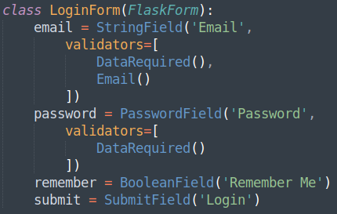
forms.py – LoginForm
Before building the ‘login.html’ template out, a form must be created:
Nothing should be unfamiliar here, except the use of a new field type, the ‘BooleanField’ field:

Slide 5
login.html
Update the ‘login.html’ template to accommodate a login form: This will required an email and a password, and should look very similar to the ‘RegistrationForm’ form.
The new addition here is the ‘BooleanField’ that was created in ‘forms.py’ - this is created in the same way as any other form object:

Slide 6
routes.py – flask_login
Before creating the route that is required for the ‘login.html’ tempalte, the ‘flask_login’ library must have some methods imported from it:
login_user : this creates and maintains a session for the user logging in
current_user : this checks to see if the current user is ‘is_authenticated’
logout_user : updates/removes the user session from being logged in
login_required : is a decorator that is used to force the user to be logged in, before accessing the route

Slide 7
routes.py – More Dependencies
As well as the new ‘flask_login’ library being imported, the ‘request’ method from the ‘flask’ library should be used:
The new form needs to be imported too:

Slide 8
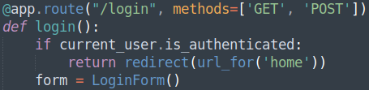
routes.py – Login Route
At the top of the ‘/login’ route, some new code can be seen:
‘if current_user.is_authenticated’ will return a boolean value of True or False, if the user is already authenticated (that is to say, logged in), then the user should not be presented the login page, instead, they should be directed to the home page.

Slide 9
current_user Properties & Methods
‘current_user’ has some properties and methods that will aid in maintaining user sessions:
is_authenticated : Returns true if the user is authenticated (logged in).
is_active : Returns true if the user is active, authenticated and not suspended – more of this later.
get_id() : This method returns a unicode that uniquely identifies the user (in this case, the ‘id’ from ‘Users’ table), and can be used to load the user from the ‘user_loader’ callback. This must be a unicode string. If it is an integer, it will need to be converted.

Slide 10
routes.py – Login Route
Next, a conditional check for the ‘validate_on_submit()’ method, as well as doing a query to the database for the supplied email attempting to be logged in with:
The next conditional check is doing two checks. The first, is one that has previously been seen, the ‘if user’ check. The second check is comparing both the password presented to the application, with the password stored within the database. For this to occur, the password stored within the database needs to be decrypted, during the comparison:

Slide 11

routes.py – Login Route
With the user credentials successfully compared against the databased, the user can now be logged in, passing in the value of the ‘BooleanField’, ‘remember’:
The ‘@login_required’, when used, will force the user to be logged in to access certain pages, otherwise, direct the user to the ‘login.html’ template. Add the decorator to the ‘/post’ route:

Slide 12
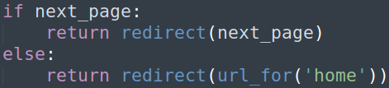
routes.py – Login Route
The next block of code is only utilised if the user has tried to access a page that is decorated with ‘@login_required’. ‘next_page’ is set to ‘request.args.get(‘next’)’. This utilises the ‘request’ object imported earlier:
If the user is redirected to another page because the ‘@login_required’ decorator exists for that route, the page that was attempted to access will be held as an argument called ‘next’. If the ‘next_page’ argument exists (and so is not null), the page will redirect to the stored page, otherwise, redirect the user to the ‘home.html’ template.

Slide 13
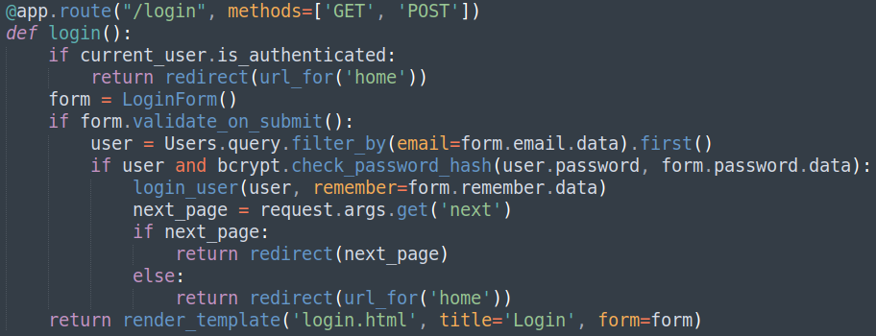
routes.py – /login Route Overview
The final login route should look similar to (left):

Slide 14
models.py - login_manager
For the user to be considered as ‘active’ or ‘logged on’, an ‘@login_manager’ decorator is needed, above a ‘load_user(id)’ method. This method will be the callback that will reload the user object from the ID of the user stored in the session (‘id’ field of the ‘Users’ table):
For this method to work, the ‘login_manager’ needs to be imported:

Slide 15
models.py - UserMixin
Finally, for the Users table to be associated with user sessions, ‘UserMixin’ will need importing from the ‘flask_login’ library:
This object then needs to be passed to the ‘Users’ model:

Slide 16
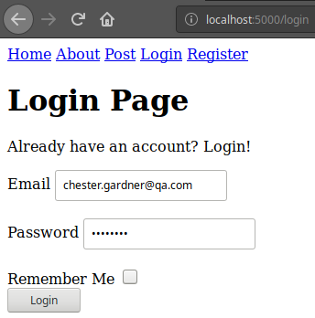
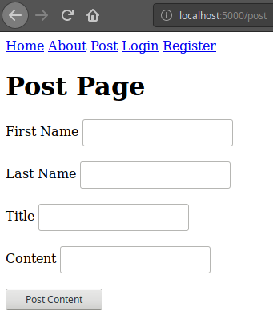
Checking the Application
The addition of the ‘login.html’ template, and affiliated route and form, as well as the introduction of ‘is_authenticated’ and ‘next_page’ has added quite the overhead for this next round of Checking the Application.
First, attempting to log in from the ‘login.html’ template directly (not a redirect to the ‘LoginForm’ form), should direct the user to the ‘post.html’ template:

Slide 17
routes.py – Logging Out
Next, the redirect functionality needs to be tested. Unfortunately, there is no current way of logging out, so that the user can log back in after being redirected to the login page, after attempting to access any ‘@login_required’ page.
Create a new route for ‘/logout’, and utilise the ‘logout_user()’ method that was previously imported, with a redirect to the ‘/login’ route:

Slide 18
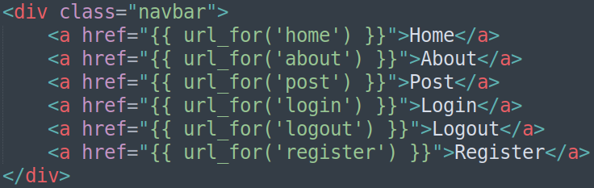
layout.html
Add the new ‘/logout’ route to the ‘layout.html’ template. Although this page doesn’t have a template, the route still exists – this is because the logout route does not need a page, to execute the ‘logout_user()’ method:

Slide 19
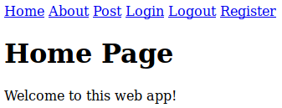
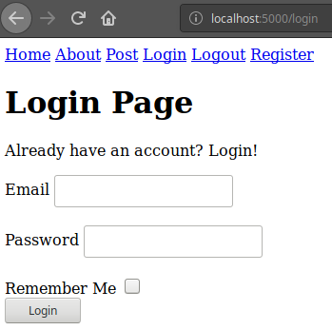
Checking the Application
Now that a ‘/logout’ route exists, clicking it should log the user out, and allow a new user to be logged in. Once logged out, the page should redirect to the ‘login.html’ template:

Slide 20

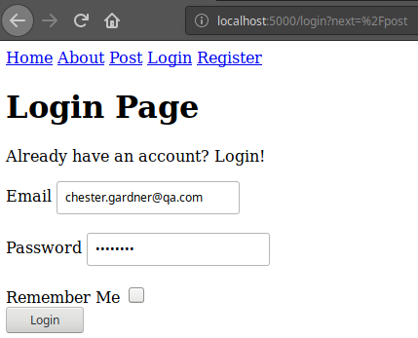
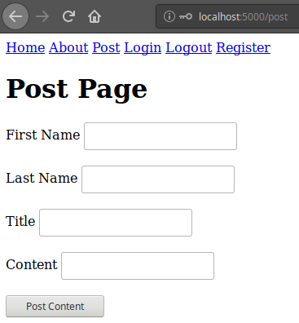
Checking the Application Cont.
Once logged out, attempt to access the ‘post.html’ page, and the application should redirect the user to the ‘login.html’ page. This is where the ‘next=’ is utilised:

Slide 21
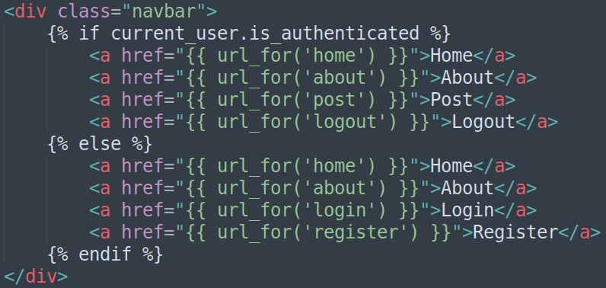
layout.html – Design Considerations
Now that the application can handle user sessions with a login and logout system implemented, it no longer makes sense to display the ‘Login’ and ‘Register’ link if the user is actually logged in. Similarly, if the user is not logged in, the ‘Post’ link should not be displayed.
Using Jinja syntax, the application can serve different content, if the user is authenticated:

Slide 22
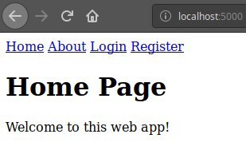
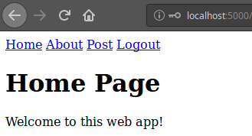
Checking the Application
A logged in user verses a logged out user:

Slide 23
Creating Login and Logout User Sessions
Directions
60 - 90 minutes
Update your project to implement a log in and log out session system. This will require:
2 new routes, a login manager, a new template, a new model(form) and a method to load the user session.
Don’t forget to update the ‘layout.html’ template to serve only relevant pages to logged in users
Debrief
Discuss how the current models created are not the best format they can be, for user created content.
<number>

Slide 24
Thank you for listening.
Any questions?

