Slide 1
Python Flask
Updating models

Slide 2
models.py – Design Consideration
Now that a login/logout system has been implemented, and only logged in users can make posts, the ‘Posts’ model needs to be updated.
‘Posts’ should no longer house ‘first_name’ and ‘last_name’. These now belong with the user’s details, within the ‘Users’ class.
‘PostForm’ should also be able to link to the ‘Users’ table, to pull this information out when the user makes a post. This will be achieved by making a relationship between the two tables, as well as creating a ‘backref’ so that the data within ‘Users’ may be accessed.
It would also be a good idea to post the time and date of the post being made, and this field should not be null, and should default to the time of posting (this should not be user entered).
These changes will mean that the ‘Users’ and ‘Posts’ models need to be updated, as well as ‘home.html’ template.

Slide 3
models.py – Users Class
Begin by moving ‘first_name’ and ‘last_name’ from the ‘Posts’ class, to the ‘Users’ class.
A new field must now be created that will link back to the posts made by that user. This will create a relationship between this class, and the ‘Posts’ class, and will utilise the ‘backref’ previously mentioned.
Lastly, this new field will have a new property called ‘lazy’ which will be set to ‘true’. This will load all data as necessary, in a single request. This will allows the application to grab all posts made by the user:

Slide 4
models.py – Users Class
With the changes made to the ‘Users’ class, the return statement needs to be updated to include the new fields:

Slide 5
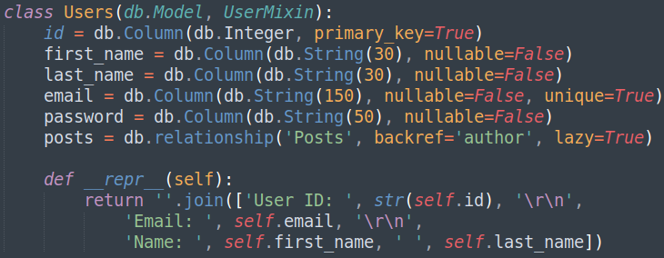
models.py – Users Class Overview
The ‘Users’ class should look similar too:

Slide 6
models.py – Posts Class
The ‘Posts’ class should include the time and date of the post being made, therefore ‘datetime’ must be imported:
The ‘date_posted’ field can now be created. This field will utilise ‘db.DateTime’. It also features a ‘default’ property, setting the default to ‘time.utcnow’:
A field that will be related to the ‘primary_key’ field from the ‘Users’ table must be made. This field shall be called ‘user_id’:

Slide 7
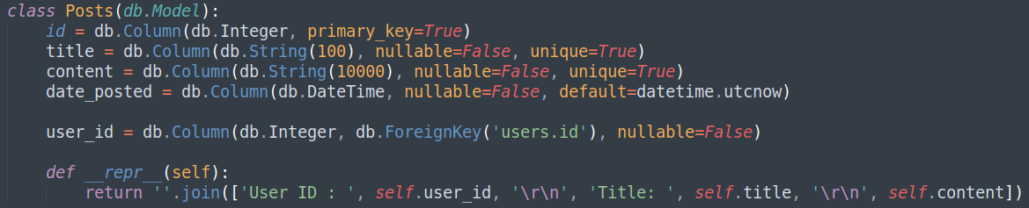
models.py – Posts Class Overview
Finally, the return statement needs updating. The ‘Posts’ class should now look similar to:

Slide 8
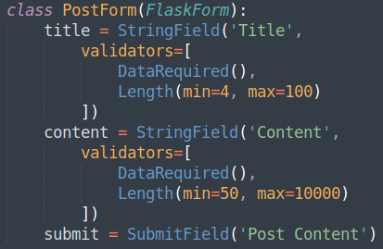
forms.py – Posts Class
Now that the models have been updated, the forms need to reflect the new changes. Move the ‘first_name’ and ‘last_name’ from the ‘PostForm’ form, to the ‘RegistrationForm’:

Slide 9

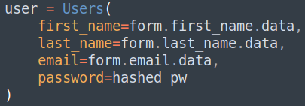
routes.py – Register Route
A few changes can now be made to the ‘/register’ route. The first change should be to check to see if the user is currently logged in, and if so, redirect them to the ‘/home’ route. Although the route is not exposed to the user from the web application user interface, the user may still access the route by entering the route in to the address bar directly:
The ‘user’ that is being built, ready to add to the ‘Users’ table, needs updating too:

Slide 10
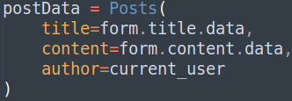
routes.py - Post Route
The next step will be to change the ‘/post’ route to conform to the new table structure ‘Posts’:
The ‘author’ field is actually a reference to the ‘backref’ previously mentioned. This ‘backref’, along with the relationship created between ‘Users’ and ‘Posts’, allows access to the owner of the contents record, from the ‘Users’ table.

Slide 11
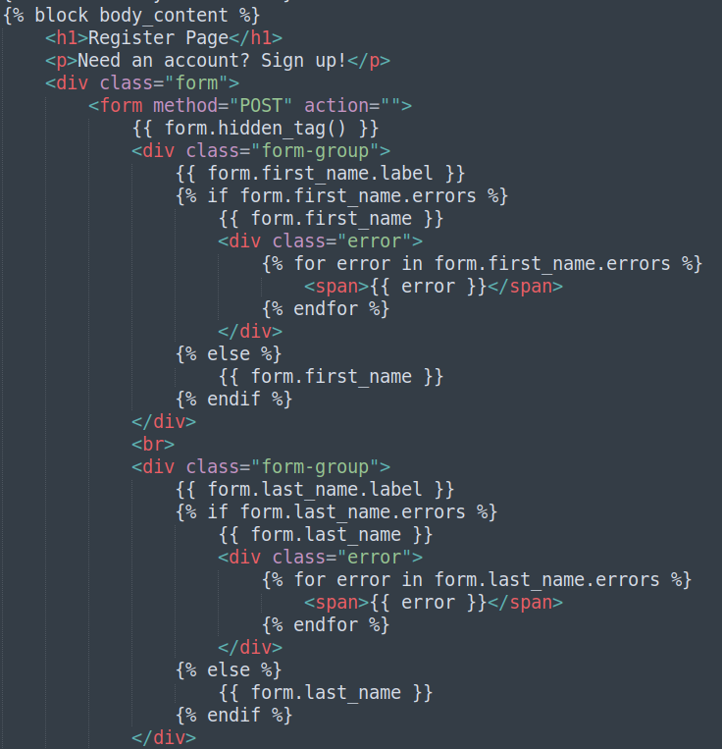
register.html
And of course, the templates must also be updated to reflect the changes. Moving the ‘first_name’ and ‘last_name’ fields from ‘post.html’ to ‘register.html’:

Slide 12
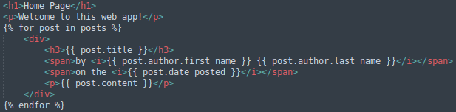
home.html
The only change needed to be made here, is a reference to the ‘backref’
by {{ post.first_name }} {{ post.last_name }} →
by {{ post.author.first_name }} {{ post.author.last_name }}

Slide 13
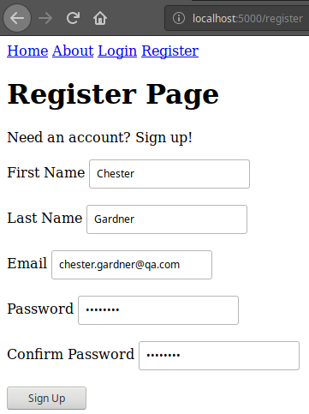
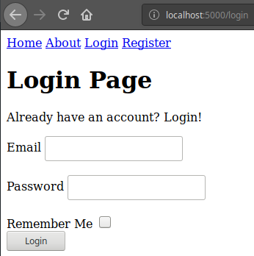
Checking the Application
The application should now present a better registration form than previously seen. Signing up with a new user, including a ‘first_name’ and ‘last_name’, should once more, direct the user to the ‘/login’ route once submitted and validated:

Slide 14
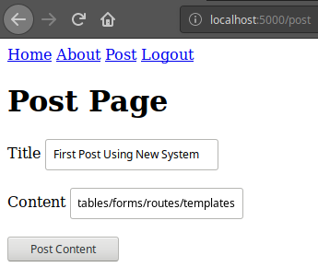
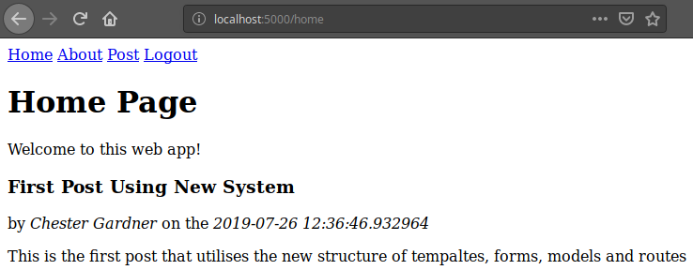
Checking the Application
Once logged in, creating a new post should now present the author’s first and last name:

Slide 15
Creating Better Forms and Models
Directions
1 hour
Update your project to update the database models, conforming to the better design (first and last name in Users not Posts), including the relationship between these tables.
Ensure you have a ‘backref’ to allow accessing the Users data from the Post & current_user.
Debrief
Discuss how you may approach a new project in the future, giving thought to the design considerations and changes made throughout these lectures.

Slide 16
Thank you for listening.
Any questions?

