Slide 1
Python Flask
Account page

Slide 2
Account Page – Design Considerations
Now that ‘Users’ can be created properly, and the user can be logged in and out, it now makes sense to build an ‘accounts’ route and template.
Within the accounts page, the user must be able to update their first and last name, as well as email address.
From the accounts page, the user should also be able to close down/delete their account. This in turn should delete all posts the user has made.
The account page should validate that the data submitted is valid, and that the email field is still unique to the rest of the system.
If the user updates their name, but not their email address, the application should not prevent the user from updating their details (as the email will not be unique, it will already exist on the system).
The account page form should have the same level of validation as the registration page.

Slide 3
forms.py – Update Account
The account form should include the following fields and validation, as well as a submit button:
first_name : String type, length min 4 and max 30, not null
last_name : String type, length min 4 and max 30, not null
email : String type, not null, email
These fields are essentially the same as the ‘RegistrationForm’ form.
The form will also need a ‘validate_email’ method too, passing in ‘self’ and ‘email’

Slide 4

forms.py – validate_email
The validation of the email field will not need to occur if the ‘current_user’’s email, and the email submitted in the form are the same. This is because of the unique field validation error that will be thrown for the ‘email’ field of the ‘users’ table.
This can be achieved by importing the ‘current_user’ module from ‘login_manager’:
Comparing the current user’s email, and the email of the form data:

Slide 5
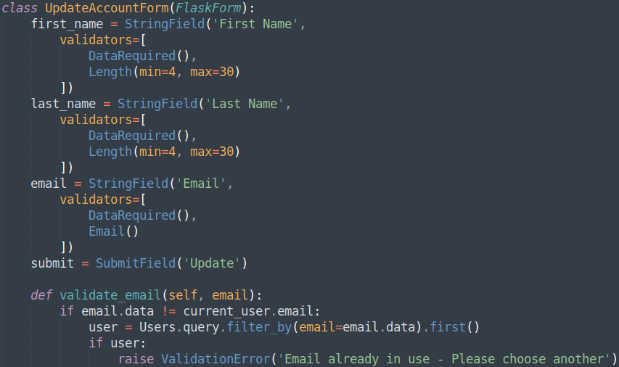
forms.py – Update Account Overview
The ‘UpdateAccountForm’ should now look similar to:

Slide 6
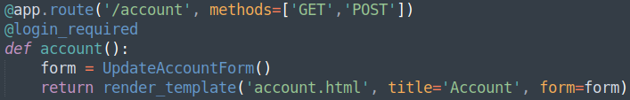
routes.py – Account Route
The ‘UpdateAccountForm’ form needs importing:
With a basic route to render a yet to be made, ‘account.html’ template, passing the form:

Slide 7
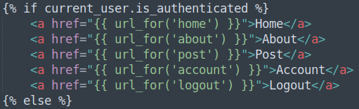
account.html & layout.html
The account page should be almost identical to the ‘Registration’ page, except without the ‘password’ and ‘confirm_password’ fields.
With a slight modification to the html, the currently logged in user’s first and last name can be displayed:
Lastly, update the navigation bar to include the new account page for a logged in user:

Slide 8

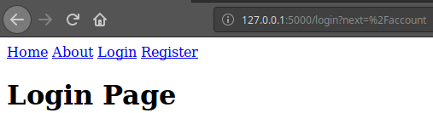
Checking the Application
Trying to access the ‘/account’ route should redirect the user to the ‘/login’ route, due to the ‘@login_required’ decorator, and provide a ‘next’ argument:

Slide 9
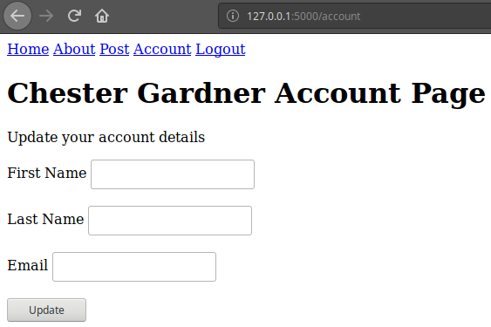
Checking the Application Cont.
Logging in at this point, the application should return the user to the account page:
At this stage, pressing the ‘Update’ button should return the user to the same page.

Slide 10
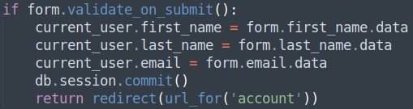
routes.py – Account Route
Due to the application logging the user in from the ‘/login’ route, with:
The ‘current_user’ data needs to correspond with the new changes that are being made:
Note, that the details entered must pass the validation checks required by the form, then update the ‘current_user’ details, commit the changes to the database, followed by a redirect to the ‘account’ page again.

Slide 11
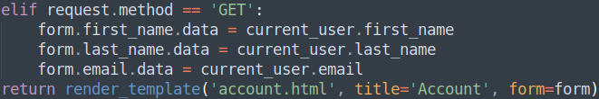
routes.py – Account Route Cont.
Utilising the ‘request’ module imported from ‘flask’, analysis on the type of request can be done. If the user is accessing the page from a ‘GET’ request, it would be a good idea to present the ‘current_user’’s details within the form already, so that the user is able to see and update accordingly:

Slide 12
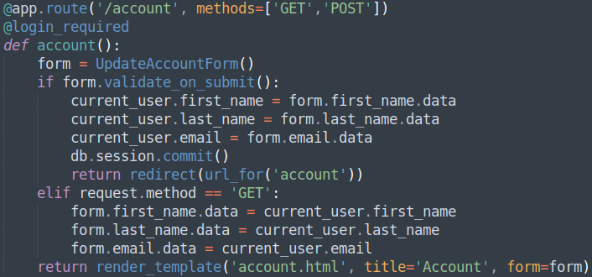
routes.py – Account Route Overview
The ‘/account’ route should look similar to:

Slide 13
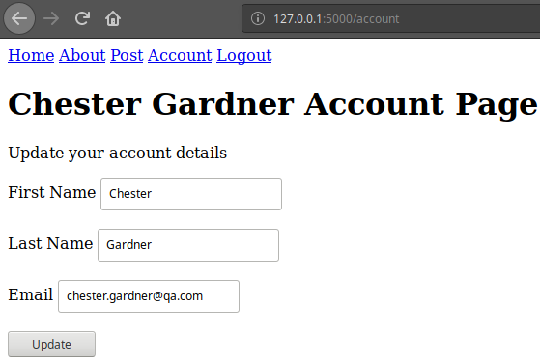
Checking the Application
Accessing the ‘/account’ route should now present the currently logged in user’s details:

Slide 14
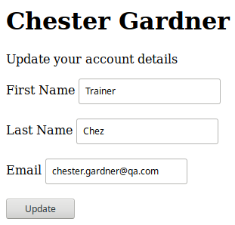
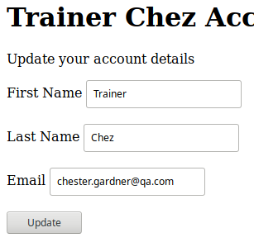
Checking the Application Cont.
Changing just the first and last name fields, and them submitting, should return back to the account page, but the name displayed should change:

Slide 15
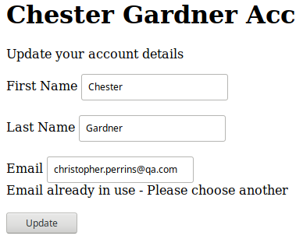
Checking the Application Cont.
Changing the email address to one that already exists, should raise the validation error:

Slide 16
Creating An Account Page
Directions
60 – 90 minutes
Update your project to include a new account page route, including a template, form and validation.
Debrief
Discuss how this task was difficult to understand if changes were made or not, from the web application.
<number>

Slide 17
Thank you for listening.
Any questions?

