Slide 1
Political Trends on Reddit
An Analysis of the Subreddits:
r/Republican
r/democrats
Notes:
Good Morning everyone. As you know, my name is Ian Irizarry. I was brought on this team to identify political trends on Reddit by analyzing text data within the subreddits r/ Republican and r/ democrats. Now, before we begin, I have a quick warning. Because you are a sophisticated audience, there will be some jargon, but not much. Promise. (next slide)

Slide 2
Overview
Brief introduction on the data
Future Action
Findings
Notes:
So, just to keep us on track, here is an overview of what we are going to be focusing on:
First, a quick overview of the data. This is primarily going to cover some quick observations of the data before gathering it.
Second, we come to the findings. This is where I show you how the model performed and what key words were the strongest predictors for determining one subreddit over the other. Plus I have a small bonus to help better understand NLP.
Finally, we will discuss future actions. This analysis revealed a lot and we should go over that.
So here we go (change slide).

Slide 3
Before we begin…
Notes:
Now before we begin, I want to introduce the term that guided this analysis: Natural Language Processing, or NLP for short.
As I thought about explaining NLP, I asked myself how to best explain it as a concept. What would be the best way to demonstrate what NLP is? Then it hit me. But before I show you what that is. Let's cover the material and the model a little bit. (change slide)

Slide 4
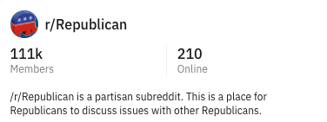
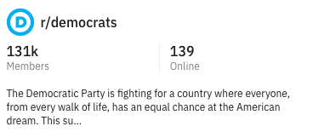
Notes:
As part of my analysis process, I used Reddits API (or Appliction programming interface) to pull data from two subreddits: r/Republican and r/democrats.
As you can see in this image, democrats have more members but potentially less active users compared to the republican subreddits membership to membership online.
As I gathered the data, and ran my models, here is what I found. (change slide)

Slide 5

Logistic Regression
Notes:
So this confusing looking table is called a confusion matrix. The point of this matrix is to demonstrate what predictions our model made compared to what the actual data is. For example, do you see that 2,311 number? That is my “True Positive”. That just means that out of the total predictions made, my model predicted 2311 Republican subreddit titles correctly. Do you see that 1024? That is my “False Positive” and all that means is my model falsely predicted a democrat title as a Republican.
Which brings me to my next slide which is evaluating how my model performed. (change slide)
Republican TP = 2311
Republican FP = 953 (type 1 error)
Democrats TN = 2106
Democrats FN = 1024 (type 2 error)

Slide 6
Logistic Regression
Classification Metrics | Scores
Accuracy | 69%
Sensitivity (Republicans) | 71%
Specificity (Democrats) | 67%
Precision | 69%
Notes:
So, you see four metrics here. These are classfication metrics.
Accuracy = TP + TN/ TP + TN + FP + FN: What percentage of observations did my model correctly predict?
Sensitivity/Recall/True Positive Rate = TP/FP + FN: of all the Republican’s, how many did I correctly predict
Specificity/True Negative Rate = TN/TN + FP: how many Democrats did I correctly predict?
Precision = TP/TP + FP: Of those my model predicted were Republican, how many were correct?

Slide 7
How shall we introduce NLP…
Notes:
So we just reviewed, the metrics but they don't really tell us how the model works. So we must ask our original question, how does NLP work? How shall we introduce NLP? And the best way is obviously…(change slide)

Slide 8
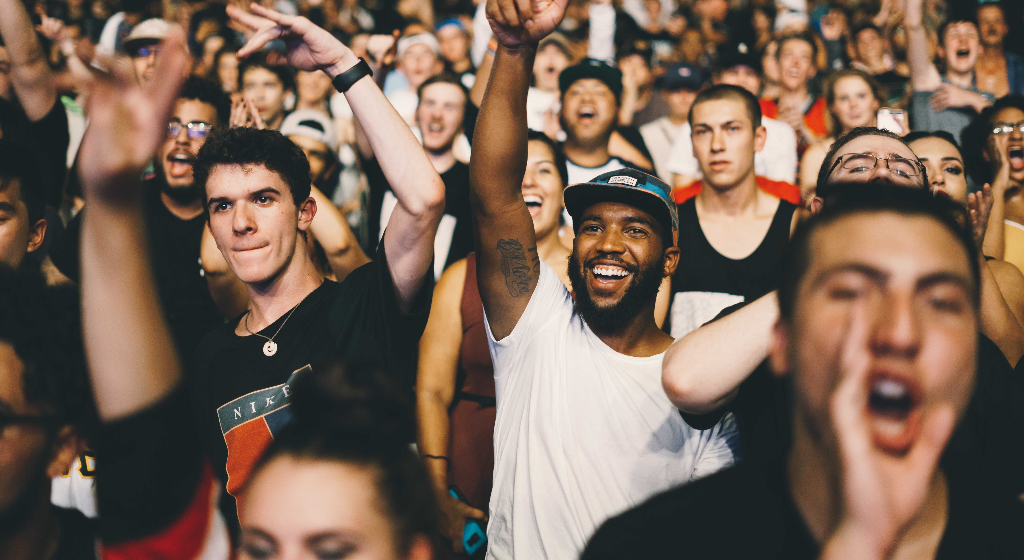
Game Show
Notes:
With a game show. And not just any game show, we'll be playing... (change slide)
Photo by Nicholas Green on Unsplash

Slide 9

Who Said It!
A Game Show That Isn’t a Game Show and Is Actually a Data Science Presentation.
Notes:
WHO SAID IT. (click next) A game show that isn't a game show and is actually a data science presentation where the only prize is having heard and seen it.
Now the game is simple, it’s all about predictions.
Why are we doing this? Because that's what NLP is all about. Making predictions with text data (change slide)

Slide 10
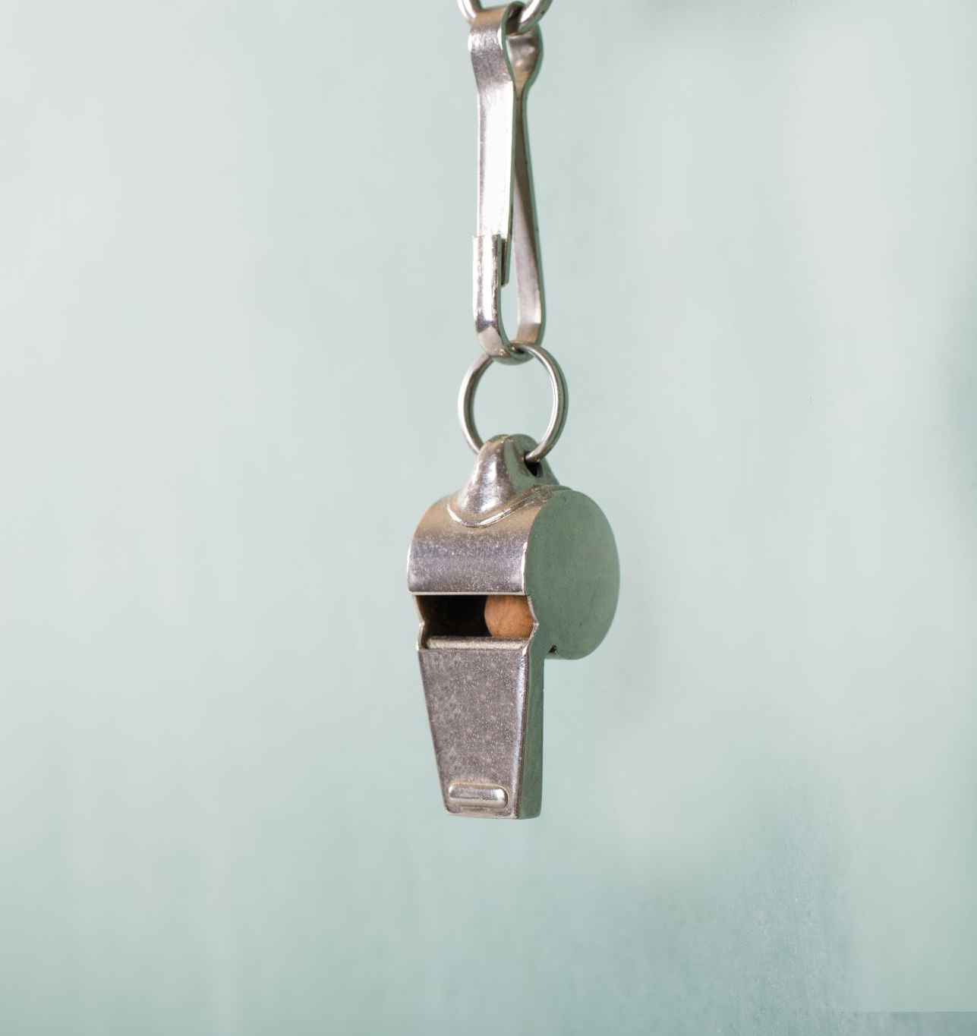
Rules
Notes:
Just to be clear, this game show still has rules (change slide)

Slide 11
1. Silence is key
2. Enjoy the show
Notes:
The first rule (click): silence is key. This means, I want you to play, without actually answering out loud. If you want to, throw it in Slack.
The second rule (click): enjoy the show. This means exactly how it sounds. It is my hope that this will be a fun little break from our busy days.

Slide 12
How to Play
Notes:
So I went over the basic rules of the game but now you’re wondering: “how do we play?”.
Unlike an NLP model, the game is simple: I give you an actual reddit title post and you tell me quietly, to yourself, what subreddit you think the title appeared in: r/Republican or r/democrats. Since the data is new to you, you are my testing group.
At the end of each round, I will tell you the answer. Each round will be harder than the last and the 3rd may make you wonder.

Slide 13
Who Said It!
Round 1
Notes:
So, round 1 begins now. Who said it? (change slide)

Slide 14
Who Said It!
"Trump doesn't have to spend a dime on any anti-Biden material. Sanders supporters do it all for him."
Notes:
Any guesses?
(silently)
3
2
1
The answer is: (change slide)

Slide 15
Who Said It!
r/democrats
Notes:
Based on our model and the actual subreddit the title was found in, the correct answer is r/democrats. (change slide)

Slide 16
Who Said It!
Round 2
Notes:
Round 2. Who said it.(change slides)

Slide 17
Who Said It!
'House Dem closing argument: Only guilty people assert their rights and insist on judicial review, or something'
Notes:
Any guesses?
(silently)
3
2
1
Survey says: (change slide)

Slide 18
Who Said It!
r/Republican
Notes:
Based on our model and the actual subreddit the title was found in, the correct answer is r/Republican. (change slide)

Slide 19
Who Said It!
Round 3
Notes:
Welcome to round three. Our final round. Who said it! (change slide)

Slide 20
Who Said It!
'Have the left side statistically speaking done good?'
Notes:
Can you guess?
(silently)
3
2
1
(change slide)

Slide 21
Who Said It!
r/Republican
Notes:
If you guessed, r/ Republican, then you might be my model which did get a lot right but in this case, not so much. (change slide)

Slide 22
Who Said It!
Actual Answer:
Notes:
That’s because the actual answer is (change slide)

Slide 23
Who Said It!
r/democrats
Notes:
r/democrats! ( change slide)

Slide 24
What Just Happened?
Notes:
So all fun aside, what happened here? (change slide)

Slide 25
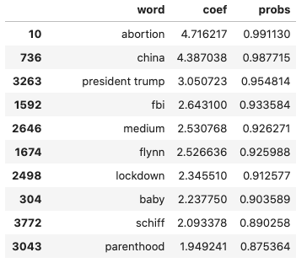
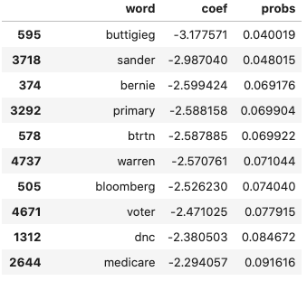
Republicans
Democrats
Notes:
These are the words with the strongest probability of predicting whether they came from the Republican or democrats subreddit.
In the left table, are the values that will most likely lead to a republican prediction. On the right, the democrats.
If you are looking at the ”probs” section, you will notice really high numbers on the left table and really low numbers on the right table. The reason for that is because our model’s goal was to predict Republicans for us. So the higher probability shows the likelihood of us being able to do so. The lower probability indicates a low likelihood which means it inevitably would indicate the democrats subreddit.
So, in short, if you had this information, you probably would have made better predictions, if your predictions were wrong. (next slide)

Slide 26

Next Steps

Slide 27
Future Action
Do a sentiment analysis
Re-run analysis to improve predictions
Notes:
So, you may or may not have realized that this model has some predictive power but it’s not perfect.
After reviewing several random samples of the title data that I gathered, I noticed that some posts contained certain predictive words that would have been indicators in the opposing subreddit.. So what should we do to improve the predictions? Do a sentiment analysis. I think that, with the proper context, we can probably determine how the same word or phrase used in both subreddits may be interpreted differently.
Using the information in the sentiment analysis, the next goal might be to find a way to apply weights to certain words as stronger predictors of whether it’s republican or democrat.
So, with this all said and done…(change slide)

Slide 28

Notes:
Thanks for playing ‘Who Said It’ and remember, I’m not wrong, but my model might be.
Questions?

