Slide 1


Slide 2

WHAT DO THESE HAVE IN COMMON?
Lasers
Fidget Spinners
Smoke
Financial Software

Slide 3
They make you Cool

Slide 4
THEY MAKE PEOPLE RESPECT YOU

Slide 5
THEY MAKE PEOPLE WANT TO BE YOUR FRIEND

Slide 6
TODAY BESMOKE IS GOING TO INTRODUCE YOU TO A NEW FRIEND…

Slide 7
…A FRIEND YOU CAN COUNT ON…

Slide 8
…A FRIEND YOU CAN TRUST…

Slide 9
… A FRIEND WHO WILL PROTECT YOUR FINANCIAL FUTURE…

Slide 10
THAT FRIEND IS…

Slide 11

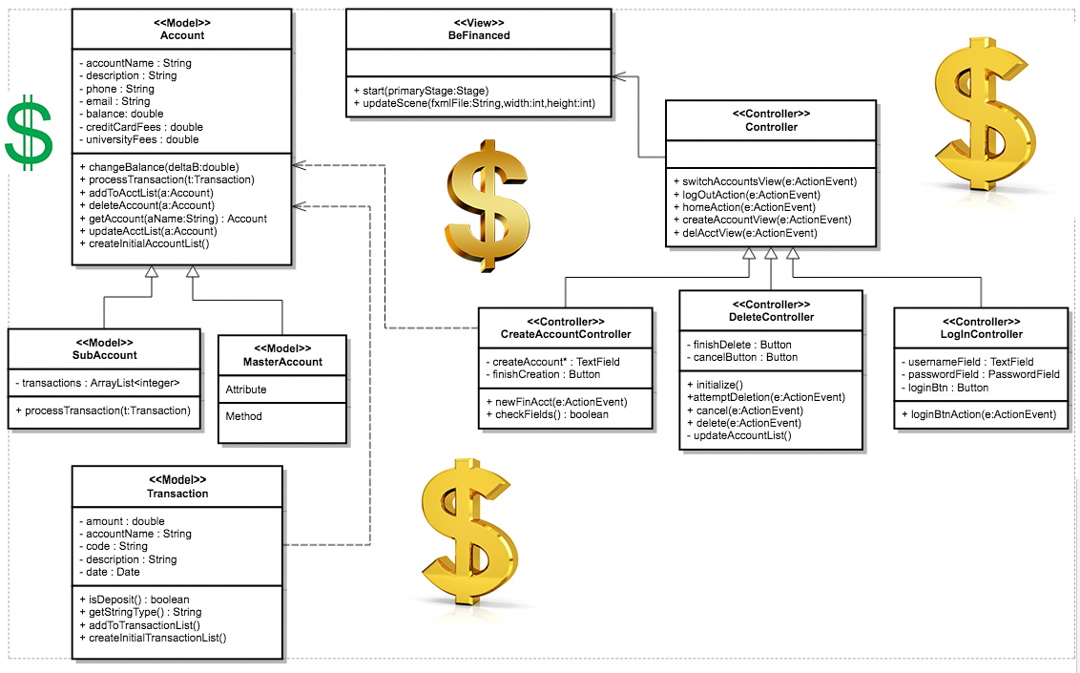

Slide 12

Profits = Skyrocket

Slide 13

PRODUCTIVITY = SKYROCKEt

Slide 14

VACATION TIME = SKYROCKET

Slide 15
You’ll GO HOME EARLY
YOU’ll COME IN LATE
YOUR BOSS WILL GIVE YOU A RAISE
YOUR FAMILY WILL APPRECIATE YOU
YOUR WIFE WILL TEAR UP THE DIVORCE PAPERS YOU’ll GO TO THE GYM
YOU’ll EAT KALE
YOU’LL FIND WHAT WAS MISSING YOUR WHOLE LIFE
YOU’ll LEARN THAT ALL YOUR LIFE, EVERYTHING YOU’ve DONE WAS ENOugh
YOU’ll MEET OBAMA, Abraham Lincoln, Marie Curie, Picasso, and most importantly KANYE WEST

Slide 16

ALL FOR THE LOW PRICE OF

Slide 17
TAKE THE INITIATIVE
TAKE CONTROL OF YOUR LIFE
BUY

