Slide 1

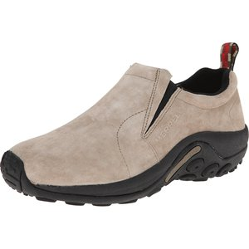
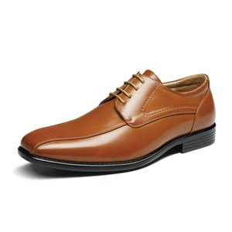
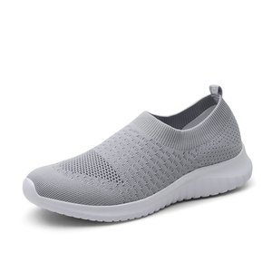
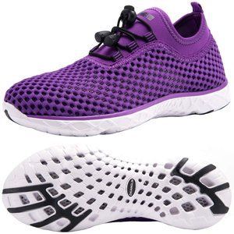
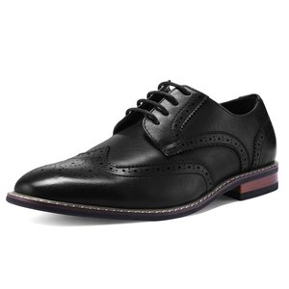
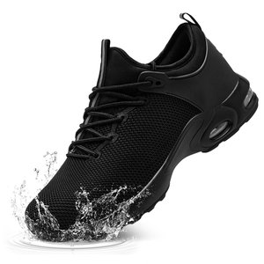
Dynamic Demand Modeling Using Multimodal AI
Price Elasticity Estimation for Amazon Shoes via Deep Embeddings and Double Machine Learning
Billy | Ian | Yuhui | Jyoti
Advisor: Guy
Replication of Victor et al. (2025) "Adventures in Demand Analysis Using AI"
Northeastern University | April 2026

Slide 2
Agenda
01
Data Collection from Keepa
02
EDA, Cleaning & Train/Val Split
03
Multimodal Embedding Training
04
PCA, Clustering & Feature Engineering
05
DoubleML: Estimating Price Elasticity
06
Results: Women's vs Men's Comparison
07
Next Steps & Future Directions

Slide 3

Data Collection
Keepa API | Amazon US | Shoes Size 8 | Women & Men
Third-party Amazon price & sales tracker
Total ASINs
7,761
Historical price, sales rank, Buy Box, ratings, reviews
Amazon does not expose this data directly
7 batch notebooks, split by sales rank range (1K-100K)
Date window: Jan 2025 to Mar 2026 (454 days)
Extended to Mar 2026 to avoid backfilling artifacts
Total Rows
1,008,930
Date Range
Jan 2025 - Mar 2026
Women
5,472 ASINs
Men
2,279 ASINs
Both Women and Men analyzed independently using the exact same pipeline and methodology
Notes:
Keepa is our data source since Amazon doesn't provide historical sales data.
We scraped 7 batches to work within Colab session and API rate limits.
The date window was extended to March 2026 (from Jan 2026) to avoid needing backfill.
Both genders are in the same raw dataset, split during data preparation.

Slide 4
EDA & Data Wrangling
Cleaning | Forward Fill | Stratified 50/50 Split
Women's Shoes
Men's Shoes
5,472 ASINs after gender filter
12 dirty ASINs removed
324 incomplete ASINs dropped post-fill
Final: 5,147 clean ASINs
Train: 2,573 | Val: 2,574
Top categories: Pumps, Flats, Heeled Sandals,
Loafers, Mules & Clogs, Ballet & Dance
2,279 ASINs after gender filter
11 dirty ASINs removed
217 incomplete ASINs dropped post-fill
Final: 2,061 clean ASINs
Train: 1,029 | Val: 1,032
Top categories: Loafers, Oxfords, Sneakers,
Walking, Road Running, Trail Running
Raw data > Remove dirty ASINs > Gender filter > Forward fill (Jan/Feb seed) > Drop incomplete > Stratified split
Notes:
Both pipelines use identical methodology. Jan/Feb 2025 data is used as forward-fill seed, then trimmed to March onwards.
Men's dataset is smaller (2,061 vs 5,147) with very different subcategory distributions.
Where women have Pumps and Heeled Sandals, men have Oxfords and Golf shoes.

Slide 5
Multimodal Embedding Training
Victor et al. (2025) Appendix G | Three Encoders + Cross-Attention Fusion
Text Encoder
Image Encoder
Tabular Encoder
RoBERTa
BEiT
SAINT
Product title, brand, model, color, size
Product photo (224x224 pixels)
Rating, reviews, offers, Buy Box, deals
Cross-Attention Fusion > LayerNorm > FC Projection > 128 / 256-dim Embedding
Sales Rank Prediction (Q)
Price Prediction (P)
4 Training Variants (NVIDIA H200 GPUs on Northeastern RC Cluster)
Part 3a
Part 3b
Part 3c
Part 3d
Text + Image + Tab
Text + Image + Tab
Text only
Text only
Lag-1
Time-indep.
Lag-1
Time-indep.
Each variant produces 6 prediction zip files (2 embedding dims x 2 splits + 1 diff model x 2 splits) = 24 total

Slide 6
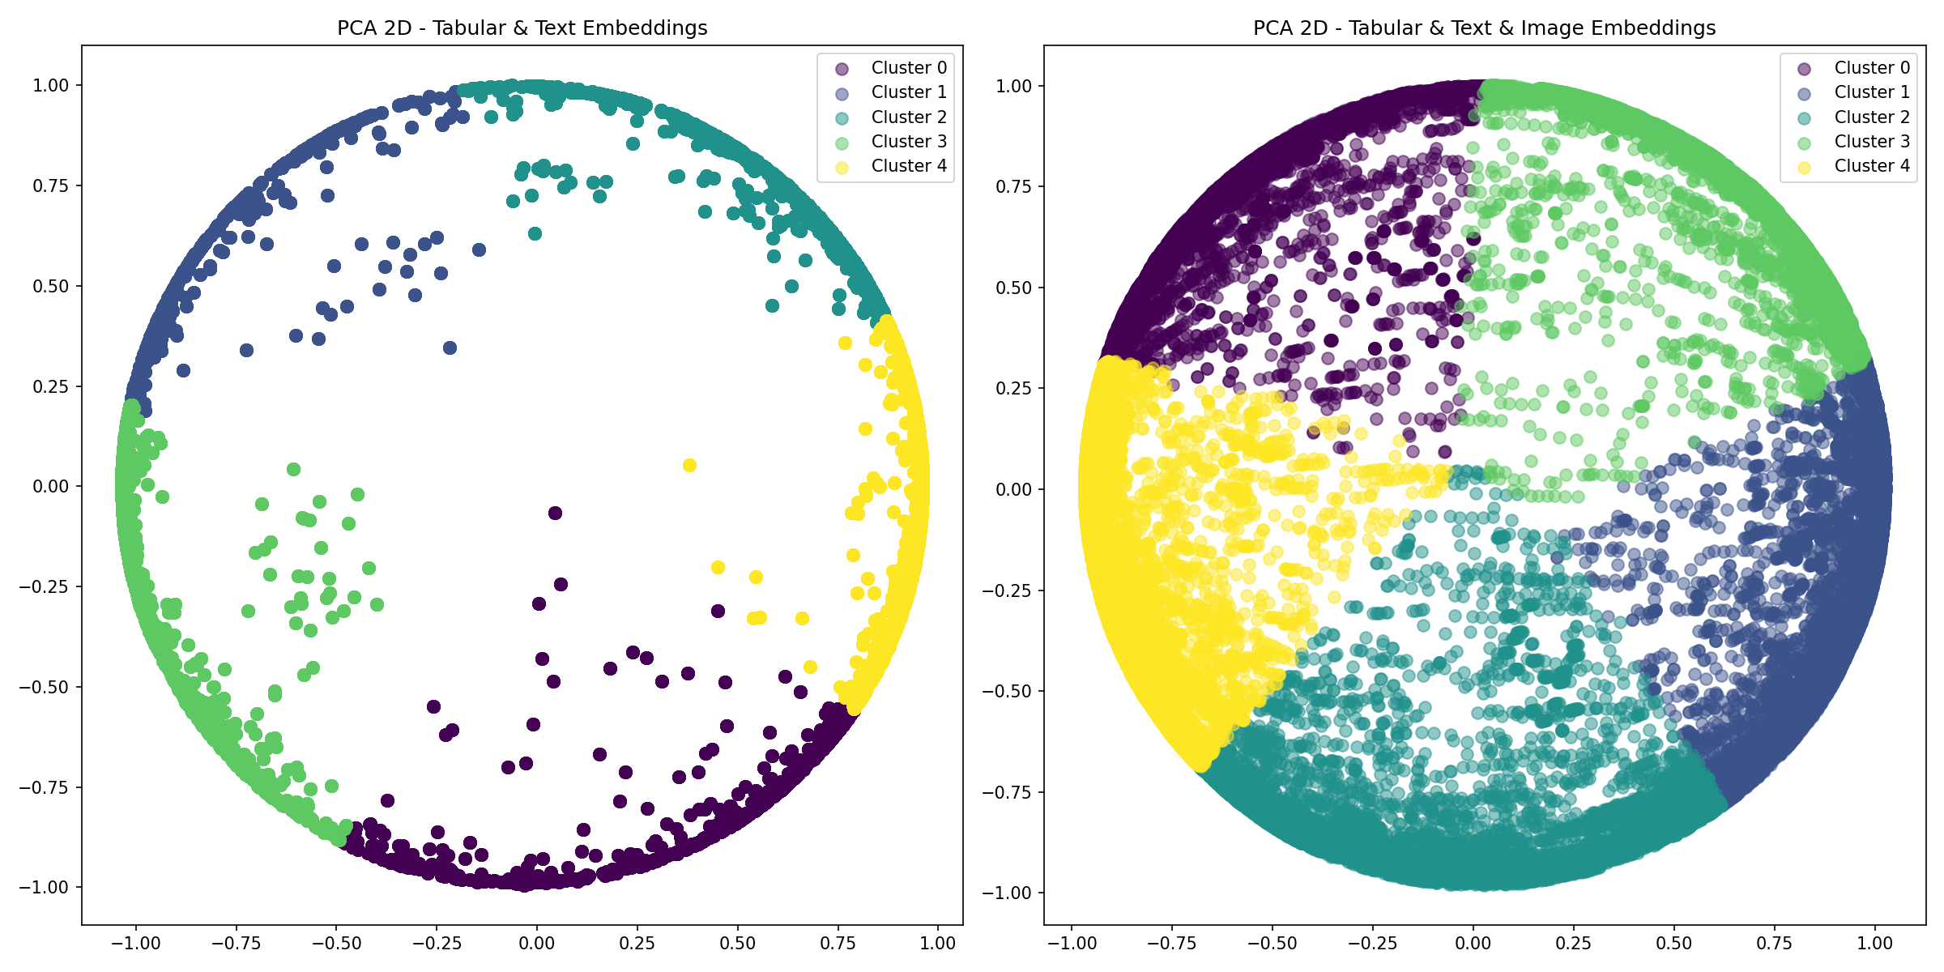
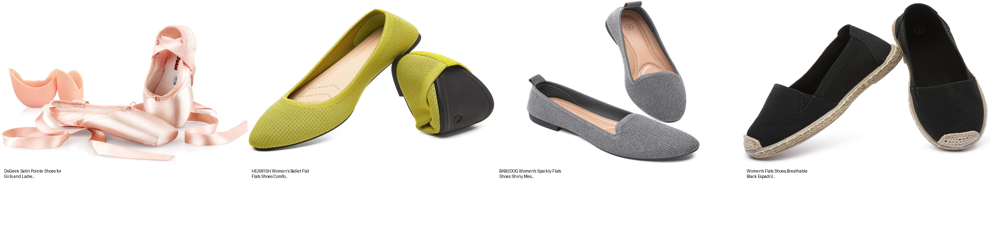
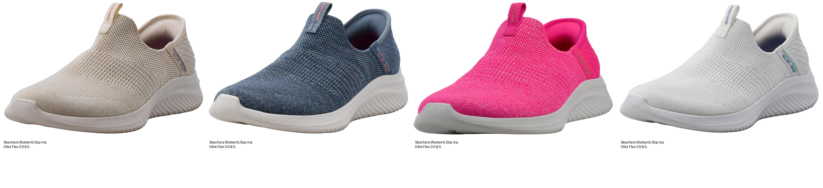
PCA & Product Clustering
KMeans (k=5) | Embedding Space | Women's Shoes
Women's Shoe Clusters
Cluster 0
n=19,620
-0.15 CATE
Largest cluster
Cluster 1
n=17,194
-0.14 CATE
Second largest
Cluster 2
n=9,211
-0.34 CATE
High sensitivity
Cluster 3
n=9,026
-0.14 CATE
Moderate
Cluster 4
n=4,927
-0.43 CATE
Most elastic

Slide 7
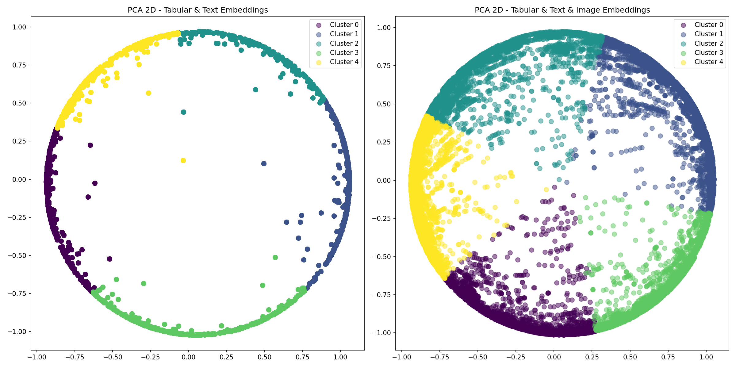
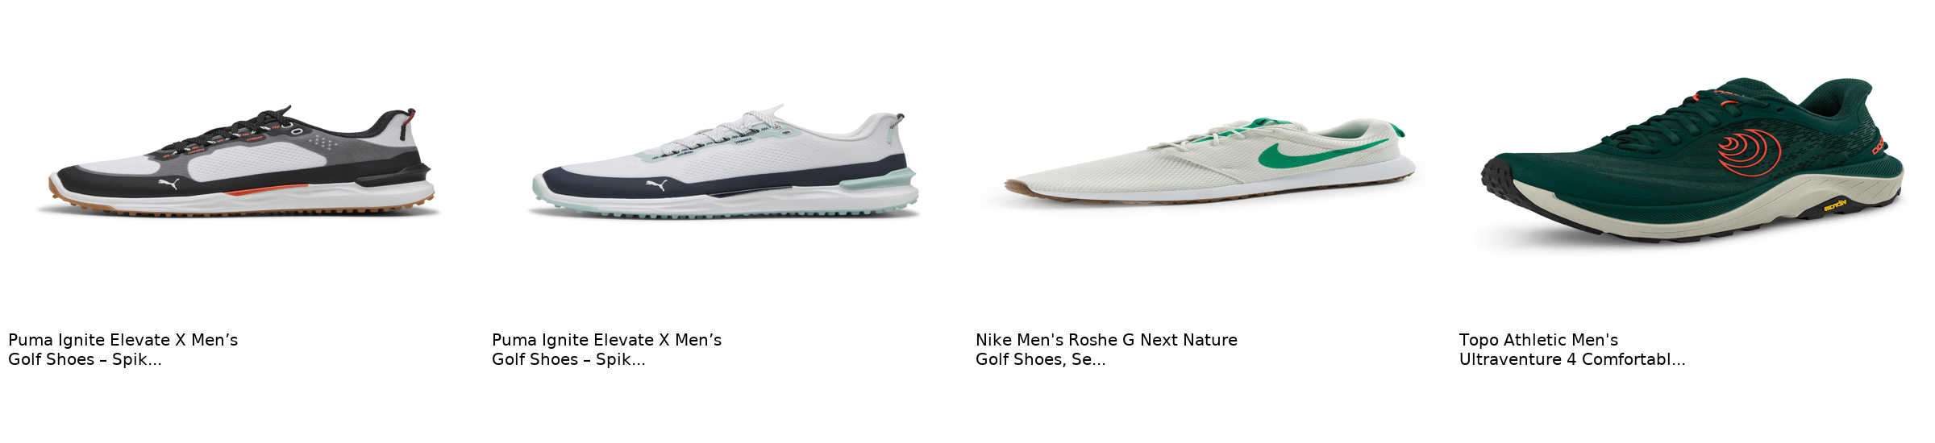
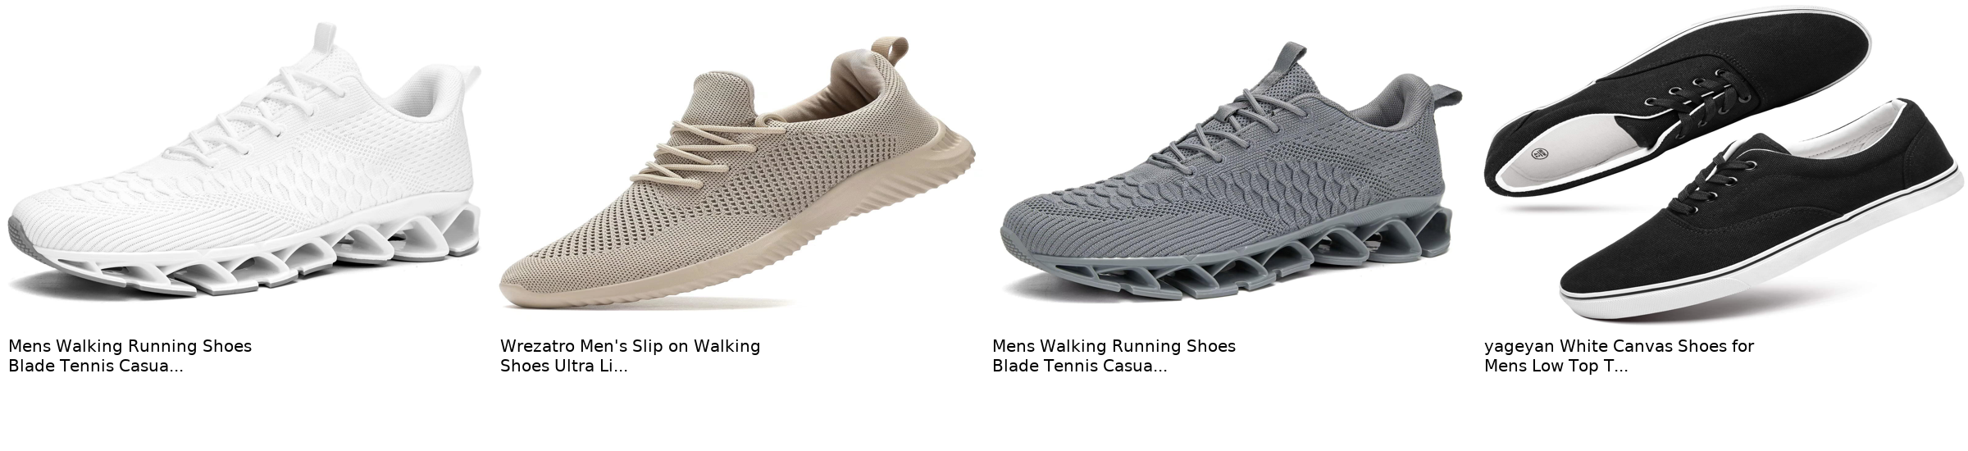
PCA & Product Clustering
KMeans (k=5) | Embedding Space | Men's Shoes
Men's Shoe Clusters
Cluster 0
~$31
-0.12 CATE
Walking, Sneakers
Cluster 1
~$42
-0.15 CATE
Loafers, Dress
Cluster 2
~$87
-0.34 CATE
Premium Athletic
Cluster 3
~$39
-0.19 CATE
Mixed Casual
Cluster 4
~$94
-0.37 CATE
Premium Performance
Cluster 0: Budget walking/sneakers
Cluster 2: Premium athletic

Slide 8
Double Machine Learning (DoubleML)
Causal Inference for Price Elasticity
The Challenge
DoubleML Solution
"If price goes up 1%, how does demand change?"
Naive regression is biased: brand, quality,
reviews all affect BOTH price and demand
We need to isolate the true causal effect
Stage 1: ML predicts sales rank AND price
using embeddings as controls. Save residuals.
Stage 2: Regress residuals on each other.
Removes confounding, isolates true effect.
Why AI Embeddings as Controls?
Traditional controls (brand, category) miss subtle product characteristics. Multimodal embeddings capture visual style, text semantics, and market positioning that humans recognize but standard variables cannot encode. Better controls = less omitted variable bias = more accurate elasticity.
Instrumental Variable: Weighted Substitute Price
Distance-weighted average price of 5 nearest neighbors in embedding space, lagged one period. Competitors' prices affect this product's demand (consumers can switch), but don't directly cause this product's price to change. Valid instrument for causal inference.

Slide 9
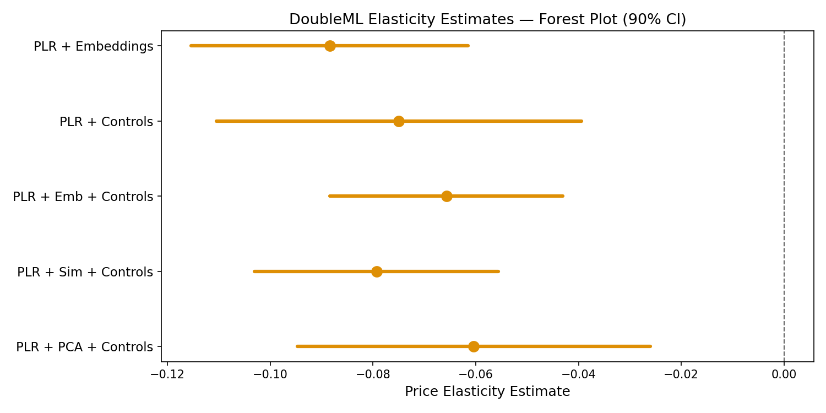
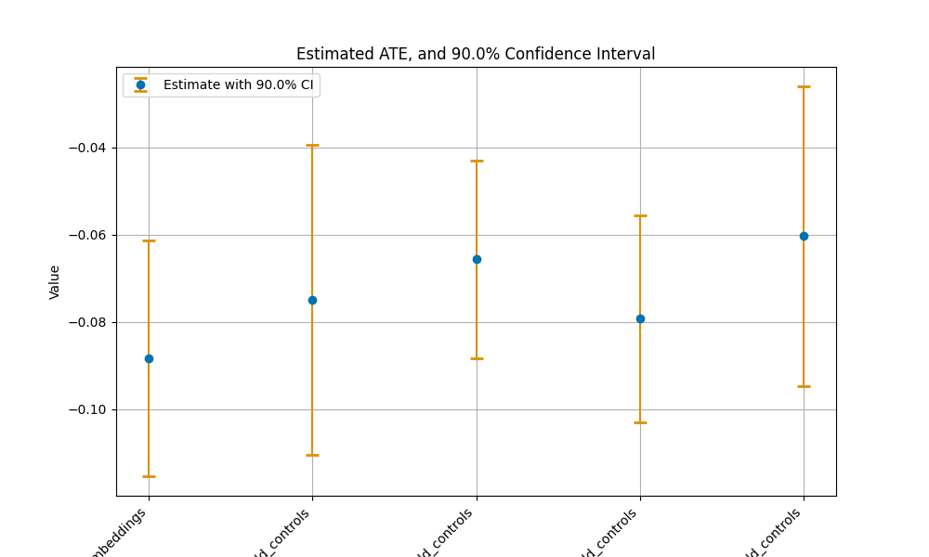
Price Elasticity Results: Women's Shoes
DoubleML Partially Linear Regression (PLR)
Key Finding
~-0.07 to -0.09
Significant negative elasticity across all PLR specifications 5,147 ASINs in analysis
PLR Specifications
+ Embeddings
~-0.09
+ Controls
~-0.07
+ Emb + Controls
~-0.065
+ Sim + Controls
~-0.08
+ PCA + Controls
~-0.06

Slide 10
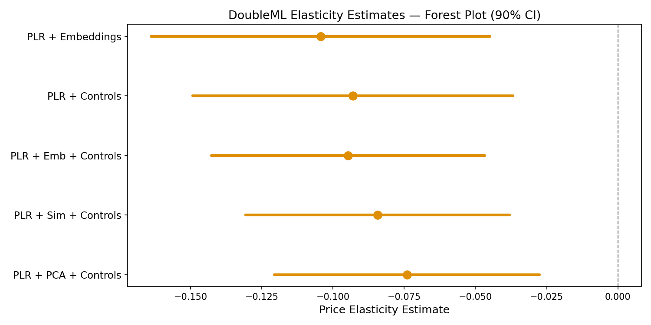
Price Elasticity Results: Men's Shoes
DoubleML Partially Linear Regression (PLR)
Key Finding
-0.095
1% price increase leads to ~0.095% worsening in sales rank All specs significant (p < 0.01)
PLR Specifications
+ Embeddings
-0.104
+ Controls
-0.093
+ Emb + Controls
-0.095
+ Sim + Controls
-0.084
+ PCA + Controls
-0.074

Slide 11
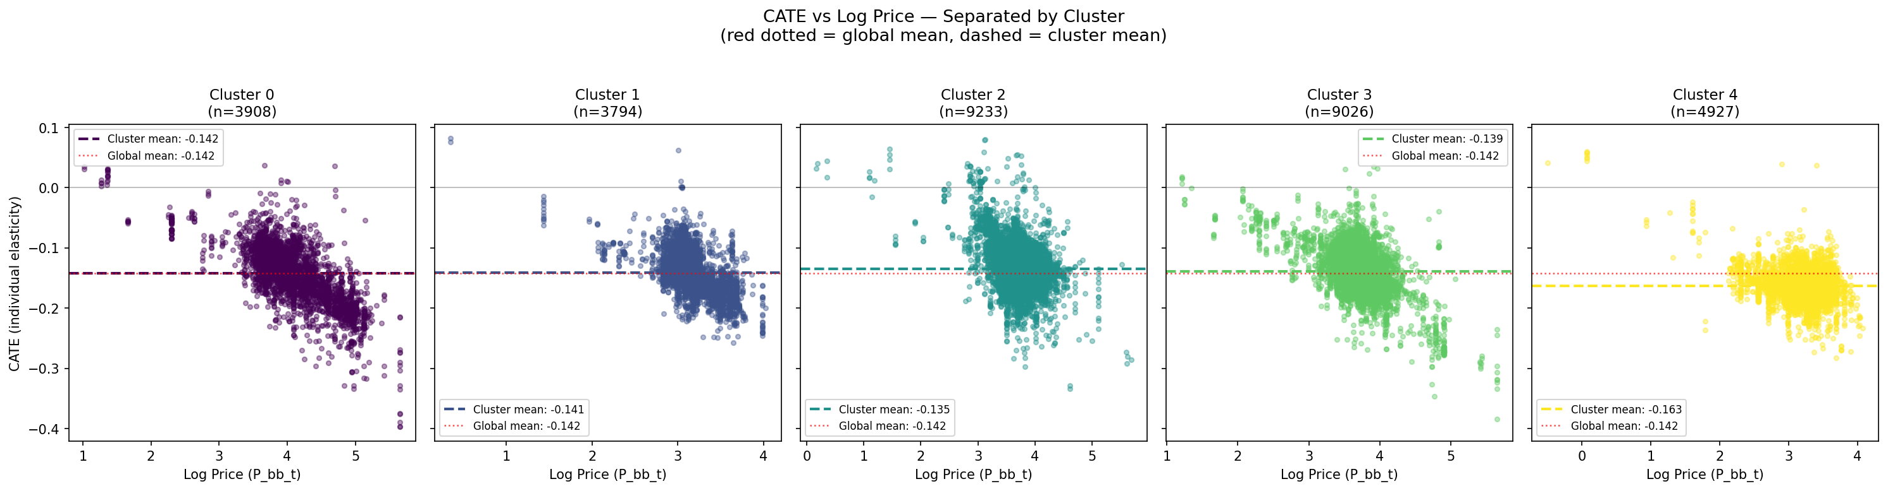
Heterogeneous Effects (CATE)
Price Sensitivity by Cluster | Women's Shoes
Price Sensitivity by Cluster
Cl. 0
n=19,620
-0.15
Largest cluster
Cl. 1
n=17,194
-0.14
Second largest
Cl. 2
n=9,211
-0.34
High sensitivity
Cl. 3
n=9,026
-0.14
Moderate
Cl. 4
n=4,927
-0.43
Most elastic
Cluster 4 (smallest) shows strongest price sensitivity at CATE = -0.43

Slide 12
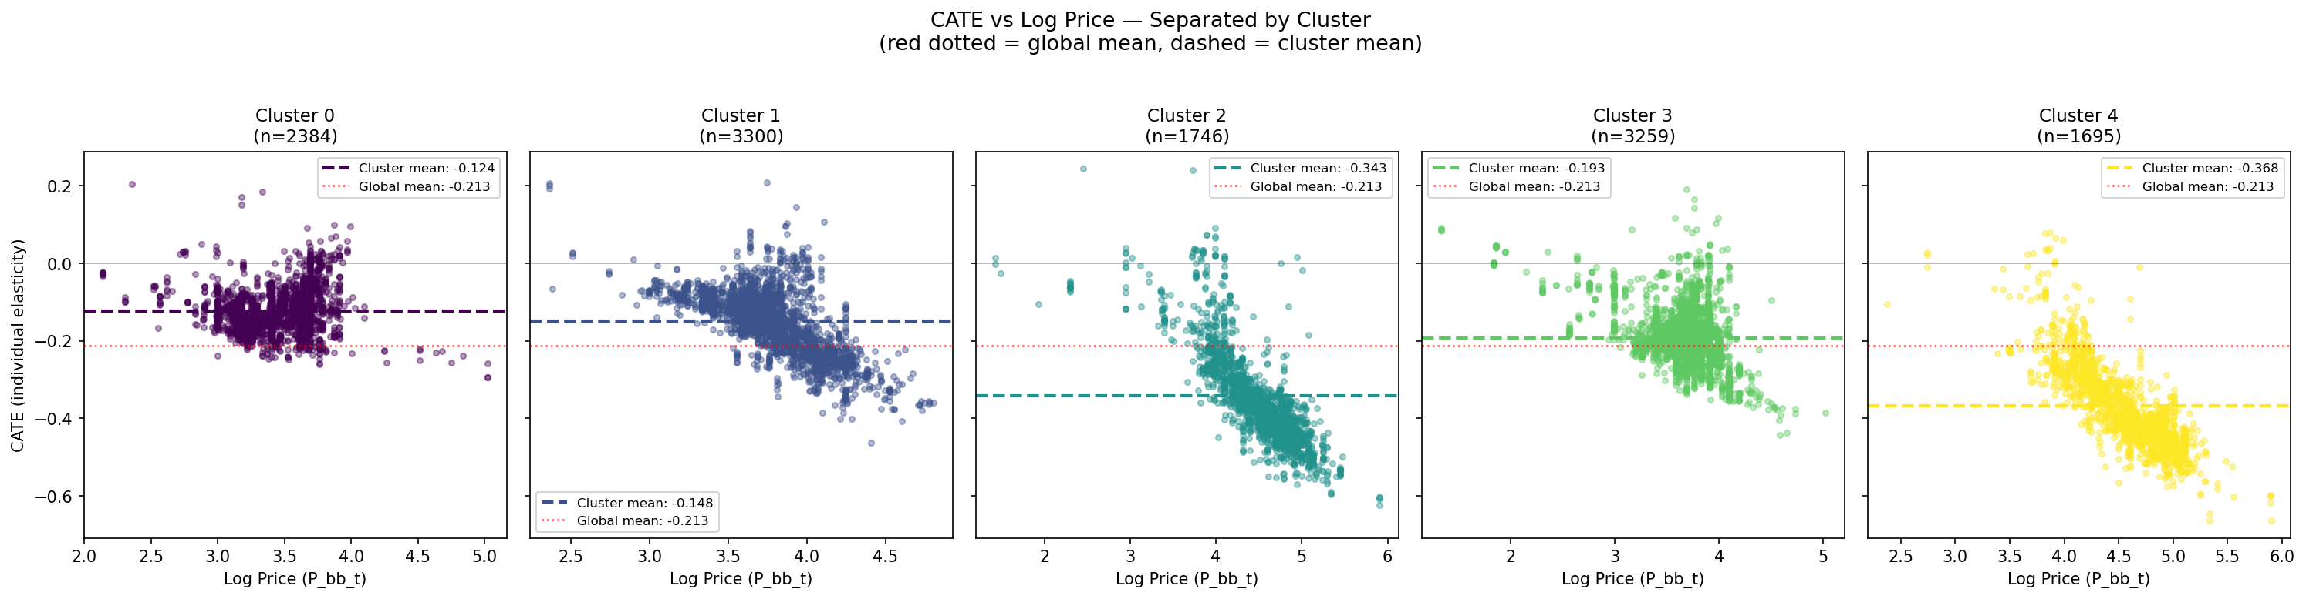
Heterogeneous Effects (CATE)
How Price Sensitivity Varies Across Product Clusters | Men's Shoes
Price Sensitivity by Cluster
Cl. 0
$31
-0.12
Budget walking
Cl. 1
$42
-0.15
Loafers, dress
Cl. 2
$87
-0.34
Premium athletic
Cl. 3
$39
-0.19
Mixed casual
Cl. 4
$94
-0.37
Premium perf.
Premium shoes ($87-94) are 3x more price-elastic than budget shoes ($31)

Slide 13
Women's vs Men's: Elasticity Comparison
Side-by-Side DoubleML Results
Women's Shoes (5,147 ASINs)
Men's Shoes (2,061 ASINs)
Key Observations
Both segments show significant negative price elasticity, confirming the approach works across genders
Identical methodology, only the data differs, making this a clean apples-to-apples comparison
Different category structures (Pumps/Heels vs Oxfords/Loafers) lead to different cluster dynamics

Slide 14
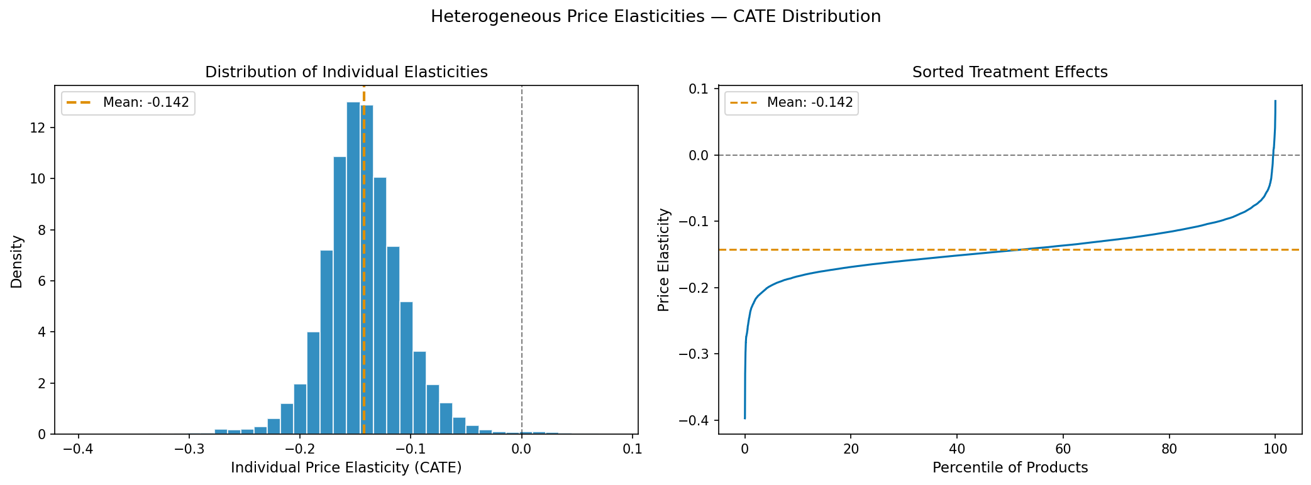
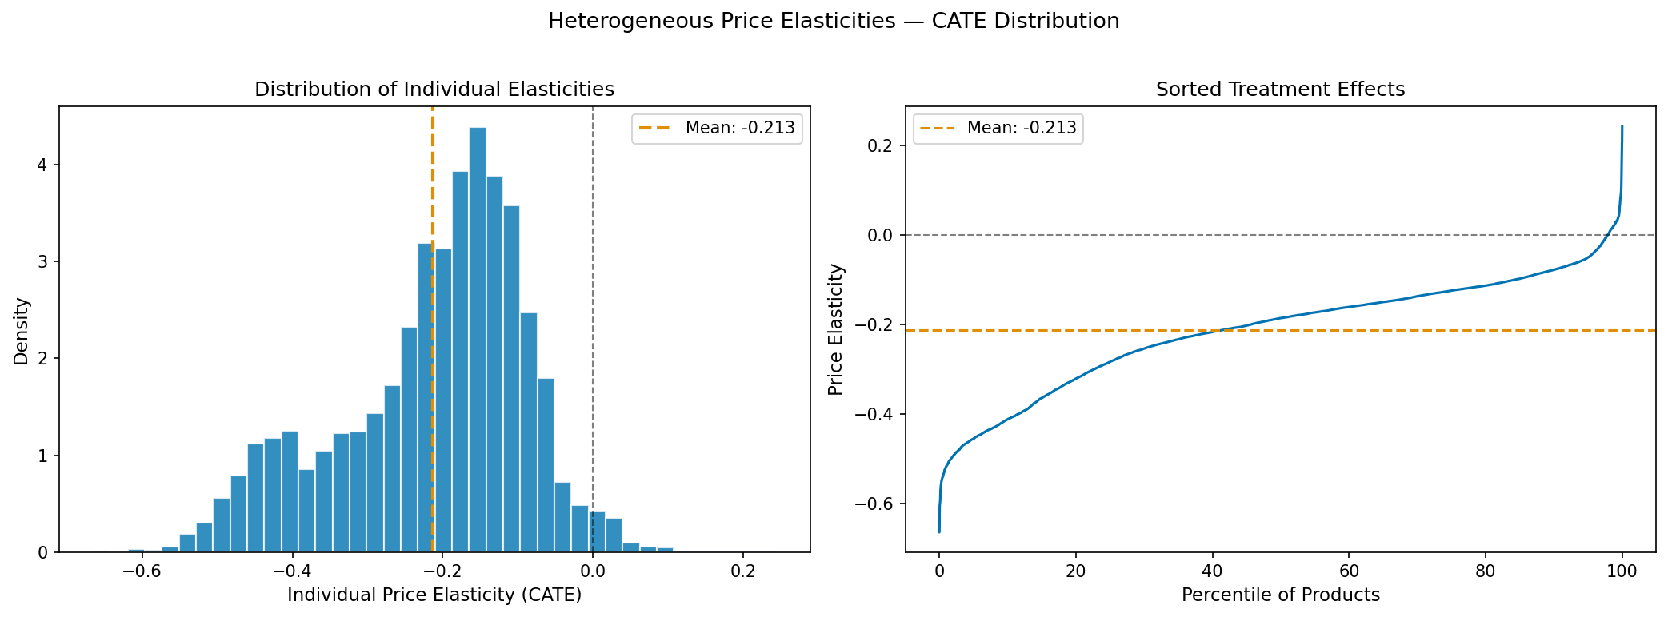
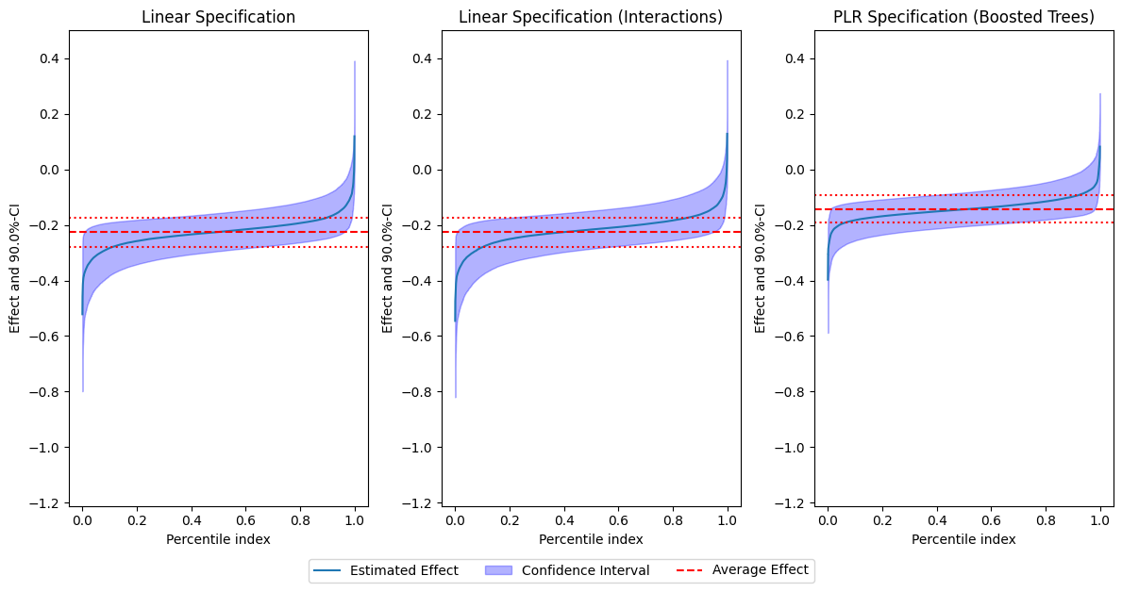
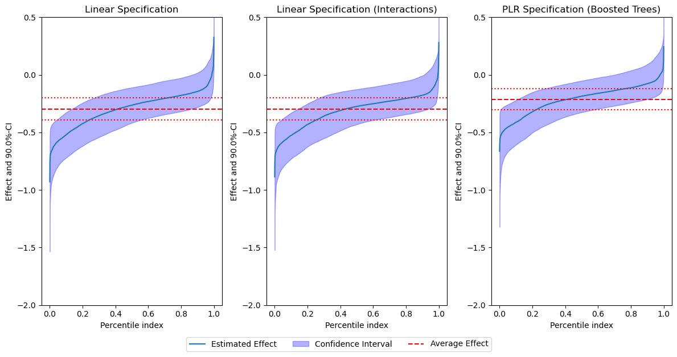
CATE Distributions: Women vs Men
Heterogeneous Treatment Effects Across Gender Segments
Women's CATE Distribution
Men's CATE Distribution
Women's Cluster Sorted Effects
Men's Cluster Sorted Effects

Slide 15
Next Steps & Future Directions
Expand to More Sizes
Apply pipeline to sizes 7, 9, 10 to test if elasticity patterns hold
Cross-Gender Statistical Tests
Formally test whether Women vs Men elasticities are significantly different
Temporal Dynamics
Analyze seasonal effects: holiday pricing, back-to-school, Prime Day impacts
Category-Level DoubleML
Separate models per subcategory for finer-grained pricing insights
Dynamic Pricing Application
Build a recommendation system using estimated elasticities for real-time pricing
Additional Data Sources
Incorporate customer review text, Q&A data, and competitor pricing signals

Slide 16
Thank You!
Questions & Discussion
Billy | Ian | Yuhui | Jyoti
Advisor: Guy
Victor et al. (2025) "Adventures in Demand Analysis Using AI"
Northeastern University | April 2026

