Slide 1
Final Project Review
Project Group: D3
Marc Aldrich, Brett Bookout, Ian Davis

Slide 2
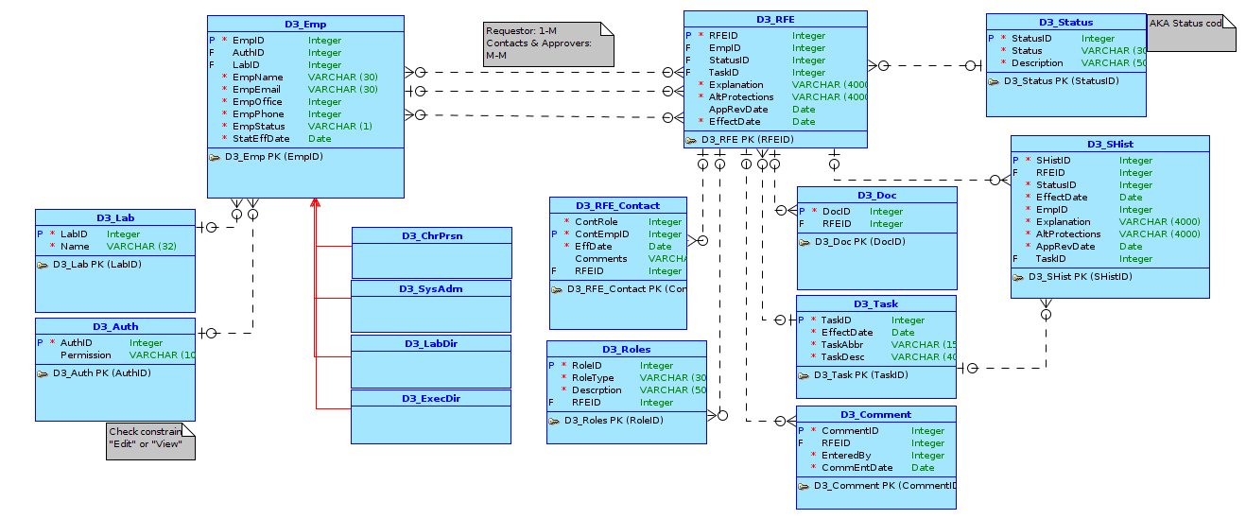
Conceptual Model

Slide 3
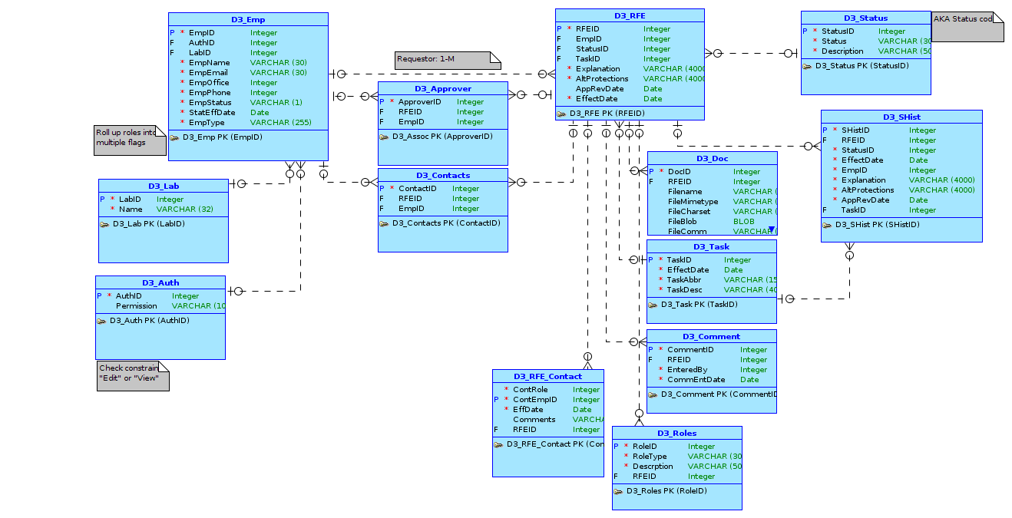
Logical Model

Slide 4
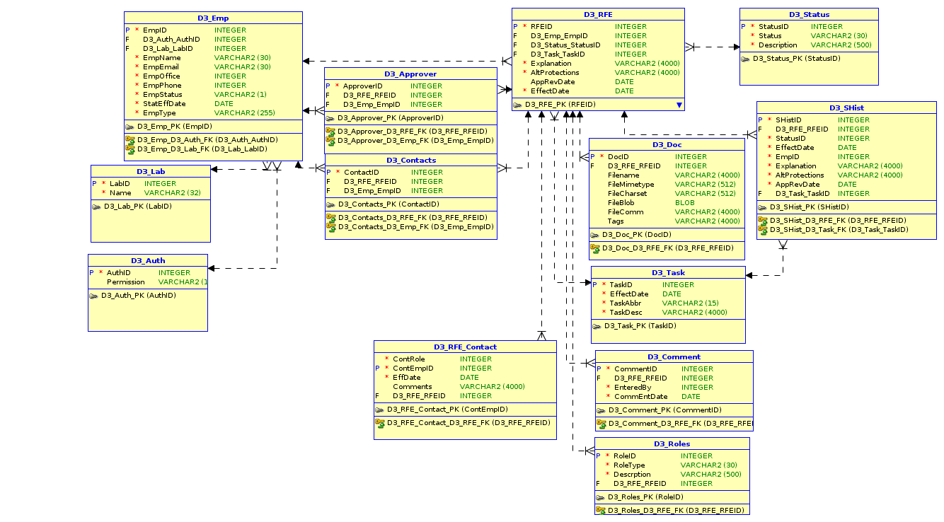
Relational Model

Slide 5
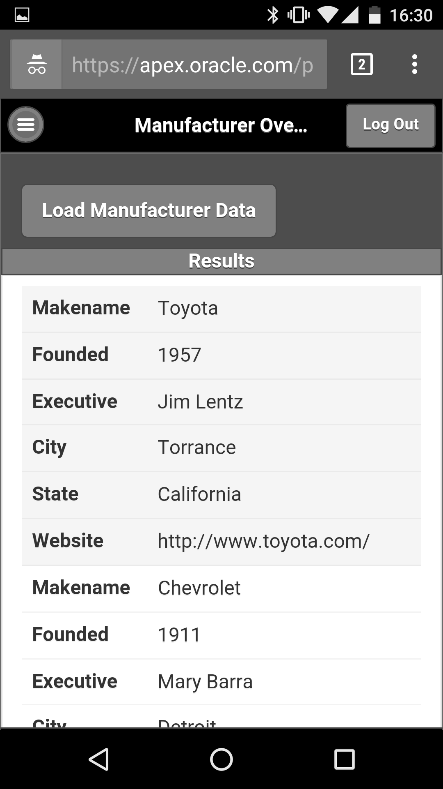
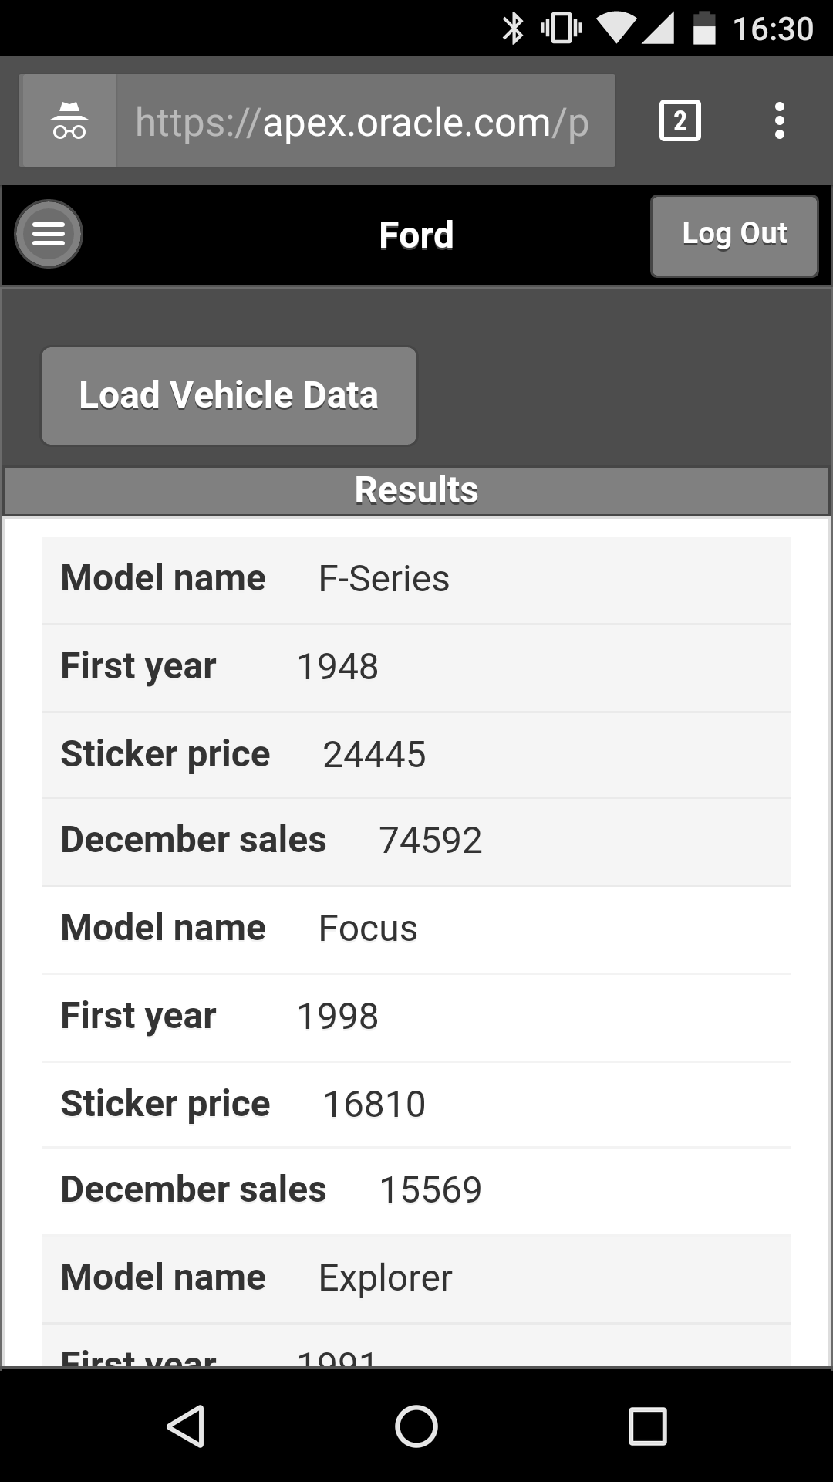
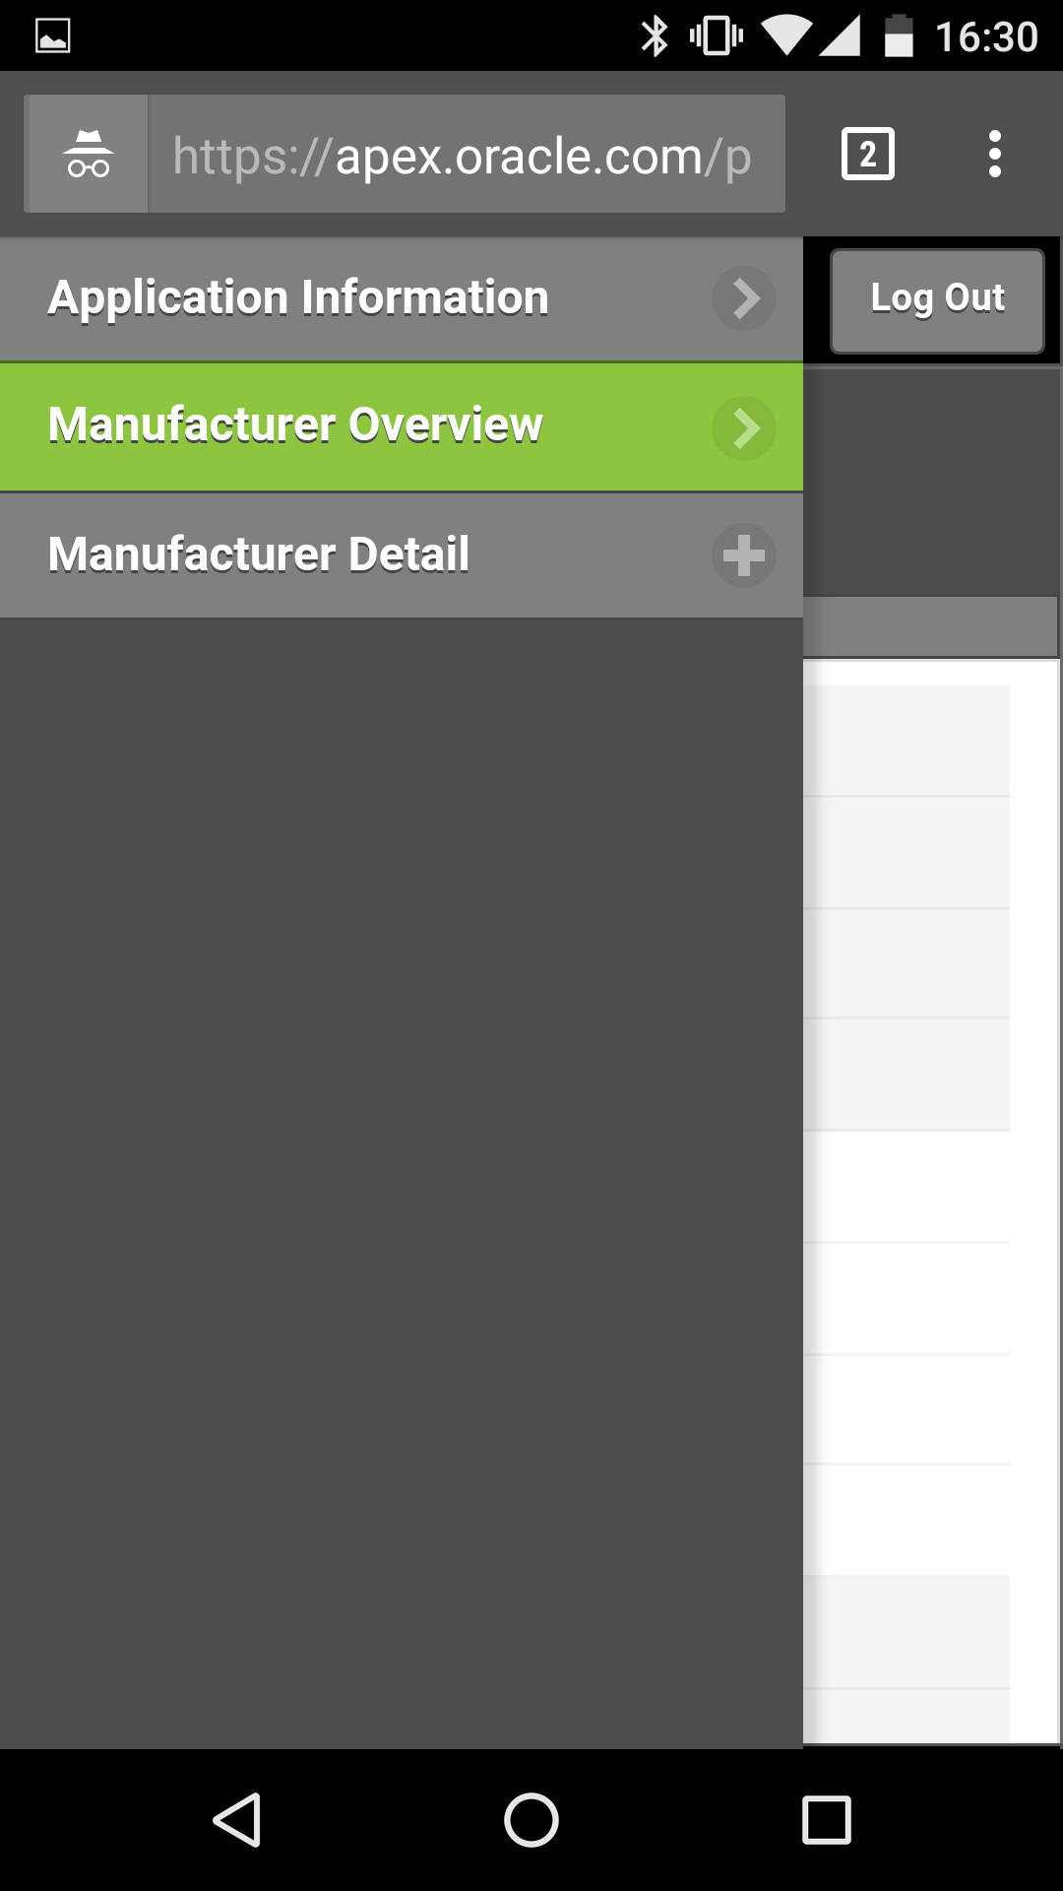
Mobile Application
https://apex.oracle.com/pls/apex/f?p=99026:1:101237456979226:::::

Slide 6
DEsktop Application
https://apex.oracle.com/pls/apex/f?p=97417:1:107345729468157:::::

