Slide 1




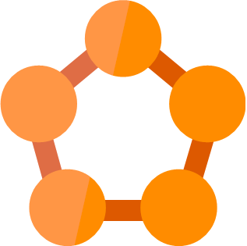







Companies
Microservice
Rule #1
Microservice
Web
Microservice
Portfolio
Microservice
REST
AMQP
WebSockets
REST
AMQP
WebSockets
HTTP/2
REST
AMQP
WebSockets
Browser
API
Gateway
Microservice
Watchlist
Microservice
GraphQL
WebSockets
REST
AMQP
WebSockets
REST
AMQP
WebSockets
Mobile
Service Fabric
Cluster
Identity
Microservice
REST
AMQP
WebSockets
iOS
Android
REST
AMQP
WebSockets
REST
AMQP
WebSockets
Gamification
Microservice
Email
Microservice
Windows

