Slide 1


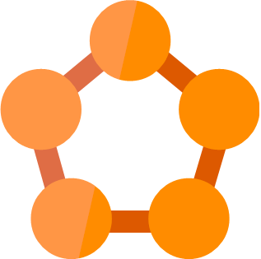









Rule #1
Microservice
Companies
Microservice
Stock Quotes
Microservice
REST
AMQP
WebSockets
Web
Microservice
REST
AMQP
WebSockets
REST
AMQP
WebSockets
Portfolio
Microservice
HTTP/2
REST
AMQP
WebSockets
Browser
API
Gateway
Microservice
Watchlist
Microservice
GraphQL
WebSockets
REST
AMQP
WebSockets
REST
AMQP
WebSockets
Service Fabric
Cluster
Mobile
REST
AMQP
WebSockets
REST
AMQP
WebSockets
Gamification
Microservice
Identity
Microservice
REST
AMQP
WebSockets
Email
Microservice
iOS
Android
Windows

