Slide 1

Asset Allocation Decision Support System
Back End: Bowen Chen
Front End: Jessica Leung
Business Logic: Yinger Li

Slide 2

Asset Allocation Decision Support System
We understand
Financial stock market is a dynamic and complex system
Even the professional users need to use computer technology for its modeling and prediction.
Not to mention people with no financial knowledge and background, it’s much harder for them to make investment to fit their financial goals
Simplify the process and make the tool more available

Slide 3
Asset Allocation Decision Support System
Current Market
SmartFolio
Designed by BMO
Online portfolio manager
Enable to customize portfolio using the Black-Litterman
401K Plus
Developed by Retirement Management System Inc.
Use Mean Variance optimization as one of their tool to make asset allocation decisions

Slide 4
Asset Allocation Decision Support System
Problem Definition
Create a software system that allows a user to create multiple portfolios given a set of assets and associated data.
Also, the system should allow ad-hoc side constraints for all model types e.g. portfolio limits
The system is user friendly in terms of entering data, choosing portfolio model types, and displaying results

Slide 5
Asset Allocation Decision Support System
Models Adopted
Mean Variance Optimization
Fundamental of many portfolio management techniques
Asset allocation by considering the trade-off between risk and return.
Enable to choose either a desired minimum level of return or maximum level of risk with the combination of the assets
Maximize the return with minimizing the covariance between each asset
Black-Litterman
The model combines CAPM, MVO, and specific user views into a single model, creating a sophisticated, yet customizable model.
The model provides a clear way to specify investors views on returns and to blend the investors views with prior information.
It uses the equilibrium market portfolio, as a starting point for estimation of asset returns, to balance against investor’s subjective view

Slide 6
Asset Allocation Decision Support System
BUT

Slide 7
Asset Allocation Decision Support System
Mean Variance Optimization
Early tests show that MVO results in portfolios with unrealistically heavy weights in a small number of assets, especially there are more stocks get selected.
MVO also possesses many limitations that could potentially derail the result produced. MVO tends to creates biased portfolios when there are more stocks selected

Slide 8

Asset Allocation Decision Support System
Black -Litterman
Notes:
So we decide to focus on the black litterman, and re-define our problems and constraints after discussion with Prof. Kwon and Minho

Slide 9
Asset Allocation Decision Support System
New
Problem Re-Definition
Create an asset allocation decision software system
Enable to customize equity portfolio for both professional and non-professional groups
The system should allow ad-hoc side constraints for professional users, and generate portfolio automatically for non-professional users
The system is user friendly in terms of entering data, and displaying results

Slide 10

Asset Allocation Decision Support System
Targeting Users
Professional
Use the Black-Litterman as the main model to optimize the portfolio
Able to input their selected stocks and views, and generate the portfolio weights based on the views and market equilibrium expected return
Non-Professional
Use the Black-Litterman as the main model to optimize as well
Stocks will be selected from different sectors based on their Earning Per Share
Relative Strength Index and Stochastic Oscillator will be used to generate the views

Slide 11

Asset Allocation Decision Support System
Professional Users
Stocks can be selected from S&P500
Views can be input by the users
The market equilibrium portfolio is calculated from market capitalizations of portfolio components
Covariance matrix will be calculated every time based on the different combination of the assets
Notes:
It is pretty straight forward for the professional users

Slide 12









Asset Allocation Decision Support System
Non-Professional Users
Information Technology
Health Care
Relative Strength Index
Stochastic Oscillator
Financials
Consumer Discretionary
6 more sectors …..
Stocks
View
View

Slide 13
Asset Allocation Decision Support System
Non- professional Users
Stocks can be chosen from the list we provide from S&P 500. The list is generated based on the top earning per share performances in different sectors
Views are generated using Relevant Asset Index and Stochastic Oscillator
The market equilibrium portfolio is calculated from market capitalizations of portfolio components
Covariance matrix will be calculated in python every time based on the different combination of the assets
Notes:
It is pretty straight forward for the professional users

Slide 14
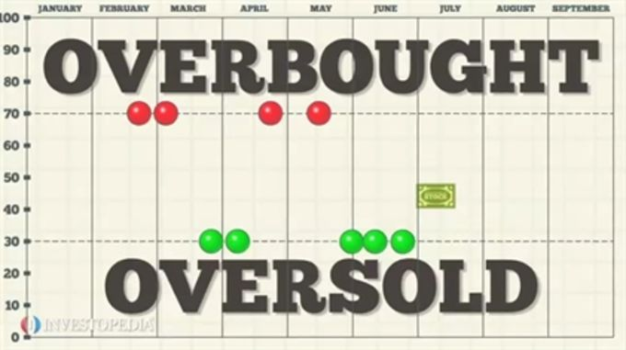
Asset Allocation Decision Support System
Relative Strength Index
RSI = 100 -100/ RS
Average Gain
Average Loss
RS =
Gain
Loss
14 Days Average
> 80 Overbought
< 20 Oversold
Oversold will outperform overbought by 2%
Notes:
It is pretty straight forward for the professional users

Slide 15
Asset Allocation Decision Support System
Stochastic Oscillator
-
High close
High 20 days
Low close
Low 20 days
Low 20 days
K% =
Current Close
-
Compare 20 Days
> 80 Overbought
Oversold will outperform overbought by 1%
< 20 Oversold
Notes:
It is pretty straight forward for the professional users

Slide 16
Asset Allocation Decision Support System
Product Design: Back-End Flow
S&P500
market cap
market_weight
Black-Litterman
Input
list_asset
covarience
results
return
monthly
daily_price
RSI, STO
views
Notes:
It is pretty straight forward for the professional users

Slide 17
Asset Allocation Decision Support System
Product Design: Front-End Flow
@app.route (‘/customtportfolio’)
@app.route (‘/customtportfolio’)
/customportfolio
2) Request.form.getlist(“form1)
3) Python code to change input from form into type suited for optimization functions
4) Get weights back from optimization functions
5) saves the results in a session cookie for passing between pages
6) Return direct (‘/customresult’)
7) cookie data from previous page
8) Return render_template (‘customresulthtml,’ data=data)
form 1
1)
submit
customresult.html
ticker
holdings
Table is generated by jinja {{data|safe}}
Notes:
It is pretty straight forward for the professional users

Slide 18
Asset Allocation Decision Support System
User Work Flow
Professional
Quick create
Specify the stocks we want to invest
Generate to get the optimized portfolio
Input stocks and views
Generate to get the optimized portfolio
Register
New Portfolio
Log-in
Compare Portfolio
Notes:
It is pretty straight forward for the professional users

Slide 19

Asset Allocation Decision Support System
Demo Time
Notes:
It is pretty straight forward for the professional users

Slide 20
Asset Allocation Decision Support System
Product Strengths
We have provide an alternative approach to use the Black –Litterman, as we generate the views from Relative Strength Index and Stochastic Oscillator
Our product enable to select a large combination of assets from S&P500, and easy and effective to use for both professional and non-professional users
Input Views are really simple, no dimension matches
Notes:
It is pretty straight forward for the professional users

Slide 21
Asset Allocation Decision Support System
Further Improvements
Transaction cost has not been used in the model, which in fact can affect many decisions in real life scenarios.
Diversified models adopted in the future. ie.VaR and CVaR
Implementing caching, improve speed of the system
Notes:
It is pretty straight forward for the professional users

Slide 22

Asset Allocation Decision Support System
Thank You
Thank You
Notes:
It is pretty straight forward for the professional users

