Slide 1
Stock Portfolio System
Team Members:
Aarti Chella
Hema Begur
Dipeeka Patil
Madhura S Sambe

Slide 2
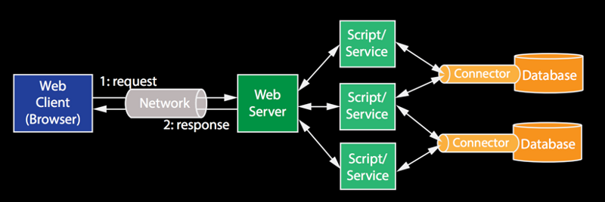
Overall Architecture

Slide 3
Features
Attractive UI using Bootstrap, Google Charts, HTML5
Stocks and ETFs are mapped to investing strategies
User is suggested how the money can be divided amongst different companies or strategies for buying stocks and ETFs
Real time data retrieved using Yahoo Finance API
Weekly history of portfolio value displayed as result

Slide 4
Extra Features
Pie Chart to display allocation of percentage of Stocks/ETFs amongst different companies
Bar Graph to indicate the trend in the closing stock value prices for the top 3 recommended companies
Tabular display of the current Stock Market Values
Future Scope :
1. Taking Risk Analysis and Income Stability into consideration to recommend portfolio
2. Predicting portfolio based on previous 10 years data for Value and Growth Investment Strategies.

Slide 5
Challenges Faced
Researching and understanding the investment strategies and Stock Market terminologies and methodologies.
Fetching different parameters like return on equity, debt to equity, earnings variability, profit & assets from a open source finance API
Coming up with most profitable investment portfolio for the user
Integrating the code of all the team members

