Slide 1
What is Price Monitoring System
A product price monitoring system, similar to dealmoon.com, to notify subscribers about discount products.
Acquire product info from Amazon web site and store into MySQL DB.
Sort products according to category.
Users can subscribe via email the interested categories.
Notify user when product prices in the subscribed categories is reduced.
User can also query discount products of any category.

Slide 2







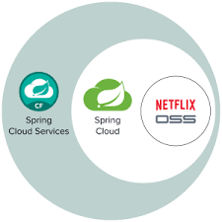
Price Monitoring System Design
User Service
Health Check Service
HTTP Request
Deal Search Service
Health Check Service
Instant Notification Service
Health Check Service
Price Monitoring Service
Health Check Service
Product Crawler
Health Check Service
Product Log Service
Health Check Service
Category Crawler
Health Check Service
Cloud Infrastructure Service

Slide 3
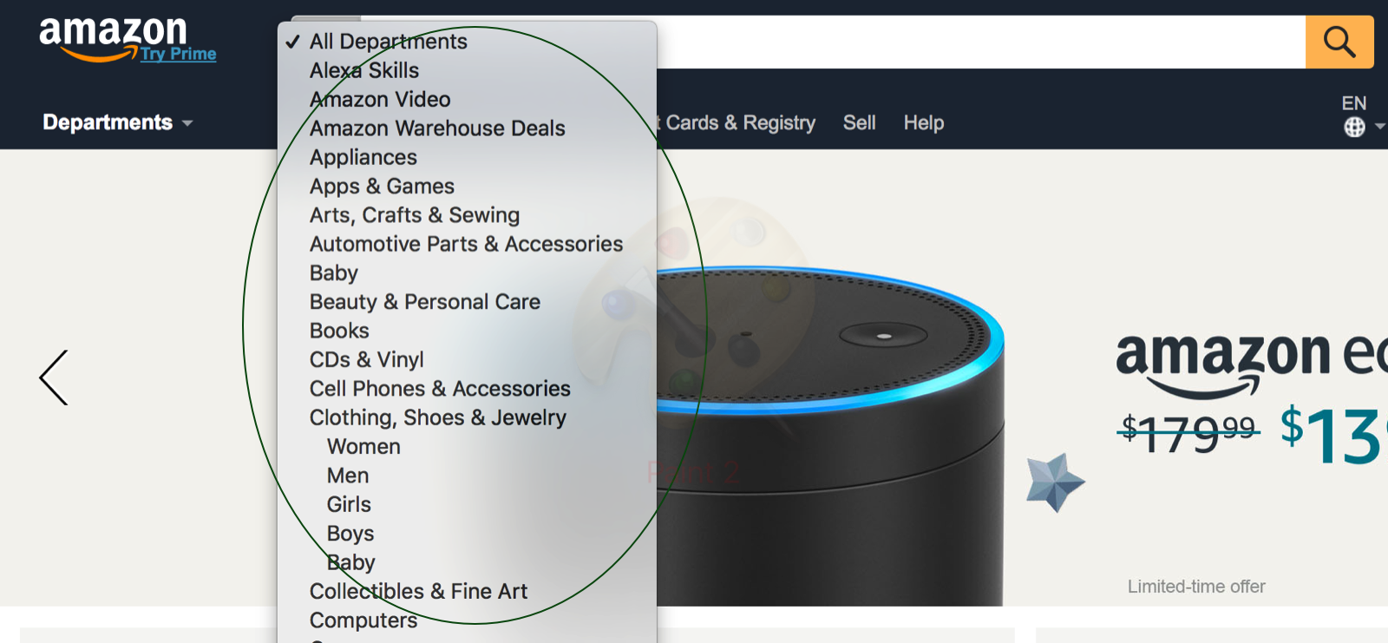
Category Crawler
Offline service: executed weekly at 00:00:00 AM
Category Crawler
Crawl categories from Amazon web site, store into DB.
Set category priorities according to subscribers count.
Categories with subscribers count > THRESHOLD, set to HIGH (1) priority.
Sort the rest of the categories by subscribers count in descending order.
The first half groups are set to MEDIUM (2) priority.
The second half groups are set to LOW (3) priority.

Slide 4
Product Crawler
HIGH priority: executed every 3 hours starting at 01:00:00 AM
MIDUM priority: executed every 12 hours starting at 02:00:00 AM
LOW priority: executed every day at 03:00:00 AM
q_product_p1 (High)
Category Crawler (p1)
q_product_p2 (Medium)
Category Crawler (p2)
q_product_p3 (Low)
Category Crawler (p3)
q_product_log
Get category list from Category table with matching priority.
Product is sent to q_product_p1, q_product_p2, q_product_p3.
For each category, a new worker thread is started to parallel crawling the products.
Log information is sent to q_product_log with status SUCCESS (0) or FAIL (1).

Slide 5
Price Monitoring Flow
Offline service
Category Queue
Price Monitoring Services
for each category
Price Reduction Queue
Product Price Cache
Product DB
Product DB: product table
product_id, category_id, title, thumnail, detail_url, price, old_price, last_updated_time
Product Price Cache:
Key: product_id, value: last_price

Slide 6
Instant Notification Flow
Offline service
Price Reduction Queue
Notification Service
Send Email
User DB
User DB:
user table
user_id, email, password, last_updated_time
user_category table
user_id, category_id, notification_type (0: instant, 1: daily)

Slide 7
Daily Notification Flow
Offline service
Start Notification Service For Each Category
Daily Notification Service
Send Email
User DB

Slide 8
User Subscription Flow
Online service
User
User Service
Category DB
User DB
User Service:
createUser
updateUser
getAllCategories
createSubscription
updateSubscription
deleteSubscription

Slide 9
Category Crawler Detail
Since product category won't change too fast, this crawler is scheduled to run once a week.
From url: https://www.amazon.com/s/ref=nb_sb_noss_2?url=search-alias=aps&field-keywords=-12345
Selector: #searchDropdownBox > option:nth-child(n) Where n >= 2
Get category name from child node text.
Get “search-alias=xxx” as category search alias
Repeat till empty element is reached.
The product list url for each category is in the following format: https://www.amazon.com/s/ref=nb_sb_noss?url=$SEARCH_ALIAS&field-keywords=-12345&page=$PAGE_NO Replace the $SEARCH_ALIAS with category name and $PAGE_NO with the desired product list.
Store the <Category name, product list url> pairs into Category DB.

Slide 10
Product Crawler Detail
This crawler is scheduled to run every 4 hours to quickly catch price changing information.
If a category contains a lot of products, multiple crawlers can be started to share the load.
Only subscribed categories will be crawled.
Title: get title from selector: #result_$RESULT_NO > div > div > div > div.a-fixed-left-grid-col.a-col-right > div.a-row.a-spacing-small > div:nth-child(1) > a Where $RESULT_NO starts from 0
Price: get aria-label from selector: #result_$RESULT_NO > div > div > div > div.a-fixed-left-grid-col.a-col-right > div:nth-child(2) > div.a-column.a-span7 > div.a-row.a-spacing-none > a > span
Thumnail: get src from selector: #result_$RESULT_NO > div > div > div > div.a-fixed-left-grid-col.a-col-left > div > div > a > img
Detail_url: get href from selector: #result _$RESULT_NO > div > div > div > div.a-fixed-left-grid-col.a-col-right > div.a-row.a-spacing-small > div:nth-child(1) > a
product_id: get last portion of detail_url.

Slide 11
Scheduling
Category Crawler
Every week at 12:00 AM Sunday
High Priority Product Crawler
Every 3 hours starting from 1:00 AM daily
Medium Priority Product Crawler
Every 12 hours starting from 2:00 AM daily
Low Priority Product Crawler
Every day at 3:00 AM
Order categories by subscribers count, then by category id.
User-count-threshold property decides if the category belongs to high priority group.
Category crawler sets the threshold in DB at start time.
User can dynamically change the threshold through REST api.
Categories w/ user count > threshold belongs to the high priority group (priority = 1).
The rest of categories are ordered by user count, first half go to medium group (priority = 2).
The other half of the rest categories go to low priority group (priority = 3).

