Slide 1
Privacy Enhancing Technologies and Limitations
Preliminary Examination
Ian Martiny

Slide 2

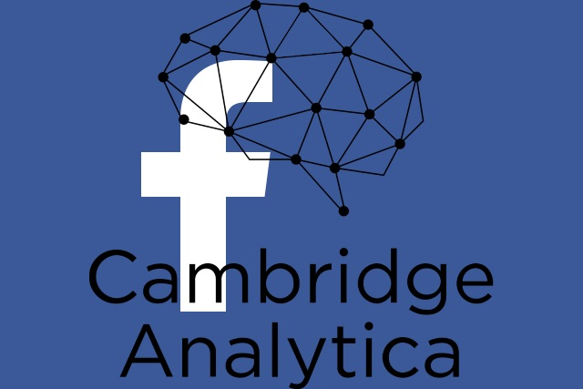
Introduction
Recent events remind people that their data is not safe with third-parties.
Researchers develop tools for clients to interact privately
There is a gap between current research and usability
Notes:
Equifax and cambridge analytica
Research tools
Gap between current research and usability
Current research → what is missing

Slide 3
Privacy

