Slide 1
Privacy Enhancing Technologies and Limitations
Preliminary Examination
Ian Martiny

Slide 2

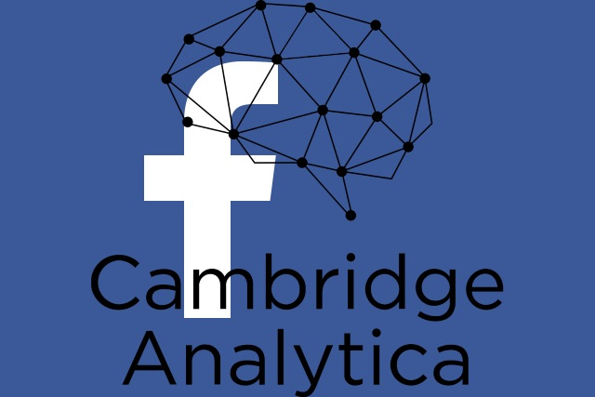
Introduction
Recent events remind people that their data is not safe with third-parties.
Researchers develop tools for clients to interact privately
There is a gap between current research and usability
Notes:
Equifax and cambridge analytica
Research tools
Gap between current research and usability
Current research → what is missing
Talk will follow paper:
Privacy
Computation
Differential Privacy
Discussion of future work

Slide 3
Privacy
Overall goal is privacy or anonymity
Users want services but don’t trust service providers

Slide 4
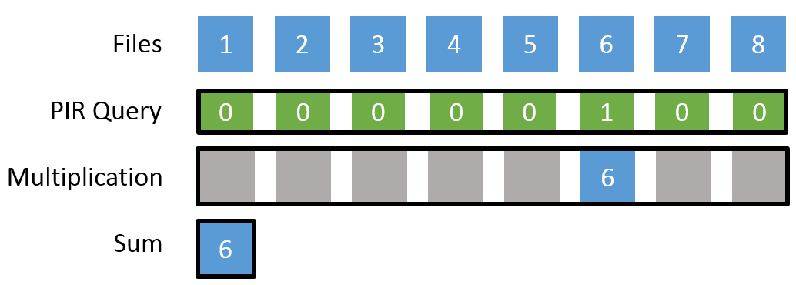
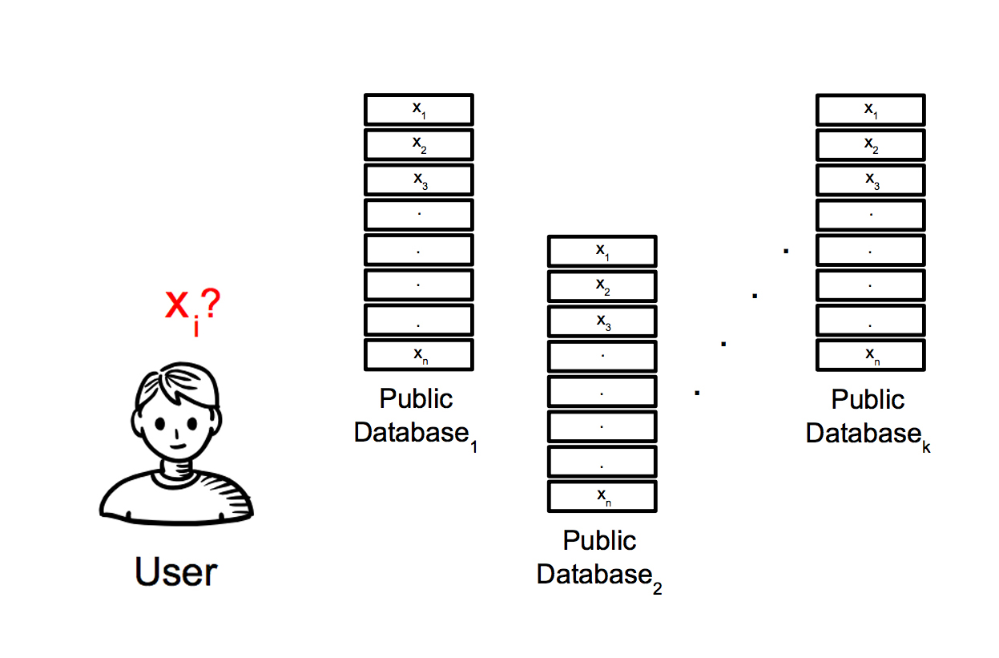
Private Information Retrieval
Computational PIR
Information Theoretic PIR
Notes:
Two types of PIR
Computational PIR
Single server
Not trusted
Homomorphic encryption
Information Theoretic PIR
Multiple non-colluding servers
Clients must trust this
Various threat models
Locally construct answer based on responses

Slide 5
Contact Discovery (Applied PIR)
Need to know which of your contacts use a service
In theory could use PIR, but too expensive
Combine PIR with other methods
PSI
Statefulness
Notes:
How to privately query if your contacts are in a database?
PIR is expensive
Combine PIR with:
PSI
Does client and server have same info
Client state
infrequent long computations speed up queries

Slide 6
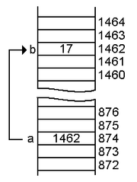
Presence Discovery
Context of PIR being “expensive”
How often is the database queried
How large is that database
Indirection
One large database
One small database
Notes:
Presence discovery deals with how to discover who is online
PIR being expensive depends on context
DP5
PIR
2 databases
one large database queried infrequently, once per day
And one small database queried every few minutes

Slide 7

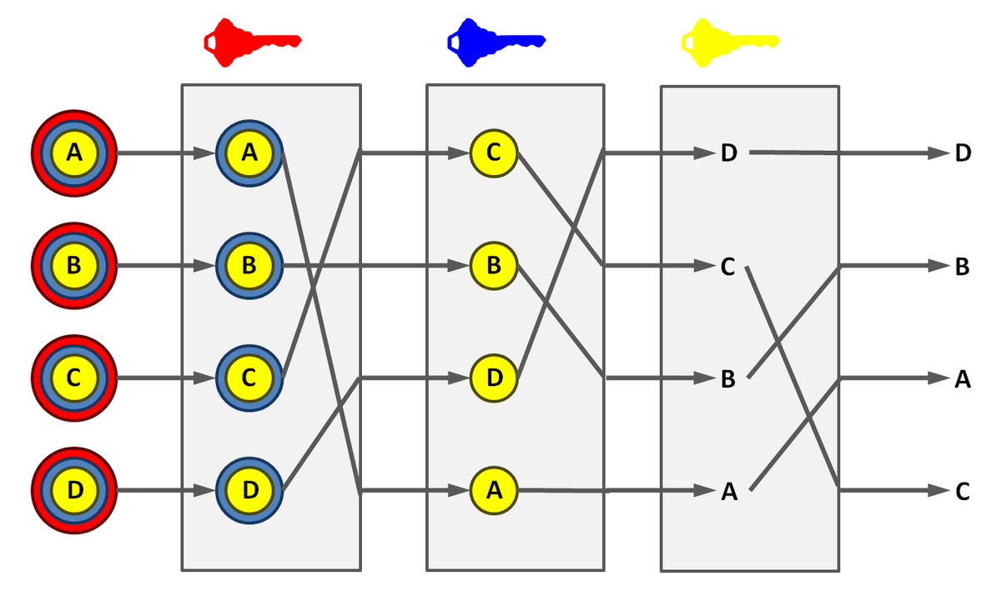
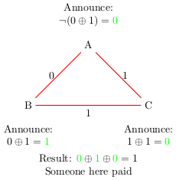
Anonymous Communication
Trade off between scalability and anonymity
Notes:
Trade-off
Tor
2 million users daily
traffic analysis
compromised nodes
Vuvuzela
68,000 mess/s
1 million users
37s latency
mixnets and dead drops
Dissent
DC-Nets
5000 simultaneous
Both act under anytrust model

Slide 8
Computation

Slide 9

Secure Computation
Computation without sharing data
Ideal world has honest and competent third party
Real world needs to prove just as secure as ideal world
Notes:
Two entities
Hospital Example
Ideally a trusted third party would take both data sets, perform the computation, report results which everyone would trust, and delete the data
Real world schemes must prove they are just as secure as the ideal world, i.e. proving that attacks on their scheme would lead to attacks on the ideal world
One practical implementation leverages Shamir secret sharing to compute market prices on an auction without participants having to announce all prices, only winners.

