Slide 1
Privacy Enhancing Technologies and Limitations
Preliminary Examination
Ian Martiny

Slide 2

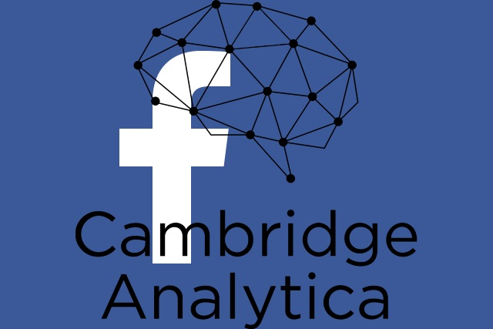
Introduction
Recent events remind people that their data is not safe with third-parties.
Researchers develop tools for clients to interact privately
There is a gap between current research and usability
Notes:
Equifax and cambridge analytica
Research tools
Gap between current research and usability
Current research → what is missing
Talk will follow paper:
Privacy
Computation
Differential Privacy
Discussion of future work

Slide 3
Privacy
Overall goal is privacy or anonymity
Users want services but don’t trust service providers

Slide 4
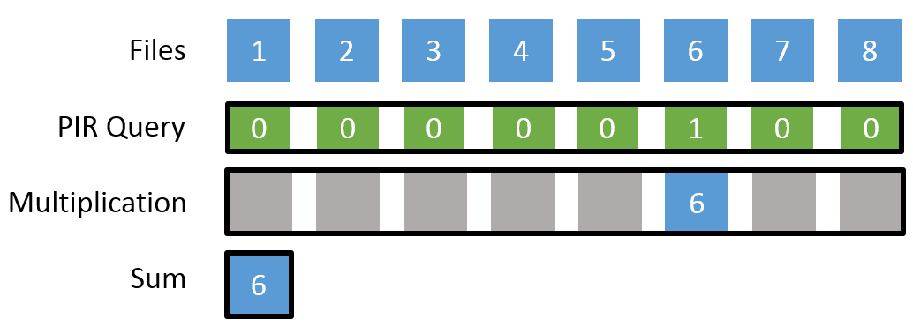
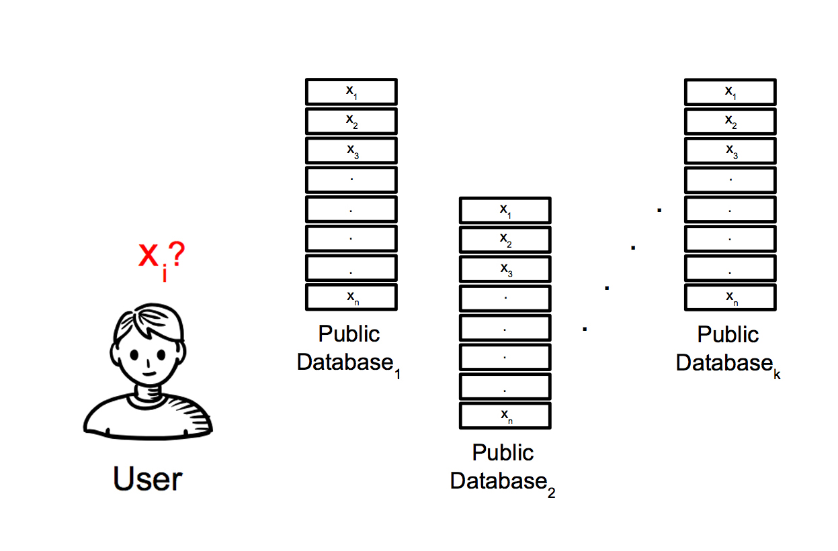
Private Information Retrieval
Computational PIR
Information Theoretic PIR
Notes:
Two types of PIR
Computational PIR
Single server
Not trusted
Homomorphic encryption
Information Theoretic PIR
Multiple non-colluding servers
Clients must trust this
Various threat models
Locally construct answer based on responses

Slide 5
Contact Discovery
Need to know which of your contacts use a service
In theory could use PIR, but too expensive
Combine PIR with other methods
PSI
Statefulness
Notes:
How to privately query if your contacts are in a database?
PIR is expensive
Combine PIR with:
PSI
Does client and server have same info
Client state
infrequent long computations speed up queries

