Slide 1
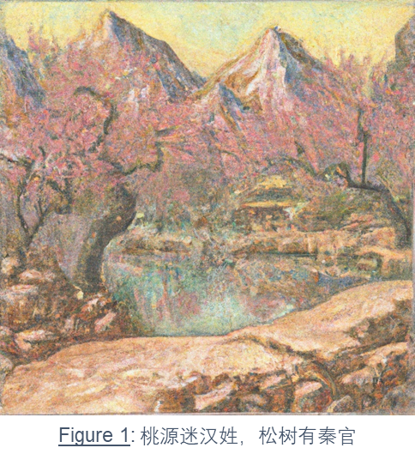
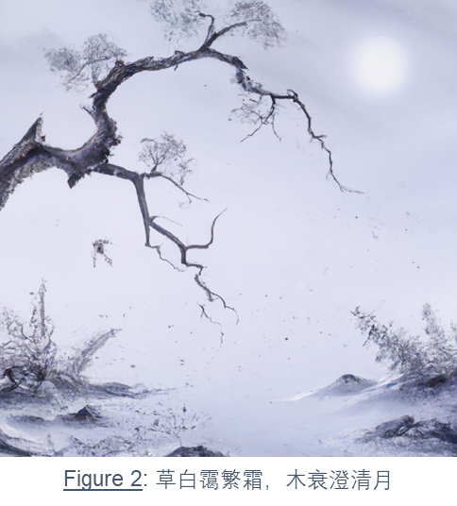
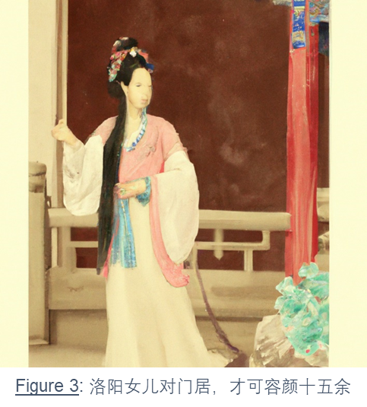

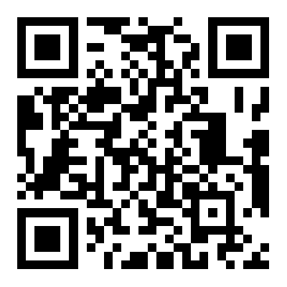
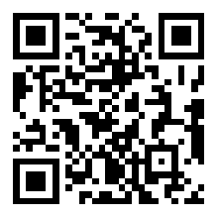
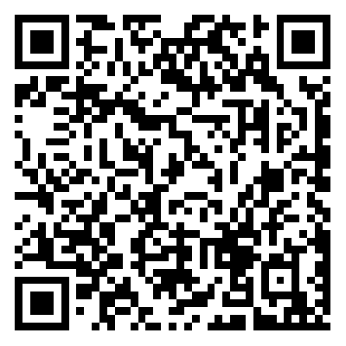
Verse Into vision
Yantao Mei
Data Science| Signature Work Class of 2024
Mentor: Prof. Benjamin Bacon
Introduction
Results
Discussion
This Signature Work investigates the intriguing potential of artificial intelligence (AI) in interpreting Chinese poetry, embodied through the development of the "Verse Into Vision" tool and the subsequent art collection. Integrating machine learning, semiotics, and information theory, it questions AI's capacity to comprehend the intricate layers of meaning inherent in Chinese poetry. The project bridges technology and traditional literature, offering a fresh perspective on AI's role in artistic interpretation. Through a detailed examination of AI's interpretive capabilities and limitations, it sheds light on the complex dialogue between human creativity and computational analysis, setting the stage for future explorations in this interdisciplinary field.
The project's outcome centered on developing the "Verse Into Vision" tool and generating the "In Poetry, Paintings; In Paintings, Poetry" collection from Wang Wei's poetry. This collection, showcasing over 1053 images for 351 poems, underscores the tool's potential to bring new perspectives to ancient Chinese poetry through AI interpretation. Deployed on a website for public interaction, the project not only highlights AI's ability to offer diverse interpretations but also explores its limitations and the nuances of translating and visualizing poetry. The engaging platform further allows users to interact with the artwork, offering insights into the convergence of AI, art, and literature. The endeavor marks a significant stride in digital humanities, showcasing how AI can transcend traditional literary analysis and offer a novel lens through which to view and interpret Chinese poetic heritage.
The discussion around whether AI can interpret Chinese poetry intertwines with deep dives into machine learning, semiotics, and information theory, exploring the multifaceted nature of "understanding." Through the lens of the literature review, it's evident that AI's ability to parse the complex imagery and nuanced expressions of Chinese poetry presents both promise and limitations. Reflections on the project underscore the critical role of cultural and historical context in interpretation, highlighting the gaps in AI's current capabilities. The exploration of semantic, semiotic, and statistical models reveals AI's evolving landscape in linguistic analysis and its potential to enrich the arts. However, the reflection part brings to light the inherent limitations of AI in fully grasping the poetry's essence, emphasizing the need for advancements in understanding historical contexts and the poets' backgrounds. This synthesis of theoretical insights and technological applications not only contributes to the ongoing dialogue between technology and traditional literature but also sets the stage for future research directions. It underlines the importance of integrating deeper philosophical considerations and specialized AI models to enhance interpretation, ultimately striving for a more profound engagement with the timeless beauty of Chinese poetry.
Methods & Process
In the "Verse Into Vision" project, the methodology and process intertwine machine learning, semiotics, and information theory to interpret and visualize Chinese poetry through AI. Central to this endeavor is the creation of a digital tool that leverages GPT models for textual interpretation and DALL-E for image generation, tailored specifically to the nuances of Chinese poetic language and imagery. The process begins with the meticulous collection and preparation of poetic texts, emphasizing Wang Wei's work, to ensure a representative corpus for AI analysis. Subsequently, these texts undergo conversion into simplified Chinese to align with the model's training data, enhancing comprehension and interpretive accuracy.
Model tuning and optimization are critical phases, adjusting parameters to refine the AI's ability to capture the essence and mood of the poems accurately. This involves iterative testing and feedback loops to balance the AI's creative output with the poetic content's historical and cultural depth. The project's technical backbone is supported by data science practices, including data collection, processing, and analysis, to streamline the workflow from poem selection to visual output.
The culmination of these processes is the "Verse Into Vision" web tool, an interactive platform allowing users to explore the AI-generated imagery alongside the corresponding poems, fostering an engaging dialogue between traditional literature and modern AI technology. This methodological approach not only showcases the potential of AI in the arts but also sets a precedent for future interdisciplinary research at the intersection of technology, art, and cultural heritage.
Conclusion
The research underscores AI's evolving role in comprehending and visualizing poetic nuances, combining machine learning, semiotics, and information theory to tackle interpretative challenges. While showcasing AI's potential to bridge digital humanities and literary studies, the project also reveals AI's current limitations, particularly in grasping the cultural and historical depths of poetry. Future work aims to deepen AI's interpretive capabilities, potentially through specialized models tailored for poetic analysis. Additionally, the research highlights the necessity of enhancing AI's understanding of historical contexts and poet backgrounds for richer interpretations. Acknowledging these challenges and areas for growth sets a pathway for future investigations, aiming for a more profound synthesis of technology and traditional literature, thus enriching both fields.
GitHub Link
Verse Into Vision
Voting

