Slide 1
COLORIZATION
iMAGE RESTORATION

Slide 2
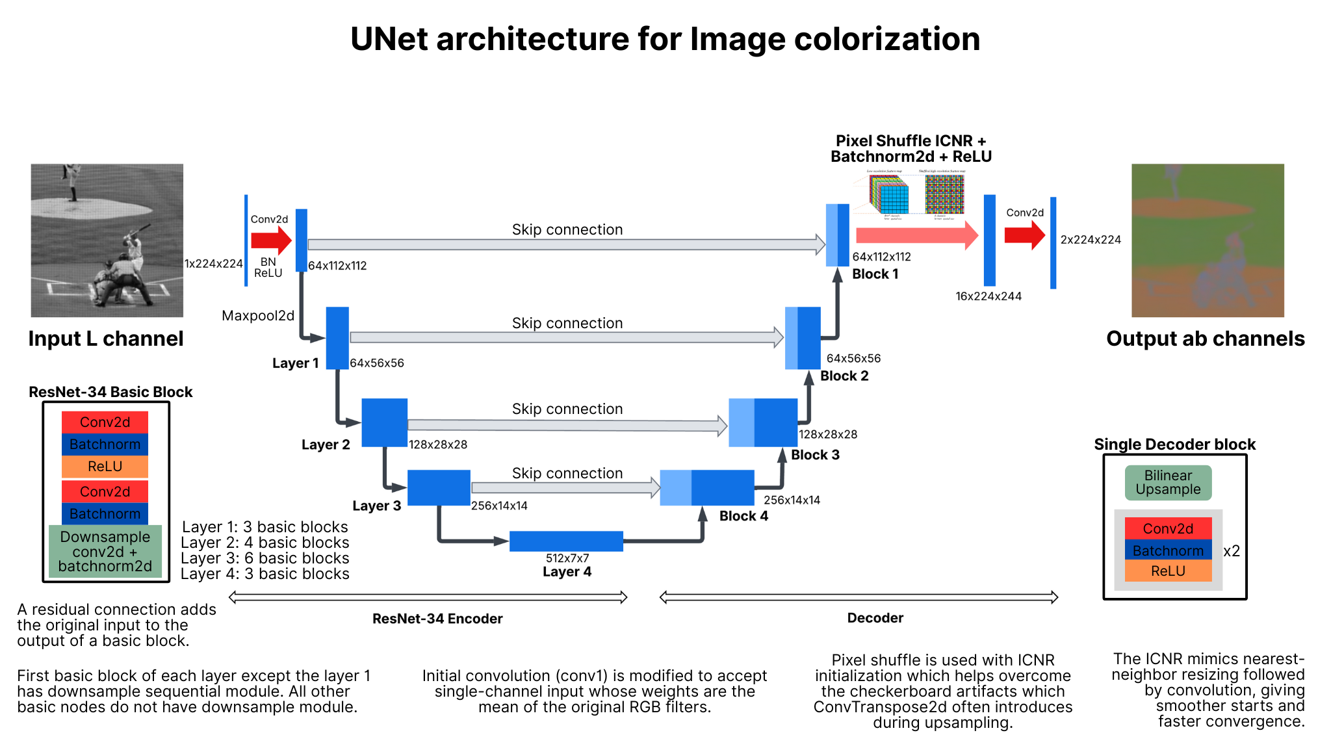
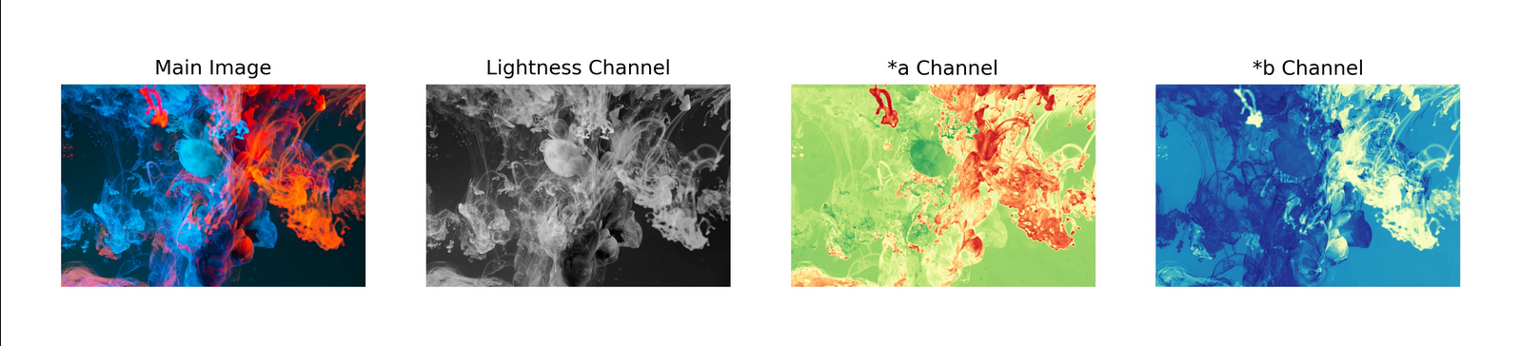
Image Colorization
https://huggingface.co/ayushshah/imagecolorization
https://github.com/ayushpatidar18/Image-Colorization

Slide 3
dATASET AND preprocessing
Curated COCO 2017 dataset (no grayscale, b/w, filtered images).
Resizing (224x224)
Google Collab
T4 GPUs, 20h+
Inference preprocessing
  Module resizing
  BGR/RGB to Grayscaled Lab (L) -> 1D tensor [0,1]
  Inference preprocessing
Inference postprocessing
  Denormalizing *a and *b channels
  LAB2RGB conversion (or BGR)

Slide 4
lIMITATIONS
Image Colorization
  Torch Architecture. Base weights downloaded (UNET)
    Train loops with curated dataset.
Colorization
  Caffe based implementation. Local setup needs GPUs.
DeOldify
  Linux support only. Locally-hosted training support only. GPU needed.
Unsloth/Axolotl Vision Llms
  Very small repertoire of Vision models (multimodal transformers). No image2image functionality, mainly image2text.
StabeDiffusion Img2Img pipeline
  Base model download (checkpoint/safetensor). Pipeline run on dataset for training. Time constrained.
https://huggingface.co/ayushshah/imagecolorization
https://github.com/richzhang/colorization/tree/caffe
https://github.com/jantic/DeOldify
https://huggingface.co/docs/diffusers/main/en/api/pipelines/stable_diffusion/img2img
https://docs.unsloth.ai/

