Slide 1


Slide 2
This is the title
Subtit

Slide 3
title of bullet
Call out the unbelivers
Use _TextFrame.add_paragraph() for subsequent bullets

Slide 4
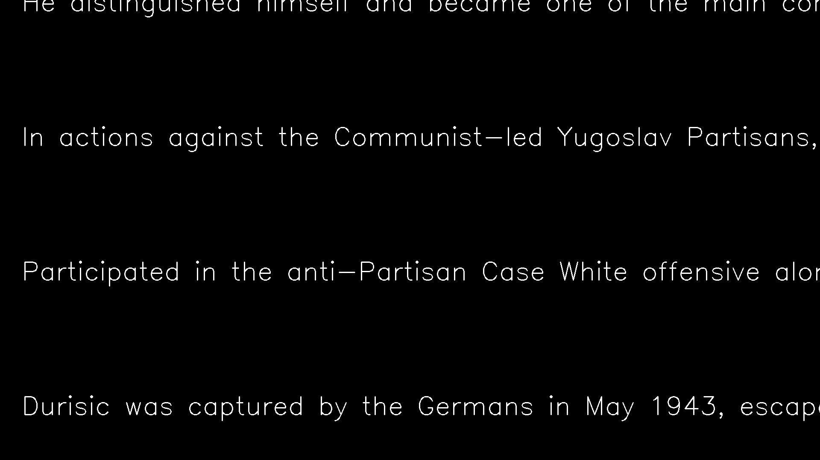

Slide 5
title of bullet
This is the first one
Thgis is the second one

