Slide 1
Chapter 2: Intro to Relational Model

Slide 2
Outline
Structure of Relational Databases
Database Schema
Keys
Schema Diagrams
Relational Query Languages
The Relational Algebra
Notes:
1

Slide 3
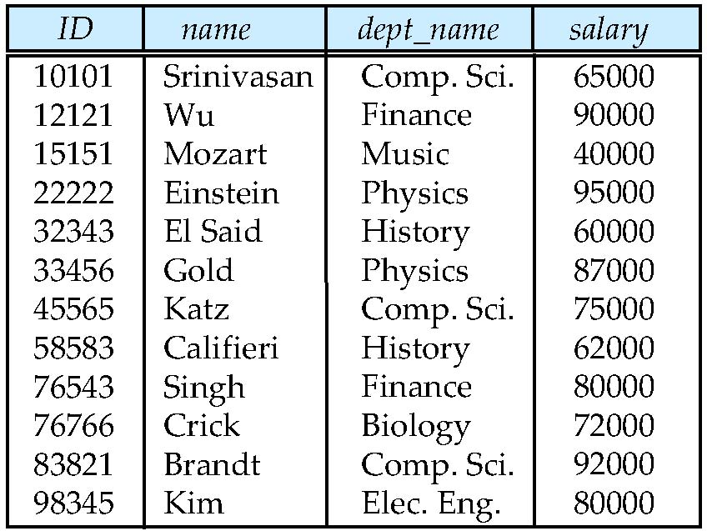
Example of an Instructor Relation
attributes
(or columns)
tuples
(or rows)

Slide 4
Attribute (屬性)
屬性指物件的特性，或欲處理的資料
The set of allowed values for each attribute is called the domain of the attribute
  例子: the domain of ID = {11, 12, 13, 14}
Attribute values are (normally) required to be atomic; that is, indivisible (分割後沒有意義)
  multivalued attribute values are not atomic-> 每個value是一個集合
  例子: the domain of phone-number = {{6601, 6602}, {6611, 6622}}
  composite attribute values are not atomic-> 每個value是不同類型資料的組合
  例子: the domain of phone-number = {(02, 24622192)}
The special value null is a member of every domain, indicating that the value is “unknown” or “does not exist”.
The null value causes complications in the definition of many operations

Slide 5
Relation Schema and Instance (補充正式定義)
A₁, A₂, …, A_{n} are attributes
R = (A₁, A₂, …, A_{n} ) is a relation schema
Example:
instructor = (ID, name, dept_name, salary)
Formally, given sets D₁, D₂, …. D_{n,} a relation r is a subset of
D₁ x D₂ x … x D_{n}
Thus, a relation is a set of n-tuples (a₁, a₂, …, a_{n}) where each a_{i} ∈ D_{i}
Example:
D₁ = {a, b, c}, D₂ = {1, 2}, D₁XD₂ = {(a, 1), (a, 2), (b, 1), (b, 2), (c, 1), (c, 2)}
r = {(a, 1), (a, 2), (b, 2)}
The current values of a relation is called the relation instance.
A relation (instance) is represented as a table.
  An attribute refers to a column of a table.
  An element t of r is a tuple, represented by a row in a table.
A1 | A2
a | 1
a | 2
b | 2

Slide 6
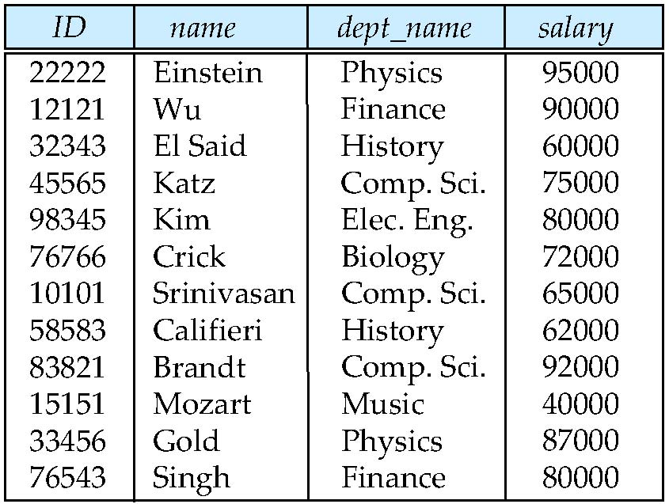
Relations are Unordered
Order of tuples is irrelevant (tuples may be stored in an arbitrary order)
  資料的排序方式屬physical level, 非logical level
  寫query時不知資料如何排序;
Example: instructor relation with unordered tuples

Slide 7
Database Schema
Database schema -- is the logical structure of the database.
Database instance -- is a snapshot of the data in the database at a given instant in time.
Example:
  schema: instructor (ID, name, dept_name, salary)
  Instance:

Slide 8
Keys
Let K ⊆ R
K is a superkey of R if values for K are sufficient to identify a unique tuple of each possible relation r(R)
  Example: {ID} and {ID, name} are both superkeys of instructor.
Superkey K is a candidate key if K is minimal
Example: {ID} is a candidate key for Instructor
One of the candidate keys is selected to be the primary key.
  which one? 通常依一般使用習慣,找最有代表性的.
  Another example: {系別, 年級,班級,座號}, {學號}, {身分證字號} 都是下面classmate表格的candidate key, 選 {學號}做為PK.
SK
CK
PK
學號 | 身分證字號 | 系別 | 年級 | 班級 | 座號 | 姓名
0995701 | A123456780 | CS | 3 | A | 1 | 張三
0995705 | A123456781 | CS | 3 | A | 2 | 李四
0995711 | A123456782 | CS | 3 | B | 1 | 王五
0985701 | A123456783 | CS | 4 | A | 1 | 趙六
0995601 | A123456784 | EE | 3 | A | 1 | 劉七

Slide 9
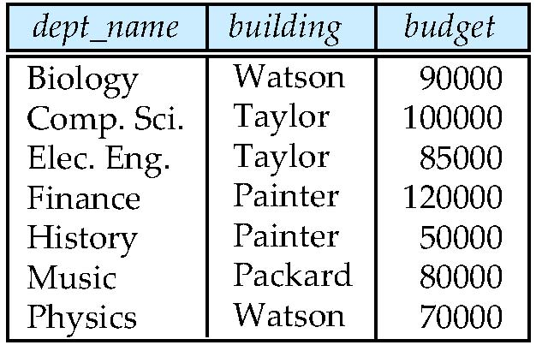
Foreign keys
Foreign key constraint: Value in one relation must appear in another
  Referencing relation，如下面的instructor
  Referenced relation，如下面的department
  Example: dept_name in instructor is a foreign key from instructor referencing department
注意: 屬性值的唯一性會隨表格表示的資料不同而改變,如dept_name，所以表格的PK會變化
department
instructor

Slide 10
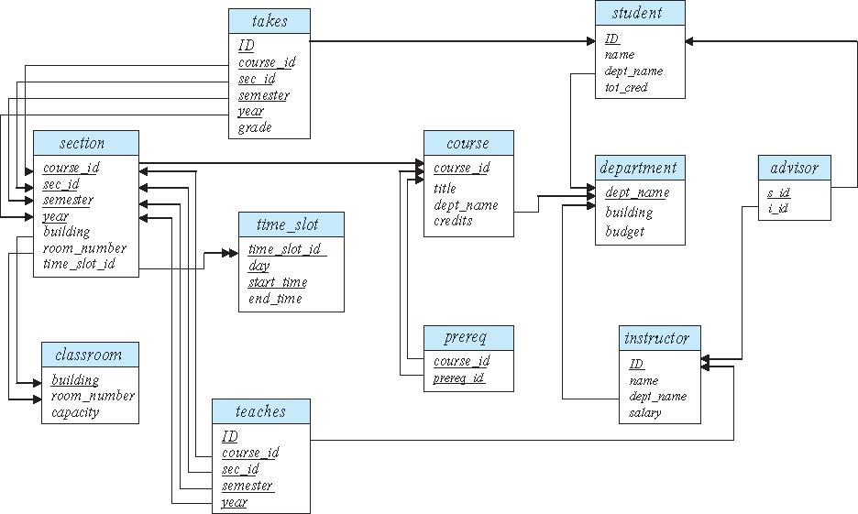
Schema Diagram for University Database

Slide 11
資料綱要常見寫法 (課本圖2.8)
classroom (building, room_number, capacity)
department (dept_name, building, budget)
course (course_id, title, dept_name, credits)
instructor (ID, name, dept_name, salary)
section (course_id, sec_id, semester, year, building, room_number, time_slot_id)
teaches (ID, course_id, sec_id, semester, year)
student (ID, name, dept_name, tot_cred)
takes (ID, course_id, sec_id, semester, year, grade)
advisor(s_ID, i_ID)
time_slot (time_slot_id, day, start_time, end_time)
prereq (course_id, prereq_id)
底線表示PK。

Slide 12
Relational Query Languages
Language in which users request information from the database.
Procedural versus non-procedural, or declarative
“Pure” languages:
  Relational algebra
  Tuple relational calculus
  Domain relational calculus
The above 3 pure languages are equivalent in computing power
We will concentrate in this chapter on relational algebra
  Not turning-machine equivalent
  Consists of 6 basic operations
算術代數: 1+5*3
學習relational algebra的重點
  使用哪些relation
  使用哪些operator

Slide 13
Relational Algebra
A procedural language consisting of a set of operations that take one or two relations as input and produce a new relation as their result.
Six basic operators
  select: σ
  project: ∏
  union: ∪
  set difference: –
  Cartesian product: x
  rename: ρ <- 上課不會教
Two additional operators
  join:
  Intersection: ∩

Slide 14
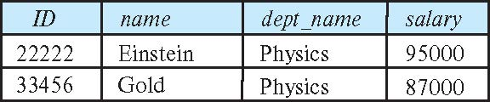
Select Operation
The select operation selects tuples that satisfy a given predicate.
Notation: σ _{p} (r)
p is called the selection predicate (限制式)
  兩個屬性值互相比較，或屬性值和常數比較
  多個限制式可用and或or連接起來 (看下一頁)
Example: select those tuples of the instructor relation where the instructor is in the “Physics” department.
  Query
  σ _{dept_name=“Physics”} (instructor)
  Result

Slide 15
Select Operation (Cont.)
We allow comparisons using
=, ≠, >, ≥, <, ≤
in the selection predicate.
We can combine several predicates into a larger predicate by using the connectives:
∧ (and), ∨ (or), ¬ (not)
Example: Find the instructors in Physics with a salary greater than $90,000, we write:
σ _{dept_name=“Physics”} ∧ _{salary > 90,000} (instructor)
Then select predicate may include comparisons between two attributes.
  Example, find all departments whose name is the same as their building name:
  σ _{dept_name=building} (department)

Slide 16
Project Operation
A unary operation that returns its argument relation, with certain attributes left out.
Notation:
∏ _{A1,A2,A3 ….Ak} (r)
where A₁, A₂ are attribute names and r is a relation name.
The result is defined as the relation of k columns obtained by erasing the columns that are not listed
Duplicate rows removed from result, since relations are sets

Slide 17
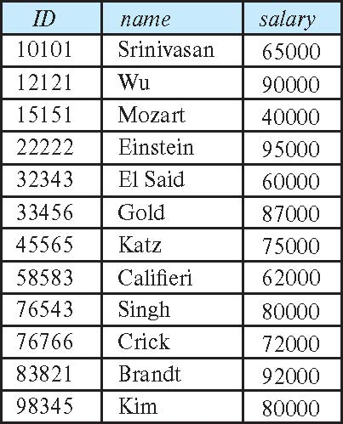
Project Operation (Cont.)
Example: eliminate the dept_name attribute of instructor
Query:
∏_{ID, name, salary} (instructor)
Result:

Slide 18
Composition of Relational Operations
The result of a relational-algebra operation is a relation, and therefore relational-algebra operations can be composed together into a relational-algebra expression.
Consider the query -- Find the names of all instructors in the Physics department.
∏_{name}(σ _{dept_name} _{=“Physics”} (instructor))
Instead of giving the name of a relation as the argument of the projection operation, we give an expression that evaluates to a relation.

Slide 19
Cartesian-Product Operation
The Cartesian-product operation (denoted by X) allows us to combine information from any two relations.
Example: the Cartesian product of the relations instructor and teaches is written as:
instructor X teaches
We construct a tuple of the result out of each possible pair of tuples: one from the instructor relation and one from the teaches relation (see next slide)
Since the instructor ID appears in both relations, we distinguish between these attributes by attaching to the attribute the name of the relation from which the attribute originally came.
  instructor.ID
  teaches.ID

Slide 20
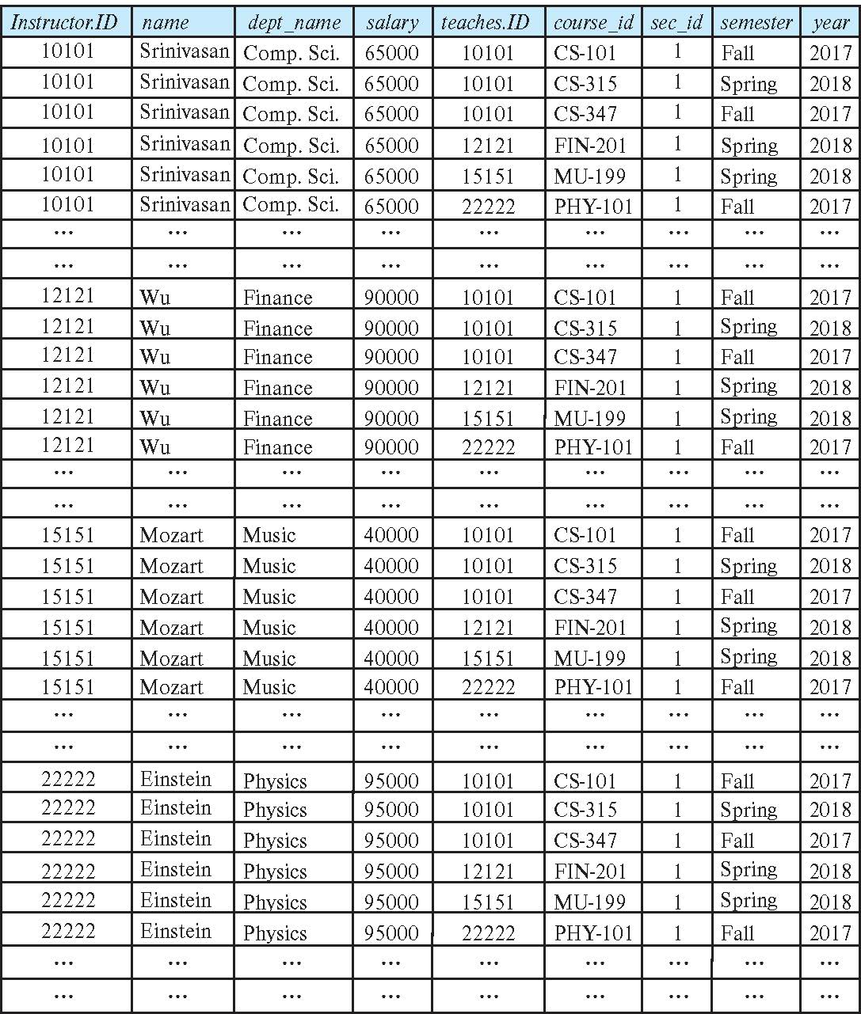
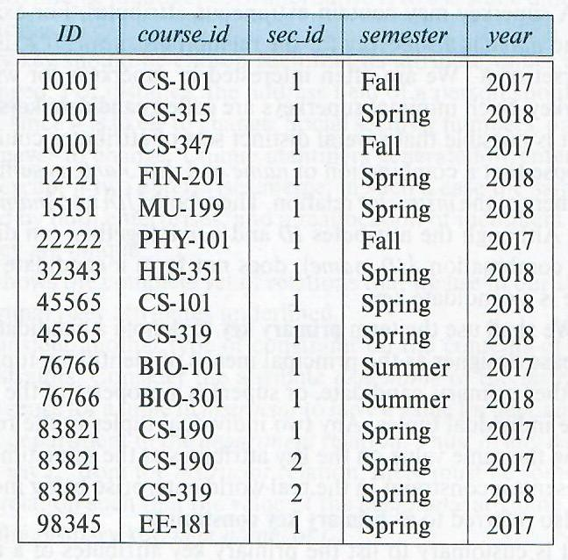
The instructor X teaches table
teaches

Slide 21
Join Operation
The Cartesian-Product
instructor X teaches
associates every tuple of instructor with every tuple of teaches.
  Most of the resulting rows have information about instructors who did NOT teach a particular course.
To get only those tuples of “instructor X teaches “ that pertain to (關於) instructors and the courses that they taught, we write:
σ _{instructor.id = teaches.id} (instructor x teaches )
The result of this expression, shown in the next slide

Slide 22
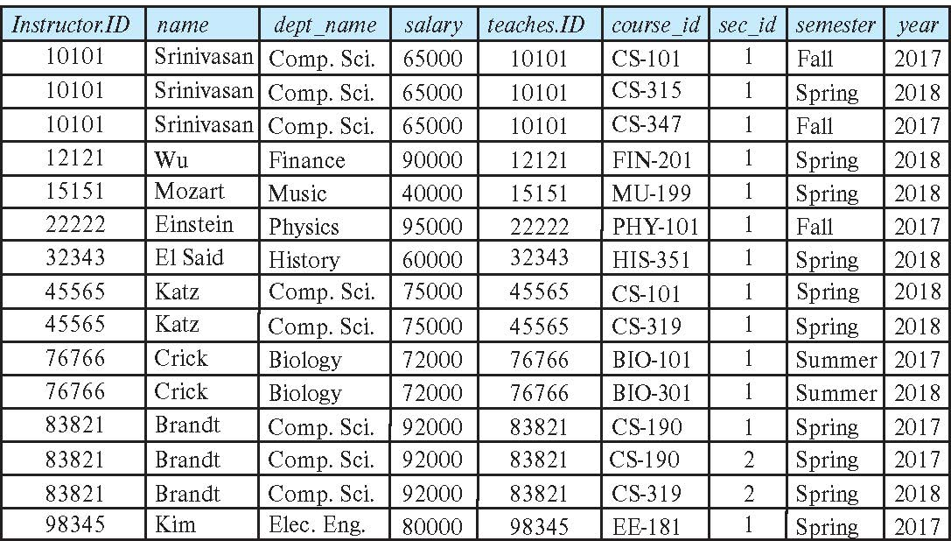
Join Operation (Cont.)
The table corresponding to:
σ _{instructor.id = teaches.id} (instructor x teaches)

Slide 23
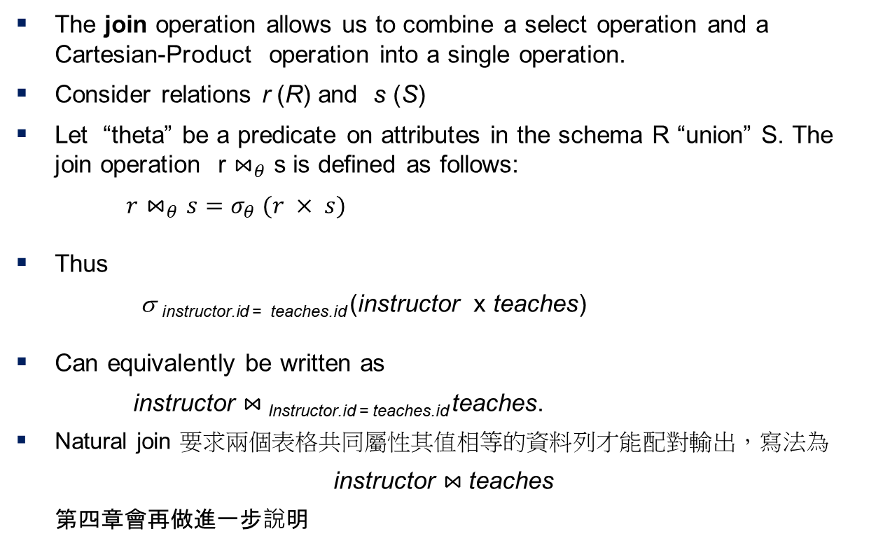
Join Operation (Cont.)
The join operation allows us to combine a select operation and a Cartesian-Product operation into a single operation.
Consider relations r (R) and s (S)
Let “theta” be a predicate on attributes in the schema R “union” S. The join operation r $⋈_{θ}$ s is defined as follows:
$r⋈_{θ}s=σ_{θ} (r × s)$
Thus
σ _{instructor.id = teaches.id} (instructor x teaches)
Can equivalently be written as
instructor $⋈_{ }$_{Instructor.id = teaches.id} teaches.
Natural join 要求兩個表格共同屬性其值相等的資料列才能配對輸出，寫法為
instructor $⋈_{ }$teaches
第四章會再做進一步說明

Slide 24
練習
Find the titles of courses in the Comp. Sci. department
Answer:
Output the attributes ID and building of instructors.
(老師的編號和辦公室所在的建築物名稱)
Answer:

Slide 25
Union Operation
The union operation allows us to combine two relations
Notation: r ∪ s
For r ∪ s to be valid.
1. r, s must have the same arity (same number of attributes)
2. The attribute domains must be compatible (example: 2nd
  column of r deals with the same type of values as does the 2nd column of s)
Example: to find all courses taught in the Fall 2017 semester, or in the Spring 2018 semester, or in both
∏_{course_id} (σ _{semester=“Fall” Λ year=2017} (section)) ∪
∏_{course_id} (σ _{semester=“Spring” Λ year=2018} (section))

Slide 26
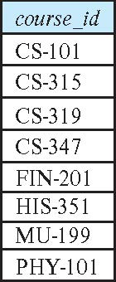
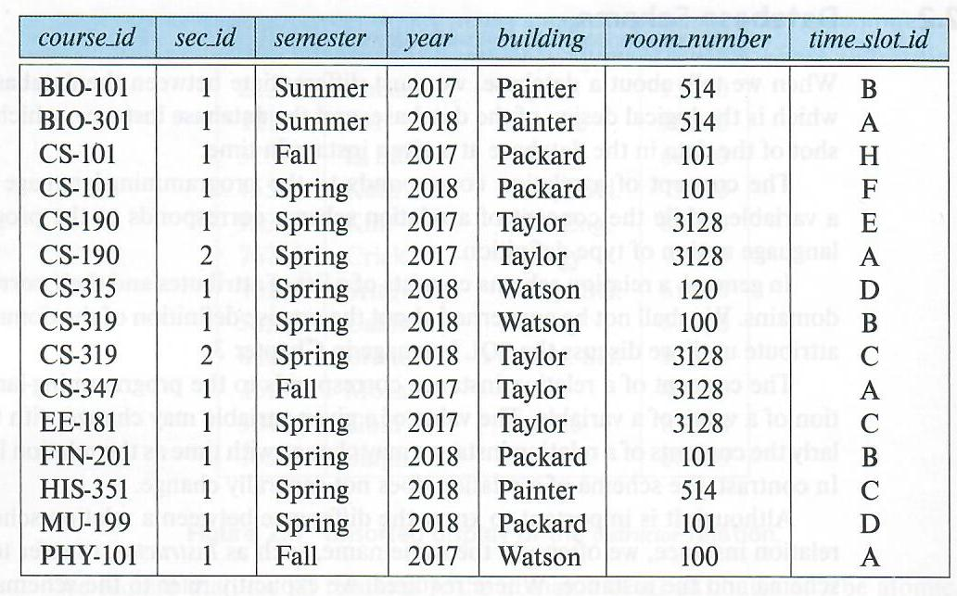
Union Operation (Cont.)
Result of:
∏_{course_id} (σ _{semester=“Fall” Λ year=2017} (section)) ∪
∏_{course_id} (σ _{semester=“Spring” Λ year=2018} (section))
section

Slide 27

Set-Intersection Operation
The set-intersection operation allows us to find tuples that are in both the input relations.
Notation: r ∩ s
Assume:
  r, s have the same arity
  attributes of r and s are compatible
Example: Find the set of all courses taught in both the Fall 2017 and the Spring 2018 semesters.
∏_{course_id} (σ _{semester=“Fall” Λ year=2017} (section)) ∩
∏_{course_id} (σ _{semester=“Spring” Λ year=2018} (section))
  Result

Slide 28
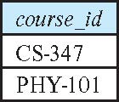
Set Difference Operation
The set-difference operation allows us to find tuples that are in one relation but are not in another.
Notation r – s
Set differences must be taken between compatible relations.
  r and s must have the same arity
  attribute domains of r and s must be compatible
Example: to find all courses taught in the Fall 2017 semester, but not in the Spring 2018 semester
∏_{course_id} (σ _{semester=“Fall” Λ year=2017} (section)) −
∏_{course_id} (σ _{semester=“Spring” Λ year=2018} (section))

Slide 29
※ The Assignment Operation
It is convenient at times to write a relational-algebra expression by assigning parts of it to temporary relation variables.
The assignment operation is denoted by ← and works like assignment in a programming language.
Example: Find all instructor in the “Physics” and Music department.
Physics ← σ _{dept_name=“Physics”} (instructor)
  Music ← σ _{dept_name=“Music”} (instructor)
  Physics ∪ Music
With the assignment operation, a query can be written as a sequential program consisting of a series of assignments followed by an expression whose value is displayed as the result of the query.

Slide 30
※ The Rename Operation
The results of relational-algebra expressions do not have a name that we can use to refer to them. The rename operator, ρ , is provided for that purpose
The expression:
ρ_{x} (E)
returns the result of expression E under the name x
Another form of the rename operation:
ρ_{x(A1,A2, .. An)} (E)

Slide 31
Equivalent Queries
There is more than one way to write a query in relational algebra.
Example: Find information about instructors in the Physics department with salary greater than 90,000
Query 1
σ _{dept_name=“Physics”} ∧ _{salary > 90,000} (instructor)
Query 2
σ _{dept_name=“Physics”} (σ _{salary > 90,000} (instructor))
The two queries are not identical; they are, however, equivalent -- they give the same result on any database.

Slide 32
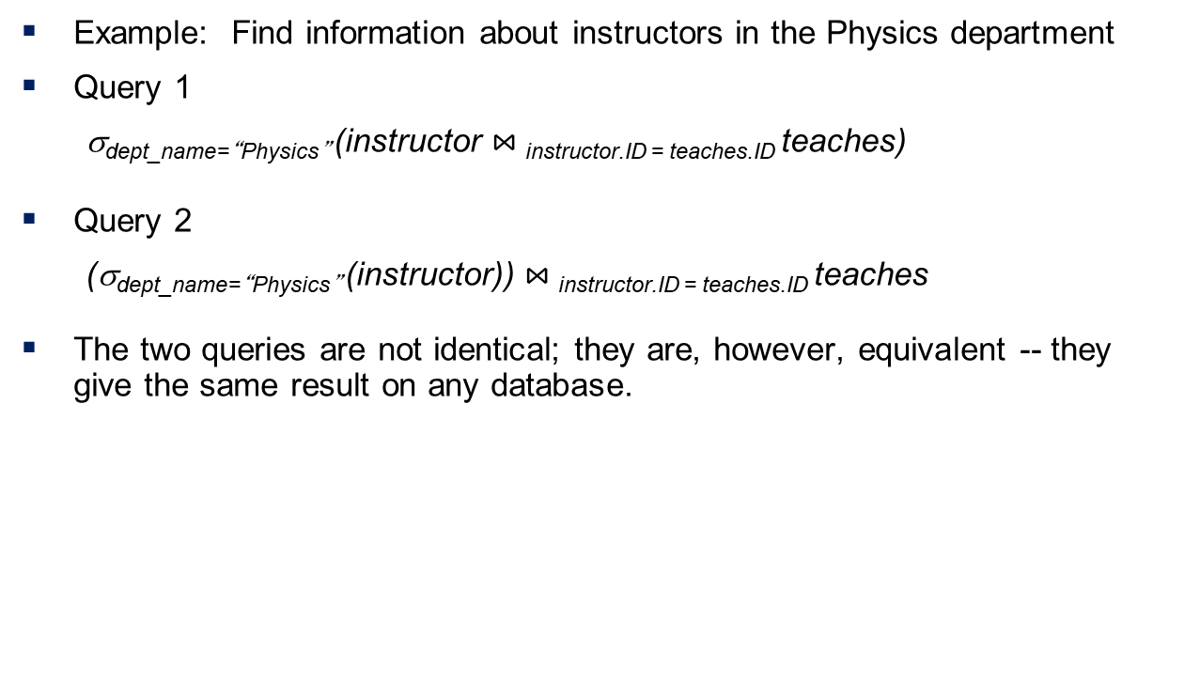
Equivalent Queries (Cont.)
Example: Find information about instructors in the Physics department
Query 1
σ_{dept_name=“Physics”} (instructor $⋈_{ }$_{instructor.ID = teaches.ID} teaches)
Query 2
(σ_{dept_name=“Physics”} (instructor)) $⋈_{ }$_{instructor.ID = teaches.ID} teaches
The two queries are not identical; they are, however, equivalent -- they give the same result on any database.

