Slide 1
Chapter 3: Introduction to SQL

Slide 2
Outline
Overview of The SQL Query Language
SQL Data Definition
Basic Query Structure of SQL Queries
Additional Basic Operations
Set Operations
Null Values
Aggregate Functions
Nested Subqueries
Modification of the Database
注意: 輸出結果請參考課本或上網執行
https://www.db-book.com/university-lab-dir/sqljs.html
Notes:
1

Slide 3
History
IBM Sequel language developed as part of System R project at the IBM San Jose Research Laboratory
Renamed Structured Query Language (SQL)
ANSI and ISO standard SQL:
  SQL-86
  SQL-89
  SQL-92
  SQL:1999 (language name became Y2K compliant!)
  SQL:2003
Commercial systems offer most, if not all, SQL-92 features, plus varying feature sets from later standards and special proprietary features.
  Not all examples here may work on your particular system.

Slide 4
SQL Parts
DML -- provides the ability to query information from the database and to insert tuples into, delete tuples from, and modify tuples in the database.
integrity – the DDL includes commands for specifying integrity constraints.
View definition -- The DDL includes commands for defining views.
Transaction control –includes commands for specifying the beginning and ending of transactions.
Embedded SQL and dynamic SQL -- define how SQL statements can be embedded within general-purpose programming languages.
Authorization – includes commands for specifying access rights to relations and views.

Slide 5
Data Definition Language
The SQL data-definition language (DDL) allows the specification of information about relations, including:
The schema for each relation.
The type of values associated with each attribute.
The Integrity constraints
The set of indices to be maintained for each relation.
Security and authorization information for each relation.
The physical storage structure of each relation on disk.

Slide 6
Domain Types in SQL
char(n). Fixed length character string, with user-specified length n.
varchar(n). Variable length character strings, with user-specified maximum length n.
int. Integer (a finite subset of the integers that is machine-dependent).
smallint. Small integer (a machine-dependent subset of the integer domain type).
numeric(p,d). Fixed point number, with user-specified precision of p digits, with d digits to the right of decimal point. (ex., numeric(3,1), allows 44.5 to be stores exactly, but not 444.5 or 0.32)
real, double precision. Floating point and double-precision floating point numbers, with machine-dependent precision.
float(n). Floating point number, with user-specified precision of at least n digits.
More are covered in Chapter 4.

Slide 7
Create Table Construct
An SQL relation is defined using the create table command:
create table r
(A₁ D₁, A₂ D₂, ..., A_{n} D_{n},
(integrity-constraint₁),
...,
(integrity-constraint_{k}))
  r is the name of the relation
  each A_{i} is an attribute name in the schema of relation r
  D_{i} is the data type of values in the domain of attribute A_{i}
Example:
create table instructor (
ID char(5),
name varchar(20),
dept_name varchar(20),
salary numeric(8,2))

Slide 8
Integrity Constraints in Create Table
Types of integrity constraints
  primary key (A₁, ..., A_{n} )
  foreign key (A_{m}, ..., A_{n} ) references r
  not null
SQL prevents any update to the database that violates an integrity constraint.
Example:
create table instructor (
ID char(5),
name varchar(20) not null,
dept_name varchar(20),
salary numeric(8,2),
primary key (ID),
foreign key (dept_name) references department);
注意: primary key屬性也要求nonnull，大部分的軟體都有做到這一點。

Slide 9
And a Few More Relation Definitions
create table student (
ID varchar(5),
name varchar(20) not null,
dept_name varchar(20),
tot_cred numeric(3,0),
primary key (ID),
foreign key (dept_name) references department);
create table takes (
ID varchar(5),
course_id varchar(8),
sec_id varchar(8),
semester varchar(6),
year numeric(4,0),
grade varchar(2),
primary key (ID, course_id, sec_id, semester, year) ,
foreign key (ID) references student,
foreign key (course_id, sec_id, semester, year) references section);
注意: 1. A primary key can consist of many attributes.
2. A table can have many foreign keys.

Slide 10
And more still
create table course (
course_id varchar(8),
title varchar(50),
dept_name varchar(20),
credits numeric(2,0),
primary key (course_id),
foreign key (dept_name) references department);

Slide 11
Updates to tables
Insert
  insert into instructor values (‘10211’, ‘Smith’, ‘Biology’, 66000);->字串加單引號
  insert into instructor values (‘10211’, null, ’Biology’, 66000); ->出現錯誤訊息
  insert into instructor values (‘10211’, ’Smith’, ’Biology’, null); ->可執行
Delete
  Remove all tuples from the student relation
    delete from student
Drop Table: 刪掉資料和全部定義
  drop table r
Alter
  alter table r add A D
    where A is the name of the attribute to be added to relation r and D is the domain of A.
    All existing tuples in the relation are assigned null as the value for the new attribute.
  alter table r drop A
    where A is the name of an attribute of relation r

Slide 12
資料庫綱要 (課本圖2.8)
classroom (building, room_number, capacity)
department (dept_name, building, budget)
course (course_id, title, dept_name, credits)
instructor (ID, name, dept_name, salary)
section (course_id, sec_id, semester, year, building, room_number, time_slot_id)
teaches (ID, course_id, sec_id, semester, year)
student (ID, name, dept_name, tot_cred)
takes (ID, course_id, sec_id, semester, year, grade)

Slide 13
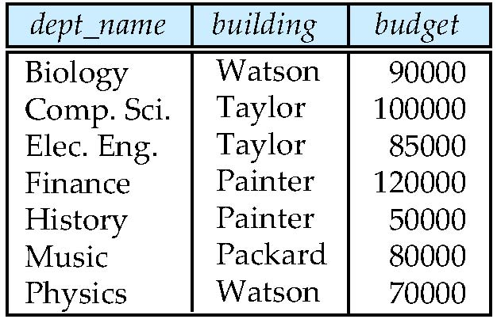
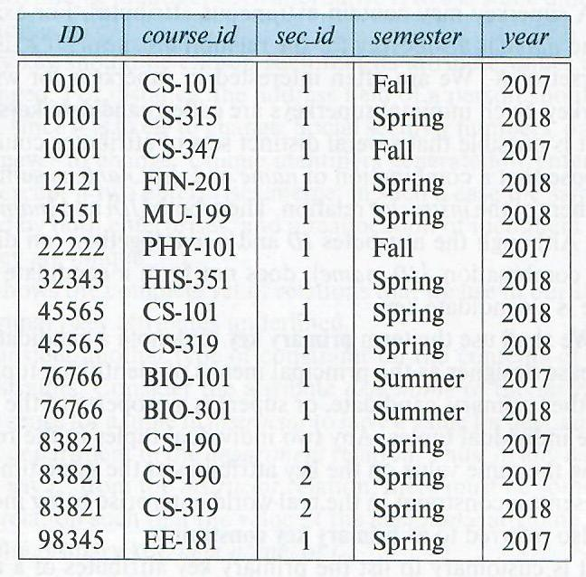
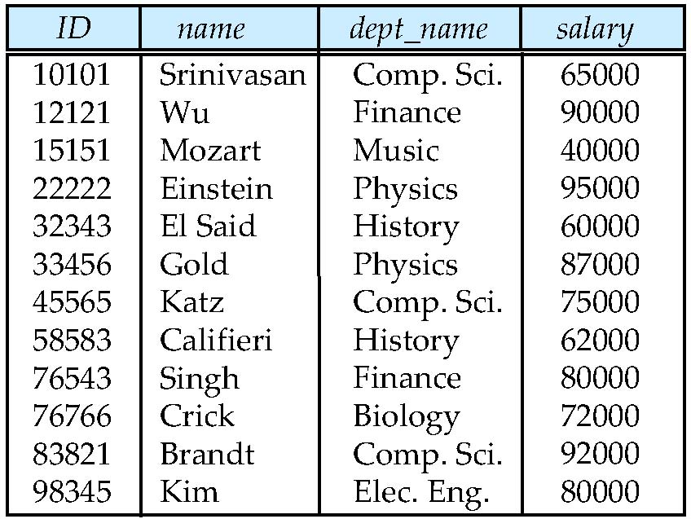
Relational Instances (課本圖2.5, 2.1, 2.7)
department
teaches
instructor

Slide 14
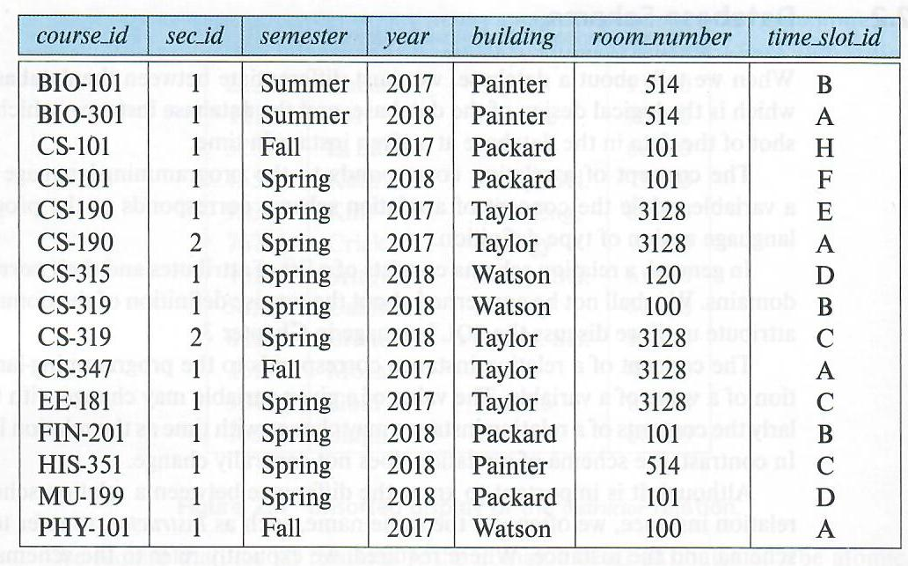
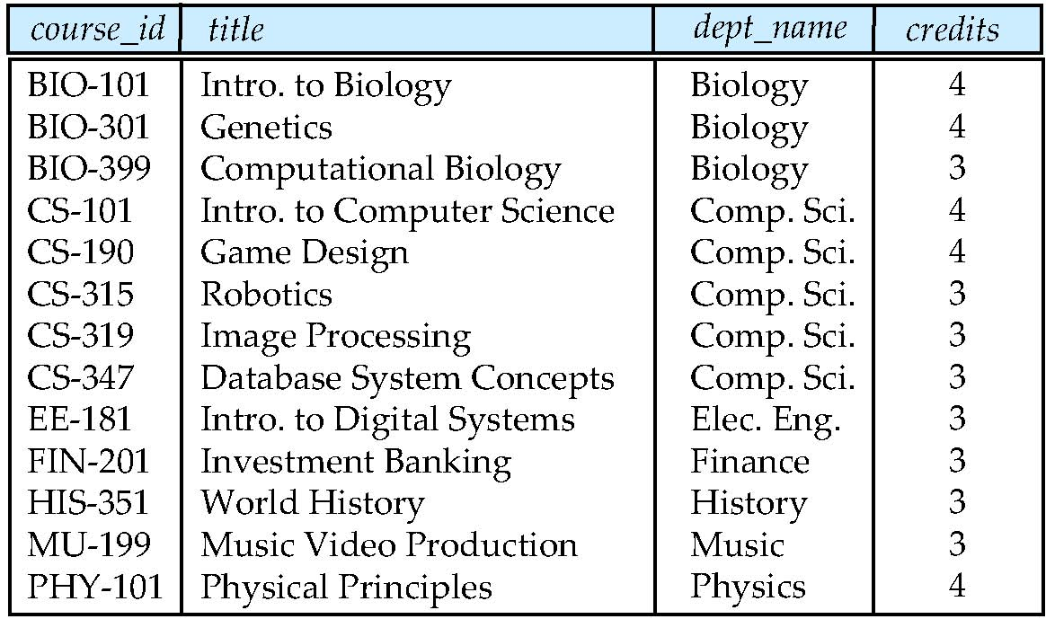
More Relational Instances (課本圖2.6, 2.2)
section
course

Slide 15
Basic Query Structure
A typical SQL query has the form:
select A₁, A₂, ..., A_{n}
from r₁, r₂, ..., r_{m}
where P
  A_{i} represents an attribute
  r_{i} represents a relation
  P is a predicate.
The result of an SQL query is a relation.
注意: An SQL query is usually ended with the semicolon “;” ，實作上各軟體不同，考試和作業加不加都OK
Notes:
2

Slide 16
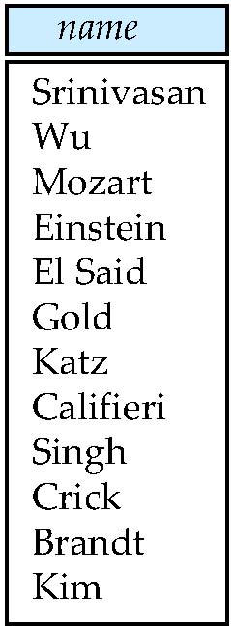
The select Clause
The select clause lists the attributes desired in the result of a query
  corresponds to the projection operation of the relational algebra
Example: find the names of all instructors:
select name
from instructor
NOTE: SQL names are case insensitive (i.e., you may use upper- or lower-case letters.)
  E.g., Name ≡ NAME ≡ name
  Some people use upper case wherever we use bold font.
Notes:
3

Slide 17
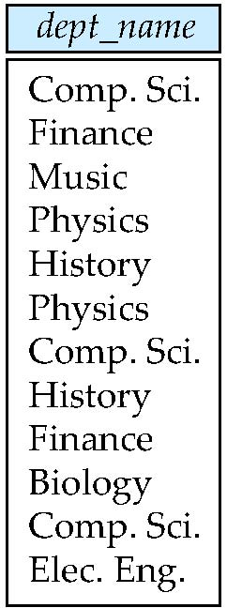
The select Clause (Cont.)
SQL allows duplicates in relations as well as in query results.
To force the elimination of duplicates, insert the keyword distinct after select.
Find the department names of all instructors, and remove duplicates
select distinct dept_name
from instructor
The keyword all specifies that duplicates should not be removed. (因為all是default，所以習慣上都不寫)
select all dept_name
from instructor
Notes:
4

Slide 18
The select Clause (Cont.)
An asterisk in the select clause denotes “all attributes”
select *
from instructor
The select clause can contain arithmetic expressions involving the operation, +, –, ∗, and /, and operating on constants or attributes of tuples.
  The query:
  select ID, name, salary/12
  from instructor
  would return a relation that is the same as the instructor relation, except that the value of the attribute salary is divided by 12.
Notes:
5

Slide 19
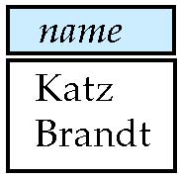
The where Clause
The where clause specifies conditions that the result must satisfy
  Corresponds to the selection predicate of the relational algebra.
To find the names of all instructors in Comp. Sci. dept
select name
from instructor
where dept_name = ‘Comp. Sci.’
SQL allows the use of the logical connectives and, or, and not
The operands of the logical connectives can be expressions involving the comparison operators <, <=, >, >=, =, and <> (不等於).
Comparisons can be applied to results of arithmetic expressions
To find all instructors in Comp. Sci. dept with salary > 70000
  select name
  from instructor
  where dept_name = 'Comp. Sci.' and salary > 70000
Notes:
6

Slide 20
The from Clause
The from clause lists the relations involved in the query
  Corresponds to the Cartesian product operation of the relational algebra.
Find the Cartesian product instructor X teaches
select ∗
from instructor, teaches
  generates every possible instructor – teaches pair, with all attributes from both relations. (參考第二章投影片或課本圖3.6)
  For common attributes (e.g., ID), the attributes in the resulting table are renamed using the relation name (e.g., instructor.ID)
Cartesian product not very useful directly, but useful combined with where-clause condition (selection operation in relational algebra).
Notes:
8

Slide 21
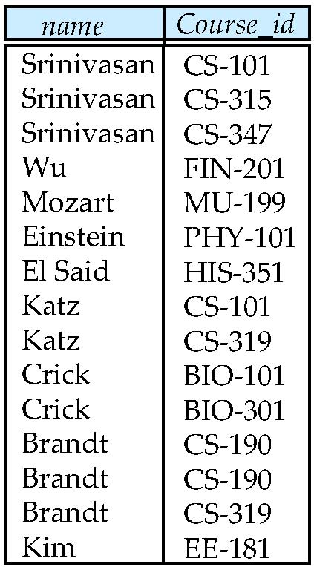
Examples
Find the names of all instructors who have taught some course and the course_id
  select name, course_id
  from instructor , teaches
  where instructor.ID = teaches.ID
Find the names of all instructors in the Art department who have taught some course and the course_id
  select name, course_id
  from instructor, teaches
  where instructor.ID = teaches.ID and
  instructor.dept_name = 'Art'
Notes:
9

Slide 22
練習
Find the titles of courses in the Comp. Sci. department that have 3 credits.
Answer:
Output the ID and building of the instructor named “Einstein”.
(Einstein老師的編號和辦公室所在的建築物名稱)
Answer:

Slide 23
The Rename Operation
The SQL allows renaming relations and attributes using the as clause:
  old-name as new-name
  as is optional, so “instructor as T” ≡ “instructor T”
attribute的例子在講aggregate function時會提到
relation的例子見下一頁
Notes:
9

Slide 24
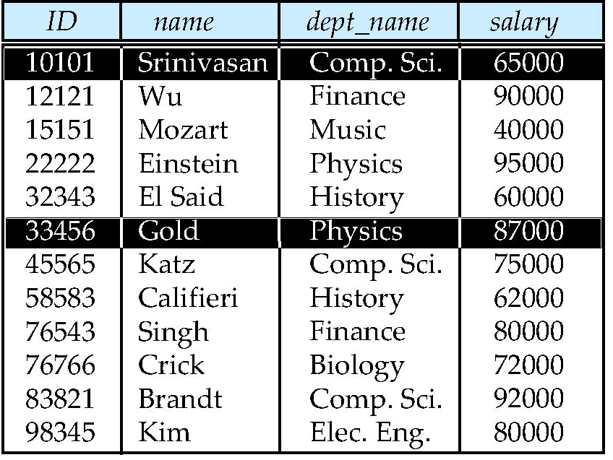
The Rename Operation (Cont.)
Find the names of all instructors who have a higher salary than
some instructor in 'Comp. Sci'.
  select distinct T.name
  from instructor as T, instructor as S =>特別稱呼為tuple variable
  where T.salary > S.salary and S.dept_name = 'Comp. Sci.’
S
T
Notes:
9

Slide 25
String Operations
SQL includes a string-matching operator for comparisons on character strings. The operator like uses patterns that are described using two special characters:
  percent ( % ). The % character matches any substring.
  underscore ( _ ). The _ character matches any character.
Find the names of all departments whose building name includes the substring “Watson”.
select dept_name
from department
where building like ‘%Watson%'
Match the string “100%”
like '100 \%' escape '\'
in that above we use backslash (\) as the escape character.

Slide 26
String Operations (Cont.)
Patterns are case sensitive.
Pattern matching examples:
  'Intro%' matches any string beginning with “Intro”.
  '%Comp%' matches any string containing “Comp” as a substring.
  '_ _ _' matches any string of exactly three characters.
  '_ _ _ %' matches any string of at least three characters.
SQL supports a variety of string operations such as
  concatenation (using “||”)
  converting from upper to lower case (and vice versa)
  finding string length, extracting substrings, etc.

Slide 27
Ordering the Display of Tuples
List in alphabetic order the names of all instructors in the Physics department.
select name
from instructor
where dept_name = `Physics’
order by name
We may specify desc for descending order or asc for ascending order, for each attribute; ascending order is the default.
  Example: order by name desc
Can sort on multiple attributes
  Example:
  select *
  from instructor
  order by salary desc, name asc
name
Einstein
Gold
name
Gold
Einstein

Slide 28
Where Clause Predicates
SQL includes a between comparison operator
Example: Find the names of all instructors with salary between $90,000 and $100,000 (that is, ≥ $90,000 and ≤ $100,000)
  select name
  from instructor
  where salary between 90000 and 100000
  另一種寫法如下:
  select name
  from instructor
  where salary >= 90000 and salary <= 100000;
Tuple comparison
  select name, course_id
  from instructor, teaches
  where (instructor.ID, dept_name) = (teaches.ID, 'Biology');
Notes:
7

Slide 29
Set Operations
Find courses that ran in Fall 2017 or in Spring 2018
(select course_id from section where semester = 'Fall' and year = 2017)
union
(select course_id from section where semester = 'Spring' and year = 2018)
Find courses that ran in Fall 2017 and in Spring 2018
(select course_id from section where semester = 'Fall' and year = 2017)
intersect
(select course_id from section where semester = 'Spring' and year = 2018)
Find courses that ran in Fall 2017 but not in Spring 2018
(select course_id from section where semester = 'Fall' and year = 2017)
except
(select course_id from section where semester = 'Spring' and year = 2018)

Slide 30
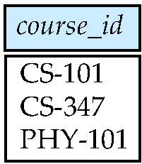
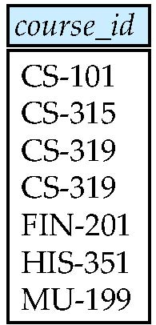
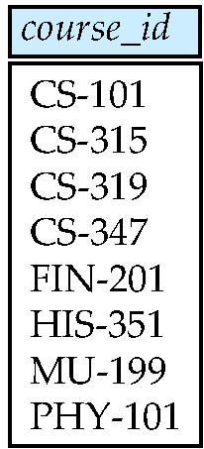
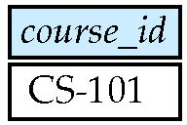
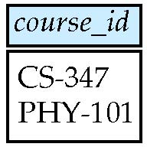
Set Operation Example (課本圖3.8-3.12)
union
intersect
except

Slide 31
Set Operations (Cont.)
Set operations union, intersect, and except
  Each of the above operations automatically eliminates duplicates
To retain all duplicates use the
  union all,
  intersect all
  except all.
例子: A = {p, p, q}, B = {p, r}
  A union all B = {p, p, p, q, r}; A union B = {p, q, r}
  A intersect all B = {p}
  A except all B = {p, q}; B except all A = {r}

Slide 32
Null Values
It is possible for tuples to have a null value, denoted by null, for some of their attributes
null signifies an unknown value or that a value does not exist.
The result of any arithmetic expression involving null is null
  Example: 5 + null returns null
The predicate is null can be used to check for null values.
  Example: Find all instructors whose salary is null.
select name
from instructor
where salary is null
The predicate is not null succeeds if the value on which it is applied is not null.

Slide 33
Null Values (Cont.)
SQL treats as unknown the result of any comparison involving a null value (other than predicates is null and is not null).
  Example: 5 < null or null <> null or null = null
The predicate in a where clause can involve Boolean operations (and, or, not); thus the definitions of the Boolean operations need to be extended to deal with the value unknown.
  and : (true and unknown) = unknown,
  (false and unknown) = false,
  (unknown and unknown) = unknown
  or: (unknown or true) = true,
  (unknown or false) = unknown
  (unknown or unknown) = unknown
Result of where clause predicate is treated as false if it evaluates to unknown
例子:
  Select C from T1 where A = ‘α’ and B = ‘β’ => {7}
  Select C from T1 where A = ‘α’ or B = ‘β’ => {8, 7}
A
B
C
α
α
β
8
7
T1

Slide 34
Aggregate Functions
These functions operate on the multiset of values of a column of a relation, and return a value
avg: average value 平均
min: minimum value 極小
max: maximum value 極大
sum: sum of values 總和
count: number of values 個數
All aggregate operations except count(*) ignore tuples with null values on the aggregated attributes
If a collection has only null values,
  count returns 0
  all other aggregates return null

Slide 35
Aggregate Functions Examples
Find the average salary of instructors in the Computer Science department
  select avg (salary) as avg_salary
  from instructor
  where dept_name= 'Comp. Sci.';
Find the total number of instructors who teach a course in the Spring 2018 semester
  select count (distinct ID)
  from teaches
  where semester = 'Spring' and year = 2018;
Find the number of tuples in the course relation
  select count (*)
  from course;
avg_salary
77333
count (distinct ID)
6
count (*)
13

Slide 36
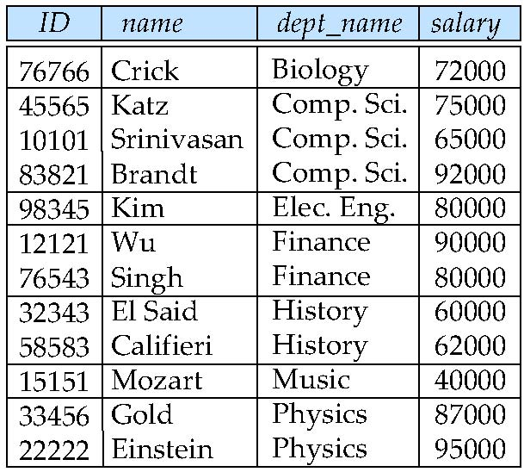
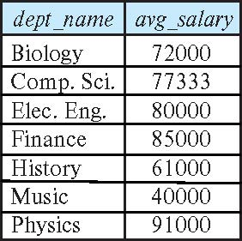
Aggregate Functions – Group By
Find the average salary of instructors in each department
  select dept_name, avg (salary) as avg_salary
  from instructor
  group by dept_name;

Slide 37
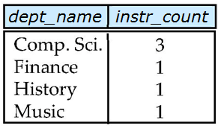
Aggregation (Cont.)
Attributes in select clause outside of aggregate functions must appear in group by list
  否則會出現multi-valued的狀況，
  違反atomic的限制
  /* erroneous query */
  select dept_name, ID, avg (salary)
  from instructor
  group by dept_name;
(使用到where和group by的例子)
Find the number of instructors in each department who teach a course in the Spring 2018 semester.
  select dept_name, count (distinct ID) as instr_count
  from instructor, teaches
  where instructor.ID = teaches.ID and
    semester= ‘Spring’ and year = 2018
  group by dept_name;
dept_name
ID
avg(salary)
biology
Comp. Sci
…..
76766
45565
10101
83821
…..
72000
77333
……….

Slide 38
Aggregate Functions – Having Clause
Find the names and average salaries of all departments whose average salary is greater than 42000
Note: predicates in the having clause are applied after the formation of groups whereas predicates in the where clause are applied before forming groups
  aggregate function 不能直接使用在where clause裡.
  放在having和select clause裡的aggregate function 可不同
(使用到where, group by, having的例子)
For each course section offered in 2017, find the average total credits (tot_cred) of all students enrolled in the section, if the section had at least 2 students.
select course_id, semester, year, sec_id, avg (tot_cred)
from takes, student
where takes.ID = student.ID and year = 2017
group by course_id, sec_id, semester, year
having count (ID) >= 2;
select dept_name, avg (salary) as avg_salary
from instructor
group by dept_name
having avg (salary) > 42000;

Slide 39
練習
Find the number of instructors in each department.
Find the names of all departments whose instructors are more than 10.

Slide 40
Nested Subqueries
SQL provides a mechanism for the nesting of subqueries. A subquery is a select-from-where expression that is nested within another query.
The nesting can be done in the following SQL query
select A₁, A₂, ..., A_{n}
from r₁, r₂, ..., r_{m}
where P
as follows:
  From clause: r_{i} can be replaced by any valid subquery
  Where clause: P can be replaced with an expression of the form:
  B <operation> (subquery)
  B is an attribute and <operation> to be defined later.
  Select clause:
    A_{i} can be replaced by a subquery that generates a single value.

Slide 41
Set Membership

Slide 42
Set Membership
Find courses offered in Fall 2017 and in Spring 2018
Find courses offered in Fall 2017 but not in Spring 2018
select distinct course_id
from section
where semester = 'Fall' and year= 2017 and
course_id in (select course_id
from section
where semester = 'Spring' and year= 2018);
select distinct course_id
from section
where semester = 'Fall' and year= 2017 and
course_id not in (select course_id
from section
where semester = 'Spring' and year= 2018);
練習題：Find courses offered in Fall 2017 or in Spring 2018

Slide 43
Section 表格 和 Result of the subquery

Slide 44
Set Membership (Cont.)
Select the names of instructors whose names are neither “Mozart” nor Einstein”
select distinct name
from instructor
where name not in ('Mozart', 'Einstein')
Find the total number of (distinct) students who have taken course sections taught by the instructor with ID 10101
Note: Above query can be written in a much simpler manner, 而且有些軟體不支援此種寫法。 The formulation above is simply to illustrate SQL features
select count (distinct ID)
from takes
where (course_id, sec_id, semester, year) in
(select course_id, sec_id, semester, year
from teaches
where teaches.ID= 10101);

Slide 45
Set Comparison

Slide 46
Set Comparison – “some” Clause
Find names of instructors with salary greater than that of some (at least one) instructor in the Biology department.
Same query using > some clause
確定sub-query只輸出一筆資料則可省略量詞some或all.
select distinct T.name
from instructor as T, instructor as S
where T.salary > S.salary and S.dept_name = 'Biology';
select name
from instructor
where salary > some (select salary
from instructor
where dept_name = 'Biology');

Slide 47
Definition of “some” Clause
F <comp> some r ⇔ ∃ t ∈ r such that (F <comp> t )
Where <comp> can be: <, >, =, <> (也就是≠) 等
0
(5 < some
5
) = true
(read: 5 < some tuple in the relation)
6
0
(5 < some
5
) = false
0
(5 = some
) = true
5
0
(5 ≠ some
5
) = true (since 0 ≠ 5)
(= some) ≡ in
However, (≠ some) ≡ not in

Slide 48
Set Comparison – “all” Clause
Find the names of all instructors whose salary is greater than the salary of all instructors in the Biology department.
練習題：Find the names of all instructors who earn the most salary in the Biology department.
Answer:
select name
from instructor
where salary > all (select salary
from instructor
where dept_name = 'Biology');

Slide 49
Definition of “all” Clause
F <comp> all r ⇔ ∀ t ∈ r (F <comp> t)
0
(5 < all
5
) = false
6
6
(5 < all
) = true
10
4
(5 = all
) = false
5
4
(5 ≠ all
) = true (since 5 ≠ 4 and 5 ≠ 6)
6
(≠ all) ≡ not in
However, (= all) ≡ in

Slide 50
Test for Empty Relations
The exists construct returns the value true if the argument subquery is nonempty.
exists r ⇔ r ≠ Ø
not exists r ⇔ r = Ø

Slide 51
Use of “exists” Clause
Another way of specifying the query “Find all courses taught in both the Fall 2017 semester and in the Spring 2018 semester”
select course_id
from section as S
where semester = 'Fall' and year = 2017 and
exists (select *
from section as T
where semester = 'Spring' and year= 2018
and S.course_id = T.course_id);
Correlation name – variable S in the outer query
Correlated subquery – the inner query
注意：有的subquery需要額外宣告變數，有的不需要
前面不要有屬性

Slide 53
Use of “not exists” Clause
Find all students who have taken all courses offered in the Biology department.
First nested query lists all courses offered in Biology => X
Second nested query lists all courses a particular student took => Y
Note that X – Y = Ø ⇔ X ⊆ Y
Note: Cannot write this query using = all and its variants
select distinct S.ID, S.name
from student as S
where not exists ( (select course_id
from course
where dept_name = 'Biology')
except
(select T.course_id
from takes as T
where S.ID = T.ID));
X
Y
X
Y
Y
X
Y
X
Y
X

Slide 54
※ Test for Absence of Duplicate Tuples
The unique construct tests whether a subquery has any duplicate tuples in its result.
The unique construct evaluates to “true” if a given subquery contains no duplicates .
Find all courses that were offered at most once in 2017
  select T.course_id
  from course as T
  where unique ( select R.course_id
  from section as R
  where T.course_id= R.course_id
  and R.year = 2017);

Slide 55
Subqueries in the From Clause

Slide 56
Subqueries in the From Clause
SQL allows a subquery expression to be used in the from clause
Find the average instructors’ salaries of those departments where the average salary is greater than $42,000.”
  select dept_name, avg_salary
  from ( select dept_name, avg (salary) as avg_salary
  from instructor
  group by dept_name)
  where avg_salary > 42000;
Note that we do not need to use the having clause
Another way to write above query
  select dept_name, avg_salary
  from ( select dept_name, avg (salary)
  from instructor
  group by dept_name)
  as dept_avg (dept_name, avg_salary)
  where avg_salary > 42000; <-只能用新定義的relation裡的屬性
注意： (1) 寫在from的subquery不能用到同層from的其他relation.
(2) 有的軟體要求一定要把derived relation改名
更改屬性的名稱
更改表格的名稱

Slide 57
With Clause
The with clause provides a way of defining a temporary relation whose definition is available only to the query in which the with clause occurs.
Find all departments with the maximum budget
with max_budget (value) as
(select max(budget)
from department)
select department.name
from department, max_budget
where department.budget = max_budget.value;
value
120000
暫存
最
後
結
果
dept_name
finance

Slide 58
Complex Queries using With Clause
Find all departments where the total salary is greater than the average of the total salary at all departments
注意:
  有的軟體沒支援with語法
  定義的順序，後面的可用到前面的定義，整個query的輸出為最後select-from-where所定義的。
with dept _total (dept_name, value) as
(select dept_name, sum(salary)
from instructor
group by dept_name),
dept_total_avg(value) as
(select avg(value)
from dept_total)
select dept_name
from dept_total, dept_total_avg
where dept_total.value > dept_total_avg.value;

Slide 59
Scalar Subquery
Scalar subquery is one which is used where a single value is expected
List all departments along with the number of instructors in each department
select dept_name,
( select count(*)
from instructor
where department.dept_name = instructor.dept_name)
as num_instructors
from department;
Runtime error if subquery returns more than one result tuple

Slide 60
Modification of the Database
Deletion of tuples from a given relation.
Insertion of new tuples into a given relation
Updating of values in some tuples in a given relation

Slide 61
Deletion
Delete all instructors
delete from instructor
Delete all instructors from the Finance department
delete from instructor
where dept_name= 'Finance’;
Delete all tuples in the instructor relation for those instructors associated with a department located in the Watson building.
delete from instructor
where dept_name in (select dept_name
from department
where building = 'Watson');

Slide 62
Deletion (Cont.)
Delete all instructors whose salary is less than the average salary of instructors
  Problem: as we delete tuples from instructor, the average salary changes
  Solution used in SQL:
    First, compute avg (salary) and find all tuples to delete
    Next, delete all tuples found above (without recomputing avg or retesting the tuples)
delete from instructor
where salary < (select avg (salary)
from instructor);

Slide 63
Insertion
Add a new tuple to course
insert into course
values ('CS-437', 'Database Systems', 'Comp. Sci.', 4);
or equivalently
insert into course (course_id, title, dept_name, credits)
values ('CS-437', 'Database Systems', 'Comp. Sci.', 4);
Add a new tuple to student with tot_creds set to null
insert into student
values ('3003', 'Green', 'Finance', null);

Slide 64
Insertion (Cont.)
Make each student in the Music department who has earned more than 144 credit hours an instructor in the Music department with a salary of $18,000.
insert into instructor
select ID, name, dept_name, 18000
from student
where dept_name = 'Music' and total_cred > 144;
The select from where statement is evaluated fully before any of its results are inserted into the relation.
Otherwise queries like
insert into table1 select * from table1
would cause problem

Slide 65
Updates
Give a 5% salary raise to all instructors
  update instructor
  set salary = salary * 1.05
  注意: 若同時修改多個欄位，每組中間用逗號隔開
Give a 5% salary raise to those instructors who earn less than 70000
update instructor
set salary = salary * 1.05
where salary < 70000;
Give a 5% salary raise to instructors whose salary is less than average
update instructor
set salary = salary * 1.05
where salary < (select avg (salary)
from instructor);
新的欄位值
欲修改的欄位名稱

Slide 66
Updates (Cont.)
Increase salaries of instructors whose salary is over $100,000 by 3%, and all others by a 5%
  Write two update statements:
  update instructor
  set salary = salary * 1.03
  where salary > 100000;
  update instructor
  set salary = salary * 1.05
  where salary <= 100000;
  The order is important
  Can be done better using the case statement
  update instructor
  set salary = case
  when salary <= 100000 then salary * 1.05
  else salary * 1.03
  end
  注意: 若有case沒被涵蓋到，其值會被設為0。

Slide 67
Updates with Scalar Subqueries
Recompute and update tot_creds value for all students
update student
set tot_cred = (select sum(credits)
from takes, course
where student.ID= takes.ID and
takes.course_id = course.course_id and takes.grade <> 'F' and
takes.grade is not null);
The above statement sets tot_creds to null for students who have not taken any course. The following statement will set tot_creds to “0”.
  Instead of sum(credits), use:
select case
when sum(credits) is not null then sum(credits)
else 0
end

