Slide 1
Chapter 4 : Intermediate SQL

Slide 2
Outline
Join Expressions
Views
Transactions
Integrity Constraints
SQL Data Types and Schemas
Index Definition in SQL
Authorization
Notes:
1

Slide 3
Joined Relations
Join operations take two relations and return as a result another relation.
A join operation is a Cartesian product which requires that tuples in the two relations match (under some condition). It also specifies the attributes that are present in the result of the join
The join operations are typically used as subquery expressions in the from clause
Three types of joins:
  Natural join
  Inner join
  Outer join

Slide 4
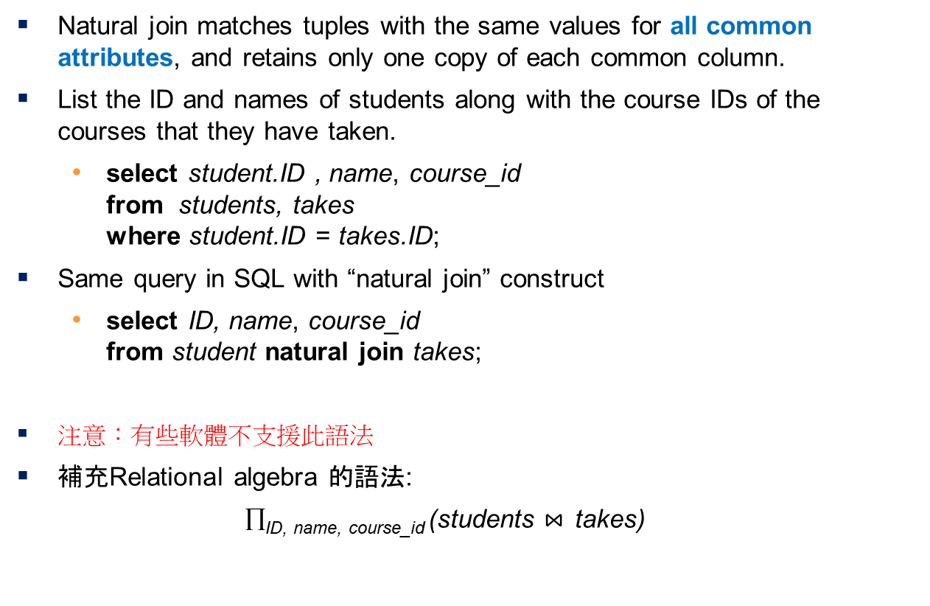
Natural Join in SQL
Natural join matches tuples with the same values for all common attributes, and retains only one copy of each common column.
List the ID and names of students along with the course IDs of the courses that they have taken.
  select student.ID , name, course_id
  from students, takes
  where student.ID = takes.ID;
Same query in SQL with “natural join” construct
  select ID, name, course_id
  from student natural join takes;
注意：有些軟體不支援此語法
補充Relational algebra 的語法:
∏_{ID, name,} _{course_id} (students $⋈_{ }$ takes)

Slide 5
Natural Join in SQL (Cont.)
The from clause can have multiple relations combined using natural join:
  select A₁, A₂, … A_{n}
  from r₁ natural join r₂ natural join .. natural join r_{n}
  where P ;

Slide 6
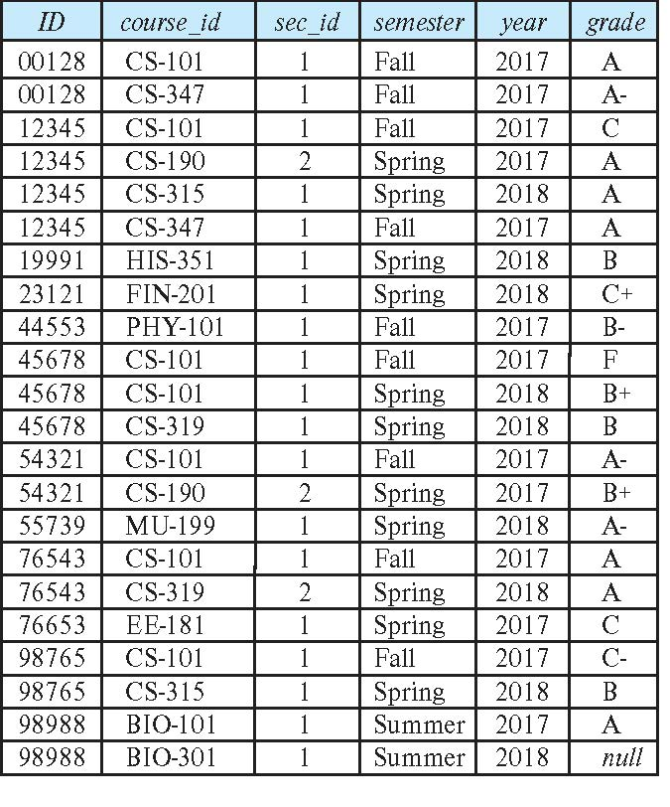
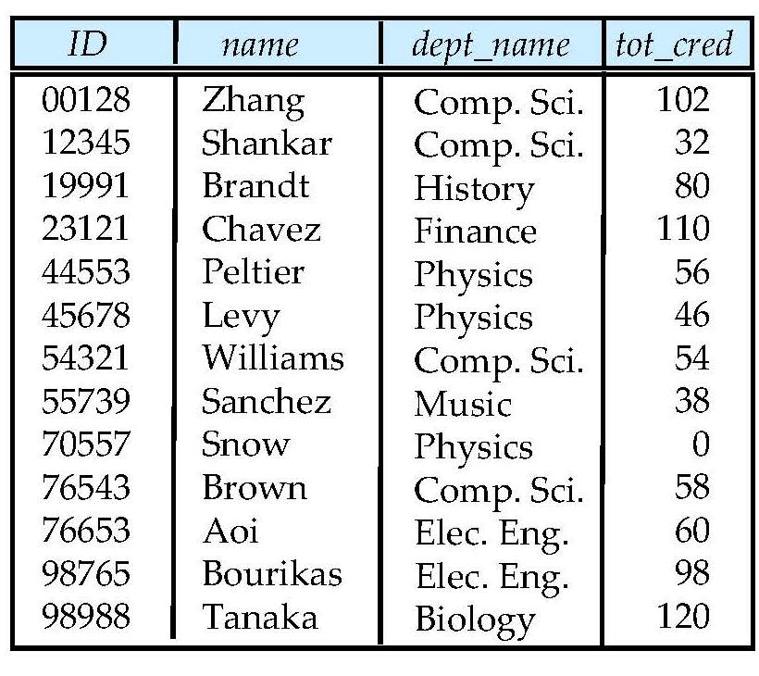
Takes Relation
Student Relation

Slide 7
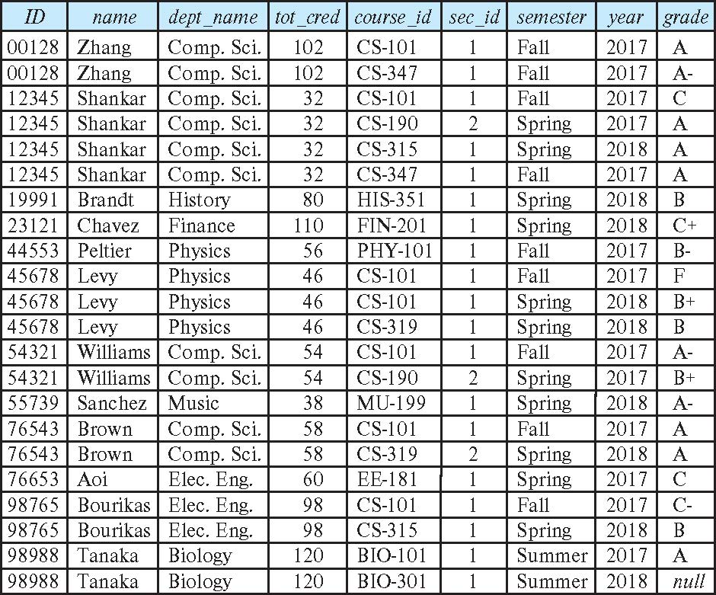
student natural join takes

Slide 8
Dangerous in Natural Join
Beware of unrelated attributes with same name which get equated incorrectly
Example -- List the names of students along with the titles of courses that they have taken
  Correct version
  select name, title
  from student natural join takes, course
  where takes.course_id = course.course_id;
  在from裡使用逗號”,”，所以course是和前一個combined relation做cartesian product, 而非natural join.
  Incorrect version
    select name, title
    from student natural join takes natural join course;
    This query omits all (student.name, course.title) pairs where the student takes a course in a department other than the student‘s own department. <- 錯誤的原因在於多了student.dept_name= course.dept_name的限制，但student和course不需要同一系!
    The correct version (above), correctly outputs such pairs.
student (ID, name, dept_name, tot_cred)
takes (ID, course_id, sec_id, semester, year, grade)
course (course_id, title, dept_name, credits)

Slide 9
Natural Join with Using Clause
To avoid the danger of equating attributes erroneously, we can use the “using” construct that allows us to specify exactly which columns should be equated.
Query example
select name, title
from (student natural join takes) join course using (course_id)
注意: 多個表格進行join時，要注意同名的屬性是否意義相同，以及是否要求其值相同的才能配對輸出。

Slide 10
Join Condition
The on condition allows a general predicate over the relations being joined
This predicate is written like a where clause predicate except for the use of the keyword on
Query example
select *
from student join takes on student.ID = takes.ID
  The on condition above specifies that a tuple from student matches a tuple from takes if their ID values are equal.
Equivalent to:
select *
from student , takes
where student.ID = takes.ID
注意: on後面不要寫個別屬性值的限制

Slide 11
Outer Join
An extension of the join operation that avoids loss of information.
Computes the join and then adds tuples form one relation that does not match tuples in the other relation to the result of the join.
Uses null values.
Three forms of outer join:
  left outer join
  right outer join
  full outer join
為了對照之用，the join operations we studied earlier that do not preserve nonmatched tuples are called inner join operations.

Slide 12
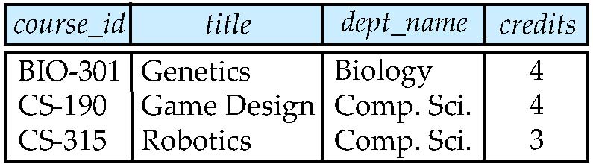
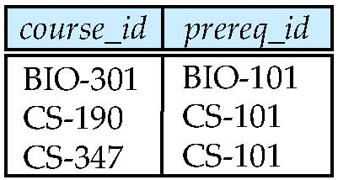
Outer Join Examples
Relation course
Relation prereq
Observe that
course information is missing CS-437
prereq information is missing CS-315
course prereq 會沒有CS-315和CS-437的任何資料.

Slide 13
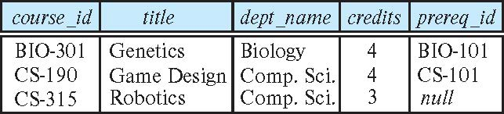
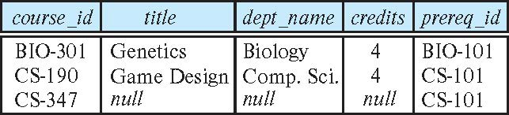
Example of Left/Right Outer Join
course natural left outer join prereq
    注意: “natural”會要求兩個relation的共同屬性其值相等.
course natural right outer join prereq

Slide 14
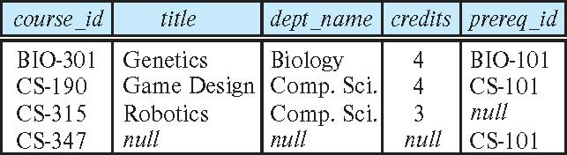
Full Outer Join
course natural full outer join prereq
注意: 有些軟體不支援full outer join

Slide 15
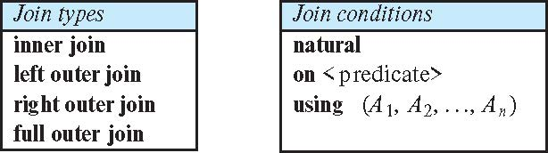
Joined Types and Conditions
Join operations take two relations and return as a result another relation.
These additional operations are typically used as subquery expressions in the from clause
Join condition – defines which tuples in the two relations match, and what attributes are present in the result of the join.
Join type – defines how tuples in each relation that do not match any tuple in the other relation (based on the join condition) are treated.
各軟體的功能不盡相同，大部分的軟體支援 (inner, left outer, right outer) join + on <predicate>

Slide 16
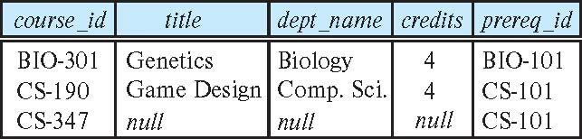
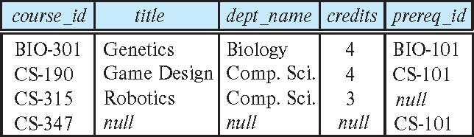
Joined Relations – Examples
course natural right outer join prereq
course full outer join prereq using (course_id)

Slide 17
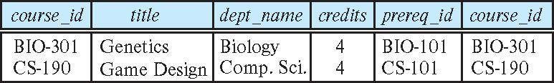
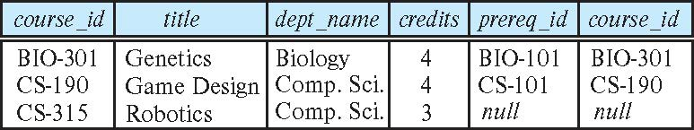
Joined Relations – Examples
course inner join prereq on
course.course_id = prereq.course_id
What is the difference between the above, and a natural join?
course left outer join prereq on course.course_id = prereq.course_id
注意: The joined relations are used as subquery expressions in the from clause
prereq.course_id
course.course_id
prereq.course_id
course.course_id

Slide 18
練習
Find the course_ids and sec_ids which were offered by an instructor named “Einstein”, using the “inner join” expression.
Answer:
(1) using “natural” expression
(2) Using “on” expression
(3) Using “using” expression

Slide 19
Views
In some cases, it is not desirable for all users to see the entire logical model (that is, all the actual relations stored in the database.)
Consider a person who needs to know an instructor’s name and department, but not the salary. This person should see a relation described, in SQL, by
select ID, name, dept_name
from instructor
A view provides a mechanism to hide certain data from the view of certain users.
Any relation that is not part of the conceptual model but is made visible to a user as a “virtual relation” is called a view.

Slide 20
View Definition
A view is defined using the create view statement which has the form
create view v as < query expression >
where <query expression> is any legal SQL expression. The view name is represented by v.
Once a view is defined, the view name can be used to refer to the virtual relation that the view generates.
注意: 此處所定義的view可以被多個查詢句使用，和with所定義的不同.
View definition is not the same as creating a new relation by evaluating the query expression
  Rather, a view definition causes the saving of an expression; the expression is substituted into queries using the view.

Slide 21
View Definition and Use
A view of instructors without their salary
create view faculty as
select ID, name, dept_name
from instructor
Find all instructors in the Biology department
select name
from faculty
where dept_name = 'Biology'
Create a view of department salary totals
create view departments_total_salary(dept_name, total_salary) as
select dept_name, sum (salary)
from instructor
group by dept_name;

Slide 22
Views Defined Using Other Views
create view physics_fall_2017 as
select course.course_id, sec_id, building, room_number
from course, section
where course.course_id = section.course_id
and course.dept_name = 'Physics'
and section.semester = 'Fall'
and section.year = '2017’;
create view physics_fall_2017_watson as
select course_id, room_number
from physics_fall_2017
where building= 'Watson';

Slide 23
View Expansion
Expand the view :
create view physics_fall_2017_watson as
select course_id, room_number
from physics_fall_2017
where building= 'Watson'
To:
create view physics_fall_2017_watson as
select course_id, room_number
from (select course.course_id, building, room_number
from course, section
where course.course_id = section.course_id
and course.dept_name = 'Physics'
and section.semester = 'Fall'
and section.year = '2017')
where building= 'Watson';

Slide 24
※Views Defined Using Other Views
One view may be used in the expression defining another view
A view relation v₁ is said to depend directly on a view relation v₂ if v₂ is used in the expression defining v₁
A view relation v₁ is said to depend on view relation v₂ if either v₁ depends directly to v₂ or there is a path of dependencies from v₁ to v₂
A view relation v is said to be recursive if it depends on itself.

Slide 25
※ View Expansion
A way to define the meaning of views defined in terms of other views.
Let view v₁ be defined by an expression e₁ that may itself contain uses of view relations.
View expansion of an expression repeats the following replacement step:
repeat
Find any view relation v_{i} in e₁
Replace the view relation v_{i} by the expression defining v_{i}
until no more view relations are present in e₁
As long as the view definitions are not recursive, this loop will terminate

Slide 26
※ Materialized Views
Certain database systems allow view relations to be physically stored.
  Physical copy created when the view is defined.
  Such views are called Materialized view:
If relations used in the query are updated, the materialized view result becomes out of date
  Need to maintain the view, by updating the view whenever the underlying relations are updated.

Slide 27
Update of a View
Add a new tuple to faculty view which we defined earlier
insert into faculty
values ('30765', 'Green', 'Music');
This insertion must be represented by the insertion into the instructor relation
  Must have a value for salary.
Two approaches
  Reject the insert
  Insert the tuple
('30765', 'Green', 'Music', null)
into the instructor relation

Slide 28
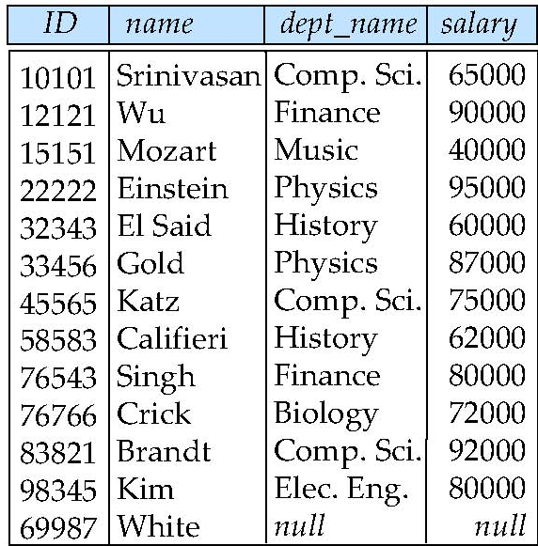
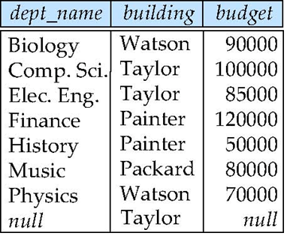
Some Updates Cannot be Translated Uniquely
create view instructor_info as
select ID, name, building
from instructor, department
where instructor.dept_name= department.dept_name;
insert into instructor_info
values ('69987', 'White', 'Taylor');
Issues
  Which department, if multiple departments in Taylor?
  What if no department is in Taylor?
instructor
department

Slide 29
And Some Not at All
create view history_instructors as
select *
from instructor
where dept_name= 'History';
What happens if we insert
('25566', 'Brown', 'Biology', 100000)
into history_instructors?

Slide 30
View Updates in SQL
Most SQL implementations allow updates only on simple views
  The from clause has only one database relation.
  The select clause contains only attribute names of the relation, and does not have any expressions, aggregates, or distinct specification.
  Any attribute not listed in the select clause can be set to null
  The query does not have a group by or having clause.

Slide 31
Transactions
A transaction consists of a sequence of query and/or update statements and is a “unit” of work
The SQL standard specifies that a transaction begins implicitly when an SQL statement is executed.
The transaction must end with one of the following statements:
  Commit work. The updates performed by the transaction become permanent in the database.
  Rollback work. All the updates performed by the SQL statements in the transaction are undone.
Atomic transaction
  either fully executed or rolled back as if it never occurred
Isolation from concurrent transactions
第五章會有進一步SQL語法和API的用法說明。

Slide 32
Integrity Constraints
Integrity constraints guard against accidental damage to the database, by ensuring that authorized changes to the database do not result in a loss of data consistency.
  A checking account must have a balance greater than $10,000.00
  A salary of a bank employee must be at least $4.00 an hour
  A customer must have a (non-null) phone number
注意: When an integrity constraint is violated, the normal procedure is to reject the action that caused the violation.
大部分資料庫軟體支援的兩種 integrity constraints 類型
  Constraints on a single relation
  Constraints on two relations (Referential Integrity constraints)

Slide 33
Constraints on a Single Relation
not null
primary key
unique
check (P), where P is a predicate

Slide 34
Not Null Constraints
not null
  Declare name and budget to be not null
name varchar(20) not null
budget numeric(12,2) not null

Slide 35
Unique Constraints
unique ( A₁, A₂, …, A_{m})
  The unique specification states that the attributes A₁, A₂, …, A_{m} form a candidate key.
  Candidate keys are permitted to be null (in contrast to primary keys).

Slide 36
The check clause
The check (P) clause specifies a predicate P that must be satisfied by every tuple in a relation.
Example: ensure that semester is one of fall, winter, spring or summer
create table section
(course_id varchar (8),
sec_id varchar (8),
semester varchar (6),
year numeric (4,0),
building varchar (15),
room_number varchar (7),
time slot id varchar (4),
primary key (course_id, sec_id, semester, year),
check (semester in ('Fall', 'Winter', 'Spring', 'Summer')))
有的資料庫軟體允許此功能在資料庫裡宣告，有的則只能利用應用程式，如利用asp.net的物件定義。

Slide 37
Referential Integrity
Ensures that a value that appears in one relation for a given set of attributes also appears for a certain set of attributes in another relation.
  Example: If “Biology” is a department name appearing in one of the tuples in the instructor relation, then there exists a tuple in the department relation for “Biology”.
Let A be a set of attributes. Let R and S be two relations that contain attributes A and where A is the primary key of S. A is said to be a foreign key of R if for any values of A appearing in R these values also appear in S.
R
S
 | A
 | A

Slide 38
Referential Integrity (Cont.)
Foreign keys can be specified as part of the SQL create table statement
foreign key (dept_name) references department
By default, a foreign key references the primary-key attributes of the referenced table.
foreign key (dept_name) references department (dept_name)
SQL allows a list of attributes of the referenced relation to be specified explicitly.
此限制對新增、刪除、修改的動作，都可能會影響到。

Slide 39
練習
For the following two tables, suppose branch_name in the account relation is a foreign key referencing the branch table. When will the referential constraint be violated? (Consider the case of insert, delete, update).
branch
account
branch_name
branch_city
assets
Perryridge
Downtown
Brighton
Mianus
Redwood
Horseneck
Brooklyn
Brooklyn
Horseneck
Palo Alto
1700000
9000000
7100000
400000
2100000
branch_name
account_number
balance
Perryridge
Perryridge
Brighton
Brighton
Redwood
A-102
A-201
A-217
A-215
A-222
400
900
750
750
700

Slide 40
Cascading Actions in Referential Integrity
When a referential-integrity constraint is violated, the normal procedure is to reject the action that caused the violation.
An alternative, in case of delete or update is to cascade
create table course (
(…
dept_name varchar(20),
foreign key (dept_name) references department
on delete cascade
on update cascade,
. . .)
Instead of cascade we can use :
  set null,
  set default
注意: 不同軟體支援的選項可能會有些微的差異
delete和update可以不一樣

Slide 41
※ Integrity Constraint Violation During Transactions
Consider:
  create table person (
  ID char(10),
  name char(40),
  mother char(10),
  father char(10),
  primary key ID,
  foreign key father references person,
  foreign key mother references person)
How to insert a tuple without causing constraint violation?
  Insert father and mother of a person before inserting person
  OR, set father and mother to null initially, update after inserting all persons (not possible if father and mother attributes declared to be not null)
  OR defer constraint checking:
  set constraints constraint-list deferred (commit時才check)
ID | name | mother | father
2 | John | null | null
3 | Mary | null | Null
10 | Tom | 3 | 2

Slide 42
※ Complex Check Conditions
The predicate in the check clause can be an arbitrary predicate that can include a subquery.
check (time_slot_id in (select time_slot_id from time_slot))
The check condition states that the time_slot_id in each tuple in the section relation is actually the identifier of a time slot in the time_slot relation.
  The condition has to be checked not only when a tuple is inserted or modified in section , but also when the relation time_slot changes

Slide 43
Built-in Data Types in SQL
date: Dates, containing a (4 digit) year, month and date
  Example: date '2005-7-27'
time: Time of day, in hours, minutes and seconds.
  Example: time '09:00:30' time '09:00:30.75'
timestamp: date plus time of day
  Example: timestamp '2005-7-27 09:00:30.75'
interval: period of time
  Example: interval '1' day
  Subtracting a date/time/timestamp value from another gives an interval value
  Interval values can be added to date/time/timestamp values
各資料庫軟體的做法不同,一般利用程式語言提供的函數或類別實做下述功能:
  functions to convert a character string to the type above.
  functions to get the current time.

Slide 44
Large-Object Types
Large objects (photos, videos, CAD files, etc.) are stored as a large object:
  blob: binary large object -- object is a large collection of uninterpreted binary data (whose interpretation is left to an application outside of the database system)
  clob: character large object -- object is a large collection of character data
When a query returns a large object, a pointer is returned rather than the large object itself.
補充：In MS SQL，提供binary, image, text 等型態

Slide 45
User-Defined Types
create type construct in SQL creates user-defined type
  create type Dollars as numeric (12,2) final
Example:
create table department
(dept_name varchar (20),
building varchar (15),
budget Dollars);

Slide 46
Domains
create domain construct in SQL-92 creates user-defined domain types
  create domain person_name char(20) not null
Types and domains are similar. Domains can have constraints, such as not null, specified on them.
Example:
create domain degree_level varchar(10)
constraint degree_level_test
check (value in ('Bachelors', 'Masters', 'Doctorate'));
補充說明：The clause constraint is optional; it can give a name to the constraint.
各軟體支援的type/domain功能和語法差異很大.

Slide 47
Index Creation
Many queries reference only a small proportion of the records in a table.
It is inefficient for the system to read every record to find a record with particular value
An index on an attribute of a relation is a data structure that allows the database system to find those tuples in the relation that have a specified value for that attribute efficiently, without scanning through all the tuples of the relation.
We create an index with the create index command
create index <name> on <relation-name> (attribute);

Slide 48
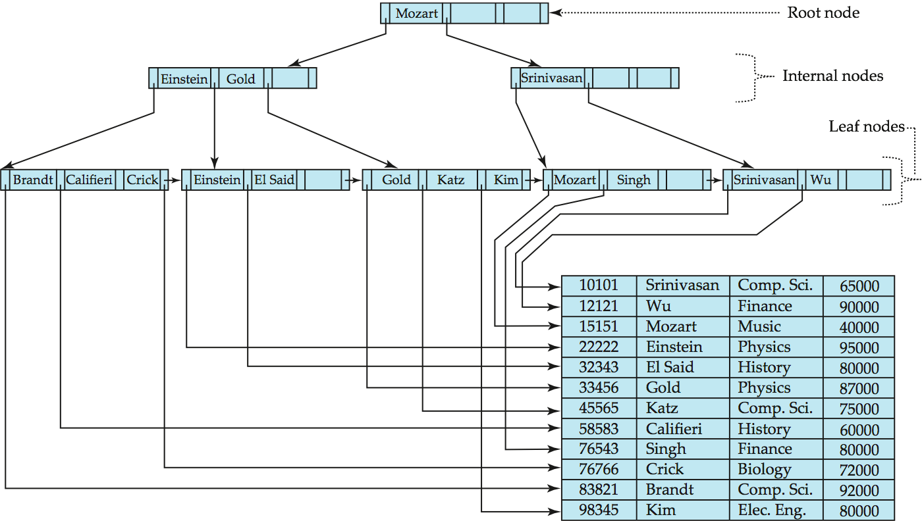
以屬性name建立Index的範例圖 (含Data File)

Slide 49
Index Creation Example
create table student
(ID varchar (5),
name varchar (20) not null,
dept_name varchar (20),
tot_cred numeric (3,0) default 0,
primary key (ID))
create index studentID_index on student(ID)
The query:
select *
from student
where ID = '12345'
can be executed by using the index to find the required record, without looking at all records of student

Slide 50
Authorization
We may assign a user several forms of authorizations on parts of the database.
  Read - allows reading, but not modification of data.
  Insert - allows insertion of new data, but not modification of existing data.
  Update - allows modification, but not deletion of data.
  Delete - allows deletion of data.
Each of these types of authorizations is called a privilege. We may authorize the user all, none, or a combination of these types of privileges on specified parts of a database, such as a relation or a view.

Slide 51
Authorization (Cont.)
Forms of authorization to modify the database schema
  Index - allows creation and deletion of indices.
  Resources - allows creation of new relations.
  Alteration - allows addition or deletion of attributes in a relation.
  Drop - allows deletion of relations.

Slide 52
Privileges in SQL
select: allows read access to relation, or the ability to query using the view
insert: the ability to insert tuples
update: the ability to update using the SQL update statement
delete: the ability to delete tuples.
all privileges: used as a short form for all the allowable privileges
(PS. 還有很多其他privileges, 各家軟體不同)

Slide 53
Authorization Specification in SQL
The grant statement is used to confer authorization
grant <privilege list> on <relation or view > to <user list>
<user list> is:
  a user-id （資料庫的帳號）
  public, which allows all valid users the privilege granted
  A role (more on this later)
Example: (Amit等是user id)
  grant select on department to Amit, Satoshi
Granting a privilege on a view does not imply granting any privileges on the underlying relations.
The grantor of the privilege must already hold the privilege on the specified item (or be the database administrator).

Slide 54
Revoking Authorization in SQL
The revoke statement is used to revoke authorization.
  revoke <privilege list> on <relation or view> from <user list>
Example:
  revoke select on student from U₁, U₂, U₃
<privilege-list> may be all to revoke all privileges the revokee may hold.
If <revokee-list> includes public, all users lose the privilege except those granted it explicitly.
If the same privilege was granted twice to the same user by different grantees, the user may retain the privilege after the revocation.
All privileges that depend on the privilege being revoked are also revoked.

Slide 55
Roles
A role is a way to distinguish among various users as far as what these users can access/update in the database.
To create a role we use:
create role <name>
Example:
  create role instructor
Once a role is created we can assign “users” to the role using:
  grant <role> to <users>
Example:
  create role instructor;
  grant instructor to Amit;

Slide 56
Roles Example
Privileges can be granted to roles:
  grant select on takes to instructor;
Roles can be granted to users, as well as to other roles
  create role teaching_assistant
  grant teaching_assistant to instructor;
    Instructor inherits all privileges of teaching_assistant
Chain of roles
  create role dean;
  grant instructor to dean;
  grant dean to Satoshi;

Slide 57
Authorization on Views
create view geo_instructor as
(select *
from instructor
where dept_name = 'Geology');
grant select on geo_instructor to geo_staff
Suppose that a geo_staff member issues
  select *
  from geo_instructor;
This staff is authorized to see the result of the above query.

